Slide 1
Washington Transition Program:
Results and Lessons Learned from a WA-DVR Model Demonstration Project
Drs. Marcus Poppen, Holly Whittenburg, Anya Sheftel, Lauren Bruno
Washington State University

Slide 2
Welcome!
Our Team!
Marcus Poppen, Ph.D.
Holly Whittenburg, Ph.D.
Anya Sheftel, Ph.D.
Lauren Bruno, Ph.D.

Slide 3
Agenda
Importance of School and Vocational Rehabilitation Collaboration
Key Features and Implementation of the Washington Transition Program
Evaluating the Impact of the Washington Transition Program
Summary and Conclusion

Slide 4
School-VR
Collaboration
Notes:
Lauren

Slide 5
Collaboration between School and DVR (1 of 2)
Despite decades of targeted interventions, young adults with disabilities continue to experience poorer post-secondary employment outcomes than young adults without disabilities
The Workforce Innovation and Opportunity Act of 2014 (WIOA) increased the level of involvement of VR agencies with schools and students with disabilities
WIOA Requires VR agencies to provide or arrange for the provision of five required Pre-Employment Transition Services (Pre-ETS) to students and potentially eligible students with disabilities who have and have not applied for VR services

Slide 6
Collaboration between School and DVR (2 of 2)
State VR agencies, including in Washington, continue to face an uphill battle in coordinated service delivery
Educators express limited familiarity with what kinds of services VR can provide to their students, how their students can access these services, and describe the partnerships between schools and VR as uneven and limited
Our team has been working with Washington DVR since 2017 to help understand and address barriers to the coordination and delivery of pre-employment transition services

Slide 7
Washington Transition Program (WTP)

Slide 8
Washington Transition Program
Post-secondary outcomes improve for students with disabilities when agencies like Vocational Rehabilitation are involved with students while they are still in school
In collaboration with Washington DVR, we developed and piloted a model demonstration project in 2021/2022, based on:
  a series of in-depth evaluations on the coordination and delivery of pre-employment transition services in Washington state
  best-practice in school and VR collaboration from research and national guidance

Slide 9
Essential Features of the
Washington Transition Program (WTP)
Student Focused and Culturally Responsive Transition Planning
Leadership Teams & Team Building
Initial Professional Development
Needs Assessment
Goal Setting & Action Planning
Plan Implementation and Professional Development
Facilitated Evaluation & Planning for Sustainability
Annual Site Showcase
Phase 1
Phase 2
Phase 3
Phase 4
Ongoing Support & Professional Development from WTP Technical Assistance Team

Slide 10

Student-Focused and Culturally Responsive Transition Planning
Within a student-focused and culturally responsive approach, the individual and other key stakeholders are involved in the planning process and the individual is in the driver’s seat

Slide 11

Leadership Teams and Team Building
Leadership Team Members
  Special Education Teacher
  Transition Specialists/Paraprofessionals who provide transition services
  Section 504 Plan Coordinator
  Career and Technical Educator
  School Psychologist/Counselor
  School Administrator
  DVR Counselor Liaison
  DVR Regional Transition Consultant
  Other?

Slide 12

Initial Professional Development
Transition 101
State and national policies and regulations
Effective strategies for School and VR collaboration

Slide 13

Needs Assessment:
Transition Self Assessment Tool (TSAT)
Team members complete a needs assessment of current school-based transition services:
  Availability
  Accessibility
  Coordination

Slide 14
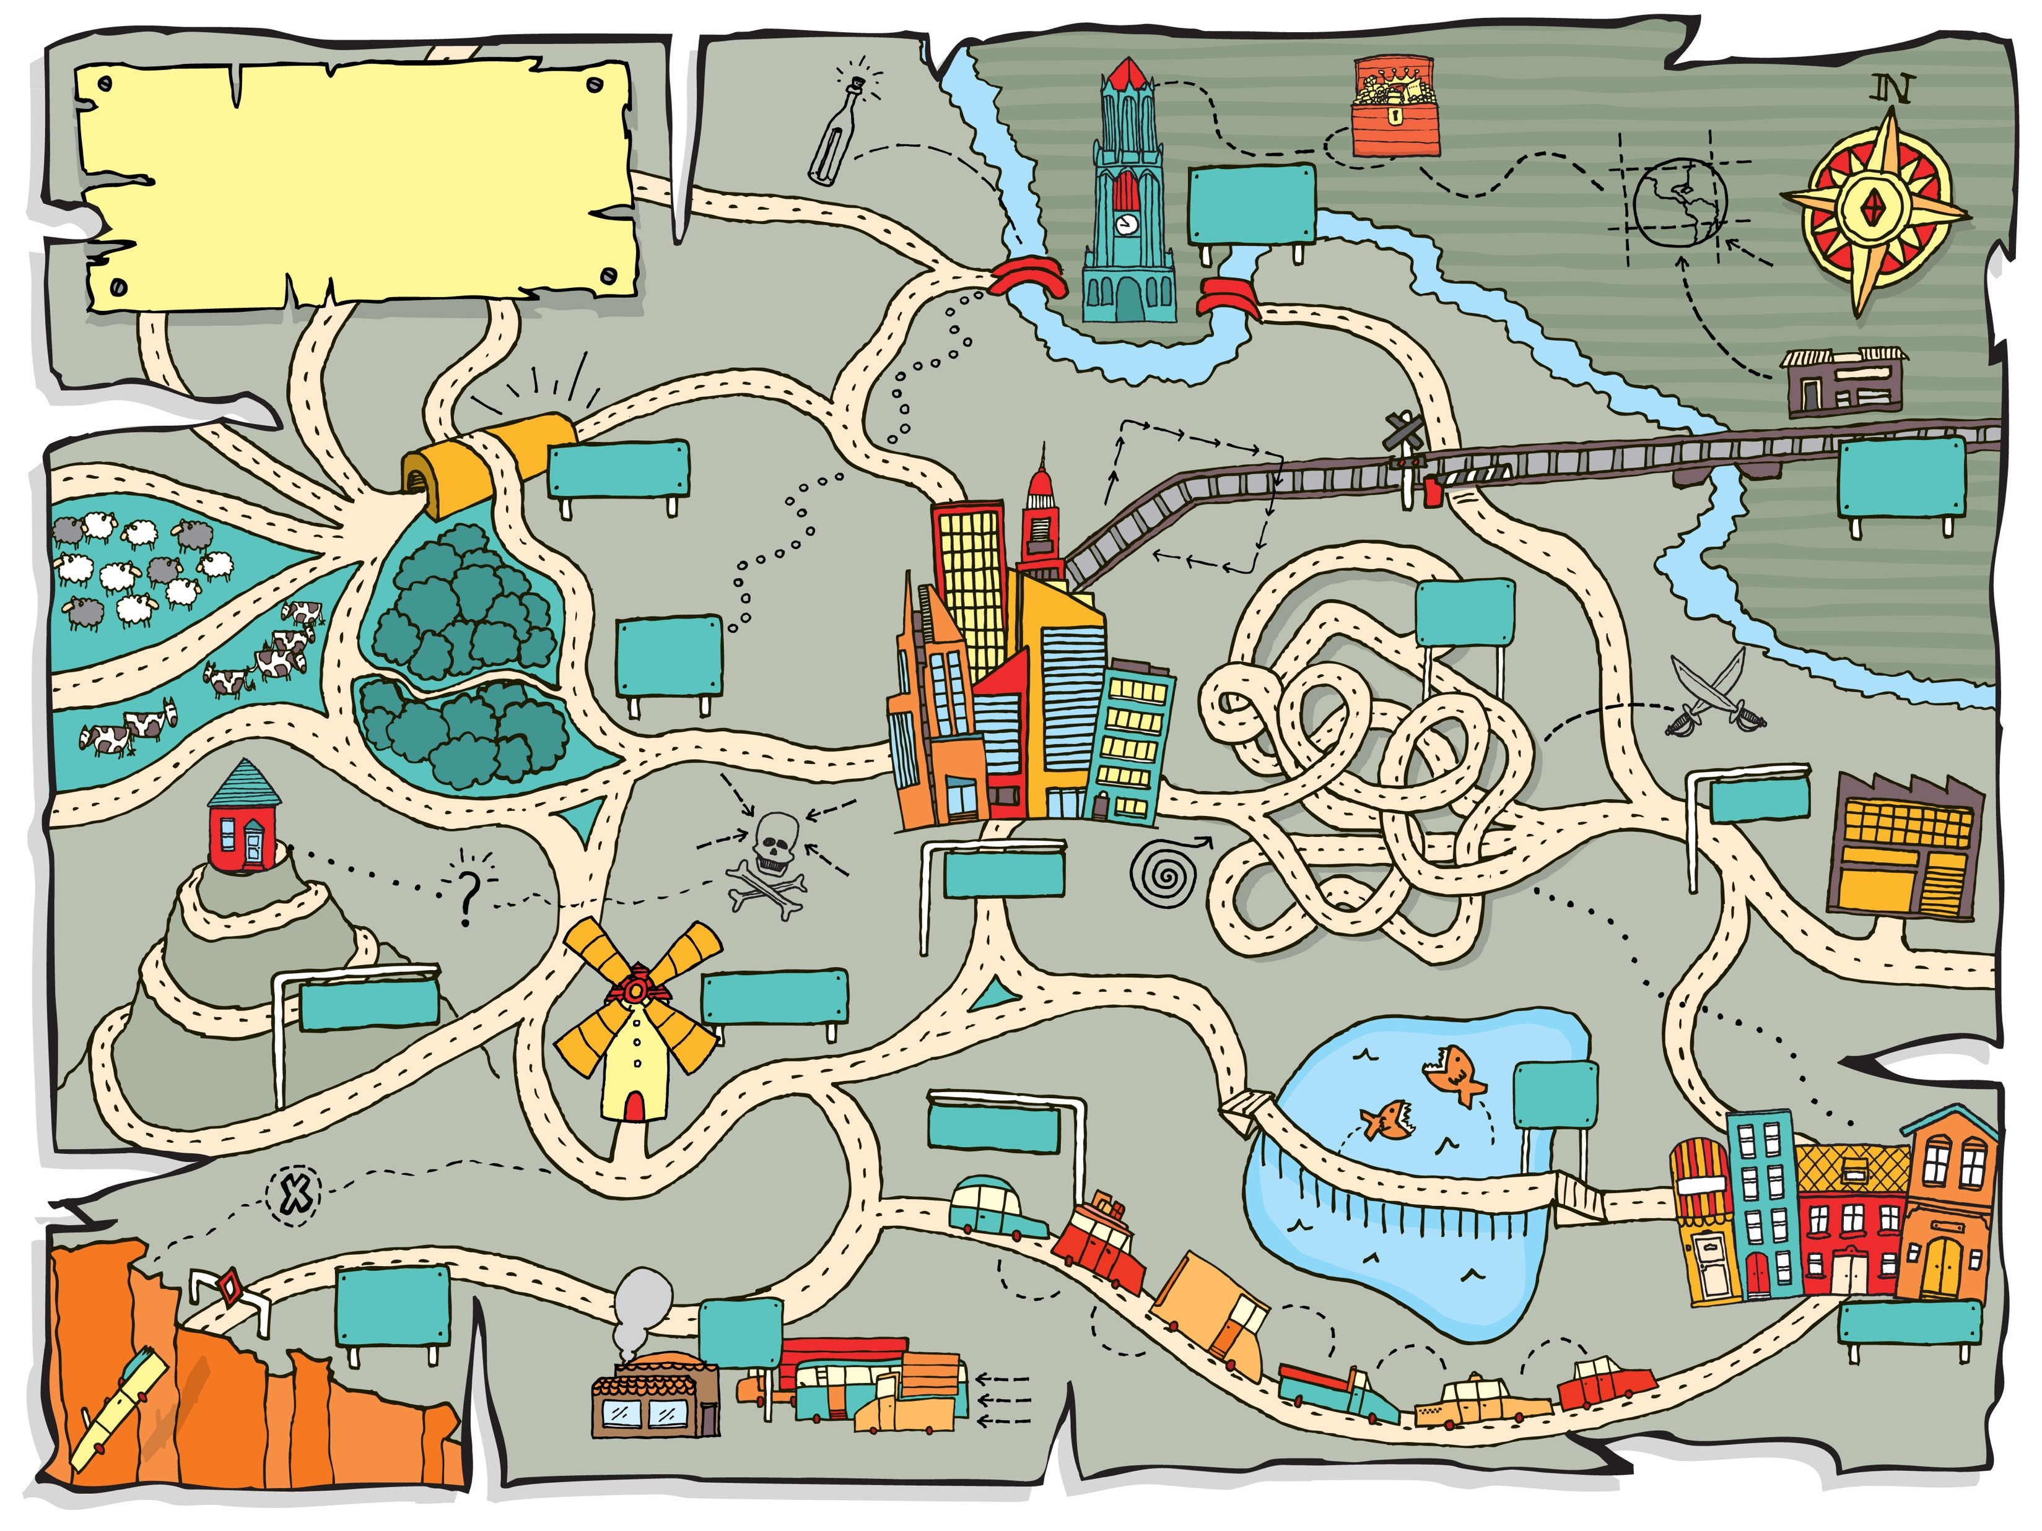
Goal Setting and Action Planning
Collaboratively review needs assessment data to identify gaps in services that can be addressed through coordinated with DVR
Build an Action Plan that supports the team in addressing those goals

Slide 15

Plan Implementation and Progress Monitoring
Monthly team meetings as a team to review and discuss progress towards their Action Plan
Independent and small group work to carry out the next steps identified during each monthly team meeting

Slide 16

Updating Goals and Maintenance
Continuous updates to goals and action plans based upon what's already been accomplished and future goals
Maintenance of monthly team meetings and independent work
Problem solving, onboarding new team members, and developing processes and procedures for continuation of service delivery

Slide 17

Ongoing Professional Development and Support
Support from WTP Technical Assistant Providers to facilitate professional development opportunities based upon team’s needs and goals

Slide 18
Model Site Activities
Professional Development
Knowledge building
Collaboration
Outreach to families and students
Coordinated Activities
Pre-ETS workshops
Information and resources
Site-based training
Guest speakers
Building business partnerships
Targeted needs assessment
Relationship building
Progress monitoring
Informational interviews
Problem solving
Goal development
Regular meetings
Professional Development
  Knowledge building
  Targeted needs assessment
  Information and resources
  Site-based training
Collaboration
  Relationship building
  Regular meetings
  Goal development
  Progress monitoring
  Problem solving
  Outreach to families and students
Coordinated Activities
  Pre-ETS workshops
  Guest speakers
  Informational interviews
  Building business partnerships
Notes:
Holly
Opportunity for others
Mention number of sites, who the teams consisted of, what they did. 2021-2023

Slide 19
Evaluating the Impact of WTP

Slide 20
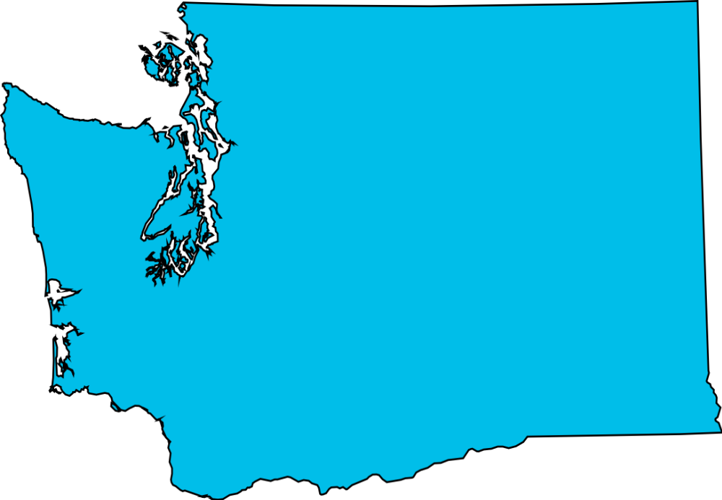

2021-2022 WTP Evaluation:
Survey Data
Notes:
Marcus

Slide 21
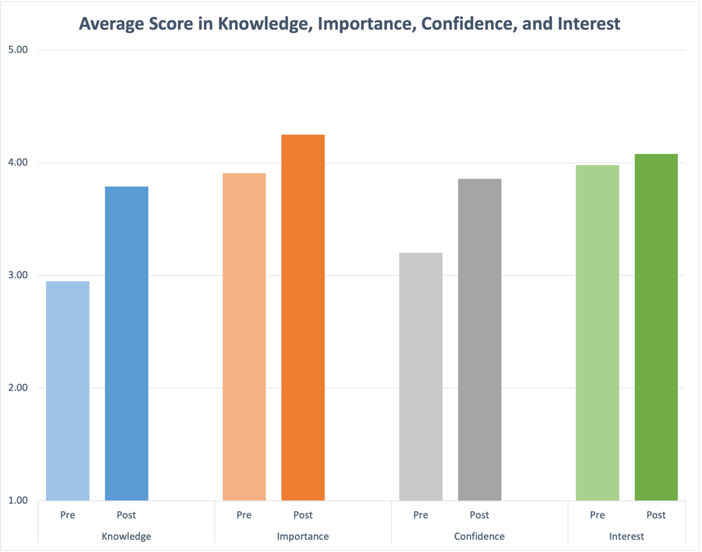
WTP Evaluation Data: Pre-Post Survey
*
*
*Indicates a statistically significant result
Pre-Survey (n =36); Post-Survey (n=16)
Notes:
Pre-Post Survey on Professional Skills and Knowledge
Quantitative – 5-point Likert scale:
Knowledge of VR Services/Activities
Importance of VR Services/Activities
Confidence in Coordination and Delivery of Services/Activities
Interest in Learning More about Services/Activities
Implementation Factors
Qualitative – Benefits, What Worked, Challenges, Suggestions
37 participants completed the Pre-Survey and 16 participants completed the Post-Survey (matched responses for 10 participants)

Slide 22
WTP Evaluation Data: Pre-Post Survey (1 of 2)
Benefits
Services to Students
Resources for Families
Understanding and Communication
New Collaborative Relationships
What worked?
Facilitation and Regular Meetings
Getting on the same page
Working as a team toward a goal
Diversity of thoughts

Slide 23
WTP Evaluation Data: Pre-Post Survey (2 of 2)
Challenges
Knowledge of DVR
Time for meetings & work
Having the right roles
Values
Suggestions
Continuation
Clarifying Team Member Roles
More Goal Setting & Action Planning
More Professional Development

Slide 24
2021-2022 WTP Evaluation:
Focus Group Data
Notes:
Anya

Slide 25
WTP Evaluation Data: Qualitative
Five participants across four WTP sites
  High school special education teacher
  School principal
  Vocational Rehabilitation Counselor
  Regional Transition Consultant
  Middle school transition teacher
One hour interview/focus group
  Focused on experience of being part of 2021-2022 WTP cohort

Slide 26
Theme: Supports for Coordinated Service Delivery
Collaborative Teams
“[T]he parent night … was definitely a collaborative partnership, and it wouldn't have happened without everybody … doing their part.” (RTC)
Starting Early
“I find that really important…connection with the family, and maybe educating the family a little earlier gives them a better understanding of what to expect …It gives them informed choice.” (VRC)
WSU Support
“I think you guys at WSU really did a great job of facilitating and supporting those conversations so that we could … get to where we needed to be and have those opportunities to talk.” (Special Educator)
Notes:
Anya

Slide 27
Theme: Barriers to Coordinated Service Delivery
Limited Transition Knowledge
“I think this, the people, the teachers in [school] didn't know anything really about transition at that point.” (Special Educator)
Staffing
“All of a sudden, somebody steps out, and it's like, they, all that, all that knowledge went with them.” (VRC)
Unequal Partnership
“We started relationship building, which was a tough road to hoe …just getting the relationships even established with the school administration has been challenging.” (RTC)
Notes:
Anya

Slide 28
Theme: Strategies for Coordinated Service Delivery
Scope and Sequence of Services
“Personally, I just think that that is so important, um, the consistency of clear procedures as to if we were to go away … what are those steps, and what does the next person coming in need to do, and consider, and think about, and those kind of things?“ (School Administrator)
Student Centered Services
“…the students are important, and this is a service that can benefit them, as well as support the school, I think that's the message that needs to get out. …I think that yours is, is really the first very successful connection that we've had, that we've seen such good response, and I think we'll continue to do this.” (VRC)
Notes:
Anya

Slide 29
Theme: Sustainability
Expanding Out
“I've been kinda putting the bug in the ear of a couple of newer teachers that I think would really benefit, at least to try and get on board.” (Special Educator)
Logistics
“We need sufficient staff. DVR needs sufficient staff.” (RTC)
Repository of Resources
“[M]aking sure that …all students had resources … to get to where they wanted to be…. They needed those resources.” (School Administrator)
Smart Change
“Whatever we're doing, it needs to be adaptable and amenable to growth.” (RTC)
Notes:
Anya

Slide 30
Summary & Conclusion

Slide 31
Summary & Conclusion
We can improve post-school outcomes for students with disabilities by supporting collaboration between schools and Vocational Rehabilitation
The Washington Transition Program is a research-informed model demonstration project funded by Washington Division of Vocational Rehabilitation
The model demonstration project was successfully implemented in five sites during the 2021/2022 school year, and has continued into the 2022/2023 school year
Participants report positive experiences and increased services to students because of their participation in the project and have offered tips and suggestions for improving the project in the future

Slide 32
Questions and Reflections
Notes:
All

Slide 33
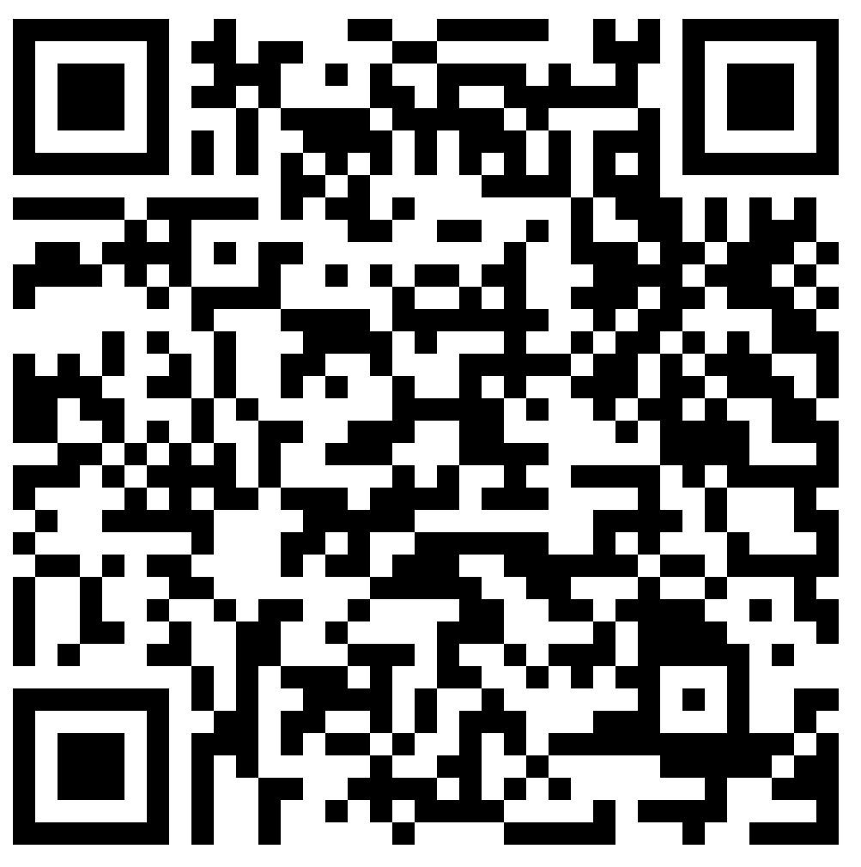
Contact Information
Dr. Marcus Poppen: marcus.poppen@wsu.edu
Dr. Holly Whittenburg: holly.whittenburg@wsu.edu
Dr. Anya Sheftel: anya.sheftel@wsu.edu
Dr. Lauren Bruno: lauren.bruno@wsu.edu
Notes:
Anya

