Slide 1
Using Post-School Outcome Data to Inform Transition Planning
University Place School District

Slide 2
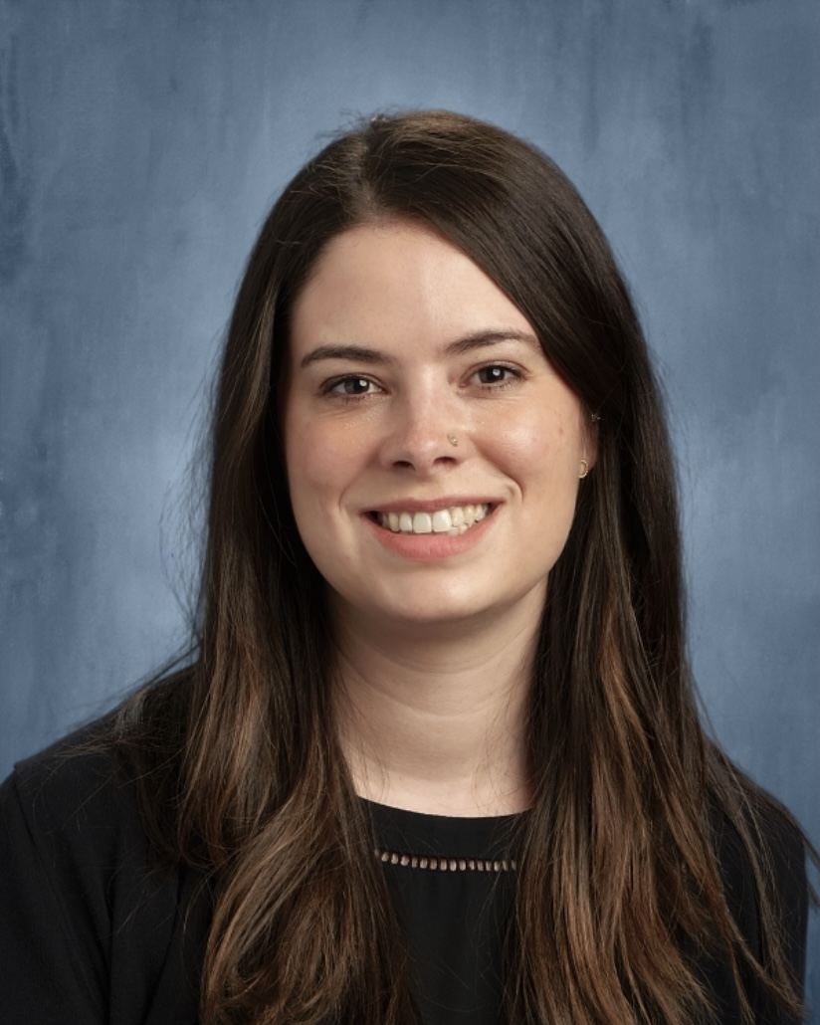
Monique Patel, MSE
Community Transition Program Teacher
University Place School District mpatel@upsd83.org (through August 2023) moniqueavelaine@protonmail.com
Notes:
My name is Monique Patel, and my pronouns are she and her.
I am a white woman of Latine and French descent with light skin, dark brown hair, and brown eyes. In the image on screen I am wearing a black shirt and my long hair is down; the background is gray.
Since 2018 I have been the Community Transition Program Teacher in University Place School District, and I will be in this role through June 2023.

Slide 3
Key Points
Identified Need
  Using post-school outcome data to identify areas of improvement in transition.
Made systemic changes
  Expanding our continuum of services and building staff capacity.
Implemented instructional changes
  Collective responsibility for transition.
Developed student and family engagement
  Engaging and connecting all students and families at all levels.
Notes:
In this presentation, I will share:
How our district identified program improvement needs using the Center for Change in Transition Services (CCTS) post-school outcome data
How we used post-school outcome data to inform program improvement across the secondary level, including:
Making systemic changes: Expanding our continuum of services and building staff capacity
Implementing instructional changes: Collective responsibility for providing transition services and instruction
Developing student and family engagement: Starting early with transition, and ensuring all families are connected.

Slide 4
District Context & Post-School Data
Notes:
First I want to contextualize our district and what we learned in our most recent post-school outcome data

Slide 5
District Context: University Place
Suburban district next to Tacoma
5,651 enrolled
10.4% students with disabilities
One Junior High & Senior High school
18-21 services connected to the high school
23 leavers in 2020-21 School Year
(OSPI, 2023).
Notes:
University Place School District is a suburban school district in Pierce County, bordering Tacoma.
Demographic changes over time, including an increase of students of color
10.4% students with disabilities
We have a junior high (grades 8-9) that feeds to one high school (grade 10-12)
18-21 transition programming and services connected to the high school
In our most recent Leaver survey year (2020-21), we had 23 leavers

Slide 6
Post-School Outcomes, 2020-21
District and Washington state graphs
(Center for Change in Transition Services, 2023).
Notes:
First, I will share our most recent post-school leaver data. Graphic of Post-school Outcomes, 2020-21, comparing University Place School District and Washington State’s results.
91% Leavers reporting
Here were our results:
Higher Education: Highest level of engagement - Approached but did not meet state average
Competitive Employment: Exceeded state average
Other Employment: Exceeded state average
Overall, we exceeded 80% engagement, up 20% from previous year
Some noticings in our most recent leaver data:
Female students had 91% engagement; compared to 70% of male students (no nonbinary students reported)
Male students had higher rate of higher education (20% vs. 9%), but female students higher in competitive employment and other employment
Multiracial (100%) and White students had highest engagement (88%) vs. Hispanic/Latine (80%), Black (66%) and Asian students (50%)
White & Multiracial students were only racial groups accessing higher education. Latine students had strongest percentage of competitive employment (80%)

Slide 7
Engagement Outcomes, Five-Year Overview, 2020-21
District and Washington state data table
District Name | Leaver Year | Resp’ts | Higher Education | Competitive Employment | Other Education | Other Employment
University Place | 2020-21 | 21 | 14.29% | 33.33% | 0.00% | 33.33%
Washington state | 2020-21 | 6,261 | 16.87% | 30.75% | 3.91% | 22.74%
University Place | 2019-20 | 20 | 5.00% | 25.00% | 0.00% | 30.00%
Washington state | 2019-20 | 7,170 | 16.74% | 27.17% | 4.64% | 21.38%
University Place | 2018-19 | 29 | 20.69% | 37.93% | 10.34% | 3.45%
Washington state | 2018-19 | 6,867 | 19.51% | 33.46% | 4.30% | 14.80%
University Place | 2017-18 | 16 | 6.25% | 25.00% | 6.25% | 18.75%
Washington state | 2017-18 | 6,825 | 20.45% | 36.19% | 4.03% | 14.01%
University Place | 2016-17 | 33 | 21.21% | 24.24% | 9.09% | 24.24%
Washington state | 2016-17 | 6,475 | 21.31% | 34.76% | 3.04% | 13.05%
(Center for Change in Transition Services, 2023).
Notes:
Table of engagement outcomes, five-year overview 2016-17 through 2020-21. University Place School District and Washington state data table.
Looking back, in 2017-18, the year before I arrived in the district, our engagement was 56%, with 33 respondents
University Place was well below state average in Higher Education and Competitive Employment
Since that time, with reflection on this data and significant efforts I will share about, we’ve started to see improvements in our students’ post-school engagement. Results fluctuated but are starting to improve in important ways.
Over time, we wanted to increase our students’ engagement especially higher education and competitive employment.
We were able to do so with employment but still have work to do with higher education.
Continue to examine how individual student groups are being served, where to focus improvement
This information contextualizes what we noticed as we considered how to make programmatic changes to improve post-school outcomes

Slide 8
Systemic Changes
Alignment
Individualization
Capacity Building
Notes:
Over the course of 5 years I’ve been in the district, we began to change the culture of our team and delivery of transition services.
Through
Alignment of the HSBP & IEP Transition Plan
Increased Individualization
Building capacity of our team – we are ALL transition service providers
Coordination with agency services to get all eligible families connected

Slide 9
Alignment: High School & Beyond Plan & IEP Transition Plan
Systemic changes in:
  Delivery of High School & Beyond Plan
  Age-appropriate transition assessment
  Agency linkages
Notes:
Engagement and Alignment in High School and Beyond Plan and IEP Transition Plan
Implemented a leveled High School and Beyond Plan platform across junior high and high school with tiered supports to ensure all students could meaningfully engage in and complete the HSBP, which is a requirement for graduation.
Aligned transition assessment information collected in the HSBP with the IEP Transition Plan, because this process provided relevant information on strengths, preferences, interests, and needs for informing postsecondary goals and activities.
Used this data to place students with disabilities in general education courses aligned to their interests, with supports – for example, Special Program students accessed more Career and Technical Education
When students transitioned between levels (junior high to high school, high school to transition), we had in-depth IEP team conversations to determine transition courses and sequencing. We also began making more agency linkages before transition and used data to inform best placement on continuum of transition services for the student to meet their goals.
Presented with OSPI to WSAC and Legislative Committee and peers across the state

Slide 10
Individualization: Continuum of Services
Specializing in services for students based on their postsecondary goals and needs
  Community Transition Program
  Community-Based Learning (starting in grade 11)
  Pierce County Skills Center
  Other specialized plans
Notes:
Reviewing post-school outcome data, we also revisited our delivery of 18-21 transition services. Prior to my arrival in 2018, several students with I/DD who had more support needs were being served at the high school through transition age and not moving on to community-based transition services. And, students who were not eligible for long-term employment supports also needed their own specialized services. These were students who were potentially not engaging because we weren’t providing the right support. We explored - how could we develop our continuum of services to meet all student needs?
We expanded.
Community Transition Program: Focus on students with I/DD and developing specialized community-based work-based learning and independent living experiences aligned to them. We also support referral to Pierce County and agency partners for School to Work
Community-Based Learning: starting in 11th grade. Community-based internship and work-based learning experiences
Pierce County Skills Center: Supported students to participate in the trades, and providing resources such as transportation extended time in school if needed to complete their program.
Specialized plans (5th year, etc) for students needing specific supports, whether it be for college, transitioning into the community, etc.

Slide 11
Capacity Building: Culture Shift
Building capacity in all case managers for delivery of transition assessment and services
Developing specialized and individualized Pre-Employment Transition Services partnerships with Division of Vocational Rehabilitation
Developing work-based learning in the community
Notes:
Staff Capacity Building
Our team was trained by Pierce County, and by Center for Change in Transition Services in writing transition plans, delivering transition instruction
We were also supported in attending trainings (for example, I attended DCDT and a WISE training on systematic instruction and person-centered planning)
DVR Partnership
We began a close collaboration with Division of Vocational Rehabilitation and local providers for pre-employment transition services, or pre-ETS. Case Managers worked to connect all students to pre-ETS and began partnering with DVR for regular group services.
We collaborated with DVR to expand pre-ETS services for individual students, and our capacity to offer unique experiences to individual students aligned with their employment goals.
Together we have been able to offer job tours, paid summer internships, and develop employment
Work-Based Learning
Teacher collaboration to develop work-based learning partnerships in the community
More teachers began job development, collaborating with each other and with agencies to develop placements for our students
Developed and expanded partnerships with local businesses and our college
Expanded individualized and group work-based learning aligned to transition goals

Slide 12
Instructional Changes
Team Collaboration
Embedded Transition Instruction
Partnerships
Notes:
Team collaboration: building collective capacity and responsibility in all roles for delivering transition services
Embedding instruction
Developing partnership with Tacoma Community College

Slide 13
Team Collaboration: PLC Work and Transition
High School & Beyond Plan: Accessibility and alignment
Vertical Alignment: Team development of Adaptive Transition Skills Progression
Soft Skills & Social Emotional Instruction
Partnership with Career and Technical Education
Student Led IEPs
Transition is a collective responsibility and priority – we all have a role!
Notes:
Our educator Professional Learning Communities shifted to focus on transition related content and outcomes, examining OSPI efforts on transition planning and our post-school data
Aforementioned High School & Beyond Plan Alignment. We also looked at the NTACT Transition Quality Indicators and how we were implementing those at the high school.
Vertical alignment: we strengthened our transition assessment and goal setting by creating an Adaptive and Functional Skills progression for Special Programs Teachers to vertically align transition skill development from 8th grade through age 21, paired with age appropriate assessments. We wanted to ensure our students were continuously deepening their transition skills and knowledge as they progressed through school and that we had ways to measure it. This was an effort by Teachers + Related Service Providers including Physical Therapists, Speech Pathologists, and Occupational Therapists. It is a tool we use for goal development and program planning.
Delivery of soft skill and social-emotional instruction, in partnership with our speech language pathologist, to practice these skills for the workplace setting
Collaboration with CTE to develop successful general education learning environments aligned to student goals – expand access to gened in Culinary, Arts, PE, Theatre, Microsoft, etc.
Partnership with College and Career Center
Collectively committed to Student Led IEP meetings
Transition is a collective responsibility and priority – we all have a role!

Slide 14
Embedding Transition Instruction
Pre-vocational instruction in high school
Transition Bell Ringer Activities in academic courses
Professional writing embedded in general education curriculum
Community-based learning
Collaboration with related service providers on campus and in the community
Notes:
We all have a role in embedding transition skills across levels and courses, so students are regularly building their skills and making progress toward their post-school goals.
Pre-vocational instruction
Classrooms participate prevocational tasks, and develop in-district work-based learning
Transition Bell Ringers and embedded activities
Starting academic courses with transition work, embedding professional writing (such as resume and application writing) in the academic classes – addressing grade level standards and transition
Community-based learning
Beginning in 11th grade with special education courses – regular volunteer experiences, job tours, field trips
Collaboration with related service
Video modeling for employment social skills
OT and PT collaboration for employment related goals
Partnership with related service providers for teaching independent living and employment skills in the community (co-taught lessons, observations, jobsite support)

Slide 15
Increasing Postsecondary Engagement:
Partnership with Tacoma Community College
Inclusion in college life with other adult peers
Partnership includes:
  College guidance and visits to participate in college courses
  Internships in the IT department
  Ongoing work-based learning sites in various departments
  Participation in recreation and events (Arts, Athletics, Music, etc.)
Support applying and enrolling as a TCC student, and developing a network of support on campus
Notes:
In order to address our area of higher education engagement in our post-school data, we looked to our local community college to partner in college access.
So our students could see themselves as college students, build connections with other adult peers and develop a network of support on our local college campus!

Slide 16
Family Engagement

Slide 17
Family Engagement
Connecting all eligible students to agency services
  DDA Intake Nights
  Link families to community organizations offering support for people with disabilities
  1:1 support for families in making agency connections
Referring all eligible students to School to Work/Job Foundations
Creating Preschool Family Partnership Project
Notes:
Transition is a complex network of supports, and we know it is important for families to be informed of and have the resources and support to connect to eligibility services that assist in the achievement of post-school outcomes.
Linking families to DDA starting early
Connecting families to parent support agencies in the area, including PAVE and PC2 who help provide an expanded network of support
Ensure families are well supported in navigating agency linkages and services – 1:1 support completing applications, partnering with agencies to get translated forms, ensuring families are informed as they pursue choices and being responsive to their needs.
Referring to School to Work. Engaging in informative conversations with students about work, and leading with the belief that meaningful employment is an option for everyone, everyone can work if they want to and build their economic agency and future choices.
Preschool Family Partnership – begin transition work with families early, and build their connection to school

Slide 18
Next Steps

Slide 19
Next Steps
Implementing co-teaching Model in 10th Grade
  More access to general education to ensure access to same content with typically developing peers
Expanding Preschool Family Partnership Project to Special Programs
  Increase communication
  Share access to resources
  Support students and families
  Start transition early
Notes:
One area of priority in our postschool data is higher education engagement
Co-teaching model
Expanding Preschool Family Partnership
Increase communication between families and school
Share access to resources
Support students and families
Start transition and linkages early!

Slide 20
Key Points
Identified Need
  Using post-school outcome data to identify areas of improvement in transition.
Made systemic changes
  Expanding our continuum of services and building staff capacity.
Implemented instructional changes
  Collective responsibility for transition.
Developed student and family engagement
  Engaging and connecting all students and families at all levels.
Notes:
Presented how we identified the needs in our post-school data, and made systemic changes in our programs, instruction, and engagement to increase post-school outcomes in employment and higher education.

Slide 21
Monique Patel, MSE
Community Transition Program Teacher
University Place School District mpatel@upsd83.org (through August 2023) moniqueavelaine@protonmail.com
Notes:
Thank you for joining! Please reach out if you would like to connect.

Slide 22
References
Center for Change in Transition Services, Seattle University (January 2023). [Engagement Outcomes, Five-Year Overview, 2020-21 District and Washington state data table]. Unpublished raw data.
Center for Change in Transition Services, Seattle University (January 2023). [Post-School outcomes, 2020-21 District and Washington state graphs]. Unpublished raw data.
Washington Office of Superintendent of Public Instruction (2023). University Place School District report card. Olympia, Washington. Retrieved from https://washingtonstatereportcard.ospi.k12.wa.us/ReportCard/ViewSchoolOrDistrict/100275

