Slide 1
CCTS Transition Forum
Day 3 Kick-Off
Thursday, June 29, 2023
Notes:
Cinda:
Welcome to our final day of the CCTS Virtual Transition Forum, Making Meaning: the Power of Post-School Outcome Data
Thank you for joining us!

Slide 2
Welcome to the final day!
Welcome messages
  Cinda Johnson, CCTS
  Alexandra Toney, OSPI
Logistics and Clock Hours – Elaine Marcinek, CCTS
Today’s Schedule – Julia Shoots, CCTS
Question to Consider – Cinda Johnson, CCTS
Notes:
Cinda:
My name is Dr. Cinda Johnson.
I am a white woman with shoulder length blonde hair. I use the pronouns she, her and hers.
I’m the Principal Investigator at the Center for Change in Transition Services, or CCTS.
Today, we’ll welcome another guest from OSPI. Alexandra Toney is here to speak about High School and Beyond Plans.
Then, my colleagues at CCTS will remind you about session availability, clock hours, and today’s schedule.
Finally, I’ll propose a question for you to consider throughout the day.

Slide 3
Alexandra Toney
Special Education Program Supervisor, Office of Superintendent of Public Instruction
Notes:
Cinda:
Now I’d like to welcome Alexandra Toney, the Special Education Program Supervisor at OSPI. We love to work with Alexandra. Her leadership and knowledge are so appreciated!

Slide 4
Secondary Transition
The Office of Superintendent of Public Instruction,
Special Education
Alexandra Toney, BCBA
Notes:
Hello and welcome , My name is Alexandra Toney and I am here today from the Special Education Office of OSPI to Chat a little bit about Secondary Transition,
focusing specifically on the High School and Beyond Plan as a tool for improving post secondary outcomes for students

Slide 5
Post-School Outcome Data
Source: Center for Change in Transition Services, Seattle University. (2023). Indicator B-14 Post-School Outcome Report, 2020-21, Washington state.
Notes:
I wanted to frame my time with everyone in sharing the most current post-school outcomes data available. So this data is collected from asking students one year after they leave school what they are doing, so for example if they went to higher education or found full time employment or some other form of employment. This data is a systems indicator of how well we are preparing students with disabilities for their next steps after highschool. In the last bar here you can see the most recent data for students who left the school system in the 2020-21 school year and when you look back you can see the data over time.
Focus on the yellow bar indicating that 26 percent or more than 1/4th of our students with Disabilities are not employed or involved in any postsecondary education or training one year after leaving HS. (PAUSE) This is the area we would want to be the smallest- Imagine what the reaction would be if our state's unemployment rate was 26%! (PAUSE) This is our call to action to better support students to be ready for their next steps after highschool (PAUSE)

Slide 6
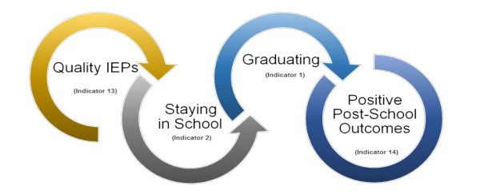
Critical Interrelationship for Achieving Post-School Outcomes
Source: Center for Change in Transition Services (2017). Writing effective transition plans, page 5. Graphic modified by CCTS from Kohler, Gothberg, and Hill. (2009). NSTTAC Evaluation Toolkit. National Secondary Transition Technical Assistance Center (NSTTAC): Western Michigan University.
Notes:
We know that Quality IEPs which include transition plans help students stay in school and complete graduation requirements and all of these things together have a positive impact on post school outcomes. In my opening today I will be focused briefly on the HSBP which is the transition planning document that is a student driven graduation requirement for all students in Washington state.

Slide 7

WAC 180-51-220 (4)
High school and beyond plan.
“For a student with an individualized education program (IEP), the student's IEP and high school and beyond plans must align”.
“Students with an IEP transition plan…may use their transition plan in support of, but not as a replacement for, their high school and beyond plan”
"The process for developing and updating the student's high school and beyond plans must be similar to and conducted with similar school personnel as for all other students".
WAC 180-51-220 (4)
Notes:
I wanted to open by referencing the WAC for High School and Beyond Plans and calling out a few direct lines.
First, for students getting special education services… the IEP transition plan and the HSBP must align. Together these two document support students to be prepared for their post secondary goals
Secondly for the IEP transition plan is not a replacement for the HSBP. Students who have IEP’s have both and these documents have different scopes and timing but align to provide needed support
Lastly the process for developing and updating a students HSBP must be similar to and conducted with similar staff as all students. So put in another way students getting special education instruction should not have their HSBP process lead out by special education staff exclusively or to have a separate process than their general education peers. The HSBP process should be inclusive and differentiated to support all students,.

Slide 8
Transition Guidance to Add to your Toolbox
Notes:
To support you in your efforts here we wanted to briefly review some of the transition guidance that is available to add this to your toolboxes.

Slide 9
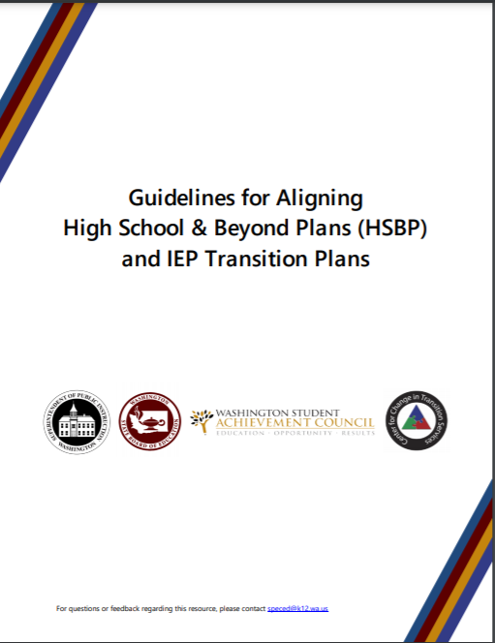
Guidelines for Aligning High School & Beyond Plans and IEP Transition Plans
Appendix A: The Transition Team Members and Roles
Appendix B: Sample HSBP and IEP Transition Plans
  Case Study of a 10th grader using a CTE Course Sequence - (Webinar)​
  Case Study of an Adult Student using the WA-AIM (Webinar)
Appendix C: High School Education and Training Opportunities
Appendix D: Post-Secondary Education and Training Opportunities
Appendix E: Post-Secondary Employment Options
Appendix F: Post-Secondary Outcomes (Indicators 1, 2, 13, and 14)
Appendix G: IEP Transition Planning Checklist for Educators
Appendix H: Transition Planning Checklist for Students
Appendix I: Transition-Planning Resources
Notes:
I wanted to call out Appendix B which includes two different case studies of an aligned HSBP and IEP Transition plan that showcase how these two documents go together to support two different students with different goals and support needs be ready for their goals after highschool. There is lots of great stuff to dig into but I wanted to make sure you had this in your toolbox

Slide 10

Thank you
Notes:
Thank you all for the time today and for your work to supports students in our state be ready for their next steps after highschool

Slide 11
Logistics and Clock Hours
Clock hours
  Available for educators and DVR staff.
  Can be earned for all live and on-demand sessions viewed by July 7, 2023.
Access and Availability
  Live session recordings will be posted by July 5, 2023.
  All materials will be available for 90 days following the Forum.
Please be sure to complete the post-session evaluations.
Notes:
Elaine:
Hello.
My name is Elaine Marcinek and I am the Director and Co-Investigator at CCTS.
I use the pronouns she/her/hers, and am a white female with long blondish brownish hair and glasses.
If you are interested in clock hours for the Forum, you can earn clock hours for all sessions that are viewed by Friday, July 7, 2023.
We’ll be adding the recordings from the live sessions to the conference site, and they should also be posted by July 5 at the latest.
All the recordings and PowerPoint presentations from the Forum will be posted to the attendee website and will remain available until late September.
Also, please be sure to complete session evaluations after each session.
There will be a link and some additional reminders in the attendee website.
This information helps us in planning future events.
And now, Julia will talk about today’s schedule.

Slide 12
Today’s Schedule – 6/29/2023
Time | Title
9-9:50 a.m. | Data Drives Thinking – Thinking Drives Success
On-Demand (starting at 10 a.m.) | Washington Transition Program: Results and Lessons Learned from a DVR Funded Model Demonstration Project
Notes:
Julia:
Thanks, Elaine.
I’m Julia Shoots, I’m the Project Coordinator for CCTS.
I use the pronouns she/her/hers, and I am a young white woman with long light hair and brown eyes.
I’m excited to get to share today’s schedule with you, for the final day of our Forum.
For our live session at 9 a.m., Sam Blazina from ESD 105 and Nora Sehnert from Yakama Nation Tribal School discuss how post-school outcome data informs agency and community partnerships.
For our on-demand session available at 10 a.m., Marcus Poppen, Anya Sheftel, Holly Whittenburg, and Lauren Bruno from Washington State University share results and lessons learned from the first year of the Washington Transition Program, a DVR-Funded Model Demonstration Project.
And now, back to Cinda for our question of the day.

Slide 13
Question:
How can schools and agencies use post-school outcome data to improve transition services for students with disabilities?
What would be some first steps in considering PSO data to strengthen the work of an ITN?
Notes:
Cinda:
Thanks, Julia.
Today you will learn more about agency collaboration. I invite you to think about agency connections in your own region. Are you involved in any ITNs? Other agency collaborations?
As you listen to the presentation ask:
How can schools and agencies use post-school outcome data to improve transition services for students with disabilities?
What would be some first steps in considering PSO data to strengthen the work of an ITN?

Slide 14
Special Thanks
OSPI
Christy Camarata and Kendall Newell – ASL interpreters
Nessa Ankney – Featured Artist
Genna Kieper – WSU ROAR Employment Services Coordinator
Presenters
Attendees
Notes:
Cinda:
As we wrap up the final day of the CCTS Transition Forum we would like to extend our thanks and gratitude.

