Slide 1
CCTS Transition Forum
Day 2 Kick-Off
Wednesday, June 28, 2023
Notes:
Cinda:
Welcome to Day 2 of the CCTS Virtual Transition Forum, Making Meaning: the Power of Post-School Outcome Data
Thank you for joining us!

Slide 2
Welcome to Day 2
Welcome messages
  Dr. Cinda Johnson, CCTS
  Dr. Tania May, OSPI
Logistics and Clock Hours – Elaine Marcinek, CCTS
Today’s Schedule – Julia Shoots, CCTS
Question to Consider – Cinda Johnson, CCTS
Notes:
Cinda:
My name is Dr. Cinda Johnson.
I am a white woman with shoulder length blonde hair. I use the pronouns she, her and hers.
I’m the Principal Investigator at the Center for Change in Transition Services, or CCTS.
Today, we’ll welcome Dr. Tania May and Dr. Cassie Martin from OSPI.
Then, Elaine will review some logistics about session availability and clock hours, and Julia will share today’s schedule.
Finally, I’ll propose a question for you to consider throughout the day.

Slide 3
Dr. Tania May
Assistant Superintendent of Special Education, Office of Superintendent of Public Instruction
Notes:
Cinda:
It’s my pleasure to welcome Dr. Tania May from OSPI. Tania is the Assistant Superintendent of Special Education. We value our collaborative work with OSPI and so appreciate Tania’s leadership.
Welcome, Tania.

Slide 4
It Takes All of Us:
Partnering for Post-School Data & Outcomes
Dr. Tania May
Assistant Superintendent of Special Education
Office of Superintendent of Public Instruction (OSPI)
tania.may@k12.wa.us

Slide 5
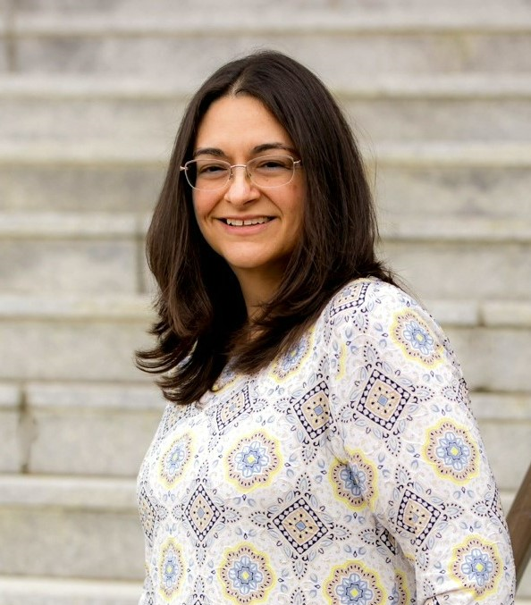
Getting to Know Tania!
Dr. Tania May is focused on collaborating with schools, community partners, families, and students in support of improved outcomes for students with disabilities in Washington.
Tania has been with OSPI since 2014, and her experiences include elementary inclusive practices, high school co-teaching, multilingual supports for students with disabilities, and behavioral supports in non-public agencies.
She also has a deep, personal connection to special education as the parent of an autistic teenager.

Slide 6
Starting with Why:
Our State Story on Transition Services

Slide 7

Post-School Data: Our Purpose, Our Why
Federal Data Collection & Reporting
State & District Determination Levels
Measuring the Impact of Transition Services
Lived experiences of our students transitioning
from school to post-school life

Slide 8
How Do We Collect These Data?

Slide 9
Post-School Data: Partnership is Key!
Washington state collects post-school data from every “leaver” meaning every student who was receiving special education services at the time they left the school system.
Washington is seen as a model for sustaining a high response rate from leavers, year over year.
The success of this data collection is directly connected to the close collaboration between OSPI, CCTS, Educational Service Districts (ESDs), Schools & Districts, and Students & Families!

Slide 10
What Do the Data Tell Us?

Slide 11
Post-School Data: Data Tell Our Stories
Data conversations help inform the need for stronger collaboration between our general education and special education staff in schools.
Student & Family Voice bring life to the post-school data numbers and identify existing supports, additional opportunities, and ongoing barriers.
These data are important sources for our other state agency partners, as well, to support higher education opportunities, community access, and competitive employment.

Slide 12
Thank you!

Slide 13
Logistics and Clock Hours
Clock hours
  Available for educators and DVR staff.
  Can be earned for all live and on-demand sessions viewed by July 7, 2023.
Access and Availability
  Live session recordings will be posted by July 5, 2023.
  All materials will be available for 90 days following the Forum.
Please be sure to complete the post-session evaluations.
Notes:
Elaine:
Hello, this is Elaine Marcinek and I am the Director and Co-Investigator at CCTS.
I use the pronouns she/her/hers, and am a white female with long blondish brownish hair and glasses.
If you are interested in clock hours for the Forum, you can earn clock hours for all sessions that are viewed by Friday, July 7, 2023.
We’ll be adding the recordings from the live sessions to the conference site, and they should also be posted by July 5 at the latest.
All the recordings and PowerPoint presentations from the Forum will be posted to the attendee website and will remain available until late September.
Also, please be sure to complete session evaluations after each session.
There will be a link and some additional reminders in the attendee website.
This information helps us in planning future events.
Up next, Julia will go over today’s schedule.

Slide 14
Today’s Schedule – 6/28/2023
Time | Title
9-9:50 a.m. | Skagit County ITN Post-School Outcome Data Take-aways
On-Demand (starting at 10 a.m.) | Advanced Manufacturing Training Options for High School Youth
Notes:
Julia:
Thanks, Elaine.
I’m Julia Shoots, I’m the Project Coordinator for CCTS.
I use the pronouns she/her/hers, and I am a young white woman with long light hair and brown eyes.
I’m excited to get to share today’s schedule with you, for the second day of our Forum.
At 9 a.m., Nick Harris from DVR will join us live to share information about the Skagit County interagency transition network, and how they’re using post-school outcome data to support students in their region.
For our on-demand session today that’s available starting at 10 a.m., Bri Durham, Chris Pierson, and Erin Williams from AJAC will share about employment and training opportunities in Washington State’s aerospace and advanced manufacturing industries for high school youth with IEPs, 504 Plans, and other documented disabilities.
And now, back to Cinda for our question to consider today.

Slide 15
Question:
What ideas did you gather to build or strengthen partnerships in your region?
Notes:
Cinda:
Thank you, Julia.
You will learn about two different organizations today, an Interagency Transition Network or ITN and a statewide non-profit training intermediary for Washington state’s aerospace and advanced manufacturing industries.
As you listen to Nick Harris from the Skagit County ITN and to AJAC consider your own local and regional partners.
What ideas did you gather to build or strengthen partnerships in your region?

