Slide 1
CCTS Transition Forum
Day 1 Kick-Off
Tuesday, June 27, 2023
Notes:
Cinda:
Welcome to Day 1 of the CCTS Virtual Transition Forum, Making Meaning: the Power of Post-School Outcome Data
Thank you for joining us!

Slide 2
Welcome to Making Meaning: The Power of PSO Data
Welcome messages
  Dr. Cinda Johnson, CCTS
  Dr. Charlotte Alverson, NTACT:C
2020-21 Post-School Outcome Data – Elaine Marcinek, CCTS
Logistics and Clock Hours – Elaine Marcinek, CCTS
Featured Artist: Nessa Ankney – Jay Shepherd, CCTS
Today’s Schedule – Julia Shoots, CCTS
Questions to Consider – Cinda Johnson, CCTS
Notes:
Cinda:
My name is Dr. Cinda Johnson.
I am a white woman with shoulder length blonde hair. I use the pronouns she, her and hers.
I’m the Principal Investigator at the Center for Change in Transition Services, or CCTS.
CCTS has been working over the last many months to bring you three days of exciting topics and exceptional speakers.
In just a few moments, I’ll introduce Dr. Charlotte Alverson, from NTACT:C who will share a welcome message.
Then, I’ll be joined by members of the CCTS team to talk about the most recent PSO data, session availability and clock hours, highlight our featured artist, and review today’s schedule.
Finally, I’ll propose a question for you to consider throughout the day.

Slide 3

Center for Change in Transition Services
Empowering educators to improve transition services for youth with disabilities through partnerships, research, and training
OSPI Special Education State Needs Project
Located at Seattle University
Notes:
Cinda:
First, I’d like to share a little bit about who we are at CCTS.
At CCTS, our mission is to empower educators and administrators to improve transition services for youth with disabilities through partnerships, research, and training.
We do this by providing secondary transition training and technical assistance to Washington state partnering agencies, Educational Service Districts (ESDs), Local Educational Agencies (LEAs), and public schools that serve high school-age students.
We’re also responsible for analyzing the district-reported post-school outcome data.
We use that data to make informed decisions related to training and technical assistance, and we submit the results of the data analysis to OSPI to be included in the state’s Annual Performance Report.
We’re are housed at Seattle University, in the College of Education.

Slide 4
Dr. Charlotte Alverson
National Technical Assistance Center for Transition: The Collaborative
Notes:
Cinda:
And with that, I’d like to introduce to you Dr. Charlotte Alverson from the National Technical Assistance Center for Transition: the Collaborative. We are very excited to have Dr. Alverson join us. She is a national leader in transition and in the post-school outcome efforts across the country. I am honored to introduce Charlotte, my colleague and my friend.
Welcome, Charlotte!

Slide 5
What, So What, Now What: Post-School Outcomes
Charlotte Alverson, PhD
NTACT:C, University of Oregon
2023 Virtual Transition Forum
Center for Change in Transition Services
Notes:
I appreciate the opportunity to join the Transition Forum. This topic, post-school outcomes, is near and dear to my heart.
Making Meaning: The Power of Post-School Outcome Data

Slide 6

What? So What? Now What (1 of 4)
(Nathan, 2021; Rolfe, Freshwater, & Jasper,2002).
Notes:
Being here today gave me an opportunity to reflect on where PSO started and where it needs to go, which led me to Rolfe, Freshwater, & Jasper’s model of critical reflection. Nathan conceptualized the model as ‘what’, ‘so what’, and ‘now what’. I thought this model was apropos for today.
What – the initiative –
So What – the significance – why it was done and why it’s important;
Now What – next steps -

Slide 7
Purpose of IDEA 2004
To ensure that all children with disabilities have available to them a free appropriate public education
that emphasizes special education and related services designed to meet their unique needs and
prepare them for further education, employment, and independent living.
(20 U.S.C. § 1400 (d)(1)(A))
Notes:
The What started with the reauthorization of IDEA in 2004 and the purpose of IDEA …

Slide 8
Part B Indicator 14 Post-School Outcomes
(B14; Indicator 14, PSO)
Percent of youth who are no longer in secondary school, had IEPs in effect at the time they left school, and were:
  Enrolled in higher education within one year of leaving high school.
  Enrolled in higher education or competitively employed within one year of leaving high school.
  Enrolled in higher education or in some other postsecondary education or training program; or competitively employed or in some other employment within one year of leaving high school.
(20 U.S.C. 1416(a)(3)(B))
Notes:
Indicator B14 is one of 17 indicators used to measure whether states are fulfilling the purpose of IDEA. Indicator Part B14, post-school outcomes specifically addresses the extent to which states prepare students with disabilities for further education, employment, and independent living.

Slide 9
What: Data Collection
 | FFY09 No. of States | FFY20 No. of States
Sampling Methods
Census | 37 | 43
Sample | 21 | 17
Unknown | 2 | 0
Data Collection Methods
Survey (interview, mail, Internet) | 38 | 34
Combination | 16 | 13
Administrative Database Only | 3 | 3
Unknown | 3 | 10
Notes:
In the early years, we were often asked, ‘what are other states doing; what is their sampling frame? Are they using a representative sample or census of all students?”
Here you see that, over time, more states have moved away from drawing a representative sample to collecting data from all leavers.
We were also frequently asked – ‘what methods are states using to collect data from former students or their designees?” Here you see there hasn’t been a big shift in data collection methods – survey methods has continued to be denominate method. Three states have consistently used an administrative database, such as data from the National Student Clearinghouse; Depart of Labor, state Institute of Higher Education, or a statewide longitudinal database.

Slide 10
Data Quality Indicators
 | FFY09 | FFY20
Response Rate
No. States Reporting | 48 | 100
Total Leavers | Unknown | 254,581
Total Number of Respondents | Unknown | 150,259
Response Rate Range | 4.7% to 94.6% | 2.58% to 100%
Median Response Rate | 47.2% | 59.3%
Representation
No. States Reporting | 39 | 60
No. States with Representative Data | 21 | 36
Notes:
‘What are the response rates’ and ‘how representative are data’ are two additional questions I’m often asked still today. Here you see the comparison between FFY 2009 and 2020 (school year 21-22).
In FFY20, states had to begin reporting the total number of leavers, regardless of whether they were using a sample or a census of leavers. The total number of students wasn’t required reporting in FFY2009; Based on the states that did report their total number of leavers, our best estimate of the total number of leavers was under 100,000.
You can see the range of response rates across time, both the low and high for response rates occurred in 2020, with the range of 2.58% to 100%. Overall, the median response rate has increased by about 12%
With regard to representation, States must now report whether their data are representative, and 60% of all states reported respondents reflected the population of all leavers based on key demographic areas selected by the state. It is important to note, not all states report what demographic group they base representation on, for example, are they considering disability category, race/ethnicity, method of exit, gender, geographic location?

Slide 11
Chart: States’ Reported Response Rates FFY 20
Notes:
If you’re curious, here is the range of state’s reported response rates for FFY20, reported in Feb 2022, from 2.58% to 100%. Notice that several states reporting 100% response rated had fewer than 100 leavers.
The median response rate was 59.3% and in comparison, WA was 78.16%.

Slide 12
What? So What? Now What? (2 of 4)
(Nathan, 2021; Rolfe, Freshwater, & Jasper,2002).
Notes:
This brings us to the ‘so what’ element of the critical reflection – why are PSO data collected and why are they important? What can be learned from PSO data? In other words, what meaning do these data have?
So What – the significance – why it was done and why it’s important;
Now What – next steps -

Slide 13
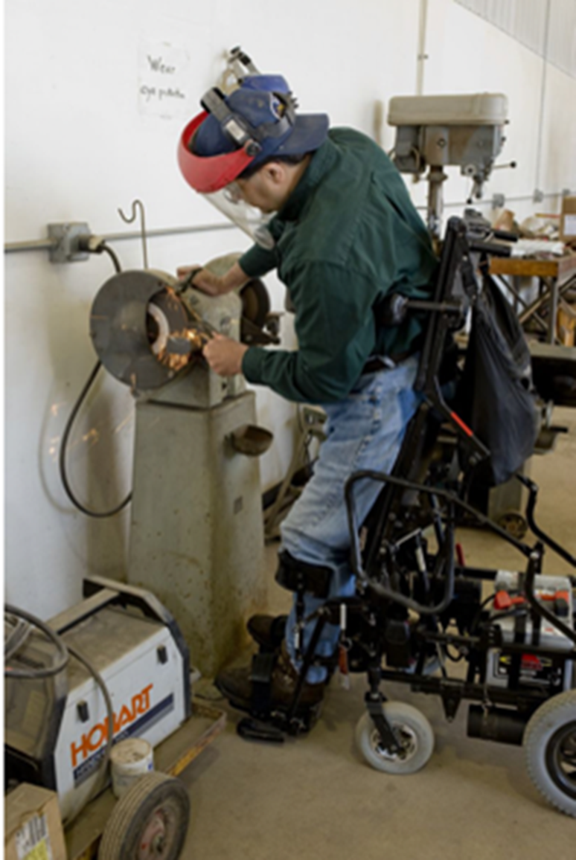
Employment Rates Feb 23, 2023
Employed Rate (ages 16-24 y.o.)
People with disabilities: 33.4%
People without disabilities: 50.1%
Unemployment Rate
People with disabilities: 17.6%
People without disabilities: 8.6%
https://www.bls.gov/news.release/pdf/disabl.pdf (Feb 2023)
Notes:
So what: so why are PSO data collected – there is a long history of individuals who experience disability being unemployed and underemployed at much lower rates when compared to their same-age peers who do not experience disability. As recently as Feb 2023, we see a gap of 17% points in the employment rate between those who do and do not experience disability. The unemployment rate for those with a disability was double that of those without a disability.

Slide 14
Historical Median Percentage of PSO Measures A, B, and C
Notes:
So what - In the PSO data, there isn’t a non-disabled comparator, but we do have 12 years of data specific to B14. We can look over time and see how things have changed. This graphs shows the percent of respondents, in aggregate, who were enrolled in higher education, Measure A. You see the percent started at 26.8% and in FFY 2020 it was 21.5%
For Measure B, HE + CE – that percentage ranges from 56.3% to 59.9%
And for Measure C, HE + CE + Other postsecondary education or training + other employment, the percentages range from 72.5% to 73.7% with a slight uptick in 2014 & 2015

Slide 15
Trendlines Across Historical Median Percentage of PSO Measures A, B, C
Notes:
So what; the theme of your Forum is Making Meaning: The Power of Post-School Outcome Data
When we strip away the yearly graphs we can see the trend lines for each measure – A, B, and C – there’s a clear downward trend in HE at the national level of post-school outcomes data, and a slight upward trend in CE. Overall, a change is barely detectable when we look at total engagement.

Slide 16
Historical Percentage of Youth Not Engaged Ffy 2009-FFY2020
Notes:
So what – the ‘so what’ is the difference seen in this graph. It shows the difference between those who responded to the data collection and those who met the criteria as engaged, as seen in Measure C - represented here by the big blue bar –and the respondents who are not engaged – If our overall engagement isn’t increasing, then conversely the percentage of not engaged isn’t decreasing. In other words, the employment and unemployment gaps aren’t closing.

Slide 17
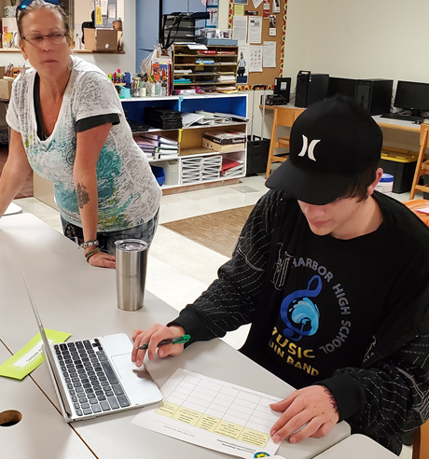


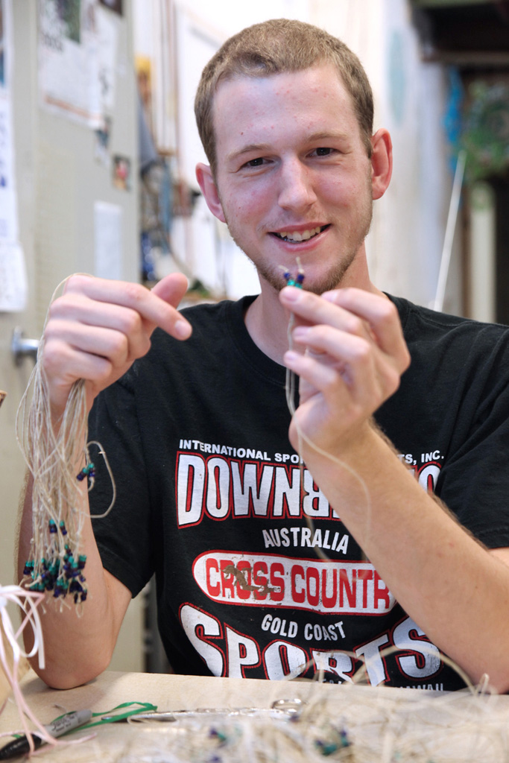
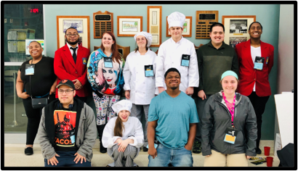
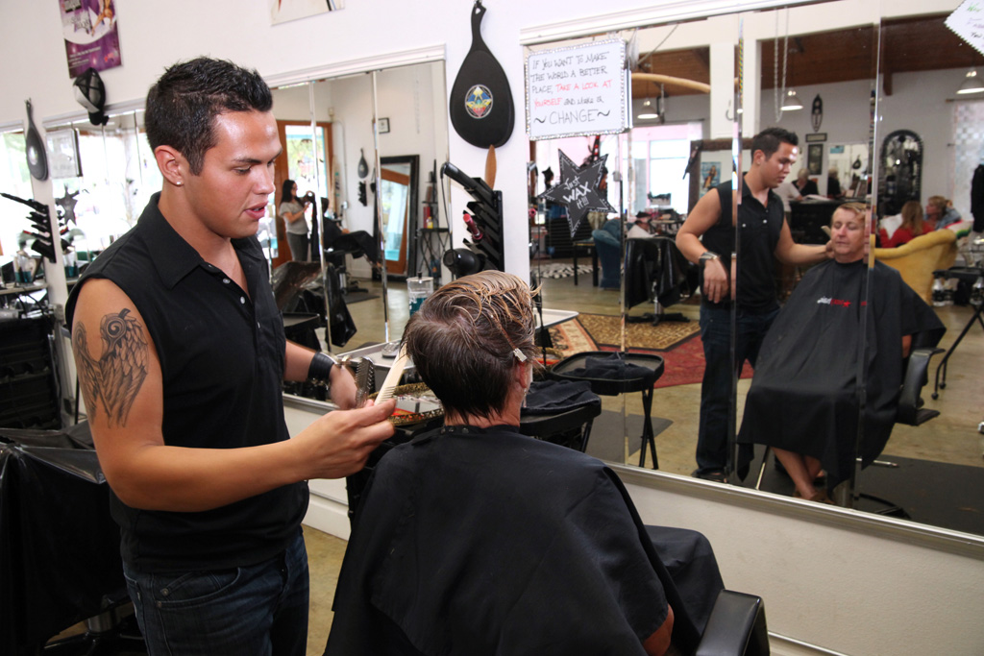
So What: students, youth, young adults who experience disabilities matter
Notes:
So what - the so what is that B14 isn’t about percentages and numbers – it is about students - the so what is that students, youth, young adults who experience disability matter.

Slide 18
States’ PSO Measure C FFY 20
Notes:
So if you’re curious, this graph shows the Measure C results in FFY2020 for all states – the range is from 33.3% to 100%. The median was 74.17% and WA 69.93%

Slide 19
What? So What? Now What? (3 of 4)
Notes:
We’ve talked about the what, so what, and next comes the ‘now what’?
Now that we know what is being done and why it is being done, what do we do with this information? The now what is “now we use these data to improve programs”. This is where PSO data get used to increase the percent of youth who engaged one year after high school -

Slide 20
How some states have used PSO data to inform transition programs
Shared PSO data with the state Interagency Council to inform and improve the cross-agency collaborative services provided while youth are in-school.
Compared outcomes of students who participated in certain transition programs to those who did not to determine program effectiveness.
Began conducting a census of leavers in order for all districts to have PSO data.
Revised their PSO survey to collect more programmatic data to examine whether in-school programs and services correlate with better post-school outcomes.
Invested in staff statewide to support secondary transition.
Conducted statewide evaluation of secondary transition programs and held listening sessions to understand needs at the local level to inform strategic planning
Notes:
Now what, do we do with these data - how do we use these data to improve outcomes?

Slide 21
How some local schools/districts have used PSO data to inform transition programs
Expanded transition programs
Added high school courses based on student feedback – financial literacy, career options
Developed stronger relationships with adult agency partners – vocational education and developmental disabilities
Made concerted effort to connect students who experience disability to career and technical education (CTE) opportunities, work-based learning opportunities, pre-employment transition services

Slide 22
Making Meaning: Understanding Your Data
Do you trust your data?
  Why/why not?
  What needs to happen?
    more responses?
    more responses from specific groups?
What are your data telling you?
  Who is and who is not engaged?
  Why are they or are they not engaged?
  What is working and what is not working?
Get talking…
Notes:
‘Now what’ is really making meaning at a local level. As you look at your data, here are some questions to consider.

Slide 23
What? So What? Now What? (4 of 4)
Notes:
‘Now what’ is about making meaning at a local level. That’s where the most important work is taking place – it is with people who walk along side students to support them and prepare the further education, employment, and independent living. Now what will you do with your PSO data? Now what will you do to support your students as they prepare to take the next step in their journey.

Slide 24

Resources and Supports @ transitionta.org
  Pre-Employment Transition Services FAQs related to RSA-911 Data Collection and Reporting
  RSA 9-11 Training Series - Pre-Employment Transition Services Presentation
  OSERS 2020 Transition Guidance Letter dated August 31, 2020
  Pre-ETS Guide for Collaboration Among State VR & Education Partners
  WIOA Performance Indicators - IDEA Part B Transition Performance Indicator Crosswalk
  NTACT:C Core Data Tools for Dropout Prevention
  Risk Calculator Tool to Assess & Address Dropout
  Transition Gradebook
B14 Data Display Templates
The Predictor Implementation Self Assessment
State Toolkit for Examining Post-School Success (STEPSS)
24
Notes:
There are many resources on the NTACT:C webpage. Here are some specific to B14.

Slide 25


Contact NTACT:C
Charlotte Alverson
calverso@uoregon.edu
Find us on
#transitionTA | transitionTA.org | ntactmail@uncc.edu
The contents of this webinar were developed under a grant funded by Cooperative Agreement #H326E20003 (NTACT: C) and #H264J200002 (VRTAC-QM) from the Department of Education. However, those contents do not necessarily represent the policy of the Department of Education, and you should not assume endorsement by the Federal Government.
Notes:
Charlotte

Slide 26
Post-School Outcome Data
Notes:
Elaine:
Thank you, Charlotte.
My name is Elaine Marcinek and I am the Director and Co-Investigator at CCTS.
I use the pronouns she/her/hers, and am a white female with long blondish brownish hair and glasses.

Slide 27
FFY 21 Data (2022 Survey, 2020-21 Leaver Year)
Federal Fiscal Year | Response Rate
FFY 20 (2019-20 leaver year) | 78.16%
FFY 21 (2020-21 leaver year) | 78.87%
FFY | Measure A (Higher Education) | Measure B (Higher Ed + Competitive Employment) | Measure C (Any Engagement)
FFY 20 | 16.74% | 43.91% | 69.93%
FFY 21 | 16.87% | 47.61% | 74.27%
Notes:
Elaine:
I want to share some additional numbers with you.
The most recent post-school outcome data from the 2022 Post-School Survey are published at the state level, but not yet at the national level.
Charlotte’s data ended at FFY 20, which we’ve included on this slide, along with data from FFY 21.
FFY 21 data are from former students who left school in the 2020-21 school year.
For FFY 21, Washington state’s response rate increased to 78.87%, and the engagement rate increased to 74.27%.
That increase had a lot to do with competitive employment.
We’ve shared the numbers on this slide in terms of Measurements A, B, and C, as Charlotte did.
Measure A includes Higher Education only. That number is very close to what it was the year before, increasing by .13 percentage points.
Measure B includes Higher Education and Competitive Employment. That number increased by almost 4 percentage points.
Measure C includes all four engagement categories: Higher Education, Competitive Employment, Other Education, and Other Employment
That number increased from 69.93% to 74.27%.

Slide 28
Post-School Outcomes, 2020-21
Washington state data tables
Total number of 2020-21 leavers | Total number of respondents (Resp'ts) | Survey response rate
7,938 | 6,261 | 78.87%
Resp’ts | Higher Education | Competitive Employment | Other Education | Other Employment | No Engagement
6,261 | 16.87% | 30.75% | 3.91% | 22.74% | 25.73%
(CCTS 2023, Indicator B14 Post-School Outcome Report, Washington state, 2020-21)
Notes:
We can look more closely at the current state-level post-school outcome data on this slide.
Again, these data are from the 2022 survey for all special education leavers from the 2020-21 school year.
The first table displays the total number of leavers in Washington state in 2020-21 (almost 8,000), followed by the total number of leavers who responded to the survey (about 6,200). The survey response rate is calculated by dividing the number of respondents by the total number of leavers, and we get almost 79%. That’s a high response rate.
The second table displays the percentages of statewide respondents who met reporting requirements for each of the five post-school outcome categories: Higher Education, Competitive Employment, Other Education, Other Employment, and No Engagement.
Remember Measure A is Higher Education only.
Measure B is Higher Education and Competitive Employment.
And Measure C is all of the engagement outcomes combined, minus those who are considered not engaged by the federal definitions.
We also have these numbers displayed on a bar chart, so I’ll flip to the next slide and we can look at them that way.

Slide 29
Post-School Outcomes, 2020-21
Washington state graph
(CCTS 2023, Indicator B14 Post-School Outcome Report, Washington state, 2020-21)
Notes:
Looking at this slide, what jumps out to me is that Competitive Employment is the highest outcome, almost 31%.
Then we see No Engagement, about 26%, followed closely by Other Employment, about 23%.
Higher Education is about 17%, which is almost half of what we see for Competitive Employment.
And finally, Other Education is peaking out at almost 4%.

Slide 30
Accessing Post-School Outcome Data
State, ESD, and county-level post-school outcome reports are available on the CCTS website.
District-level data belongs to the school district and cannot be shared without express permissions from the district.
If you are a representative from a school district and would like to access your district’s post-school outcome data, please contact your special education department, or email ccts@seattleu.edu.
Notes:
Elaine:
State, ESD, and county-level data can all be downloaded from the CCTS website.
District-level data belongs to the district, and CCTS can only share that data with representatives from those school districts.
If you are a school district representative and you’re looking for your local data, please send us an email at ccts@seattleu.edu and we can connect you with those reports.

Slide 31
Forum Logistics
Notes:
Elaine:
And now for a few Forum logistics.

Slide 32
Session Availability and Clock Hours
Clock hours
  Available for educators and DVR staff.
  Can be earned for all live and on-demand sessions viewed by July 7, 2023.
Access and Availability
  Live session recordings will be posted by July 5, 2023.
  All materials will be available for 90 days following the Forum.
Please be sure to complete the post-session evaluations.
Notes:
Elaine:
If you are interested in clock hours for the Forum, you can earn clock hours for all sessions that are viewed by Friday, July 7, 2023.
We’ll be adding the recordings from the live sessions to the conference site, and they should also be posted by July 5 at the latest.
All the recordings and PowerPoint presentations from the Forum will be posted to the attendee website and will remain available until late September.
Also, please be sure to complete session evaluations after each session.
There will be a link and some additional reminders in the attendee website.
This information helps us in planning future events.
Next, I’ll hand it over to Jay to share some information about our featured artist.

Slide 33






Artwork by Nessa Ankney
Instagram @nessabean31
Notes:
Jay:
Thanks, Elaine.
My name is Jay Shepherd.
I’m the Director of Digital Content and Accessibility here at CCTS.
I use they/them and she/her pronouns, both are good.
I am a middle-aged white person with brown hair and eyes, glasses, and dimples.
And I have the privilege of introducing the artist behind the Forum artwork, Nessa Ankney.
Nessa is a student in the ROAR program at Washington State University.
ROAR is an acronym for Responsibility Opportunity Advocacy and Respect.
And the ROAR program at WSU is a residential, inclusive postsecondary education program for students with intellectual and developmental disabilities.
We heard about Nessa from some of our colleagues at WSU.
She’s an aspiring graphic designer, and we’re so thrilled to have had the opportunity to work with her.
We met with Nessa as well as Genna Kieper, who works at WSU as the ROAR Employment Services Coordinator.
We talked to Nessa about our theme for the forum, which is kind of an abstract thing—post-school outcome data.
We really had no idea what to expect, and it’s fair to say that what she produced far surpassed what anyone on our team could have dreamed up.
She came up with six unique designs, all of which we wanted to feature in some way throughout the Forum.
You’ll see them on the conference website and in the PowerPoint presentations shared by our presenters over the next few days.
Her work is colorful, whimsical, playful—words you might not typically use to describe data analysis.
Data come to life in Nessa’s art.
And we hope that that her creations inspire you to think creatively about data—how it can be explored and utilized.
You can find more of Nessa’s designs on her Instagram page, @nessabean31.
And with that, I’ll turn it over to Julia to share today’s schedule.

Slide 34
Today’s Schedule – 6/27/2023
Time | Title
9-9:50 a.m. Keynote | Learning from the Stories Behind the Data: Why Students with Disabilities are Dropping out of High School in Washington state
On-Demand (starting at 10 a.m.) | Using Post-School Outcome Data to Inform Transition Planning in Schools
Notes:
Julia:
Hello!
I’m Julia Shoots, I’m the Project Coordinator for CCTS.
I use the pronouns she/her/hers, and I am a young white woman with long light hair and brown eyes.
I’m excited to get to share today’s schedule with you, for the first day of our Forum.
We begin our day at 9 a.m. with a live keynote presentation from Dr. Cynthia Gale and Dr. Cinda Johnson.
Cynthia will share details about her doctoral dissertation that utilized post-school outcome data to better understand why students with disabilities are dropping out of high school.
For our on-demand sessions today that are available starting at 10 a.m., Katie Leppanen and Beth Mills from Granite Falls School District, and Monique Patel from University Place School District, share how they use post-school outcome data to inform transition planning in their schools.
And now, I’ll turn it back to Cinda for some questions to consider as you tune in today.

Slide 35
Questions:
What are some similarities between the recommendations/practices regarding PSO data in the schools?
Is your school or the school you work with also doing some of these things?
Are there some you would like to develop or try?
Notes:
Cinda:
Thanks, Julia.
Today you will learn reasons why students with disabilities drop out of high school and recommendations to increase graduation rates.
You will also hear from two schools that are using their own post-school outcome data for program improvement.
As you learn from these presentations ask yourself:
What are some similarities between the recommendations you heard and the practices in the schools?
Is your school or the school you work with implementing some of these practices?
Are there some you would like to develop or try?

