Slide 1
Employment and Training Opportunities in Advanced Manufacturing
AJAC:
Advanced Manufacturing
Apprenticeships

Slide 2
Overview
Advanced Manufacturing in Washington State
Apprenticeship – elements of training, certifications, available supports
AJAC Overview – available programs, opportunities to engage during and after high school, available supports

Slide 3
Presenters
Bri Durham – Director of Programs and Business Engagement
Chris Pierson – Director of Operations and Funding
Erin Williams – Regional Program Manager

Slide 4
Advanced Manufacturing

Slide 5
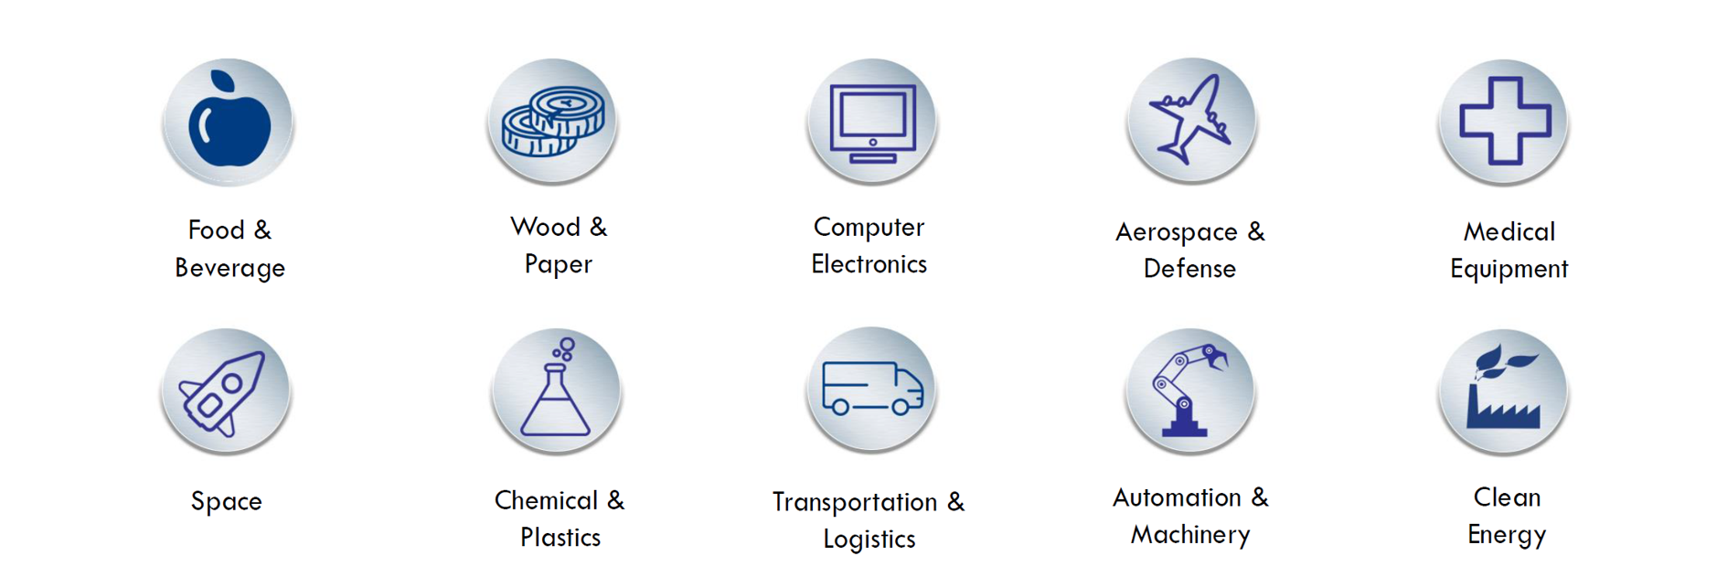
Advanced Manufacturing in Washington State

Slide 6
Advanced Manufacturing Examples (1 of 2)
Aerospace Manufacturing
  Backbone of WA State Manufacturing
  More than 1,300 aerospace companies with over 250,000 workers in industry
Food Processing
  Over 164,000 jobs including 36,000 farms producing over 3,000 different agricultural commodities
  Automation and rapid advances in technology are impacting the sector

Slide 7
Advanced Manufacturing Examples (2 of 2)
Space Exploration
  Over 6,200 workers, generating $1.76 billion in economic activity for WA State
  Parts and supplies for rockets, satellites, engines, and propulsion systems used in space flight
Maritime Manufacturing
  2,300 companies employing nearly 70,000 workers
  Ship building, recreational fishing, food processing

Slide 8
Registered Apprenticeship

Slide 9
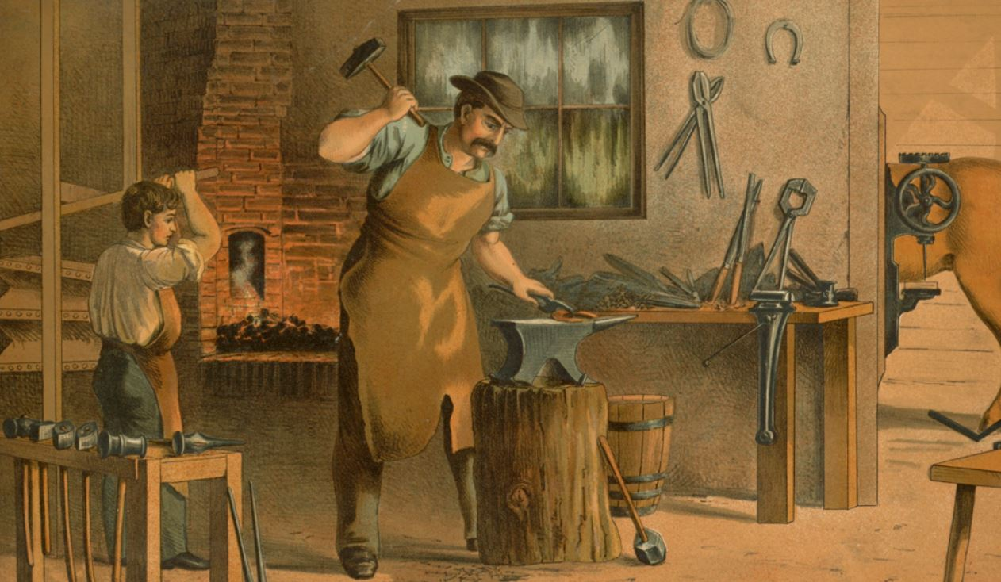
History of Apprenticeship
  A form of job training used for centuries (e.g. stonemasons, scribes, shipwrights, midwives, gunsmiths)
  “The original 4-year degree”
  Apprenticeship training split between theory and practice
  Upon completing an apprenticeship a person was called “journeyman”

Slide 10
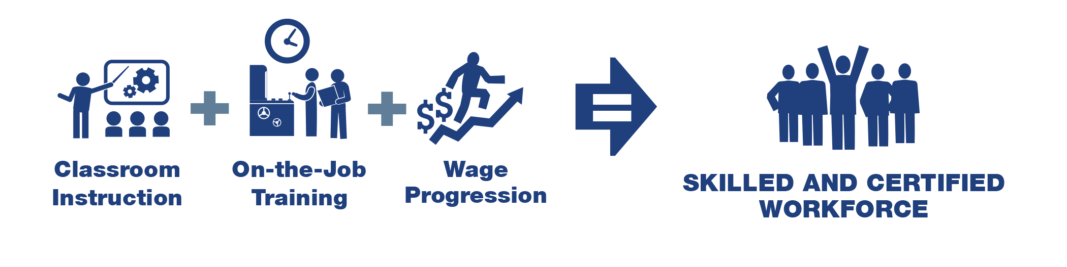
Elements of Apprenticeship
93%
7%
Results:
            Journey-Level Credential
            Transferable College Credit and/or Degree

Slide 11
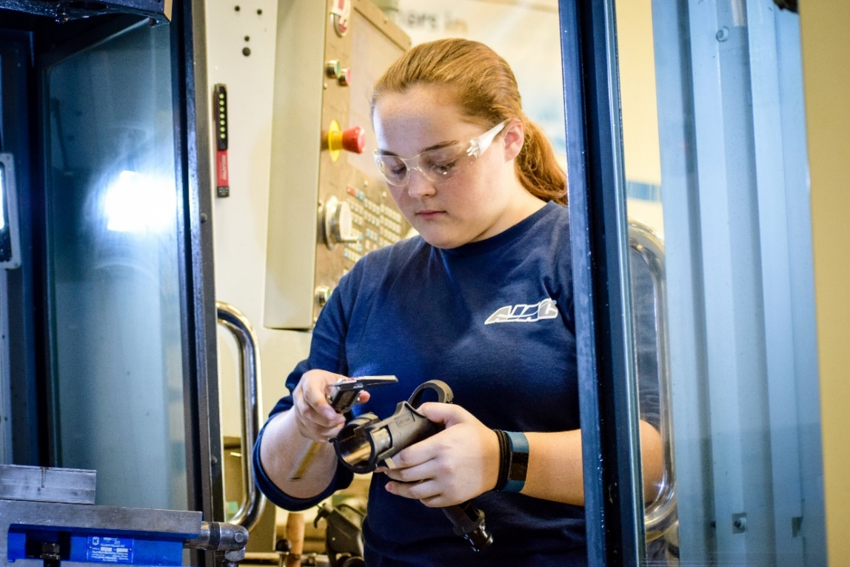
On-the-Job Training (OJT)
Supervised:
  Apprentice works with mentor(s) throughout program
Structured:
  Employer provides apprentice with practical work experience in the skill areas required to learn their trade

Slide 12

Related Supplemental Instruction (RSI)
Classroom Instruction (RSI)
  The theory behind what you are learning on the job
  Hands-on activities in the classroom
  144 hrs/year at a selected local community or technical college
    4 hours, one night a week
    3 or 4 quarters a year
  50% reduced tuition

Slide 13
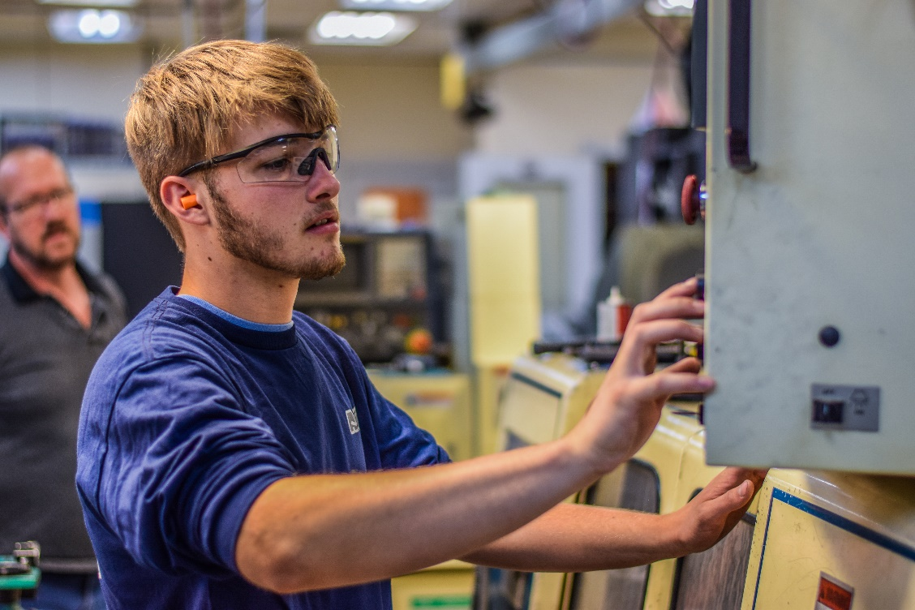
Results and Available Supports
Journey-level certificate
  National, issued by WA State
College credits
  15-60
  Apply towards 2-year degree
Financial aid available
  Washington College Grant for Apprenticeship

Slide 14

AJAC Advanced Manufacturing Apprenticeships

Slide 15
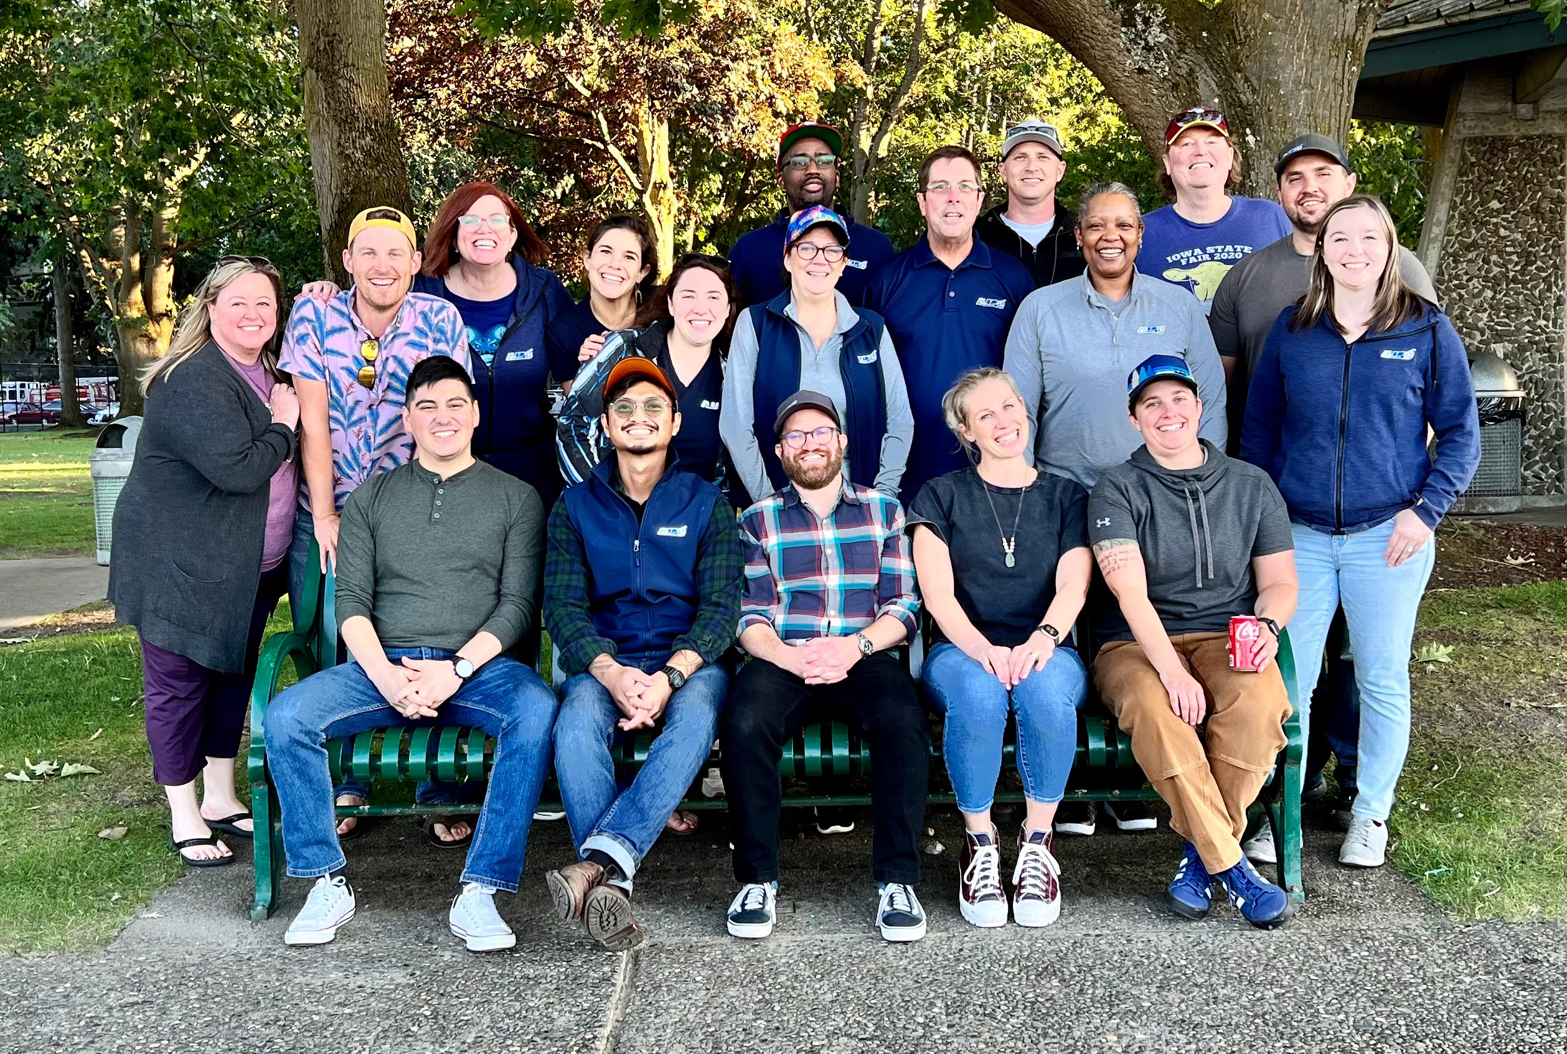
AJAC
Statewide, non-profit apprenticeship training intermediary serving aerospace & advanced manufacturing industries in WA
Designed to serve the supply chain, focus on small/ medium-sized companies
Founded in 2008 through a state investment; annual funding through SBCTC
Partner with employers, colleges, school districts, CBOs, and local workforce development boards

Slide 16
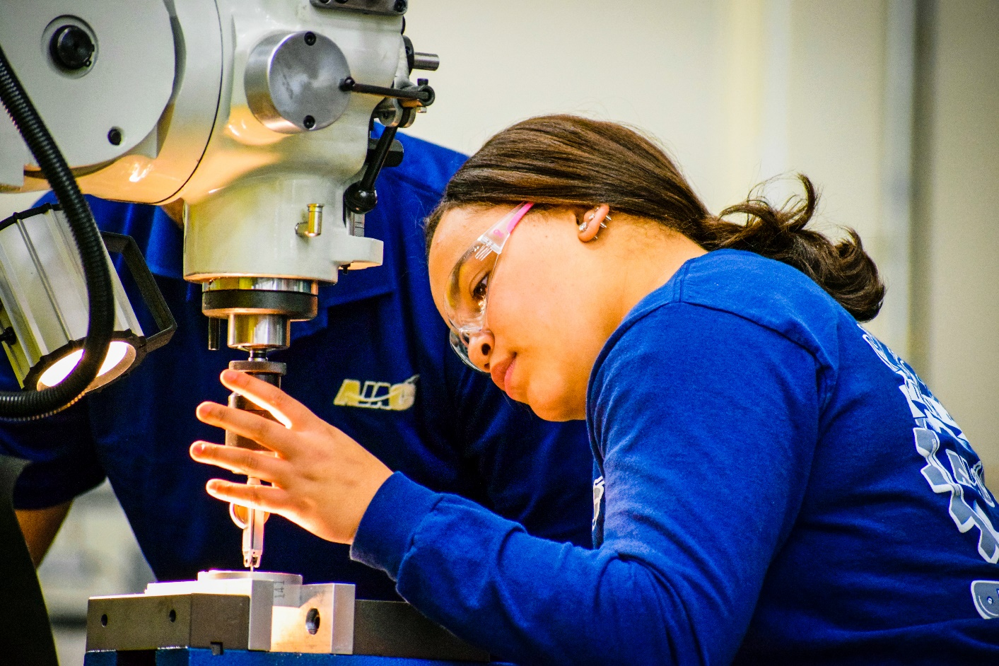
Mission and Vision
Vision: Create industry-driven apprenticeship programs that serve the lifelong learning requirements of a 21st century workforce.
Mission: AJAC is an industry-driven apprenticeship organization, founded on the belief that mastery occurs on the job. Through pre-apprenticeship, youth apprenticeship and adult apprenticeship, all people have the opportunity to earn competitive wages, find meaningful and fulfilling work, and pursue lifelong learning.

Slide 17
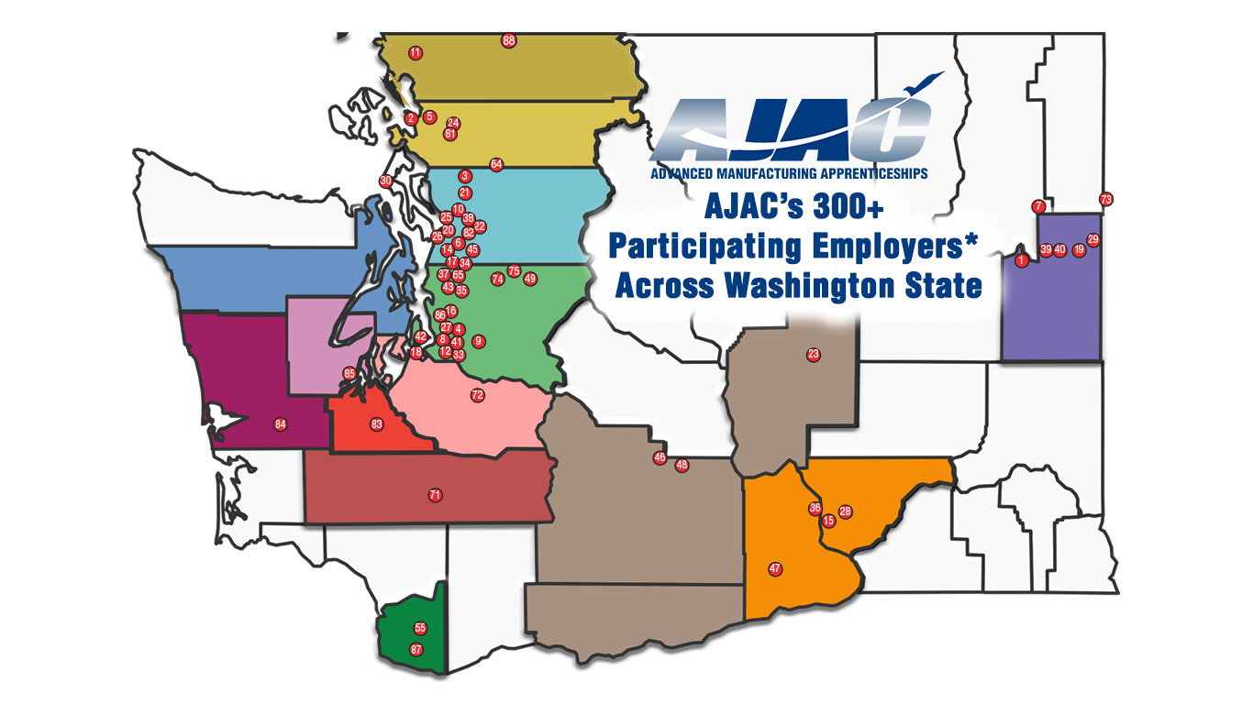
Employer Footprint

Slide 18
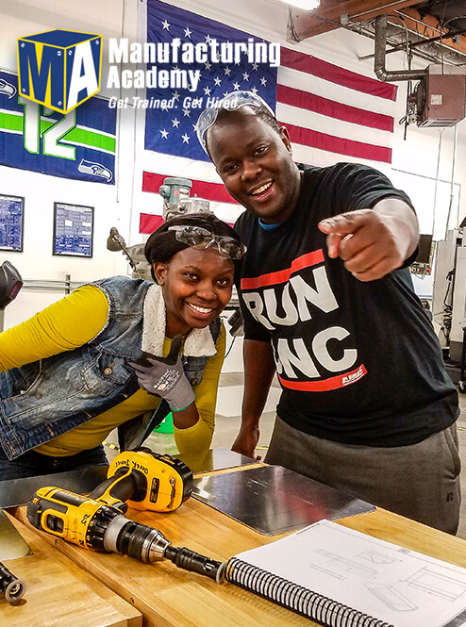
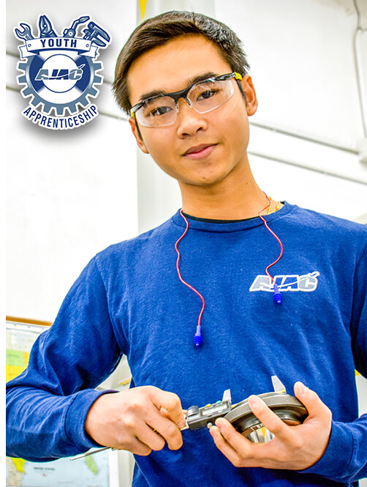
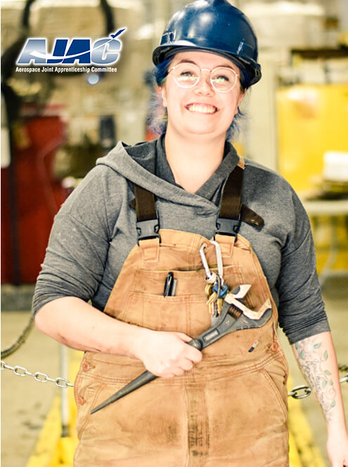
Foundational Programs
Pre-Apprenticeship
Youth Apprenticeship
Adult Apprenticeship

Slide 19
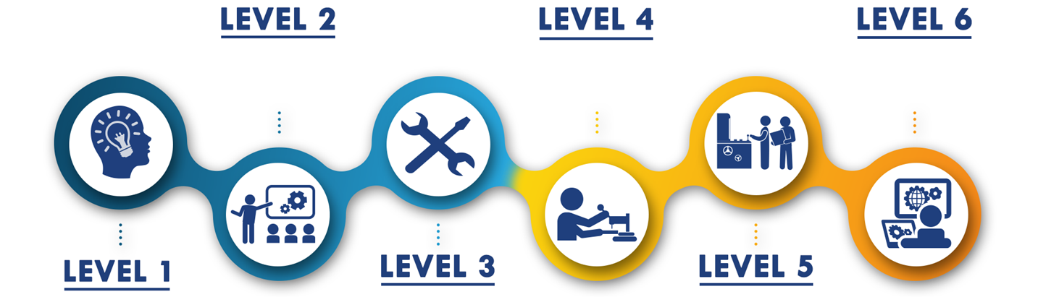
Pathways to Apprenticeship
Career Explore: Boot Camps, CTE, Core Plus, Pre-ETS
Career Launch (Entry-Level):
Youth Apprenticeship, Industrial Manufacturing Tech (1-2 years)
Career Launch:
Tool & Die, CNC Programmer, Operations (4-5 years)
Career Awareness: Career Fairs, Tours, Presentations
Career Prep: Manufacturing Academy, Pre-ETS
Career Launch: Machinist, Industrial Maintenance (3-4 years)

Slide 20
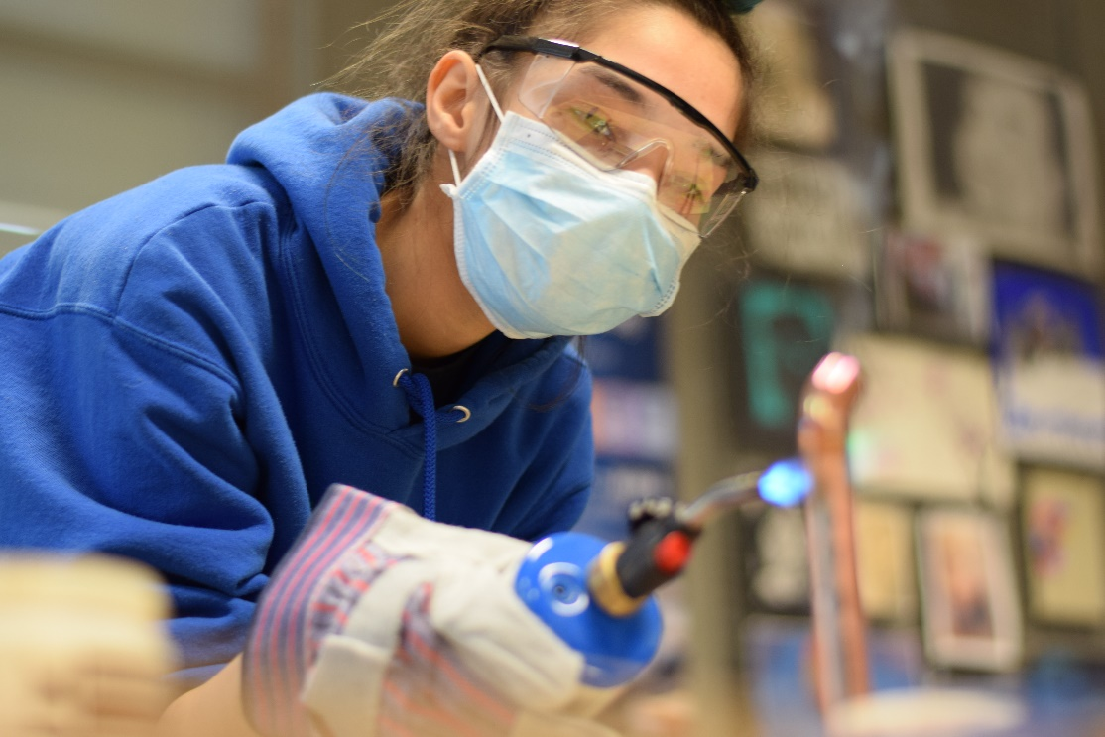
Pre-Employment Transition Services
Pre-ETS
  Workplace readiness
  Self-Advocacy
  Individual Work-Based Learning
  Paid Work-Based Learning
Embedded into MA
Can also be offered as boot camp

Slide 21
Other available supports
AJAC works with IEP counselors/teachers to support youth apprentices with disabilities
College partnerships can also be utilized to support accommodations for students
AJAC partners with numerous social enterprises to hire/train people with disabilities

Slide 22

Thank you!
bdurham@ajactraining.org
cpierson@ajactraining.org
ewilliams@ajactraining.org
www.ajactraining.org
Stay Connected
@ajactraining

