Slide 1
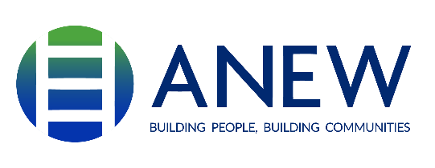
Youth Exploration Program
A Career Exploration Program of ANEW
Notes:
Training Date

Slide 2
Youth Exploration Program Overview
Youth Exploration Program overview
Non-Traditional career pathways
Work-Readiness Training
Paid Work-Based Learning Opportunity
Teachers and Community coming together to support IEP/504 students in career pathways

Slide 3
Youth Exploration Program
A Career Exploration of ANEW

Slide 4
Overview of Our Youth Program
Youth Exploration Program offers:
  Job exploration: Paid work-based learning – 40 hours
  Self-advocacy training
  Work-readiness training: 40 hours
  Students develop and apply skills that will support the success of their future career in the trades

Slide 5
Non-Traditional Pathway
Gain Understanding of
Apprenticeship Pathways

Slide 6
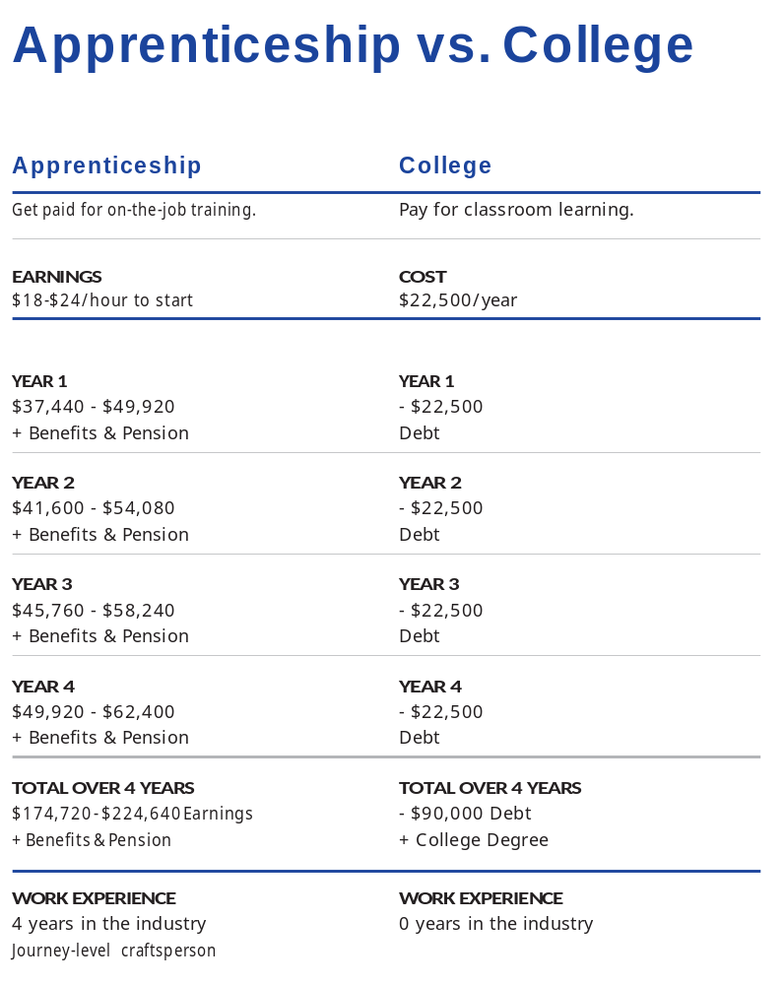
Option to a Lucrative Career
Apprenticeship model:
  Earn while you learn
  On-the-job training
  Combined with post-secondary education AKA Related Supplemental Instruction
  Hands on training with a journey worker/expert in the field
Zero debt pathway to careers in the trades

Slide 7
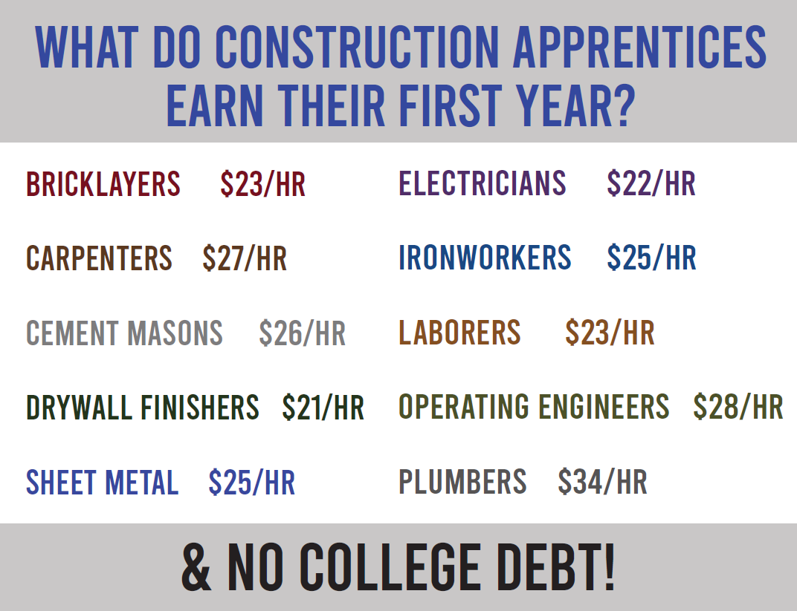
What are Typical Wages?
Trades apprentice wages start at $20+/hr.

Slide 8
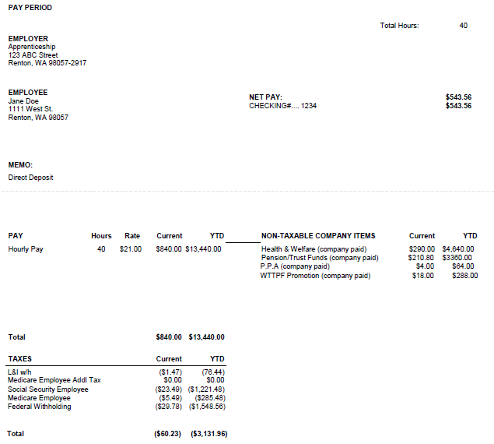
Weekly Paycheck
First-year apprentices without prior experience usually earn about $800 before taxes for 40 hours.

Slide 9
What YEP Offers

Slide 10
Work-Readiness Training
Soft Skills for the Trades

Slide 11
Skills and Knowledge Gained in Work-Readiness
Up to 40-hours of soft skills training sessions
Weekly topics that cover:
  Construction trades
  Apprenticeship
  Safety
  Self-advocacy
  Emotional intelligence
  Meet the experts from the field: Trades Folx

Slide 12
Paid
Work-Based Learning
Hands on Skills and Community Work

Slide 13
Hands-On Experience
40-hour paid work-based learning
Community project themed, “Building with a Purpose”
Safety orientation on the job site
Gain knowledge of tools and usage
Team building
Gain prospective of “Earn while you learn”

Slide 14
Community and K-12
How We Can Support Each Other

Slide 15
Let’s Support Each Other!
Connect us to the right folx in K-12
Identifying interested students
Working with ANEW Youth Exploration Program and DVR Regional DVR Counselors
Collaborating efforts to offer non-traditional career pathways

