Slide 1
Pre Employment Transition Services Partnerships: A Look into Programming with DVR and ESD 189 Schools
Presented by:
Nick Harris, DVR Regional Transition Consultant
Brian McClay, ESD 189 Program Specialist II

Slide 2
Cohort Model of Service Delivery

Slide 3
Cohort Model of Service Delivery (continued)
Students were grouped based upon their school;
Students would need to be appropriate for groups;
Students varied in ages and grade levels
Schools included 35 public, tribal, or alternative within Educational Service District 189

Slide 4
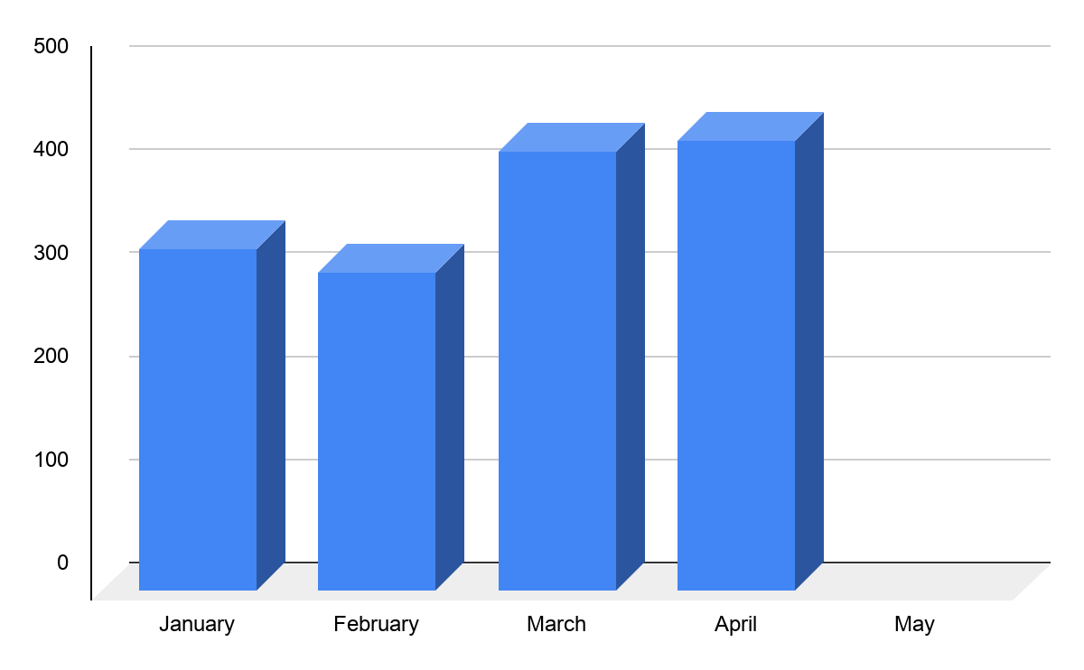
Number of Students served
331
308
425
437

Slide 5
Pandemic Plus:
Increase in frequency and guest speakers

Slide 6
Pandemic Plus: Increased frequency with schools
-The Pandemic brought about many challenges, but also opportunities:
-Digital service delivery became the main mode of services, which included platforms such as Zoom, Microsoft Teams, Skype, or Google Meets
-Digital service delivery led to no travel being necessary, which allowed for an increase in frequency in workshops at the schools from once a month to twice a month

Slide 7
Pandemic Plus: Increased guest speakers
-Using a digital service delivery model also increased the likelihood of guest speakers joining virtually
-This led to guest speakers joining monthly to talk about a topic or their business with students, which is a work-based learning activity informational interview

Slide 8
Career Clusters & Soft Skills

Slide 9
















Washington Career Bridge: 16 career clusters

Slide 10
DVR Soft Skills Curriculum: 9 topics
- Appropriate Groom & Dress
- Attendance & Punctuality
- Interpersonal Skills
- Following Directions & Instructions
- Accepting Supervision
- Positive Work Attitude & Habits
- Ethics & Integrity
- Communication
- Problem Solving & Flexibility
https://www.dshs.wa.gov/dvr/pre-employment-transition-services-pre-ets

Slide 11
Washington Career Bridge & Soft Skill Pairings
Agriculture, Food, & Natural Resources | Ethics & Integrity
Architecture & Construction | Attendance & Punctuality
Arts, Audio/Video Technology | Communications & Interpersonal Skills
Education & Training | Flexibility
Finance | Appropriate Groom & Dress
Manufacturing | Communication

Slide 12
Regional Relevancy

Slide 13
Business and Schools
Schools are paired geographically to where they live within the region.
Reaching out to companies within the region to build partnerships.
Businesses are within the area of a student’s community

Slide 14
Collaboration & Coordination:
Using a team approach

Slide 15
Collaboration & Coordination: Schools
    Special Education Director
    School Administration
    Teacher
    Superintendent
    School Counselor

Slide 16
Collaboration & Coordination: Schools
Multiple Engagement Strategies
  Calls
  Emails
  Meetings to introduce topic
  Collaborating with other agencies

Slide 17
Collaboration & Coordination: Businesses
Networking through chambers
Using Referrals
Cold Calling with a script
  Informational Interview
  Asking for Manager to speak with students to discuss lending their knowledge
Building and maintaining of relationships
  Job Site tours
  Eventually Work-based Learning
Success breeds success

Slide 18









Slide 19









Slide 20
Virtual Job Site Tour:
Nichols Brothers Boat Builders & Everett Ship Repair

Slide 21
On Site Virtual Tour
Brian toured Nichols Brothers Boat Builders and Everett Ship Repair
He was allowed to record both the tours and interviews with employees from both companies. He was able to compile the footage and create a virtual tour highlighting the benefits of apprenticeships and careers in the trades.

Slide 22
On Site Virtual Tour (cont.)
Virtual work-based learning activities included information about the following positions: welder, forklift operator, electricians, painters, apprenticeship coordinator, safety officer, project managers, logistics manager, administrative support staff.
Representatives from Nichols Brothers and Everett Ship Repair were in attendance during the presentation for questions as well as discussions about next steps

Slide 23
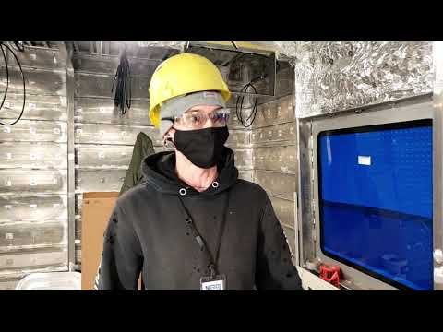
A Sample of the Virtual Job site tour
https://youtu.be/5AzH355KkNo
7:02 - 7:42

Slide 24
Thank you!

Slide 25
Contact Information
Nick Harris, DVR Regional Transition Consultant
harrind@dshs.wa.gov
(360) 429-3078
Brian McClay, ESD 189 Program Specialist II
bmmclay@nwesd.org
(209) 531-3652

