Slide 1

Achieve

Slide 2
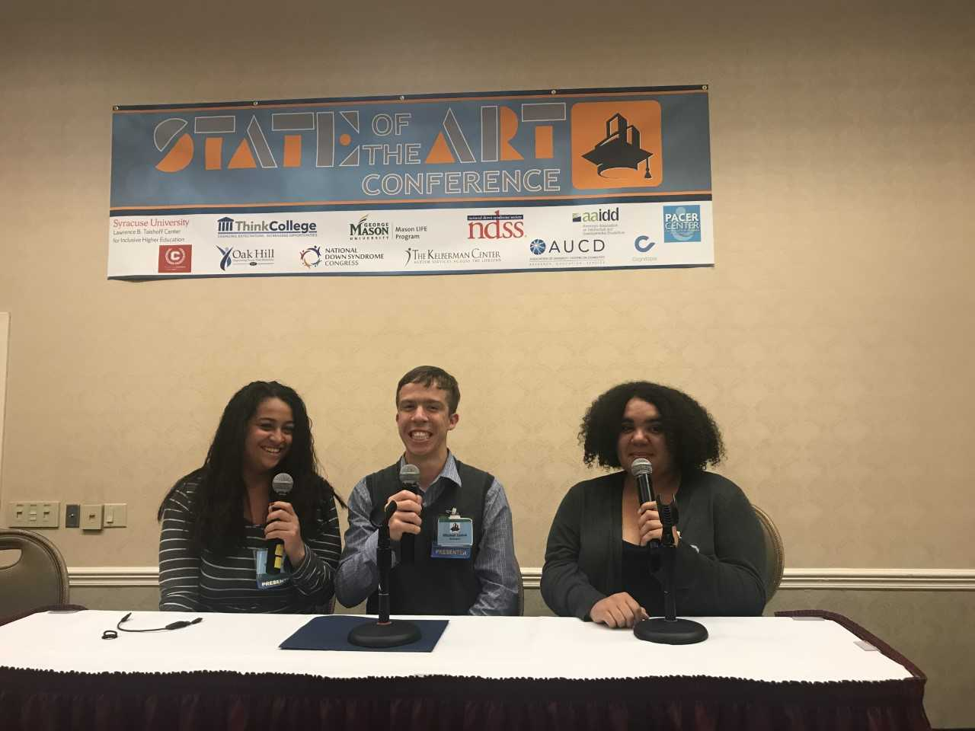

What is Achieve?
Achieve is a community college certificate program for students with intellectual disabilities that includes credit and non-credit classes, intensive advising, involvement in campus life, participation in community based internships, and assistance with job placement.

Slide 3
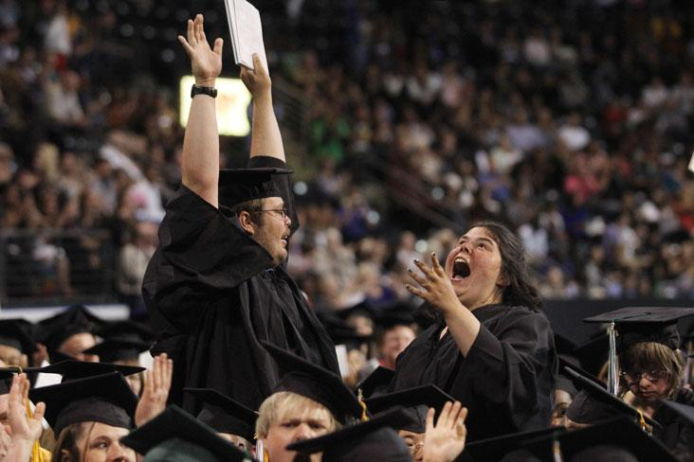
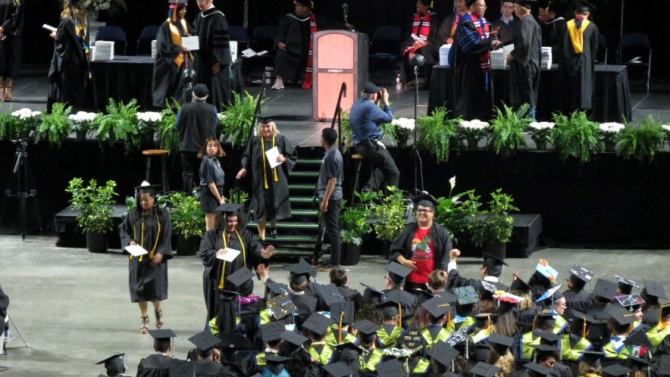
Two Certificate Options
Fast-track to Employment Certificate
  Can be completed in one year
Comprehensive Transition Certificate
  Can be completed in two years

Slide 4
Outcomes
Over 261 students served since 2010
Completion rate of 92%
Up to 25% of Achieve students continue education beyond Achieve
During 2018-19, 20 students participated in paid internships earning a total of $13,785.63, an average of $689.28 per student

Slide 5
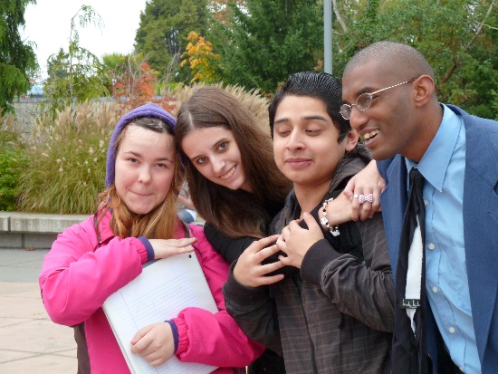
Program Eligibility
To be eligible for Achieve, students must:
Want a job and a community college experience
Be at least 18 years of age (can be enrolled in k-12)
Be eligible and willing to apply for Division of Vocational Rehabilitation (DVR) services
Be willing to follow program timelines
Have an intellectual or developmental disability
Be interested in obtaining an Achieve Certificate

Slide 6
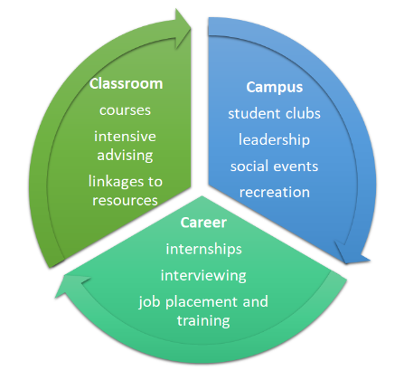
Campus
Student Clubs
Leadership
Social events
Recreation
Achieve Model

Slide 7
Student in the Spotlight

Slide 8
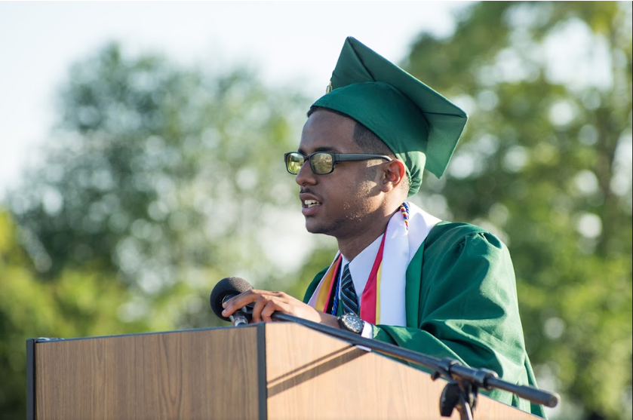
My Journey

Slide 9
Classroom Inclusion
At Highline, I took the following classes:
  Community Responsibility
  Diverse Perspectives
  Leadership
  Nutrition 101
  Biology 100
  Career Preparation
  Intro to Health Professions
  Math 098 – Intermediate Algebra

Slide 10
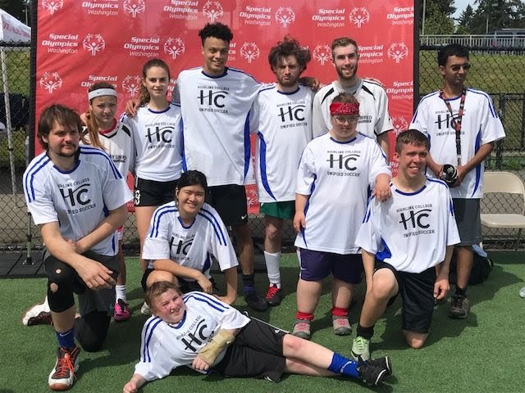
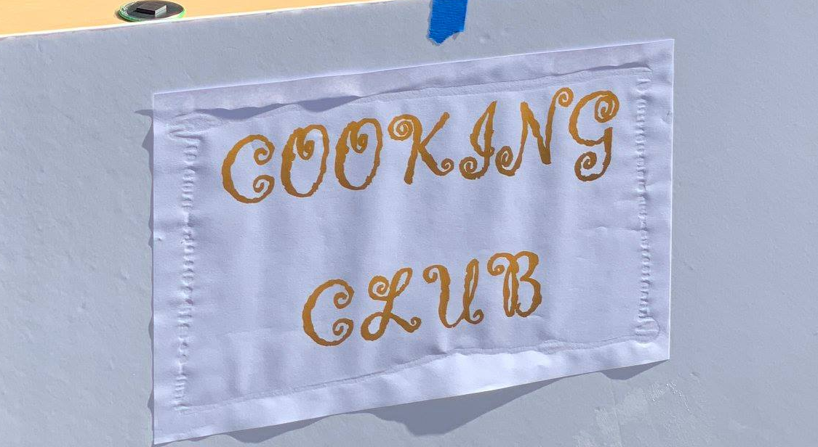
Campus Inclusion
I have been a part of several campus activities. They were:
Student Led Clubs
  Cooking Club
  Center for Leadership and Service
Conference
  State of the Art Conference in Nevada

Slide 11
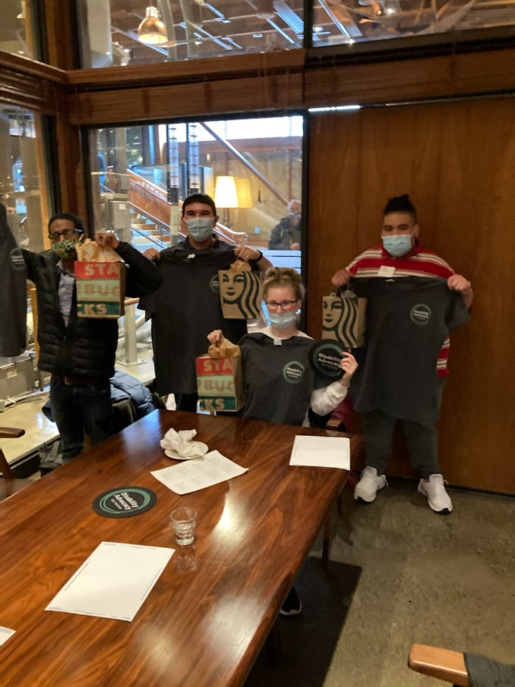
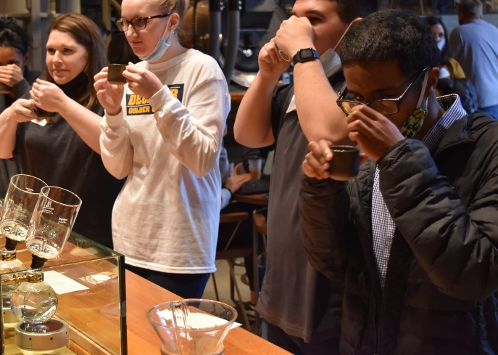
Career Inclusion
During my time at Highline College, I was involved in the following career activities:
Career Exploration
Job Fairs
Internships
Starbuck Site Visit

Slide 12
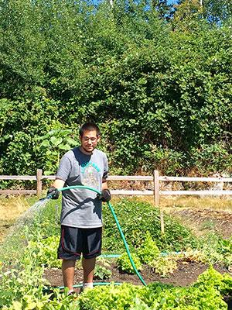
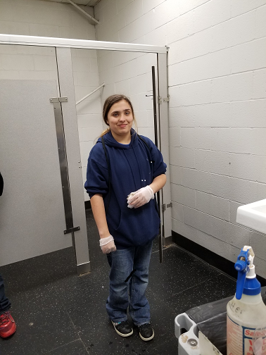
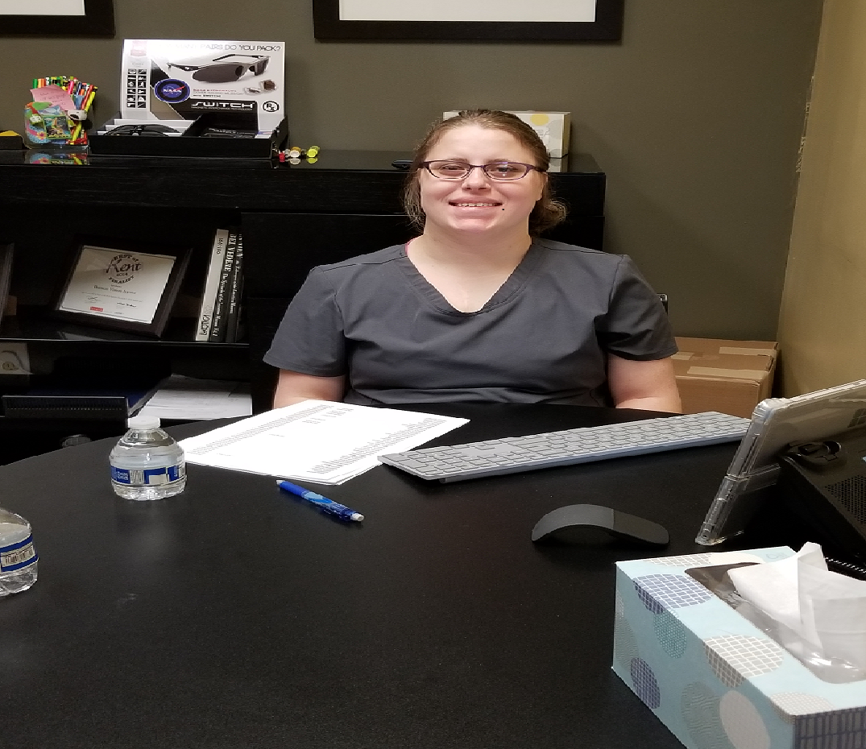
Internships
Andy,
Highline College Urban Agriculture program
Aubrey,
Kent Valley Ice Centre
Clare, Vision Source

Slide 13
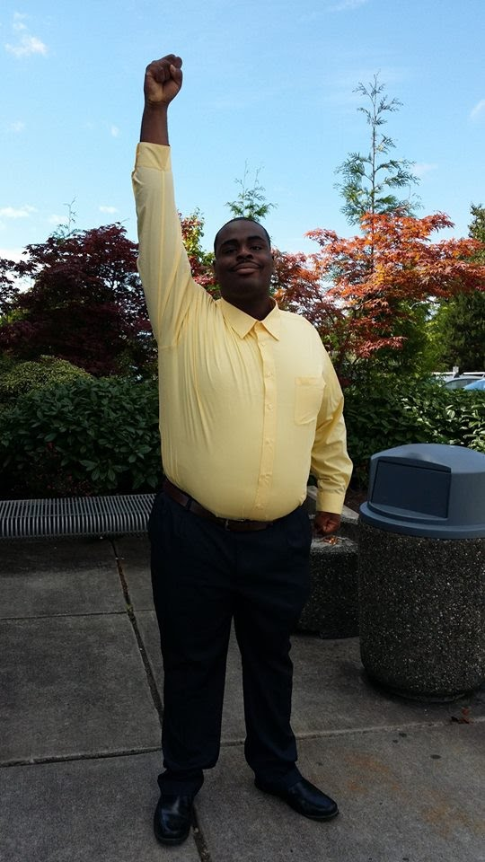
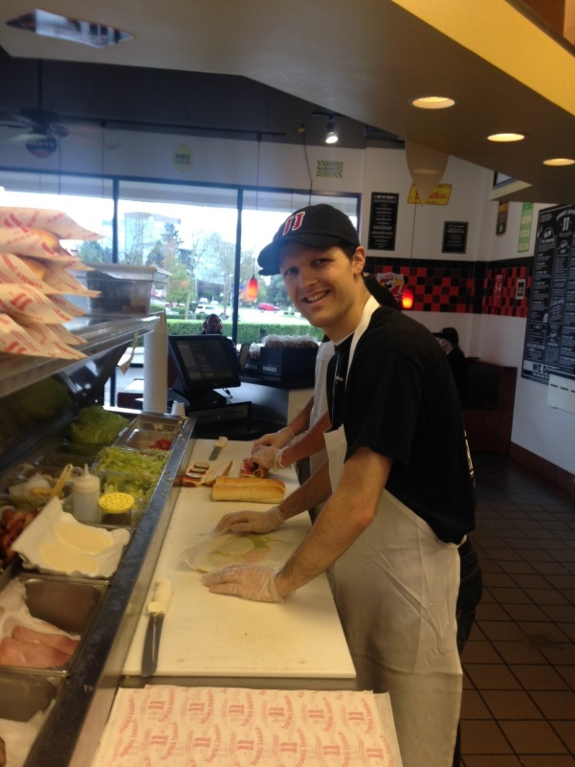
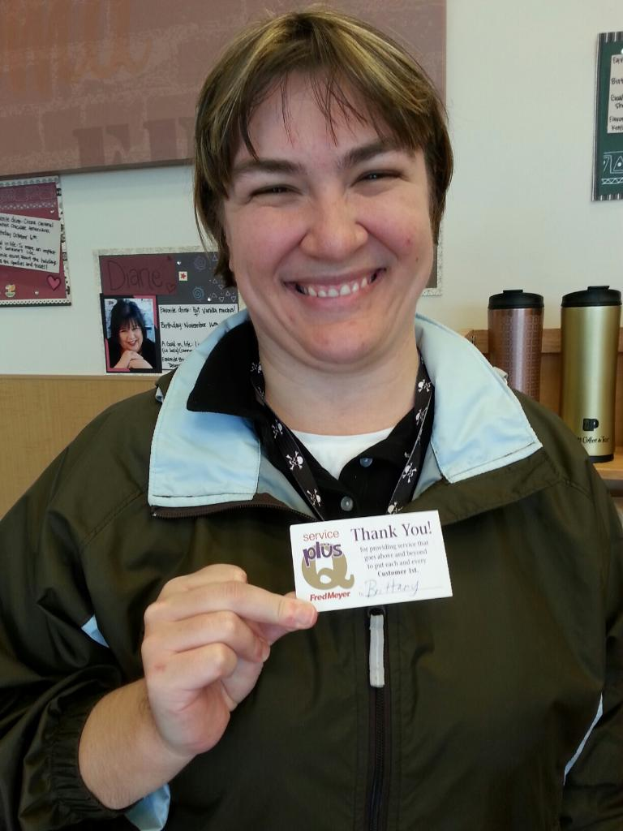

Jimmy John’s
Fred Meyer
City of Seattle
Compass Group at Microsoft

Slide 14
Next Steps

Slide 15
Application Deadline
All applications and district referral form submitted online
  achieve.highline.edu
District Referral Form due March 15th
Student Application due March 31st
  Submit supporting documents
    Documentation of Disability
    Proof of Guardianship, if applicable
Notes:
Developed a nationally recognized sustainable funding model
Share monograph

Slide 16
Funding College
Private Pay
Local School Districts (for dually-enrolled students)
Division of Vocational Rehabilitation
Financial Aid – Comprehensive Transition and Postsecondary (CTP) program specific
  Submit FAFSA application
Notes:
Developed a nationally recognized sustainable funding model
Share monograph

Slide 17

Contact Info
Erica He – Program Manager of Achieve and Future Launch
Highline College
ehe@highline.edu
**We also have translated materials! Please let me know in the chat what language you want and your email.
Website: https://achieve.highline.edu
General email: achieve@highline.edu

