Slide 1
Learning from Our Past:
A Forward View of Special Education Transition Services in Washington
Glenna Gallo
Assistant Superintendent, Special Education
glenna.gallo@k12.wa.us
Dr. Tania May
Director of Special Education
tania.may@k12.wa.us
June 2021
Notes:
Learning from Our Past: A Forward View of Special Education Transition Services in Washington

Slide 2




OSPI Strategic Goals
OSPI supports and empowers students, educators, families, and communities through equitable access to high-quality curriculum, instruction, and supports. Our shared focus is supporting all our state’s learners by providing coordinated, data-driven resources and supports to school districts. At the center of our work are our commitments to eliminating opportunity gaps and to supporting students furthest from educational justice. We are committed to undoing deficit narratives, policies, and practices; and building our knowledge and leadership for anti-racist policy and implementation.
Goal 1
Equitable Access to Strong Foundations
Increase student access to and participation in high-quality early learning and elementary by
amplifying and building on inclusive, asset-based policies and practices.
Goal 2
Rigorous Learner Centered Options in Every Community
Provide all students with access to challenging coursework, culturally responsive and anti-racist
curriculum, and pathways to graduation and beyond that meet their unique interests.
Goal 3
A Diverse, Inclusive, and Highly Skilled Workforce
Prepare all students with educators who are reflective of our global society by increasing
access to a workforce that is diverse, culturally responsive, and racially literate.
Goal 4
A Committed, Unified, and Customer-Focused OSPI
Support school districts through consistent, timely, and meaningful funding and supports that
center the needs of students. Agency operations unified in facilitating services and resources.
Source: Office of Superintendent of Public Instruction. (n.d.). OSPI Strategic Goals
Notes:
https://www.k12.wa.us/sites/default/files/public/communications/OSPI%20Strategic%20Goals.pdf

Slide 3
Graduation Pathways for All Students
Additional routes to
graduation for Class of 2021
ELA & Math
CTE
Armed Services Vocational Aptitude Battery (ASVAB) Test
Certificate of Individual Achievement (CIA)
Graduation Requirements Emergency Waiver (GREW)
ELA
Test: SBA, WA-AIM, AP, IB, SAT, ACT
Course: Bridge to College, Dual Credit, AP, IB, Cambridge
2 credits; same CTE program area; dual credit or leads to IRC
Math
Test: SBA, WA-AIM, AP, IB, SAT, ACT
Course: Bridge to College, Dual Credit, AP, IB, Cambridge
Locally developed through rule-writing process; can be locally designed & submitted to state
3

Slide 4
"Most of our assumptions have outlasted their usefulness."
Marshall McLuhan

Slide 5
Least Dangerous Assumptions
Human intelligence is multi-faceted
Measuring intelligence is flawed
Communication & high-quality instruction are prerequisites for determining capability
Presuming incompetence is harmful
Even if we are wrong, the consequence is NOT as harmful as the alternative
In the absence of conclusive data, educational decisions ought to be based on assumptions that, if incorrect, will have the least dangerous effect on the likelihood that students will be able to function independently as adults.
Evidence demonstrates that when there is adherence to the least dangerous assumption, students with disabilities can make progress on the same academic content as grade-level peers without disabilities.
Source: Donnellan (1984) Jorgensen (2005), Heinrich, Collins, Knight, & Spriggs, 2016; Ruppar, Afacan, Yang, & Pickett, 2017)

Slide 6
Leveraging Data to Reframe Assumptions
What are the characteristics of "students with disabilities"?
What is the difference in the percentage of the population who has a disability in Prek-12+ compared to adulthood in Washington state?
How do students with disabilities in Washington graduate compared to their peers without disabilities?
How do the unemployment rates of students with disabilities compare with the overall unemployment rate?

Slide 7
2020 WA Students with Disabilities, by Eligibility Category
Source: Office of Superintendent of Public Instruction. (2021). Special Education Federal LRE and Child Count Data.
Notes:
2020 Total K-12 enrollment: 1,059,618

Slide 8
2020-21 Least Restrictive Environment (LRE) by Grade Level
Source: Office of Superintendent of Public Instruction. (2021). Special Education Federal LRE and Child Count Data.

Slide 9
Percentage of Population with a Disability
13.44% of WA students, preK-12+, have an IEP.
1 in every 4 adults (25%) in the U.S. has a disability.
Washingtonians with disabilities are employed at less than half the rate of people without disabilities.
An estimated 36.8% of working age individuals with disabilities are employed, compared to 76.4% of people without disabilities.
Individuals with disabilities are less frequently employed in management and professional jobs and more frequently in service positions.
Source: Washington State Division of Vocational Rehabilitation. (2017). Disability & DVR Statistics Report.

Slide 10
Class of 2020 Graduation Pathways
Source: Graduation Pathways Dashboard, retrieved January 19, 2021.

Slide 11
Class of 2020 Graduation Pathways, Disaggregated
 | State Assessment (SBA/WA-AIM) Pathway | Military Assessment (ASVAB) Pathway | Career & Technical Education (CTE) Pathway | Alternate Pathway (CIA) | No Pathway
All Students | 66.5% | 2.9% | 9.8% | 3.4% | 25.6%
Students with Disabilities | 22.6% | 1.5% | 10.9% | 26.9% | 68.3%
English Language Learners | 31.3% | 1.4% | 8.9% | 4.9% | 62.3%
Source: OSPI. Graduation Pathways Dashboard. Retrieved June 2021.
Notes:
In spring 2020, 25% of safety net submissions included a high school and beyond plan (HSBP) for students over the age of 15.
Over 50% of students with the most significant cognitive disabilities are not engaged one year after leaving high school.

Slide 12
Certificate of Individual Achievement (CIA) Data Trends
Source: OSPI. CIA/CAA Database. Retrieved June 2021.

Slide 13
Post-School Outcome Data Trends
Source: Center for Change in Transition Services, Seattle University. (2020). Indicator B-14 Post-School Outcome Report, 2018-19, Washington state.

Slide 14
2018-19 Post-School Outcome Data, by Race/Ethnicity
Source: Center for Change in Transition Services, Seattle University. (2020). Indicator B-14 Post-School Outcome Report, 2018-19, Washington state.

Slide 15

Washington 2018-19 Leavers: Comparing Age of Exit
Except where otherwise noted, this presentation by Center for Change in Transition Services (CCTS) at Seattle University is licensed under CC BY 4.0.
Source: CCTS 2021, Unpublished raw data

Slide 16

Returning to Normal?

Slide 17
What Actions Will WE Take to Disrupt these Inequitable Outcomes?

Slide 18
Our Call to Action (or, What Keeps Us Up At Night...)
Fast implementation timeline for graduation pathways, paired with a lack of system readiness for ending the CIA alternative.
Students with disabilities continue to experience limited access to robust HSBP activities and graduation pathways.
COVID has presented enormous barriers for transition planning, work readiness and placement, and agency linkages.
Requests for graduation (i.e., CIA) and CTE pathways “just for students with disabilities.”
Challenges with accessing real-time, local data on graduation pathways.
18

Slide 19
OSPI Strategic Goals & Graduation Pathways
  Evidence-based Predictors:
  Career readiness & work study
  Inclusion & programs of study
  Career & Technical Education (CTE)
  Diploma status (and HSBP)
  Self-Determination/-Advocacy
  Family Involvement
Change ideas:
Statewide, cross-agency collaboration for transition planning, policy, and practices.
Identify (and scale) models of excellence –systems that have shifted away from CIA and offer robust, inclusive HSBP processes and CTE options?
1. Plan
2. Do
  Shape Impact:
  Every student with an IEP has a robust HSBP aligned to Transition Plan, resulting in a
  planned and completed graduation pathway.
  Transition planning student-driven, co-designed with families, and culturally responsive.
  Students exit with connections to adult agencies/supports.
4. Act
3. Study
Continuous Improvement:
Disaggregate graduation pathways data by district/school, by student group.
Map post-school outcome data to graduation pathways.
Collect data on level of student access for CTE pathways.
Source: Office of Superintendent of Public Instruction. (n.d.). OSPI Strategic Goals
Notes:
Plan – prioritize actions based on research and data (make predictions – if we do ___, then ___ will happen)
Do – test changes, gather data
Study – ongoing analysis; compare results with predictions
Act – adopt, adapt or abandon; consider ways to scale and sustain what is working.

Slide 20

Which of these challenges & opportunities do you see in your own systems?
Red Light: Which practices and outcomes will you stop or disrupt?
Yellow Light: Which practices and outcomes will you continue?
Green Light: Which practices and actions will you commit to starting?
Notes:
Transition, like inclusion, are lifelong activities. Each of us, regardless of our areas of focus, has a role to play in supporting students with a successful transition from school to post-school life. As you consider our look back today and toward the future, as you engage in the robust sessions planned for this forum, think about what resonates with you. What will you commit to stopping? What do you want to foster, continue, and protect? And what new actions can you take or start?

Slide 21
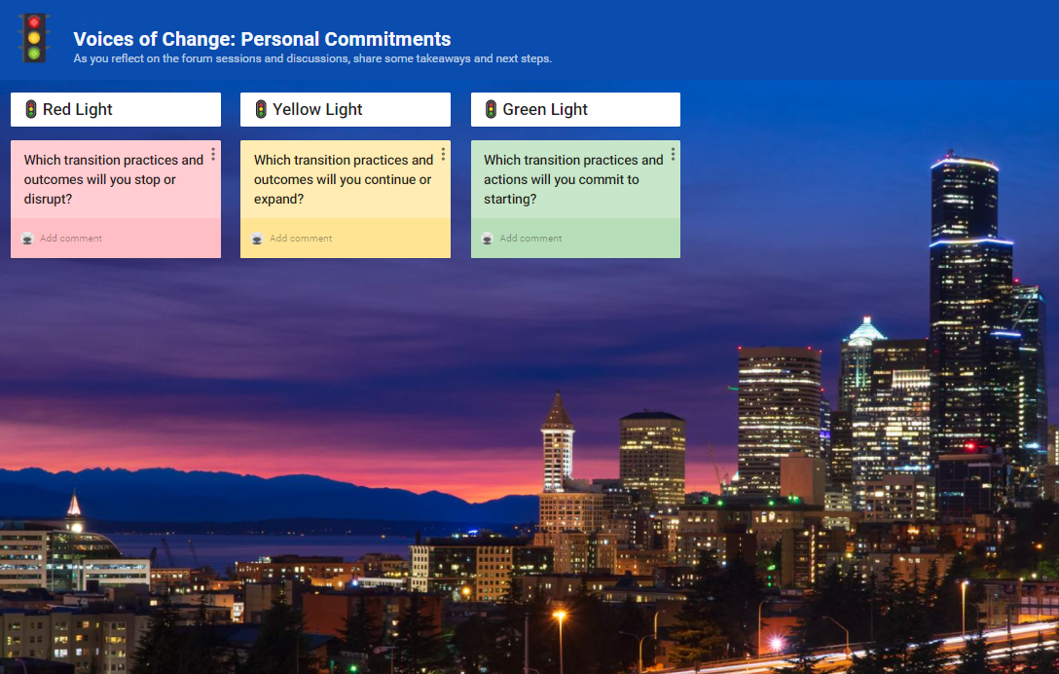
Padlet: Personal Commitments
https://padlet.com/tania_may/y1y1mxspbfywtfy4

Slide 22

Thank you!

Slide 23
Creative Commons

