Slide 1
Motivational Enhancement Group Intervention:
Adventures in Washington
Bethany Johnson, MSW
Ashley Schweiger, MS
Anya Sheftel, Ph.D.

Slide 2
Agenda for today
Story of MEGI
  MEGI description
  Oregon
  Washington
    Student and Teacher feedback
Next steps

Slide 3
Motivational Enhancement Group Intervention (MEGI)

Slide 4
What’s Important in Transition Curriculum?
Self-determination
Self-advocacy
Critical Consciousness/Empowerment

Slide 5
Motivational Interviewing
Spirit
  Partnership
  Acceptance
    Autonomy
    Affirmation
    Absolute worth
    Accurate empathy
  Compassion
  Evocation
  Emphasis on relationship
Skills
  Open questions
  Affirmations
  Reflections
  Summaries
  Emphasis on empathy and evoking conversation about change

Slide 6
MEGI
12 sessions (20-60 minutes long)
Conversation with a group of students
Focused on career exploration
Based on motivational interviewing
Emphasizes students’ job experiences, skills, values, and goals
Preparing students to further engage in developing a transition/job plan

Slide 7
Structure of MEGI
    Session 1 – Exploring past career aspirations
    Session 2 – Past job experiences
    Session 3 – How work fits into a typical day
    Session 4 – Perceptions of disability and strategies for self-advocacy
    Session 5 – Strengths
    Session 6 – Self-Advocacy
    Session 7 – Values
    Session 8 – Dream Job: Importance and Confidence
    Session 9 – Past successes
    Session 10 – First 3 steps to Dream Job and Roadblocks
    Session 11 – My Story – Summary of what students learned about themselves through MEGI
    Session 12 – Graduation!

Slide 8
MEGI
MI Spirit
MI Skills
Empowerment
Self-determination
Self-advocacy

Slide 9
MEGI In Oregon
Piloted MEGI in 2012-2013 in 6 high schools in Oregon
2015-present: one of key Pre-Employment Transition Services
Urban and rural schools

Slide 10
MEGI in Washington: Pilot (2020-present)
Washington DVR transition assessment
  Self-advocacy
  Self-determination
Approached by Transition Manager to bring MEGI to Washington
Four Regional Transition Consultants were trained
  5 schools
  66 students with variety of ability levels

Slide 11
MEGI in Washington: Pilot (2020-present)
  Collaborating with schools
  Adapting MEGI to Zoom
  Adapting MEGI to a variety of ability levels

Slide 12
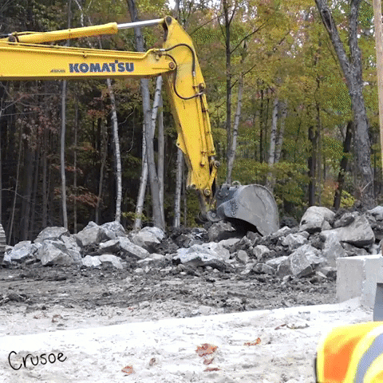
What is…SKILL?
The ability to do something well; expertise

Slide 13
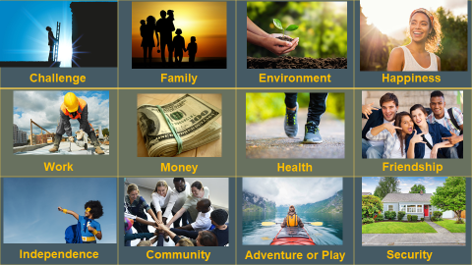

Slide 14
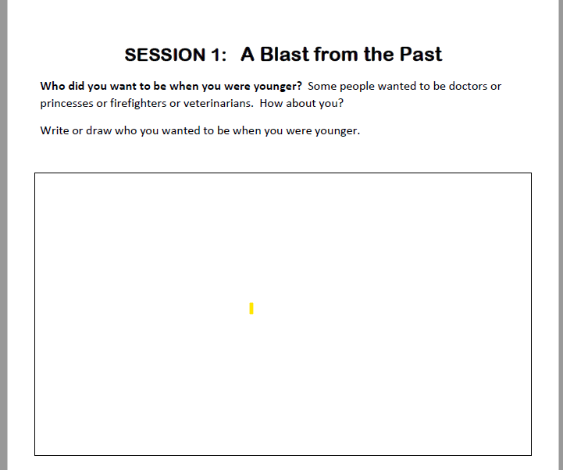
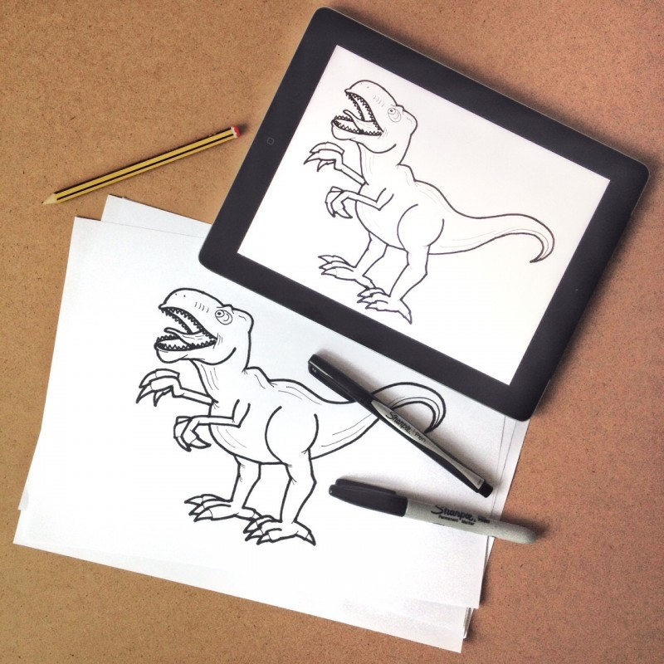
Pg. 3

Slide 15
MEGI in Washington
Self-determination
Self-advocacy
Empowerment

Slide 16
Talking about advocacy
Mindfulness activities
Getting to hear other people’s answers and goals
Meditation and relaxation

Slide 17

Student Voices

Slide 18
It talks about everything.. feelings, jobs, experiences, advocacy, talking to people about how you feel and stuff about all that. It can be pretty hard to do when you are alone and feel like there is no one out there to help you but there really is.
The experience I have had during Covid has been really awesome with MEGI because it has helped me overcome my doubts about my dream job. When we talked about overcoming roadblocks and coming up with steps to overcome those roadblocks helped me.
After you know your story you have self-respect for yourself and stand up for yourself and what you need for your life. When people don’t honor themselves they become insecure, so you need to learn to self respect and when life is hard.. keep going.

Slide 19

Teacher Voices

Slide 20
MEGI was absolutely valuable for the students.
Loved the way you tied all of the lessons together into “their story” at the end.
The reflections encouraged the students to put the pieces together.

Slide 21
Next Steps: Fall 2021
New cohort of RTCs will be trained as MEGI facilitators
  Spring 2022 increased availability of MEGI facilitators across the state

Slide 22
If You Want to Bring MEGI to Your Students
Get in touch with your Regional Transition Consultant
We’ll be excited to collaborate with you and your students!

Slide 23
Questions?

