Slide 1

Economic Empowerment Through Education

Slide 2


Why JA

Slide 3
Junior Achievement inspires and prepares young people to succeed in a global economy.
67 years of commitment in Washington
We are dedicated to giving young people the knowledge and skills they need to own their economic success, plan for their futures, and make smart academic and economic choices.

Slide 4
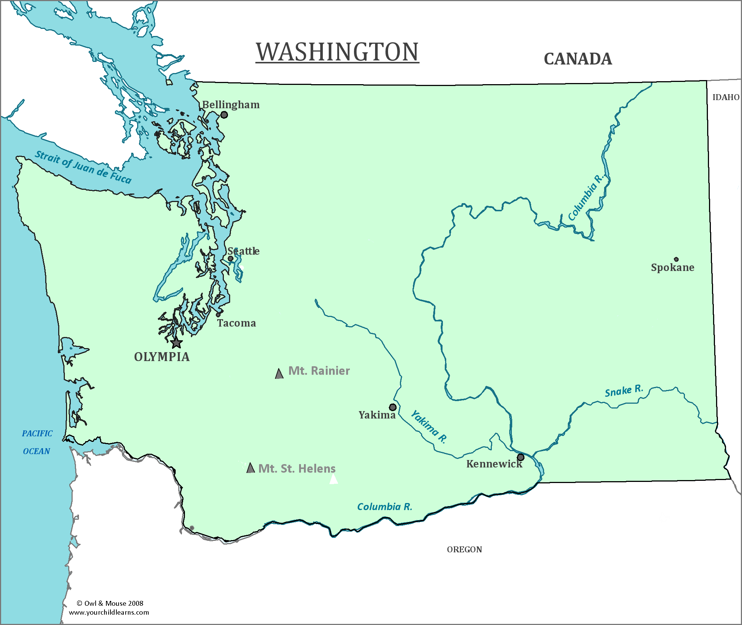
Presence Across Washington
Northern WA
Eastern WA & Northern ID
King County
Central WA
South Puget Sound
Southeast WA
Tri-Cities & Walla Walla

Slide 5
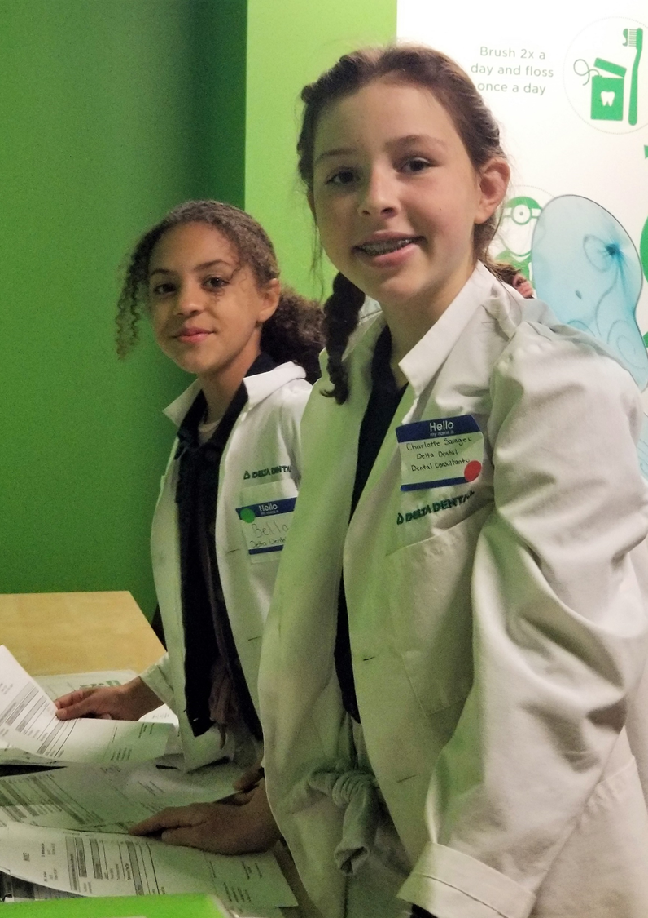
Junior Achievement offers three JA Pathways.
1
Financial Literacy
2
Work & Career Readiness
3
Entrepreneurship

Slide 6
Junior Achievement K-12 Programs supports learning standards
Correlate to
Washington State Learning Standards
English Language Arts (Core Curriculum)
Support
High School and Beyond Plan
Completing Career Interest Inventory
Incorporate
CTE Education’s 21st Century Skills
Learning & Innovation
Mathematics (Common Core)
Social Studies – Skills, Civics, Economics
Life and Career Skills
Interdisciplinary Themes (A Global Awareness & Financial, Economic, Business and Entrepreneurial Literacy)
Setting Career Goals through Career Exploration
Resume Writing / Personal Branding
Financial Education

Slide 7

How It Works
Volunteer and educator led programs
Age-appropriate programs for students K-12
In-person and remote delivery of all programs
JA programs are used to replace or supplement curriculum
Variety of in-school and out-of- school program delivery formats

Slide 8
Workplace Readiness Training Programs

Slide 9

JA BizTown®
Integrates financial literacy and work and career readiness into classrooms. After in-class sessions, students participate in a simulation and enter a mini-city and take on ‘jobs’ and operate banks, manage restaurants, write checks and vote for mayor.
Topics: Bank services, the circular flow of money and goods in an economy, how interests and skills can lead to a future career, and basics of business management.
Duration: 12 in-class sessions and 4 hour in-person simulation and/or online simulation
Level: Intermediate
Clip from Q13
https://www.youtube.com/watch?v=oKN6mRiecuU

Slide 10

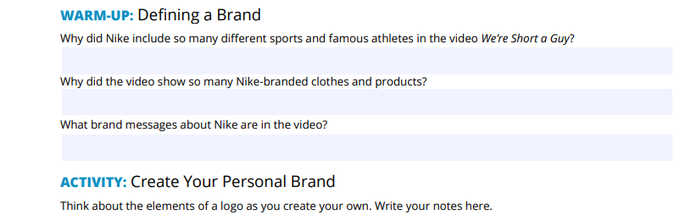
JA It’s My Future®
Offers students practical information to help prepare them for the working world.
Topics: Developing a personal brand, career clusters, interests and potential jobs, career mapping, transferable skills and job-hunting skills.
Duration: Six 45-minute sessions
Level: Intermediate

Slide 11

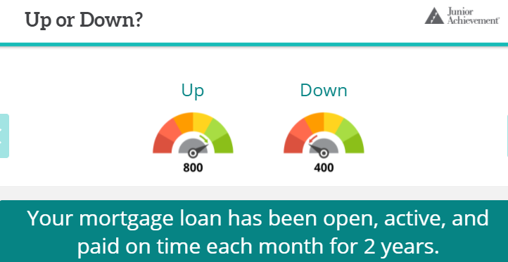
JA Economics for Success®
Lays bare for students the heart of a successful economic life: choosing the right career and managing money properly.
Topics: Students explore their skills, interests, values, and the world of work to make informed education, career, and life decisions.
Duration: Six 45-minute sessions
Level: Intermediate

Slide 12
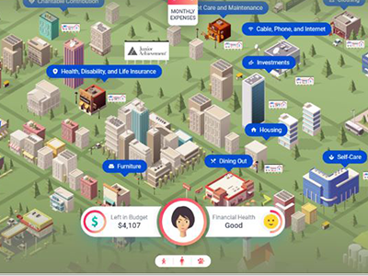
JA Finance Park®
Introduces students to personal financial planning and career exploration. At the culmination of classroom lessons, students visit JA Finance Park, a simulated town or virtual community, to put into practice what they've learned by developing and committing to a personal budget and experiencing a day as an “adult.”
Topics: Income, Debt and Credit and Budget
Duration: Thirteen 45-minute in-class lessons and 4-hour in-person simulation or 2-hour virtual simulation
Level: Intermediate & Advanced
Video Clip
https://www.youtube.com/watch?v=gN50tgJi26s

Slide 13

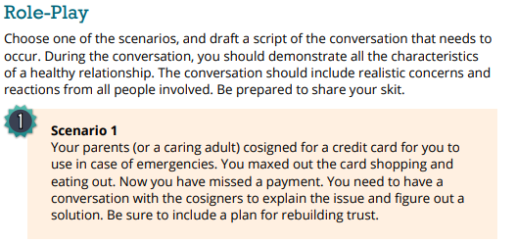
JA Personal Finance®
Allows students to experience the interrelationship between today’s financial decisions and future financial freedom.
Topics: money-management, earning, employment and income, budgeting, savings, credit and debt, consumer protection, smart shopping, risk management, and investing.
Duration: Five to eight 45-minute sessions; Five volunteer-led; Three optional educator-led
Level: Advanced

Slide 14
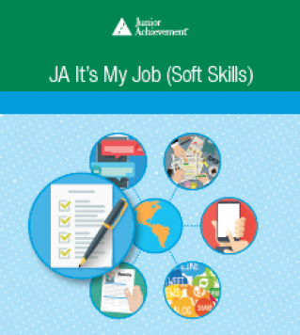
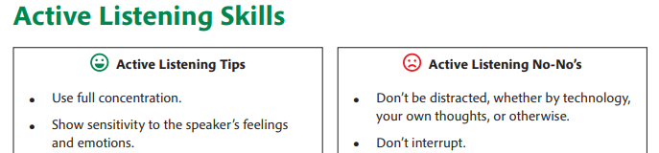
JA It’s My Job (Soft Skills)®
Helps students understand the value of professional communication and soft skills, making them more employable to future employers across multiple career clusters.
Topics: Interviewing for a Job, Workplace Communication, Cellphones on the Job, Communicating about Yourself, Workplace Writing, Applications and Resume
Sessions: Three to six 45-minute lessons, volunteer-led
Level: Advanced

Slide 15

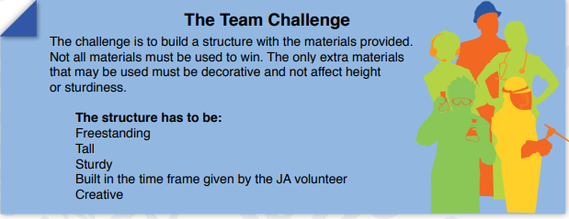
JA Career Success®
Equips students with the knowledge required to get and keep a job in high-growth
industries.
Topics: 4Cs - Critical Thinking, Communication, Collaboration & Creativity
Sessions: Seven 45-minute sessions, volunteer-led
Level: Advanced

Slide 16

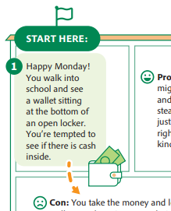
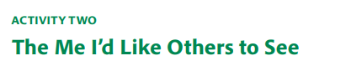
JA Excellence Through Ethics®
Students learn the importance of ethics and ethical decision-making and how ethical and unethical choices affect everyone in a community.
Topics: personal values, character development (including respect, fairness and a positive attitude) and ethical behavior
Duration: One volunteer-led session, 60 – 90 minutes; two optional educator-led sessions, 45-minute sessions
Level: Advanced

Slide 17
Work-Based Learning Programs

Slide 18

JA Job Shadow®
This program prepares students to be entrepreneurial thinkers in their approach to work. Students learn how to research career opportunities and the skills needed to land and keep their dream job. Following in-class sessions to prepare, students visit a professional work environment.
Three educator-led sessions; One 2-4 hour site visit at host company
Level: Advanced

Slide 19

JA Career Speaker Series®
A volunteer guest speaker visits the classroom and shares information about his or her career, work, and education experience.
1-hour guest speaker; optional 45-minute pre- and post-speaker educator-led lessons
Level: Intermediate & Advanced

Slide 20
JA Finance Park DVR Summer Camp

Slide 21


Details

Slide 22
Eligibility for DSHS/DVR Funded Program

Slide 23
Eligibility
Programs are available at no-cost to students who are eligible to receive DVR pre-employment transition services.
Students must be:
Between 14 years of age and 21 years of age;
Attending a secondary / high school, alternative, GED prep, post-secondary or vocational education program; and
Receiving special education services, or is an individual with a disability for purposes of 504 eligibility

Slide 24
Requesting programs

Slide 25

Contact Us
Visit our webpage
jawashington.org
Programs Team
programs@jawashington.org
206.808.5861
Munira Sheriff
VP Programs and Evaluation
muniras@jawashington.org
206.227.0871

