Slide 1
Job Foundation
Year One

Slide 2
Agenda for Presentation
Summary of project
  Process Overview
  Interagency Agreement
Job Foundation Report
  Components
  Guidelines
  Quality Oversight
  Assistive Technology
Ideal Timeline
Current Status
  Participating Counties
  What’s next
Resources & Questions
Notes:
Rod

Slide 3
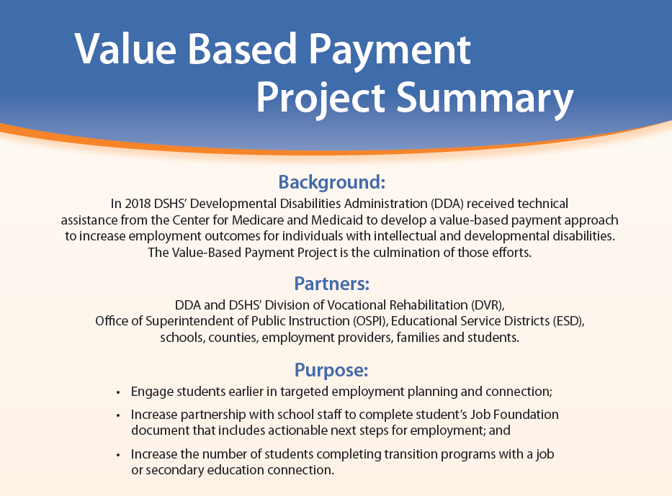
Notes:
Rod

Slide 4
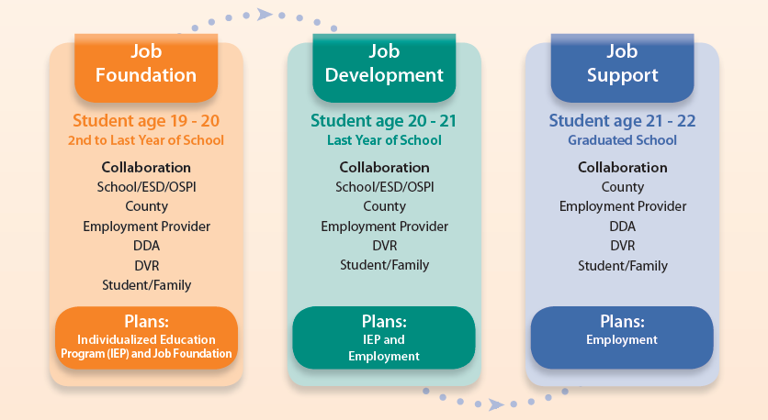
Collaboration Process Overview
Notes:
Rod

Slide 5
Interagency Agreements
DDA-DVR Job Foundation Memo
DDA-OSPI Contract
Notes:
Ann

Slide 6
Job Foundation Report Components
Communication Skills
Interactive Social Skills
Self-Advocacy Skills
Task Management Skills
Work Interest Exploration
Critical Documents & Enrollments
Notes:
Kelly

Slide 7
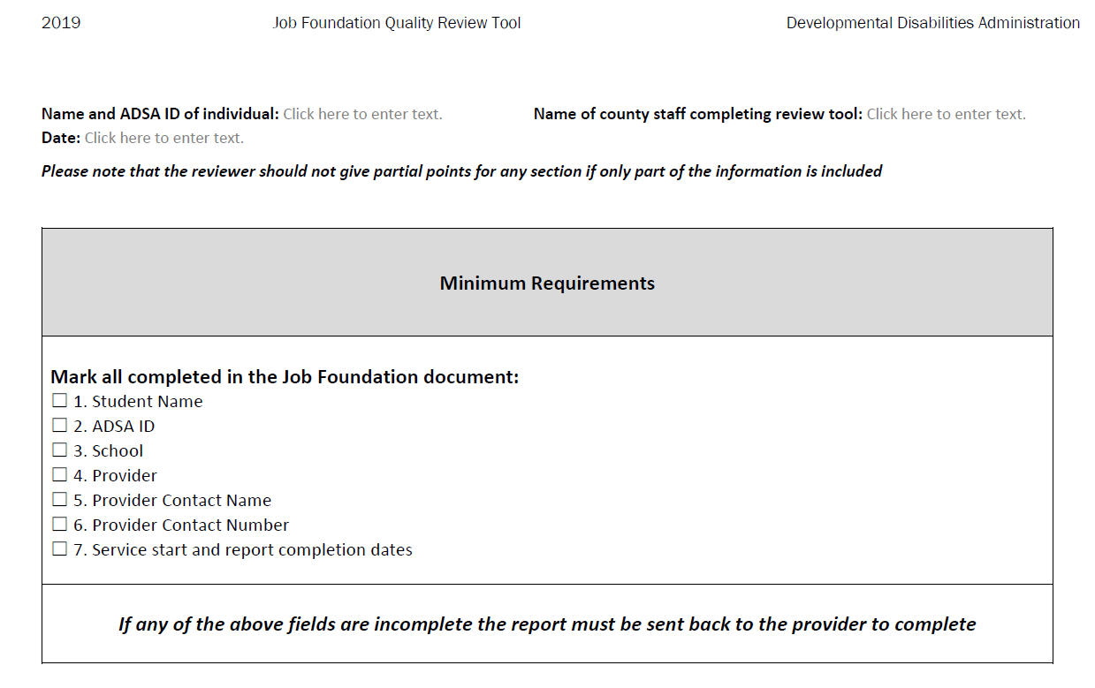
Quality Oversight
Notes:
Kelly

Slide 8
Example from Job Foundation Report
Ability to express preferences and interests in particular job environments/tasks | You came to the program knowing what you want to do when it comes to job, community involvement and plans. Your preferred jobs and interests are in the human service field. You want to teach preschool or elementary school age children. You have volunteered in the community and you want to continue after Covid subsides and it is safe to go back to communities. You enjoyed working at the poolside as a staff assistant and would love to get a job in such an environment. You also enjoyed volunteering at the retirement homes. Social justices and social issues are something that interest you and you would like to work at homeless shelters as a volunteer and continue to give back to society. With the help of your mother, you can identify and articulate your strengths, interests, passions, and career path. | Once you begin working with your employment consultant to identify the job that is suitable for you and matches your interest, it is suggested that you continue to explore additional types of work to expand your understanding of possible opportunities that you are qualified for. This way, you can apply to positions that are of interest to you and that you will do well in. Increasing the amount of jobs, you are open to will ensure you find the best job for you. It is suggested that since you have an opportunity to work this summer as a dance assistant, you should take advantage of the opportunity to strengthen work skills and learn new ones that you can market to a permanent employer. Your employment consultant is available to provide support to you that will help you strengthen your skills and be successful in your Summer job.
Recommendations:
It is recommended that you start using a cellphone to communicate with your instructors, Achieve Advisor and employment consultant to be able to gain confidence to speak louder and with confidence when you return to campus or in the workplace. Also, you should work on your nonverbal communication skills with your circle of support.
Notes:
Kelly

Slide 9
Assistive Technology/Technical Assistance
Resources available to the student-Schools, DVR and DDA roles (Communication devices, subject Matter experts) as follows:
  Student in school, devise needed for school- District funds
  Student needs devise for employment- DVR funds
  Neither apply- DDA may provide funding
DDA’s Technical Assistance
  Service Alternatives
    Published List of Resources
  WISE – (Benefit Planners)
Notes:
Ann

Slide 10
Ideal Timeline
Students at age 19 = Job Foundation start
7/1 – 9/30
Job Foundation enrollment
7/1 – 9/30
DVR application / eligibility
Job Foundation Process
10/1 – 6/30
Job Foundation with employment providers
Students at age 20 = DVR Plan and/or School 2 Work
7/1 – 9/30
DVR application if no Job Foundation
9/1– 6/30
Job placement occur throughout the year. Students stays enrolled in school even if employed. Work towards employment / career goals.
High Acuity Graduates in June w/Job, DDA CSA issued
7/1 – 9/30
Job = $1,500 plus $1,000 if > 10 hrs./wk.
9/30- 12/31
Job = $1,000 plus $1,000 if > 10 hrs./wk.
1/1– 3/31
Job = $500 plus $1,000 if > 10 hrs./wk.
4/1/– 6/30
Job = $250 plus $1,000 if > 10 hrs./wk.
Notes:
Kelly review timeline

Slide 11
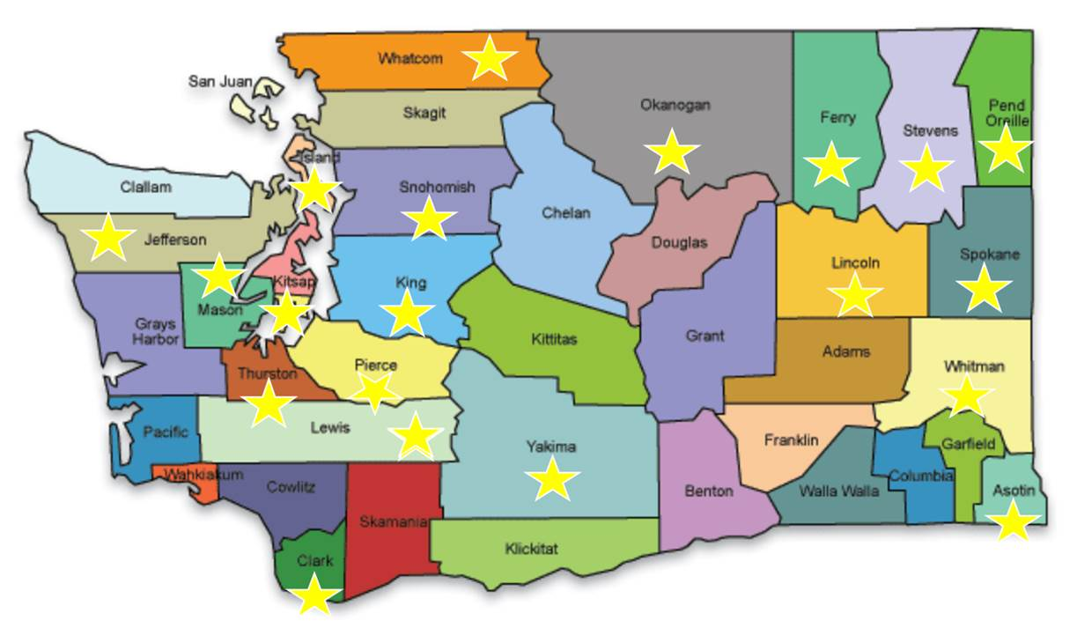


Participating Counties
Asotin
Clark
Columbia
Ferry
Island
Jefferson
King
Kitsap
Kittitas
Lewis
Lincoln
Mason
Okanogan
Pend Orielle
Pierce
Snohomish
Spokane
Stevens
Thurston
Walla Walla
Whatcom
Whitman
Yakima
Visit the Job Foundation Interactive Map to see if there is a Job Foundation Pilot Program in your county.
Notes:
Kelly reviews calls out Kittitas, Walla Walla and Columbia Counties GOLD STARS!!! Interactive map will provide contacts for specific Counties

Slide 12
2021 Job Foundation reports to date 6/16/21
56 Completed Reports
6 Counties: King, Thurston, Mason, Pierce, Kitsap and Spokane
21 Schools:
  Bellevue Federal Way Highline Ingram
  Issaquah Kent Tumwater Northshore
  Outreach Rainier Beach Seattle Shelton
  Voice SACT Mercer Island Penninsula
  Lake Washington North Thurston Puyallup
  STEP/Spokane Shorecrest
Notes:
Rod review current status –

Slide 13
Next Steps
Continued outreach
Trainings:
  Provider mentoring/trainings
  Community of practice
  DVR
  Schools
Expansion of Transition Networks
Mentoring sessions
Notes:
Rod and Ann

Slide 14
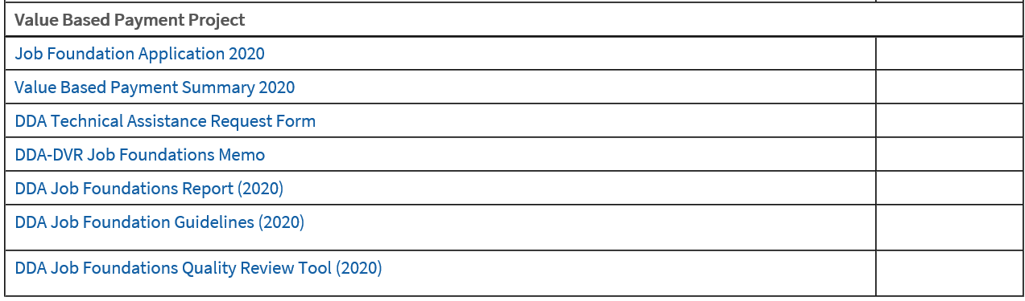
Resources
DSHS County Best Practices site, Value Based Payment Section:

Slide 15
Additional Links
Additional helpful links:
WINTAC Workforce Innovation Technical Assistance Center
NTACT National Technical Assistance Center on Transition
DDC Informing Families Informational flyer and resources in multiple languages

Slide 16


