Slide 1
H.E.R.O
Honor Education & Respect Others
Personal Enrichment Program Workshops

Slide 2

PURPOSE DRIVEN
BOA ME NA ME MMOA WO
“Help me and let me help you”

Slide 3
Mission: To provide empowering messages through mentoring sessions, and workshops; that inspire, motivate, educate, and encourages all to seek knowledge, become future leaders, and to be confident and responsible for the choices that they make in life.
Vision: To promote the value in knowledge, the power in learning, the importance of accountability and the principle of respecting others.

Slide 4
4 Pillars of H.E.R.O Program
Awareness (Knowledge of Self)
The awareness pillar is bringing out the best of these individuals. The pillar covers how one identifies themselves, how they die young themselves and what belief system they carry about themselves. How do they learn what is the best time for them to learn and how to identify their triggered emotions and their intelligence.
Knowledge (Building a Circle)
The knowledge. Peller is all about them understanding how to recognize others to be and asset to their Circle. How to unmask their own masks that they wear and the mask of others and to see that as much as they may see people to be different or to have differences there is so much similarity as well.

Slide 5
Skills (Adaptation)
The skills color is about building adaptable skill sets and people and participants to move and away where they are able to express discomfort or concern and typically difficult conversations or interactions with others. This is an emotional intelligence polar where individuals learn how to control their emotions and calling and conversation rather than call out an individual.
Self Advocacy/Action (Empower)
This pillar is about the participant recognizing the criminal justice system for what it is and how it was built to incarcerate young people of color especially the black and brown Community. This pillar takes the participants through a social justice lens and teaches them how to advocate for themselves and put themselves in action to advocate for others and to Mentor others such as young men of color who may be headed down the wrong path of destruction and be entering into the criminal justice system.

Slide 6
Topics
Self-Affirmations
Create positive affirmations that encourage personal responsibility.
Learning Styles
Recognize their individual learning styles

Slide 7
Self-Advocacy
Recognize their own inner dialogue and how it contributes to their success or getting off course.
Building Emotional Intelligence
Language choices are thoughtful and support the effectiveness of the discussion.

Slide 8
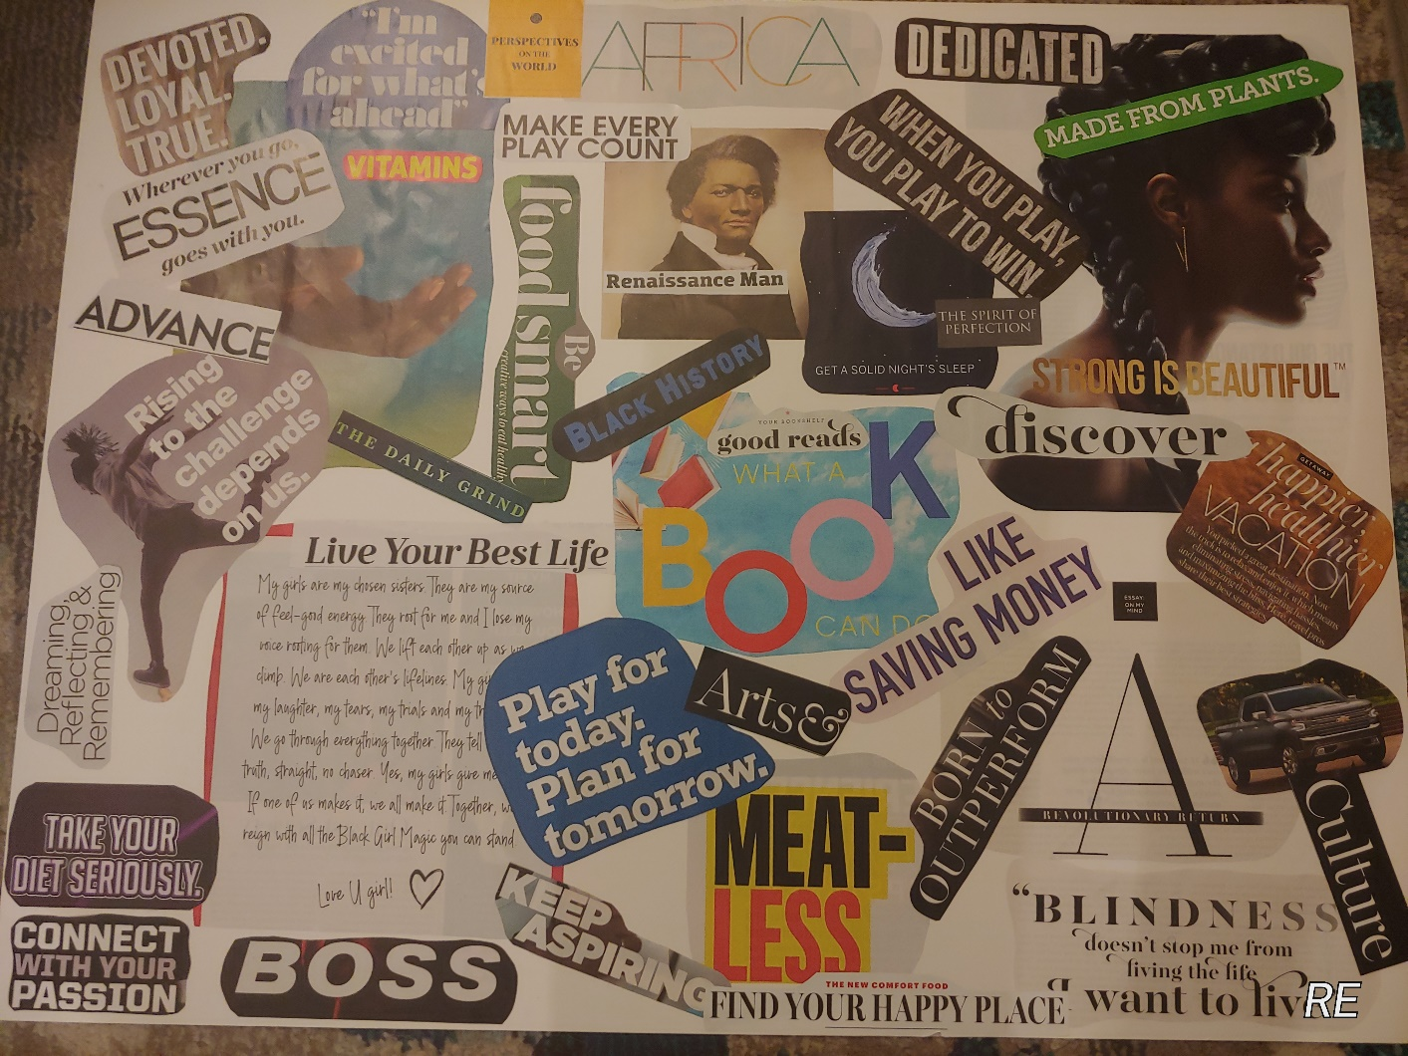
Vision Board

Slide 9
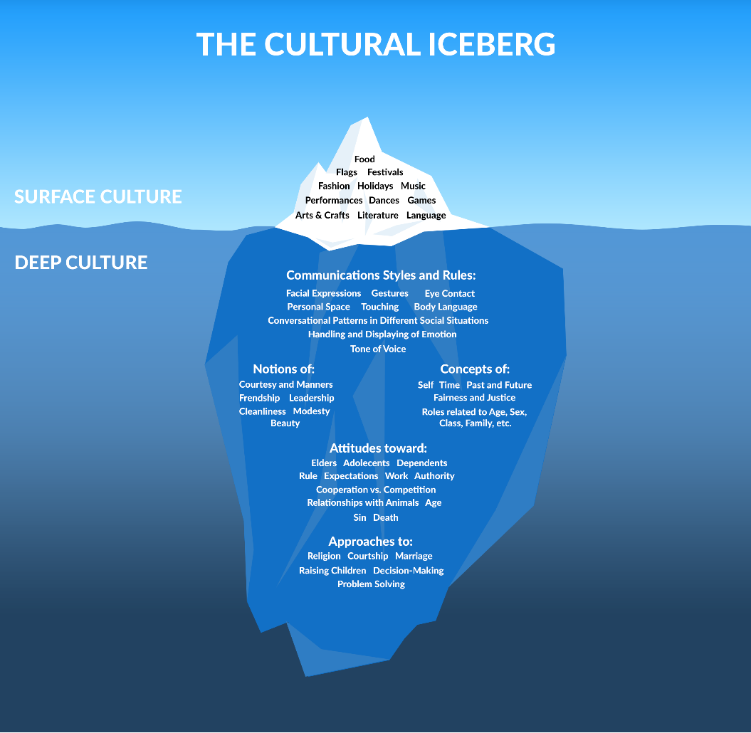
Iceberg

Slide 10
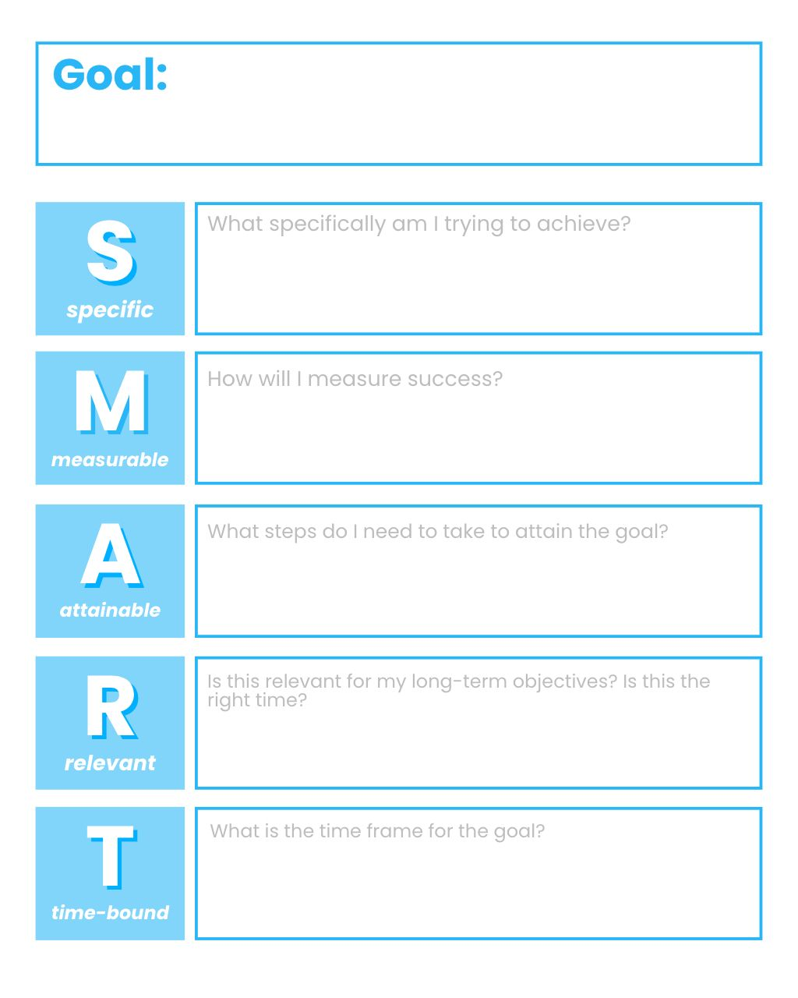
Goal Setting

Slide 11
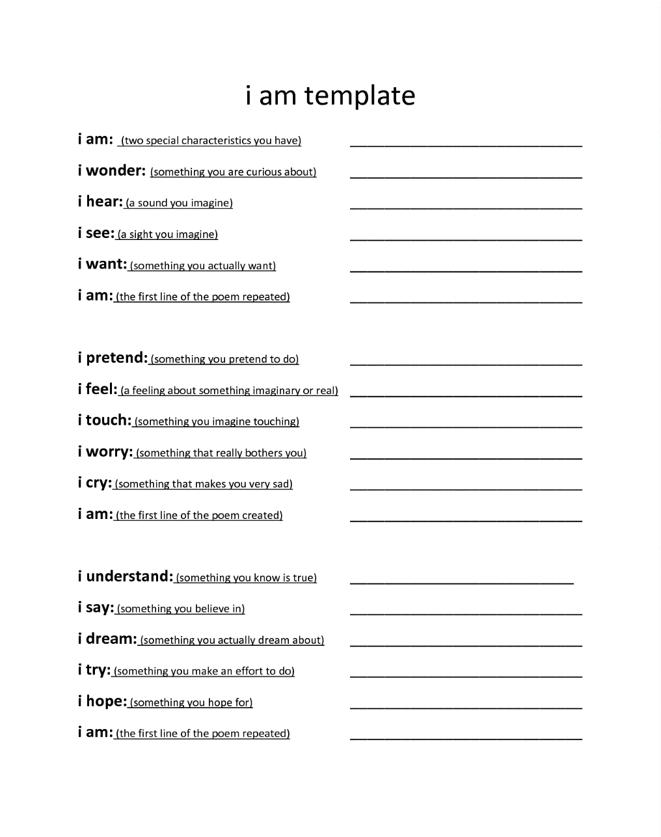
I Am Poem

Slide 12
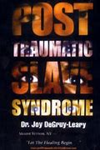
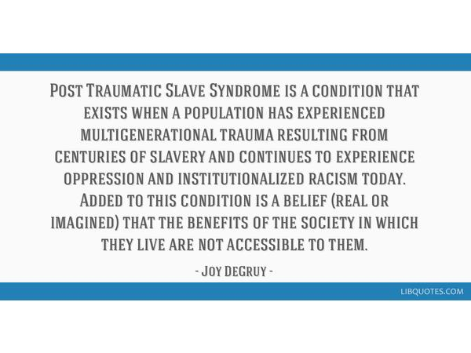
Knowledge of Others

Slide 13



Additional Resources

Slide 14
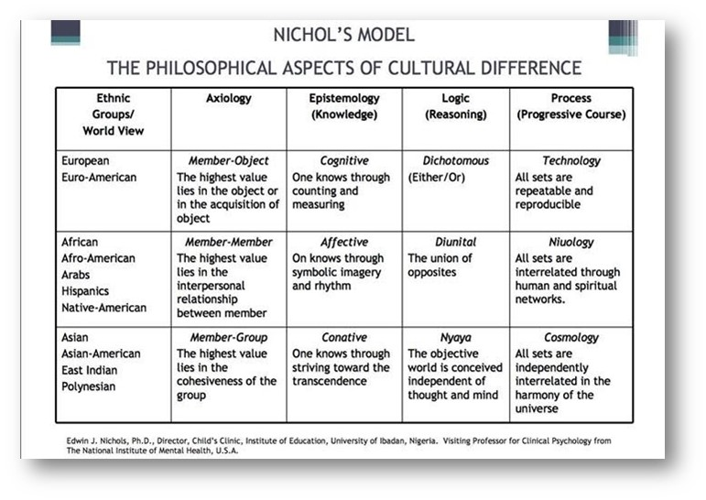
My How

Slide 15

Tree Activity
Branches – How have these values and beliefs influenced how you show up in the world?
Trunk– What values and/or beliefs came from these root?
Roots – People, places, things, identities or experiences that are central to who you are.
Directions: Identify your roots, trunk and branches. You can answer in single words or sentences. This can be brief.
Note: We recognize this tree does not capture all of who you are.

Slide 16
Reflection Session
How do you believe this tree has or could shape you as an individual?
Reflect on identities and experiences you don’t have or don’t understand. How do you believe these potential blindspots could negatively impact your learning environment?
Identify some areas of growth and/or further learning that you believe would support you as an individual that centers social justice and equity?

Slide 17
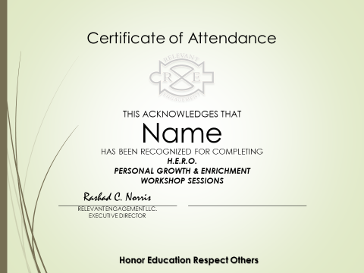
Certificate of Appreciation

Slide 18
