Slide 1
A Crisis Within A Crisis
Mental Health Needs for Youth and Young Adults Post Covid-19
Notes:
Recorded June 2nd *shree nee vah sun

Slide 2
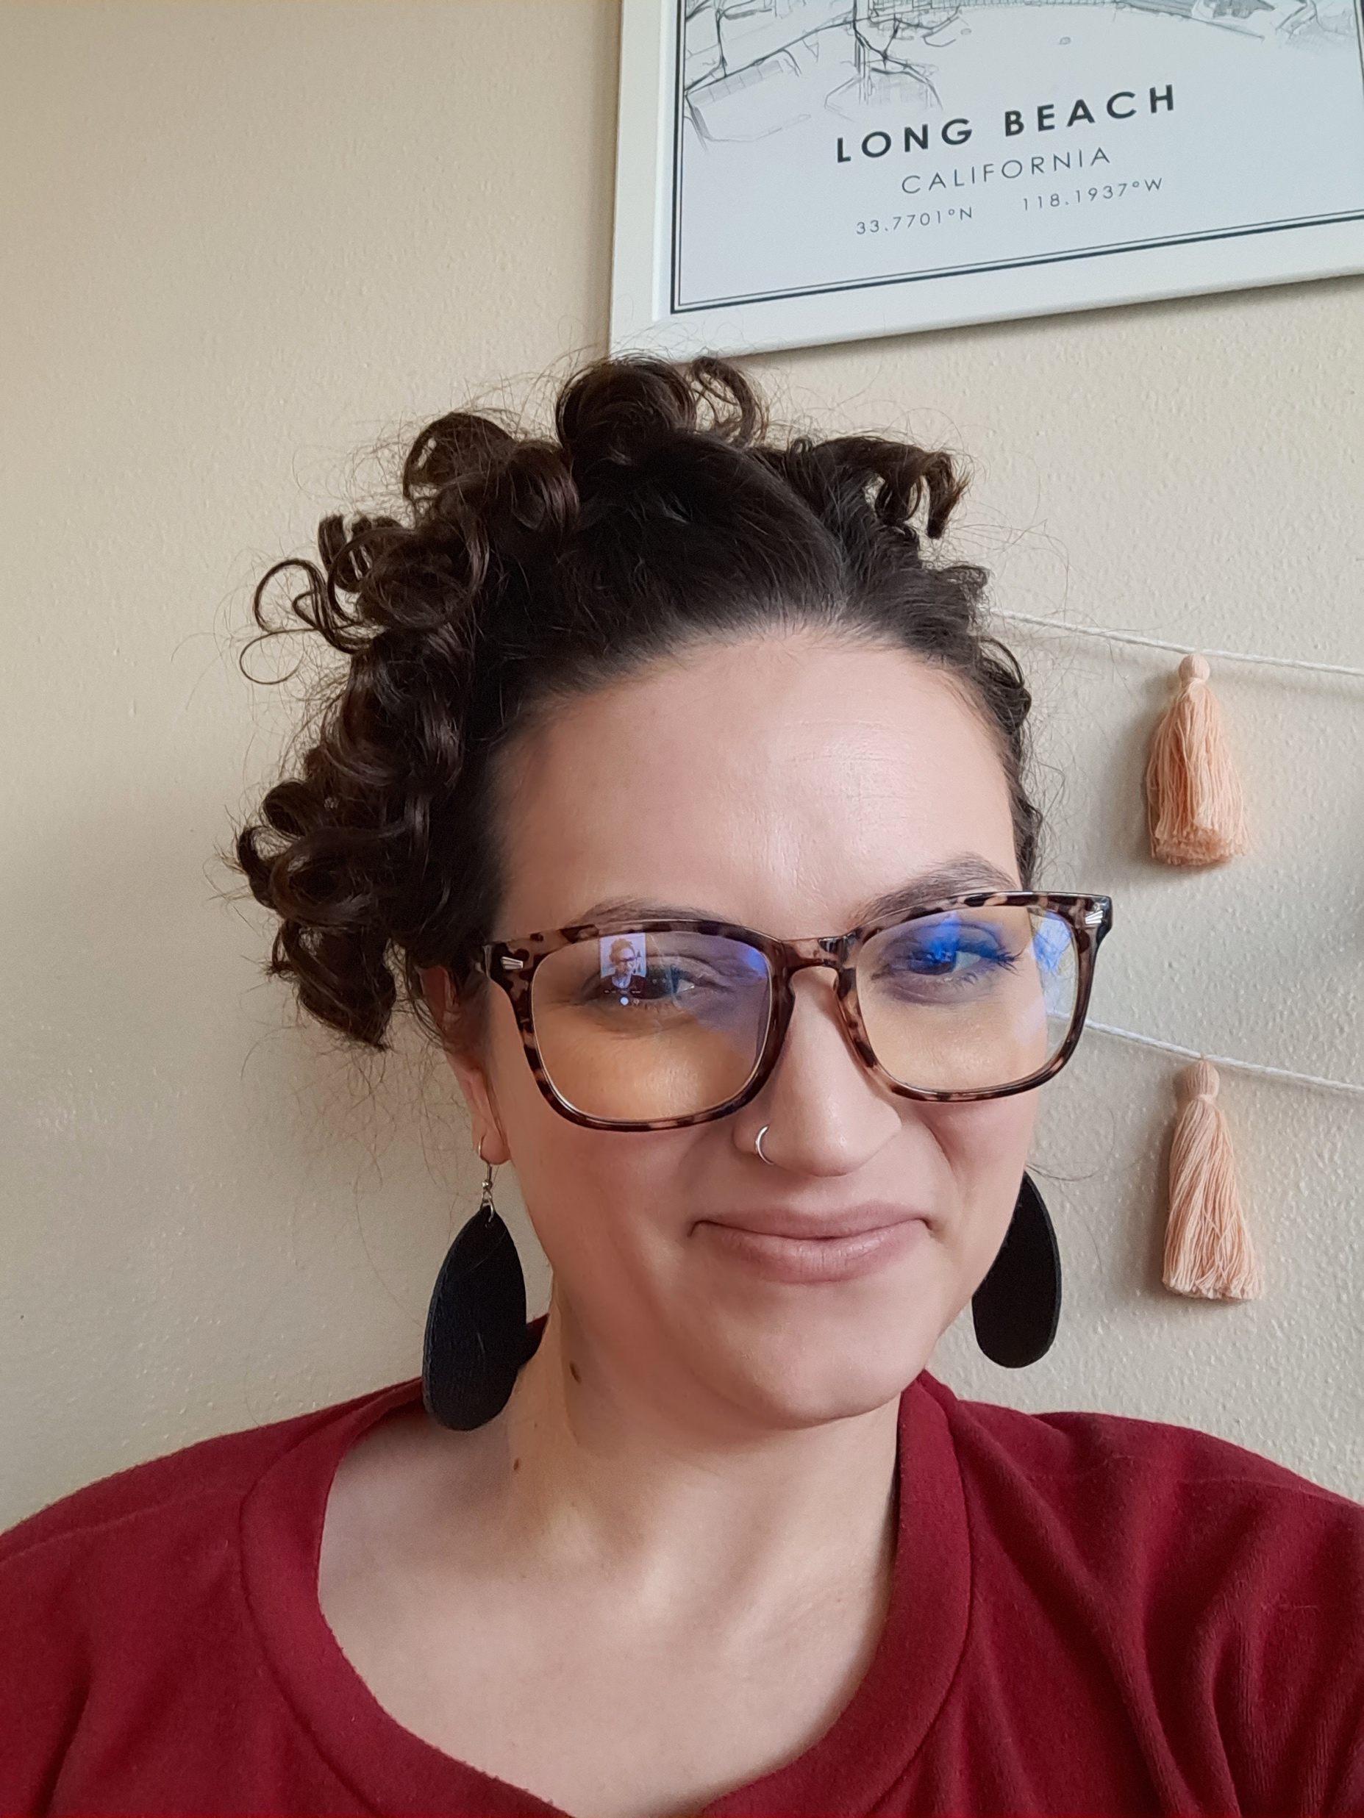
Welcome!
Michelle Pappas - I am a disability rights activist fighting for disability justice and systemic change in housing, healthcare and racial equity. I am an Independent Living Advocate at the Disability Action Center, a Center for Independent Living run by and for people with disabilities. There I assist members of the disabled community in achieving independence in a world that treats disability as a personal problem to be hidden from public view.
I attended North Idaho College and the University of Idaho studying vocal performance, with a focus on opera and jazz. Sadly a young diagnosis of cancer and the resulting mountain of medical bills prevented me from completing my studies. This experience with the healthcare system ignited my journey in activism.
Later in life I was diagnosed with complex PTSD, bipolar disorder, ADHD and several other diagnoses. I now use lived and professional experience, to educate the community on the needs of the disability community. I live in Spokane, Washington, with my son.
Notes:
Remember to describe appearance! In my 30s, white Hispanic woman with dark curly hair.

Slide 3
Centers for Independent Living
Created in the 70s to assist people with disabilities towards independence.
In 1978 the Rehabilitation Act was amended to include Title VII which provides federal funding to these programs.
6 core services:
  Youth Transition
  Information and Referral
  Personal Advocacy
- Community Advocacy
- Independent Living Training
- Peer Counseling and support
Notes:
Youth transition not a part of original act but has been added for more than a decade.

Slide 4
Objectives
Identify the mental health crisis, particularly how it affects multi-marginalized people.
Creating a plan to form a “Care Web” of community partners.
Supporting the diversifying needs from mental health professionals.

Slide 5
The Current Crisis
And multi-marginalized youth

Slide 6
Crisis
Suicide is the second leading cause of death in young people aged 15-29 (WHO, 2015)
  Globally 1 in 2 of young people aged 18-29 are possibly subject to anxiety or depression, while a further 17% are probably affected by it. (ILO, 2020)
  Factors include: family stress, social isolation, housing insecurity, food insecurity, risk of domestic abuse, disrupted education and uncertainty about the future.
75% of young people aged 18-24 reported at least one adverse mental or behavioral health symptom.
  25% had serious suicidal ideation (USA Today, 2020)

Slide 7
Crisis cont.
In Spokane Washington, 12% of people ages 20-39 are likely to experience poor mental health.
  71% of people with poor mental health have not received treatment or counseling in the past 12 months.
  Only 45% identified with poor mental health denied needing treatment.
    Poor mental health was defined as 14 or more days of self-reported poor mental health in the last 30 days.

Slide 8
Crisis cont.
    Of those who did not receive treatment important factors were identified that could inhibit them from receiving treatment.
      14% were concerned their counselor might not keep their information confidential, 17% were concerned about the cost, 12% were concerned they would be committed to an institution.

Slide 9
Crisis cont.
-The data's greatest value, experts say, is the spotlight it shines on vulnerable populations.
"It is showing that this breakdown in our society, the breakdown of the safety net, the breakdown of economic security is taking a massive toll," said Anna Mueller, a suicide researcher and professor of sociology at the Indiana University Bloomington. "These breakdowns really show how crucial economic stability and economic security are to an individual's well being. Because the people who are more vulnerable in terms of their socioeconomic status, people who are being put in harm's way, those are the people who are suffering the most.” (USA Today, 2020)

Slide 10
Who are multi-marginalized youth
BIPOC (black, indigenous, people of color), low income individuals, housing insecurity, youth, LGBTQIA+, those experience escaping domestic violence, and child maltreatment, and people with disabilities.
  Multi-marginalized or cross marginalized are people who fall into multiple vulnerable categories.

Slide 11
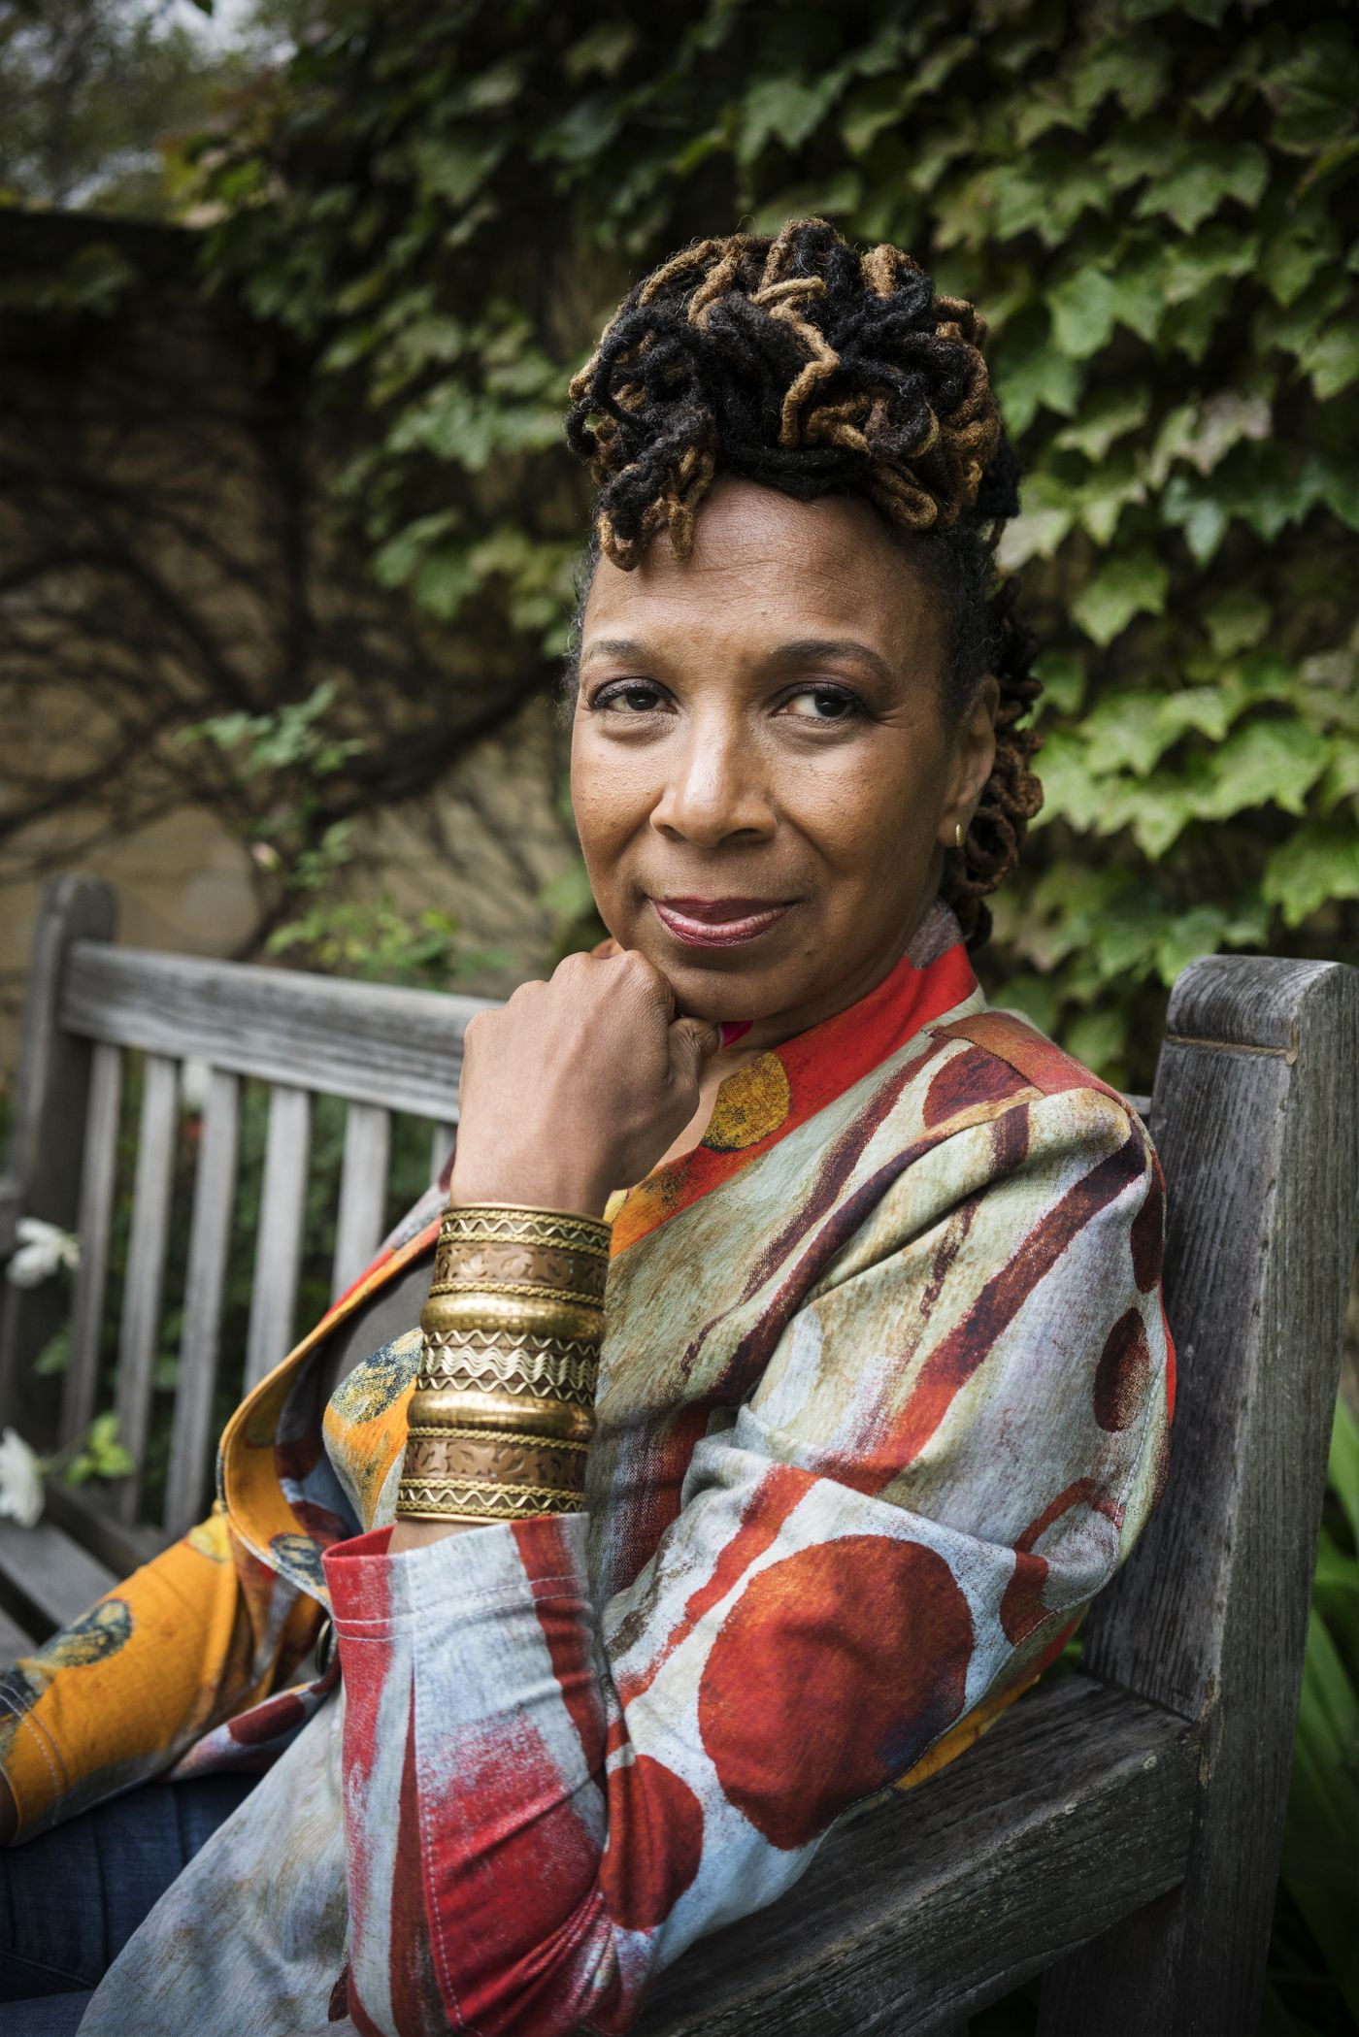
Kimberle Crenshaw
“The way we imagine discrimination or disempowerment is often more complicated for people who are subject to multiple forms of exclusion. The good news is that intersectionality provides us a way to see it.”

Slide 12
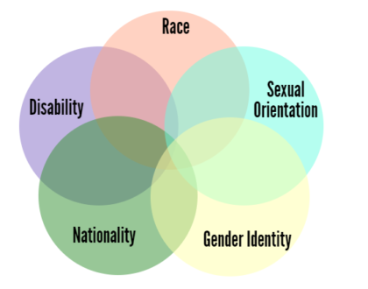
Intersectionality
The interconnected nature of social categorizations such as race, class, and gender as they apply to a given individual or group, regarded as creating overlapping and interdependent systems of discrimination or disadvantage.

Slide 13
Multi-marginalized
Young people identifying as an ethnic, religious, or other minority noted more pronounced impacts than other youth groups as regards to rights to freedom of religion or belief, housing, freedom from violence, and the right to legal aid.
  Self identified minority youth reported a significant impact on the right to housing and freedom from violence, 27% and 25% respectively. (ILO, 2020)

Slide 14
Multi-marginalized cont.
The percentage of respondents who reported having seriously considered suicide was significantly higher among Hispanic respondents 18.6% and Black respondents, 15.1%, than among White respondents at 7.9%. (USA Today, 2020)

Slide 15
Multi-marginalized cont.
“Among those with poor mental health, there was some evidence that insurance, education, general health, and neighborhood were uniquely related to not receiving treatment… For example, American Indian and Alaska Natives were six times more likely to be in poor mental health as compared to whites, even when accounting for differences in income, employment, and other factors. Thus, efforts to improve mental health in Spokane County should consider inequities by race and ethnicity specifically. “ (SRHD, 2020)

Slide 16
Meet Michael*
Disabled youth with mental illness.
Two hospitalizations for attempted suicide
Father has threatened eviction if another suicide attempt occurs.
  Housing insecurity
  Denial of disability assistance (SSI/SSDI)
Parents have gone through a collective trauma during this pandemic as well and do not have the skills to cope with their own trauma, much less their children’s.
Fear of the future, housing insecurity, financial insecurity, child mistreatment
Notes:
*all names have been changed to protect the privacy of our consumers

Slide 17
Creating a “Care Web” in Your Community

Slide 18
Care Web
Leah Lakshmi Piepzna-Samarasinha – redefined access to services as an act of love:
  “This workshop is a space to talk about the often feminized and under-respected work of care. We’ll map what allows us to ask for and give care well, and how ableism, racism, capitalism and sexism complicate who feels worthy of care and who is expected to care. We’ll look at some examples of how people create care webs for disability, chronic illness or mental health needs and access some tools we can use to create a sustainable and just care economy. We will dream what abundant care can look like in our lives and communities.”
Notes:
Piehp zna – samar ah sinha

Slide 19
Care Web cont.
Network! Connect with other organizations, build up pamphlet collection, know your community.
  Vulnerability, self care, ensure others in your organization are caring for selves.
Communities should consider: (Recommended by Organization for Economic Co-operation and Development)
  Apply a youth and intergenerational lens in crisis response and recovery measures.
  Promoting age diversity in public consultations and state institutions.

Slide 20
Care Web cont.
    Are the populations you want input from communicating with you? If not, why? Put the burden of responsibility on your organization.
Updating national youth strategies in collaboration with youth stakeholders.
Leveraging young people’s current mobilization in mitigating the crisis through existing platforms. (OECD, 2020)
  Youth are not on Facebook. Look to Discord or Snapchat.

Slide 21
Careweb cont.
Racial equity trainings to better understand and connection with marginalized communities.
  Authentic and intentional relationship building with the community you are trying to connect with.

Slide 22
Diverse needs from mental health professionals

Slide 23
Meet Tilly*
Young adult searching for mental health providers filter by sexual positivity,
  Kink affirming
    Accepting of other marginalized identities.
Values must align in order for them to feel safe and comfortable being vulnerable.
Has been hurt by other providers in the past – they need acceptance to allow their own vulnerability.

Slide 24
Thank you!
mpappas@dacnw.org
dacnw.org

