Slide 1
Crip Camp
A Guided Discussion

Slide 2

Facilitators
Cinda Johnson
Principal Investigator
Kris Hirschmann
Director of Transition Services
Robin Worley
Director of Special Projects
Notes:
Welcome to a discussion of the documentary Crip Camp.

Slide 3

Crip Camp Trailer 2:40

Slide 4

Question 1:
After watching Crip Camp, have your views of disability changed?
In what ways?

Slide 5
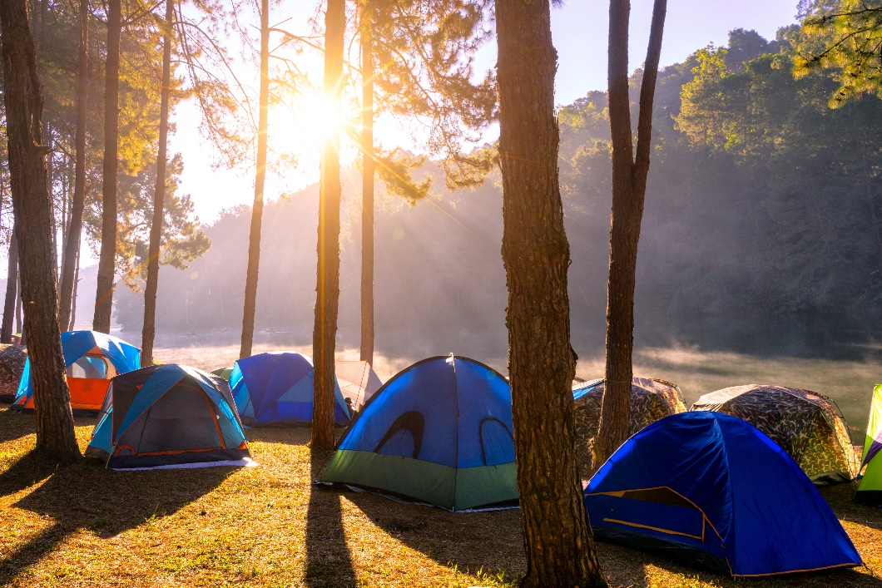
Question 2
Why was the camp such a freeing and revolutionary experience for the campers?
How did it empower the campers?

Slide 6
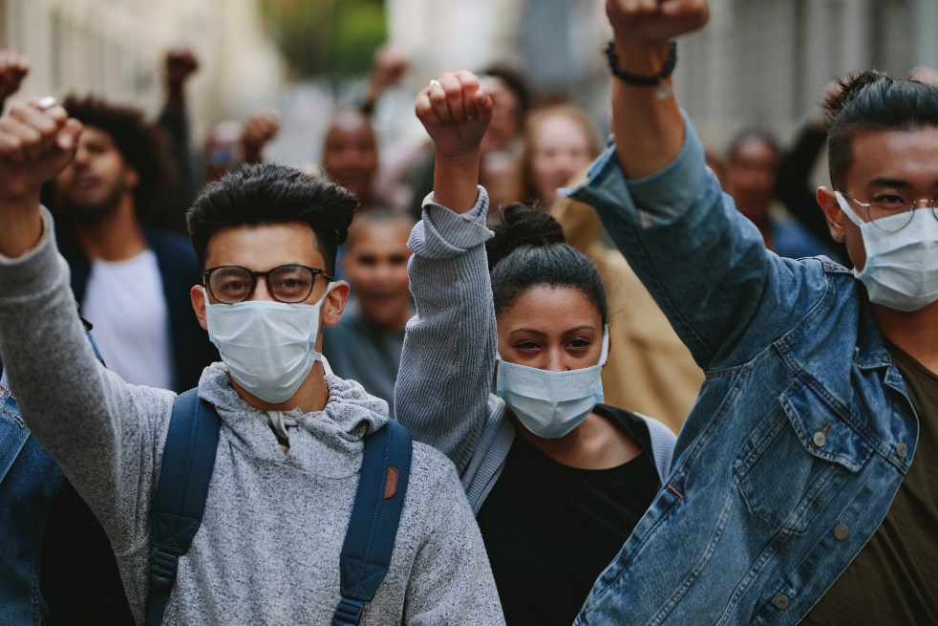
Question 3:
Looking at this through the lens of social justice, how do disability rights protests differ from others?

Slide 7
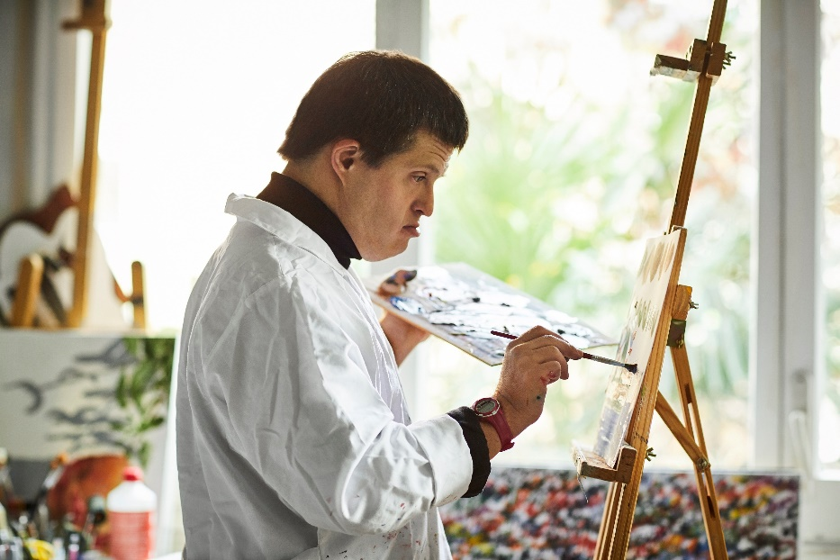
Question 4:
What did you think about the hierarchy within the disability population?

Slide 8

Question 5:
How do we keep people engaged to make a difference?

Slide 9
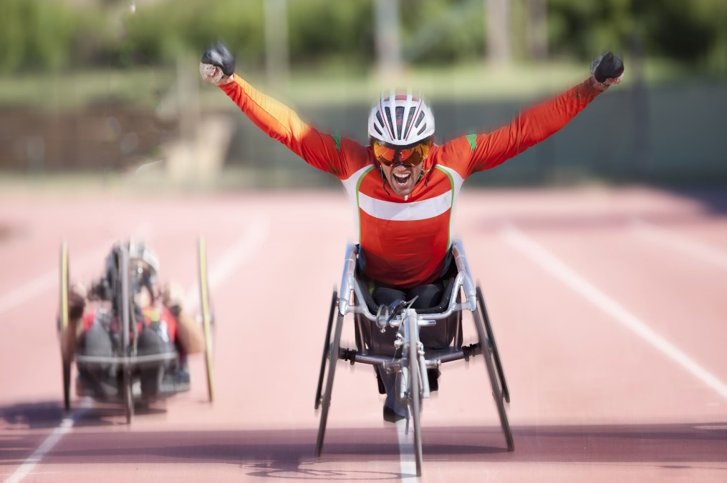
Final Thoughts and Call to Action
After seeing Crip Camp, what can you do to change perceptions, access and address ableism?

Slide 10





Thanks for your participation!
Contact and Connect with CCTS
Subscribe to our newsletters
ccts@seattleu.edu
www.seattleu.edu/ccts
Join the CCTS Transition Network on Basecamp
206-296-6494

