Slide 1
Creating Successful Pathways to Adulthood
Juvenile Justice Collaboration

Slide 2

Agenda
Leveraging partnerships for stronger outcomes
JR student demographics
Partnerships
Programs
Lessons learned / hazards
Partner expansion
Successes

Slide 3
Leveraging Partnerships for Stronger Outcomes
Systems Integration

Slide 4

Systems Integration
History
  DVR’s placement within DSHS Rehabilitation Administration
Partnership
  Fulfilling the promise of the Workforce Innovation and Opportunity Act (WIOA)
  Pre-employment Transition Services

Slide 5
Demographics of the Population

Slide 6

JR Student Characteristics
94% male
68% students of color
Ages 14-25
From 39 rural and urban counties
Represent 294 school districts

Slide 7
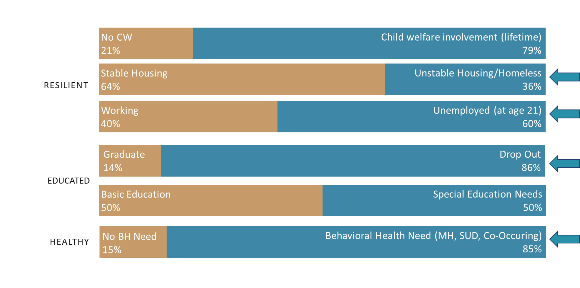
JR Student Risk Factors
SOURCES: DSHS Juvenile Rehabilitation, DSHS Research and Data Analysis Division, Center for Continuing Education and Research University of Washington, 2015 Population Query with Institution Principals, Office of the Superintendent of Public Instruction, Percentage of youth in WA with Special Education, OSPI Report Card 2014-2015, Employment Security Department/LMEA; U.S. Bureau of Labor Statistics, Current Population DSHS RDA Agency Performance Metrics, Percentage of youth served by DSHS who transition to employment at age 21

Slide 8
Improving Reentry Outcomes in JR
JR strives to develop, promote, and provide each youth with the necessary tools and resources to achieve skillful prosocial behavior, personal well-being, and self sufficiency.
We offer programs that:
  Build transferrable skills
  Build knowledge
  Build self-worth
  Help students feel confident

Slide 9
Partnerships

Slide 10

Partnerships
Division of Vocational Rehabilitation
Juvenile Rehabilitation
Local School Districts
Pacific Mountain
Workforce Development
Council
Relevant Engagement
Beauty From Ashes
Aerospace Joint Apprenticeship Council
Apprenticeship Nontraditional Employment for Women

Slide 11

Connecting Missions of Each Partner is Key
  Public safety, self-advocacy, independence
  Early exposure to employment
  Linking students to career pathways
  Connecting students to their communities

Slide 12

Unique Opportunities Provided by Partnership
Respect for partner expertise
Each bring diverse perspectives
Curriculum development
Individual student planning

Slide 13
Programs
Subheading

Slide 14

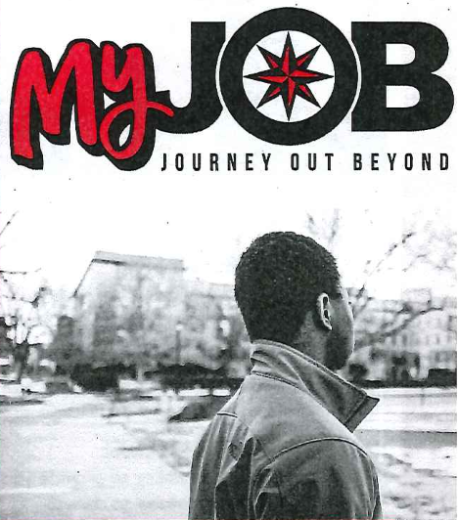
My Journey Out Beyond MyJOB
Job exploration activities
Workplace readiness training
Self advocacy training
Counseling for post secondary education
Work-based learning experiences

Slide 15

Honor Education and Respect Others
Personal Enrichment and Reading Literacy Mentoring Program
Includes:
Self-motivation/self advocacy
Recognizing gifts/talents
Personal learning styles
Emotional intelligence

Slide 16

Beauty From Ashes
Leaders Mentorship Program
Identify gifts and talents
Healthy mindset
Career exploration that fit strengths
Self advocacy
Intro to Health and Wellness
Nutrition
Personal training
Corrective specialist
Work-based learning experiences

Slide 17



Aerospace Joint Apprenticeship Committee (AJAC)
Education
  3 high school credits
  32 college credits
Training
  12 week business internship
  Skill application
  Industry experience
Certifications
Occupational Training

Slide 18

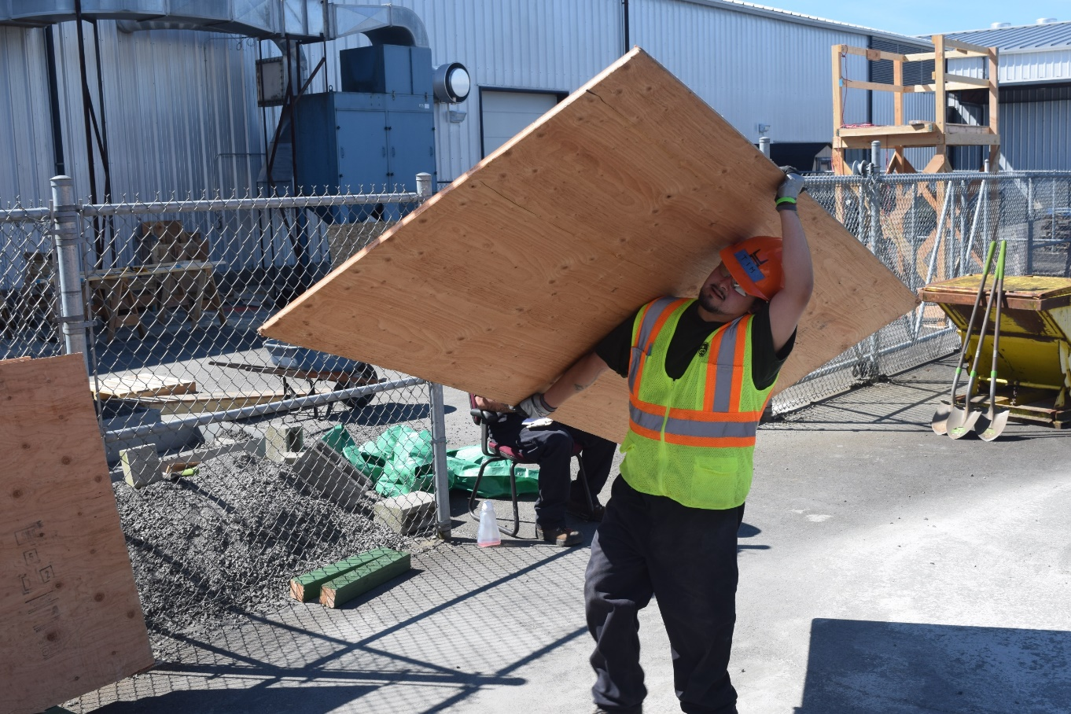
Trades Exploration
Introduction to the trades: carpentry, cement masons, laborers, ironworkers, plasterers
Safety on the job site
Self advocacy
Informational interviews
Work-based learning experiences

Slide 19
Lessons Learned
Subheading

Slide 20
Lessons Learned and Shared by Contractors
Contractors need dedicated classroom space
JR staff are needed to provide classroom support
Partnership agreements help outline each partners roles
Close partner coordination is key
Connections with local schools ideal

Slide 21
Lessons Learned Continued
Provides an opportunity for non-traditional instruction
Instructor characteristics must be considered
Math confidence is critical
Stages of Change – where youth is at in their stage of change (i.e, pre-contemplative, contemplative).
JR youth need consistency to build trust

Slide 22
Lessons Learned Continued
Clarity of information being shared, helps with comprehension
Allowing for reflection time helps solidify information being taught
Allowing for time to talk about experience in facility is sometimes necessary to get through material
Cannot assume everyone can read and write
Must diversify information delivery for each students learning style

Slide 23
Hazards
While in JR
Program options are being developed but still limited
Program options do not always align with student career goals
Students with long stays earn certs that cannot be used until release
Upon Transition
Connecting students with disabilities to DVR
Myth-busting: DVR customers and services
Destigmatizing - Juvenile offenders
Common language among partners

Slide 24
Implementation Ideas
Subheading

Slide 25
Implementation Ideas
Start with one program then build from there.
Reach out to partners who have been working in your local area with other populations.
Attend DVR Lunch and Learn – lots of partner connections to be made.
Prepare videos of the programs to share with future students to generate interest.
Be open to exploring creative funding pathways.

Slide 26
Celebrating Success
Success Stories from Participants…

Slide 27
Questions?

