Slide 1
Pilot Lessons Learned
Center for Change in Transition Services (CCTS)
Improving post-school outcomes for students with disabilities in Washington state
www.seattleu.edu/ccts

Slide 2
Introductions
Transition Specialists:
Jamie Buchholz – ESD 121
Ande Chapman – ESDs 105, 123, 171
Cindy Duncan – ESDs 114, 189
Deb Howard – ESD 101
Ed Koehl – ESDs 112, 113
Jay Shepherd – CCTS

Slide 3
Project Terms and Acronyms
Pilot District
A single district or a group of districts working together as a single collaborative.
TLC: Transition Learning Community
A team of personnel from a pilot who work together to improve transition services and outcomes for their pilot.
ITN: Interagency Transition Network
A team of school leaders, teachers, students, parents, agencies, local businesses, and other stakeholders who work to improve transition services for a region.

Slide 4
Project Scope
DVR Goal
CCTS
ITNs
Pilot TLCs
ESDs
DVR Goal: Gaps identified and filled in strategic and sustainable ways..
CCTS: Staff/transition specialists coordinate, organize and assist data collection/analysis and training.
ESDs: Collaborate within the region (separate DVR contracts).
ITNs: Identify/collaborate with various councils, networks, agencies, and community partners.
TLC Pilots: As professional learning communities, design and implement project to test-drive new/effective practices.

Slide 5
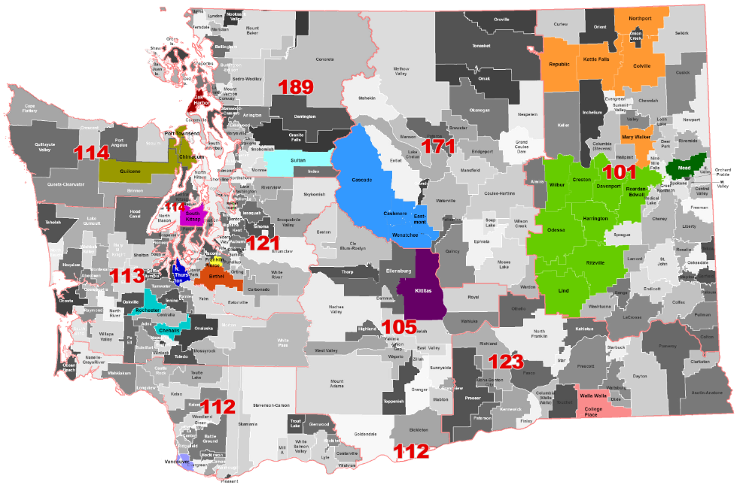
Pilot Selection
Application process based on QuIST and Indicator 13 data
Single districts and multi-district collaboratives
Diverse, statewide representation
2016 Pilot District Map

Slide 6











Transition Learning Communities - 2018
Single Districts
Educational
Service Districts
101
Kittitas
Vancouver
Washington State School for the Blind
North Thurston
Chimacum
South Kitsap
105
112
113
Bethel
Franklin-Pierce
Mercer Island
Oak Harbor
114
District Collaboratives
121
123
171
Colville, Kettle Falls, Mary Walker, Northport, Republic
Creston, Davenport, Harrington, Lind/Ritzville, Rearden-Edwall, Wilbur
Chehalis, Rochester
College Place, Walla Walla
Cascade, Cashmere, Eastmont, Wenatchee
189

Slide 7
Pilot Tasks and Deliverables Year 1 and 2
TLCs
  Establish workshop and meeting schedule (8-12)
  SMART Goal
  Action Plan
  QuIST Narratives (pre-, mid-point, final)
  AIR Self-Determination Assessments (pre- and post)
  Data reporting (IEP and 504 tallies, student-led IEP counts)
T-Specialists
  Facilitate TLC growth and development
  ITN development updates and support
  ITN directory

Slide 8
Describe your approaches to this work.
Things you considered, foundational activities, encouraging collaboration, overcoming significant challenges, etc.

Slide 9
What are your TLCs most proud of?
Poster session preview?

Slide 10
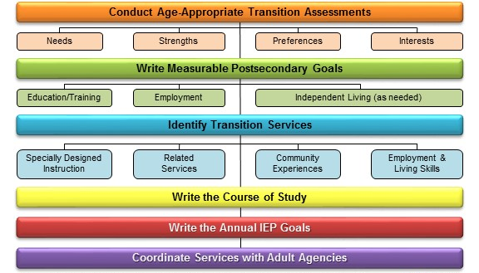
CCTS Transition Services Flow Chart

Slide 11
Transition Sequence Grades 9-12
Grade | Assessments & Instruction | Connections with Service Providers | Community Experiences | Post-High School Educ. & Employment Opportunities Living Skills
9th
10th
11th
12th

Slide 12
What practices do you hope your TLCs will continue in the future?

Slide 13
What is the most valuable lesson learned from the past two years working with your pilot groups?
How did the first year and second year differ?

Slide 14
If you were going to replicate this work, what are a few ideas on how it could be done differently?

Slide 15
Audience Questions

Slide 16
CCTS Contact
CCTS General Information
ccts@seattleu.edu
206-296-6494
www.seattleu.edu/ccts
@WACCTS on Facebook, Twitter, and Pinterest

Slide 17

Creative Commons License
Except where otherwise noted, content in this presentation is licensed under a Creative Commons Attribution 4.0 International license. All logos and trademarks are property of their respective owners.
You may share and adapt this material, but you must give appropriate credit, provide a link to the license, and indicate if changes were made.
Notes:
Unless otherwise noted, the material in this presentation is licensed under a Creative Commons Attribution 4.0 International license. All logos and trademarks are property of their respective owners. You may share and adapt this material, but you must give appropriate credit, provide a link to the license, and indicate if changes were made.

