Slide 1


Tribal VR Services & Transition Collaboration to Fulfil Employment
Goals for Youth
Wenatchee Transition Forum
Laurae MacClain
Wenatchee, WA • June 25, 2018
Notes:
This template can be used as a starter file for presenting training materials in a group setting.
Sections
Right-click on a slide to add sections. Sections can help to organize your slides or facilitate collaboration between multiple authors.
Notes
Use the Notes section for delivery notes or to provide additional details for the audience. View these notes in Presentation View during your presentation.
Keep in mind the font size (important for accessibility, visibility, videotaping, and online production)
Coordinated colors
Pay particular attention to the graphs, charts, and text boxes.
Consider that attendees will print in black and white or grayscale. Run a test print to make sure your colors work when printed in pure black and white and grayscale.
Graphics, tables, and graphs
Keep it simple: If possible, use consistent, non-distracting styles and colors.
Label all graphs and tables.

Slide 2

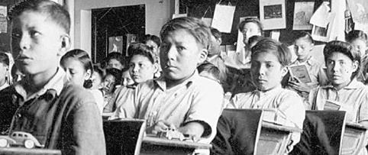
Historical differences in transitional expectations are cultural and traditional in nature
Success rates tend to stretch out generationally
Differing core values and motivations are both family and institutionally taught
Notes:
This is another option for an Overview slides using transitions.

Slide 3

Extremely low rate of high school graduates
Attaining a GED thought of as normal in many families, not the exception
Poverty level of family may be necessitating the need to work to assist family unit as a whole

Slide 4
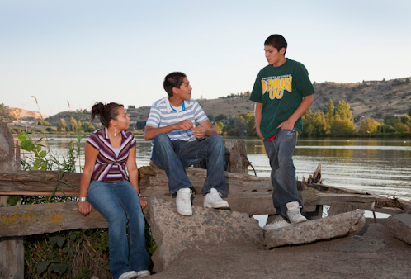

Most teens desire to stay close to home
Lack of jobs and training opportunities
Family commitments and routines can limit schedules and transportation challenges

Slide 5

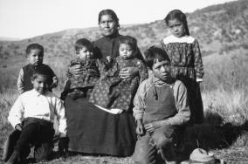
Family units are maternal
Accustomed to large extended families
Gaining trust can take time
Monetary gains may not be motivating factor behind finding vocation
Parents, Aunts/Uncles tend to be primary source of perceived career options based on their employment

Slide 6
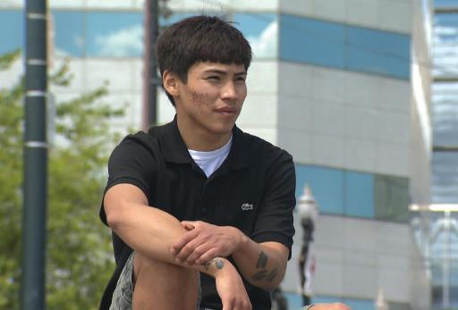
College success rates are challenged by proximity to comfort of being home and surrounded by cultural normality

Slide 7
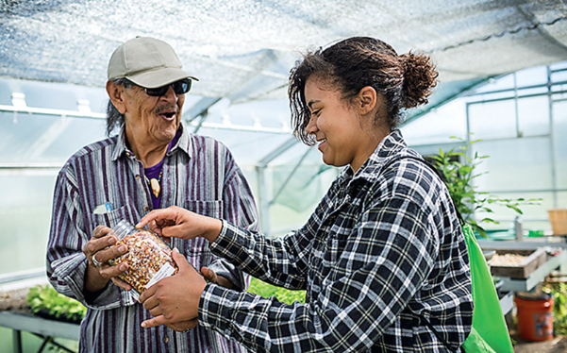
Most lessons are passed down from internal family knowledge and career developments are shaped by familiarity
There is a tendency to not trust anyone outside the family
Notes:
Use a section header for each of the topics, so there is a clear transition to the audience.

Slide 8
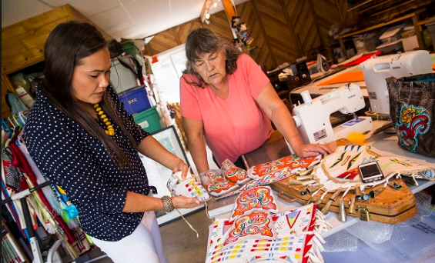
Must build relationships to gain trust
Provide narratives of success stories
Make pride and ownership of work focus
Include opportunities for family input

Slide 9
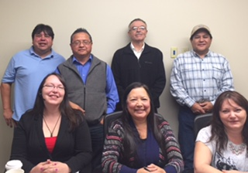
Organizational success can occur when collaboration is fully utilized
TERO, Employment and Training, TANF, Higher Ed partnerships
Consultation with other Tribes, State programs

Slide 10
Questions
Laurae MacClain, CCT Vocational Rehab
(509) 634-2723 Direct
laurae.macclain@colvilletribes.com
www.colvilletribes.com
Notes:
This is another option for an Overview slides using transitions.

