Slide 1
T-Folio Training
Center for Change in Transition Services (CCTS)
Improving post-school outcomes for students with disabilities in Washington state
www.seattleu.edu/ccts
Notes:
Welcome to the T-Folio, a transition portfolio tool for high school aged youth in Washington state, created by the Center for Change in Transition Services with funding from the Division of Vocational Rehabilitation.

Slide 2
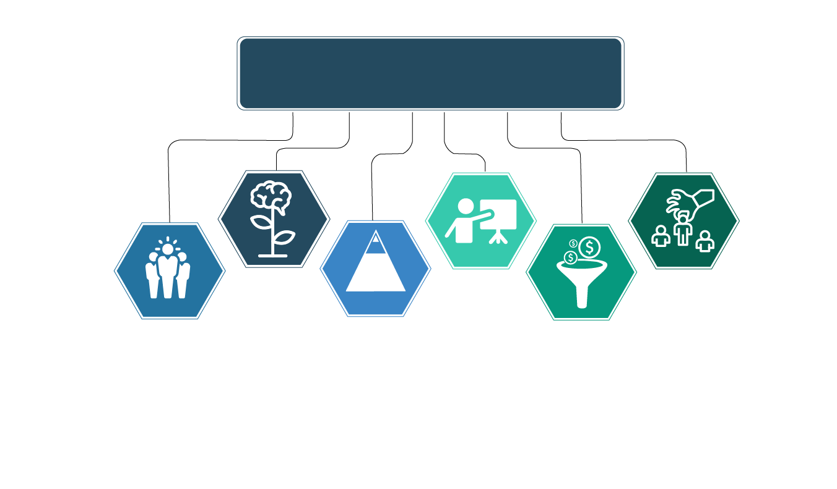
OSPI Priorities
OSPI Priorities:
Improving Outcomes for Students
with Disabilities
Growth Mindset
Increased expectations of
students with disabilities
(e.g., standards, instruction,
graduation, assessments,
attendance, IEP-related
Decisions, and post-school outcomes).
Professional Development
Joint training for general
educators, special educators,
, administrators,
and parents/families (e.g., IEP
team members).
Recruitment & Retention
Preparation programs for administrators, general educators, special educators, related service providers, and paraeducators focused around instruction and support for students with disabilities.
Leadership
Support students with disabilities (including increased collaboration and ownership of school administrators and staff) and coordinated efforts with community organizations to improve results and reduce disproportionality.
Evidence-Based Practices
Instruction and interventions
within an MTSS framework and inclusionary practices
leading to increased access
and progress in Washington
grade-level learning standards.
Resource Allocation
Braided funding, consolidated grant application, reducing costs for administrative tasks, increasing direct support to students, and data-based decision making.

Slide 3
OSPI State Needs Projects
There are five state needs projects that are funded with IDEA state discretionary dollars. These projects collectively provide:
Professional development at little to no cost to districts or participants (clock hours/credit hours available)
Technical Assistance with IEP development, compliance, evaluation, planning, learning interventions, and assessment for students with disabilities
Consultation and training for parents and families
Notes:
CCTS is one of five State Needs Projects funded with IDEA discretionary dollars. We are charged with providing professional development, technical assistance, and consultation to districts parents and families.

Slide 4
The Five State Needs Projects
Center for Change in Transition Services (CCTS)
Provides secondary transition training and technical support to districts, and Educational Service Districts, that serve students who have an Individual Education Program and are in need of transition services.
eLearning for Educators
Provides statewide access to affordable online courses designed to support educators in serving students with disabilities.
Special Education Support Center (SESC)
Provides current information and best practices through statewide training and technical assistance to families, educators, and organizations in order to meet the needs of students with disabilities.
Special Education Technology Center (SETC)
Provides training, consultation, technology loans and resource information to help school districts and families implement assistive technology (AT) interventions in addressing the special learning needs of children with disabilities.
Washington Sensory Disability Services (WSDS)
Supports individuals aged birth to 21 who are deaf, hard of hearing, blind, visually impaired, or deaf-blind, by providing training and other resources to service providers and families.
Notes:
In addition to the Center for a Change in Transition Services; the five State Needs Projects are eLearning for Educators; Special Education Support Center; the Special Education Technology Center and Washington Sensory Disability Services.

Slide 5
Center for Change in Transition Services
Improving post-school outcomes for students with disabilities.
CCTS provides secondary transition training and technical assistance to Washington state partnering agencies, Educational Service Districts (ESDs), Local Educational Agencies (LEAs), and public schools that serve high school-age students.
CCTS has responsibility for analyzing the district-reported post-school outcome data, using the data to make informed decisions related to training and technical assistance development needs, and submitting the results of the data analysis to OSPI to be included in the state’s Annual Performance Report.
Notes:
At CCTS, our goal is to improve post school outcomes for students with disabilities. We do this through training, technical assistance and analyzing post school outcome data.

Slide 6
Training Objectives
Part 1: The Basics
  What is T-Folio?
  Who should use T-Folio?
  How to implement the curriculum
  What is included
  How to navigate the lessons and activities
  Part 2: Collaboration & Facilitation
Notes:
This training is split into two parts. Part 1 covers the basic information needed to use the T-Folio, including what it is, who it is for, how to implement it, what is included, and how to navigate the lessons and activities. Part 2 offers tips on facilitation and collaboration between educators and agency personnel.

Slide 7
PART 1: The Basics
Notes:
Part 1: The Basics

Slide 8
What is the T-Folio?
A free digital platform that helps youth complete the items needed for their transition portfolios through a series of interactive exercises and the support of a facilitator.
Aligns with both Individualized Education Program (IEP) transition planning and the Division of Vocational Rehabilitation’s Pre-Employment Transition Services.
Schools and counselors are already required to provide transition services. The T-Folio is a supplemental tool that makes it easier!
Notes:
T-Folio is a free digital platform that helps youth, with the assistance of a facilitator, to complete the items needed for their transition portfolios through a series of interactive exercises. T-Folio aligns with both Individualized Education Program (or IEP) transition planning and the Division of Vocational Rehabilitation’s Pre-Employment Transition Service categories so both educators and agency personnel will find it useful.
Schools and counselors are already required to provide transition services. The T-Folio is a supplemental tool that makes it easier for anyone working with youth on their transition goals.

Slide 9
Transition Services
The T-Folio curriculum is aligned with the Transition Services Flowchart (Johnson, 2012) and is designed to guide youth through the process of planning for their future and setting goals for:
  the IEP (Individualized Education Program).
  the IPE (Individual Plan for Employment).
Notes:
The T-Folio is aligned with the Transition Services Flowchart (by Cinda Johnson) and is designed to help guide youth through the process of planning for their future and setting goals for the IEP or the IPE (the Individual Plan for Employment).

Slide 10
Who should use the T-Folio?
T-Folio is designed for youth aged 16-25 who are in the process of transitioning from high school to post-secondary employment or higher education.
T-Folio is primarily designed for students who fall into the high incidence categories (SLD, EBD, Health Impaired, etc.)
Activities have been carefully constructed to incorporate universal design principles and can be modified to meet the needs of a wider range of student abilities.
Notes:
T-Folio is designed for youth aged 16-25 who are in the process of transitioning from high school to post-secondary employment or higher education. While the T-Folio does refer to “students” throughout the curriculum, users need not be students to use and benefit from the T-Folio.
In its current stage of development, T-Folio is designed primarily for users with learning and/or emotional behavioral disabilities. However, the activities have been carefully constructed to incorporate universal design principles and can be used by anyone making the transition to life beyond high school. It is encouraged and expected that facilitators consider the youth they are working with and accommodate or modify accordingly. Finally, lesson guides may offer suggestions for different presentation or response formats depending upon the youth’s needs.

Slide 11
How to implement the curriculum
Implement the curriculum in classes that already exist:
  English Language Arts
  Life Skills
  Career Technical Education
  Advisory
  Community Experience Class
  Etc.
In small groups or individually to prepare for the development of an IPE with the help of a DVR counselor.
Notes:
The T-Folio can be used in any class (such as English Language Arts, Life Skills, Career Technical Education, Advisory, Community Experience Class, etc.), or with individuals or small groups to prepare for the development of an IPE with the help of a DVR counselor.

Slide 12
Partner with others
  CTE teacher
  School counselor
  Business partners
  Guest speakers.
  Use technology to invite speakers into your classroom via Zoom, Skype, etc.
Notes:
Try partnering with others in order to utilize their expertise. Teachers and DVR counselors may want to partner with a CTE teacher, the school counselor, business partners in the community, or other guest speakers. You can use technology to invite speakers virtually into the classroom via Zoom, Skype, etc.

Slide 13
Suggestions for timing when integrating T-Folio
The curriculum can be used throughout the student’s high-school career, as they will benefit from repeating or revisiting certain lessons each year.
  Age appropriate assessments should be done every year.
  Goals (postsecondary and annual IEP) can be written and led by the student and need to be reviewed/adjusted annually.
  Preparing for employment varies as the student matures – revisiting these areas will lead to better outcomes.
  Self-advocacy is an ongoing area of growth for youth as they experience and mature in their transition – revisit and practice often.
Notes:
In terms of integrating the T-Folio for use over the span of the student’s high school career, consider the following:
Age appropriate assessments should be done every year.
Goals (both postsecondary and annual IEP goals) can be written and led by the student and need to be reviewed and adjusted annually.
Preparing for employment varies as the student matures – revisiting these areas will lead to better outcomes.
Self-advocacy is an ongoing area of growth for youth as they experience and mature in their transition – revisit and practice often.

Slide 14
High School and Beyond Plan
Many T-Folio activities align with the High School and Beyond Plan (HSBP) required for all students for graduation, including:
  Career Interest Inventory (see T-Folio Unit 1, Lesson 3)
  Educational goals (Unit 2, Lesson 2)
  Course planner (Unit 2, Lesson 5)
  Personalized pathway (Unit 2, Lesson 7)
  Resume/activity log (Unit 4, Lesson 2)
Notes:
T-Folio activities can be used to supplement the development of the student’s High School and Beyond Plan. Some of the High School and Beyond Plan components found in the T-Folio include:
Career Interest Inventory (T-Folio Unit 1, Lesson 3)
Educational goals (Unit 2, Lesson 2)
Course planner (Unit 2, Lesson 5)
Personalized pathway (Unit 2, Lesson 7)
Resume/activity log (Unit 4, Lesson 2)

Slide 15
T-Folio Units
Student-Centered Introduction
Unit 1: Job Exploration Groundwork
Unit 2: Postsecondary Employment and Education Options
Unit 3: Work-based Learning Experiences
Unit 4: Workplace Readiness Training
Unit 5: Self-Advocacy
Notes:
The T-Folio includes a Student-Centered Introduction and five units for a total of 36 lessons.

Slide 16
Student-Centered Introduction
A warm-up unit for both youth and facilitators.
Promotes student voice.
Emboldens the students to self-reflect and explore what is important to them and their future.
Increases understanding and ability to identify and voice future desires.
Notes:
The Student-Centered Introduction acts as a warm-up unit for both youth and facilitators. It promotes student voice and gives facilitators a baseline for each individual in terms of self-knowledge and self-determination. This focus on the student is central to the work of the T-Folio and follows from research on the importance of putting youth first in order to encourage self-determination and ensure that their needs and interests are being met.

Slide 17
Unit 1: Job Exploration Groundwork
This unit consists of 8 lessons.
A series of assessments in areas of strengths, preferences, interests, needs, self-determination, and work maturity skills.
Students will analyze results of the assessments and identify connected traits in relation to potential careers.
Notes:
Unit 1: Job Exploration Groundwork contains a series of assessments in the areas of strengths, preferences, interests, and needs, as well as self-determination and work maturity skills. Students will analyze the results of the assessments and identify connected traits in relation to potential careers.

Slide 18
Unit 2: Postsecondary Employment and Education Options
This unit consists of 7 lessons which follow the Transition Flowchart.
In this unit, participants will:
  Explore and create their postsecondary education and training goals.
  Chart their course of study.
  Create an action plan for employment and education.
Notes:
Unit 2: Postsecondary Employment and Education Options helps students to explore their postsecondary education and training goals for their career(s) of interest. In this unit, students will create and document their goals; chart their course of study; and create an action plan for employment and education.

Slide 19
Unit 3: Work-based Learning Experiences
This unit consists of 6 lessons that assist students with cultivating experiences that will help prepare them for future careers:
  Introduction to work based learning.
  Workplace skills and competencies.
  Informational interviews.
  Job shadowing.
  Evaluations and letters of recommendation.
  High School and Beyond Plan alignment.
Notes:
Unit 3: Work-based Learning Experiences consists of 6 lessons that assist students with cultivating experiences that will help prepare them for future careers. Included in this unit are: a workplace skills assessment, a lesson on informational interviewing, a job shadowing workbook, sample evaluations and letters of recommendation, and a lesson designed to align the T-Folio with the High School and Beyond Plan.

Slide 20
Unit 4: Workplace Readiness Training
  This unit has 7 lessons in which students will learn about:
  Work maturity skills
  Writing a resume
  Writing and presenting an elevator speech
  Job applications
  Job interview preparation
  Writing a thank you note
  Developing an action plan for employment
Notes:
Unit 4: Workplace Readiness Training guides students in developing skills and tools such as writing a résumé, giving an elevator speech, and applying for jobs. Students will practice filling out a job application, writing thank you letters, and answering interview questions.

Slide 21
Unit 5: Self Advocacy
This unit has 6 lessons in which students will :
  Reassess their level of self-determination.
  Set goals in the area of self-advocacy.
  Set goals for independent living.
  Learn about student-led IEPs.
  Create an action plan for self-advocacy and independent living.
  Review their work in the T-Folio for completion.
Notes:
The fifth and final unit, on Self-Advocacy, will reassess the youth’s level of self-determination and assist them in making goals in the areas of self-advocacy, student-led IEPs, and independent living. In the final lesson, the youth will look back on the work they’ve done in the T-Folio and make sure their portfolios are complete!

Slide 22
Getting Started
Go to www.cctstfolio.com
Chrome has the best functionality.
There may be a short wait as the platform loads.
Familiarize yourself with the units, lesson guides, and activities.
Notes:
There is no log-in necessary to access the T-Folio. Simply navigate to www.cctstfolio.com. Chrome has the best functionality although other browsers are compatible as well. There may be a short wait as the platform loads.
Read the information on the home page if you haven’t already.
Next, familiarize yourself with the units and lessons by navigating through the menus on each page.

Slide 23
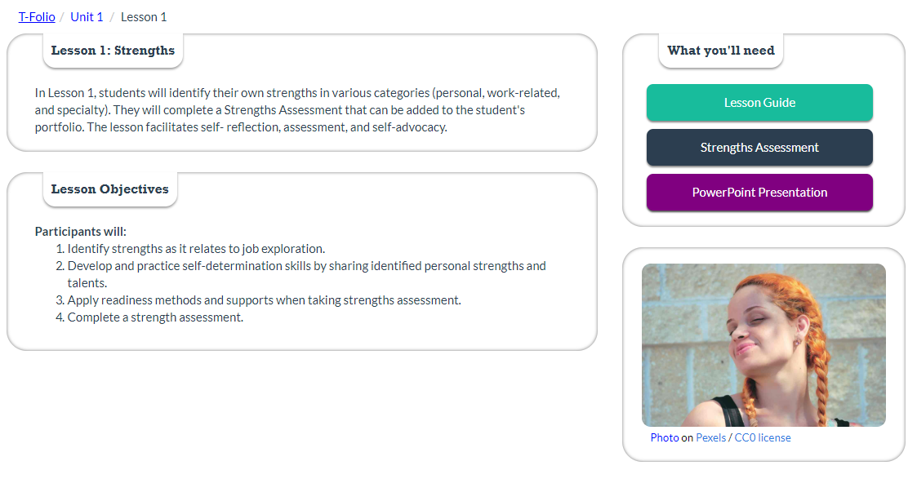
Lesson landing page
Notes:
On the lesson landing page, you will find a summary, objectives, and links to the documents needed to complete the lesson.

Slide 24
What a typical lesson includes
Lesson guide
Activity (one or more)
PowerPoint (and PDF)
Notes:
A typical lesson includes a lesson guide, at least one activity, and a PowerPoint presentation. PDFs of the PowerPoints are provided for those who prefer a print copy or choose not to use PowerPoint. Some lessons also include samples of activities or portfolio entries so that youth can work from an example.
The lesson guides can be accessed from the lesson landing page and either followed online or printed to use in hard copy.
The activities can either be completed online and saved as a PDF or printed and filled out by hand, depending on the youth’s needs.
The lessons are intended to be used as a scaffolded set of learning activities. However, they can be used as stand-alone activities after some minor preparation with the youth.

Slide 25
Lesson Guides
Lesson guides are available on each lesson landing page and include the following:
  Lesson summary and objectives.
  Facilitator notes.
  Introduction to the lesson with script suggestions.
  Activities.
  Debrief and guiding questions.
  Additional resources.
  Considerations for accommodation.
Notes:
Lesson guides are available on each lesson landing page and include:
A lesson summary and objectives.
Facilitator Notes with helpful information for the facilitator.
An Introduction to the lesson with script suggestions.
One or more activities to facilitate with the youth, usually leading to an item for their transition portfolio.
Debrief and Guiding Questions which helps youth to assimilate what they have learned.
And finally, Additional Resources and Considerations for Accommodation.

Slide 26
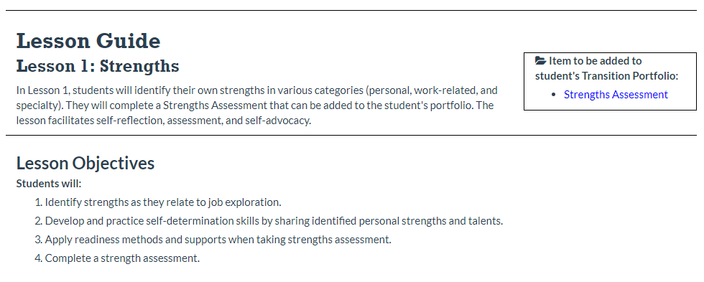
Lesson Guide: Example
Notes:
This is an example of a lesson guide from Unit 1, Lesson 1. Any items to be added to the student’s transition portfolio are noted in the box at the top right corner.

Slide 27
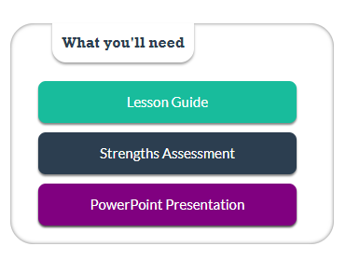
Accessing the PowerPoint
Notes:
The PowerPoint presentation can be downloaded from the lesson landing page, as shown in the image, or from the lesson guide.

Slide 28
PowerPoints
Most lessons have an accompanying PowerPoint to use as presentation or guide.
Guides the facilitator and youth through the lesson.
Many slides have notes that support the information on the slide.
Includes links to the activities or resources to be used in the lesson.
Can be modified or adapted as needed.
Notes:
Like the lesson guide, the PowerPoint presentation guides the facilitator and youth through the lesson. The PowerPoint can be used as a presentation in the classroom, or it can be used for your information as you prepare the lesson. Many slides have notes that support the information on the slide, so be sure to read the PowerPoint (or the PDF version if you prefer), including the Notes section, before conducting the lesson.
If you use the PowerPoint in the classroom, be sure to note where there are links to external websites that will be part of the activity. You may want to pull these up ahead of time or be ready to instruct the youth on how to find them.
The PowerPoint can be modified or adapted as needed.

Slide 29
Accessing the activities
Notes:
The activities can be accessed from the lesson landing page, as shown in the image, or from the lesson guide.

Slide 30
Activities
Each lesson has at least one activity for the youth to complete.
The lesson guide provides the facilitator with directions and locations of the activity(s).
There is a “product” at the end of each activity that will need to be saved in some location as a PDF:
  Cloud-based
  Thumb drive
  Printed portfolio
Notes:
Each lesson has at least one activity for the youth to complete. The lesson guide provides the facilitator with directions and links to the activity(s).
There is a “product” at the end of each activity that will need to be saved in some location as a PDF. We recommend that students have a designated location for their transition portfolio files so that they can be easily organized, whether cloud-based, a thumb drive, or a physical folder.

Slide 31
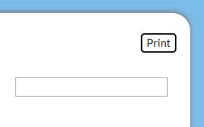
Save your work
Important! The T-Folio will not store any of the user’s work or information. It is therefore recommended that youth save their work once it is completed by creating a PDF of the activity.
First, after the activity has been completed, click on the “Print” button.
Notes:
It is important to remember that the T-Folio will not store any of the user’s work or information. It is therefore recommended that youth save their work once it is completed by creating a PDF of the activity.
First, after the activity has been completed, click on the “Print” button.

Slide 32
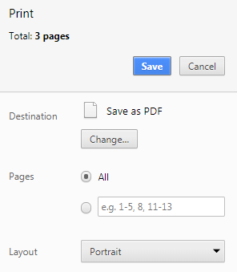
How to “Save as PDF”
  Then, from the Print screen, choose "Save as PDF“ by changing the printer destination.
Notes:
Then from the Print screen, choose “Save as PDF” by changing the printer destination. This may look different depending on your operating system.

Slide 33
Where to save work
  Choose a descriptive file name and save to a place where the student will be able to access it (local computer, thumb drive, school district server).
  Once the form is saved, it can also be printed and added to the student’s file.
  Plan activities to be completed in one sitting to avoid lost work.
Notes:
Next, choose a descriptive file name and save to a place where the student will be able to access it (local computer, thumb drive, school district server).
Once the form is saved, it can also be printed and added to the student’s file.
Since the T-Folio does not store the user’s work, be sure to plan activities so that they can be completed in a single sitting. Allow youth ample time to complete full activities before they are saved as a PDF.

Slide 34
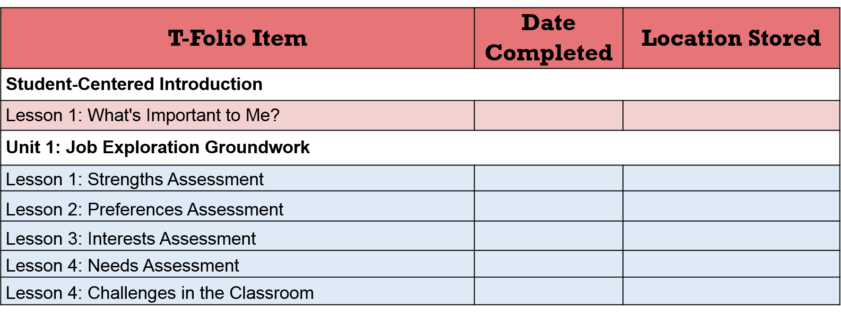
T-Folio Tracker
The T-Folio Tracker is how youth will track their work.
Notes:
After an item has been saved and added to the student’s transition portfolio, students can mark it as completed on the T-Folio Tracker.
This is how youth will track their work and remember where they have stored their documents. The T-Folio Tracker is a Word document that can be accessed from the T-Folio home page, or from the Introduction, Lesson 1, and then stored along with the student’s other transition portfolio documents.

Slide 35
The “White List”
Some schools and organizations have firewalls or other protections in place that block access to T-Folio content.
A "white list" is available for download for your IT department to add to the list of URLs recognized as safe.
The white list can be downloaded from the Feedback page.
Notes:
Some schools and organizations have firewalls or other protections in place that block access to some T-Folio content. A "white list" is available for download that can be given to your IT department to add to the list of URLs recognized as safe. The white list can be downloaded from the Feedback page.

Slide 36
PART 2: Collaboration & Facilitation
Notes:
Part 2: Collaboration and Facilitation

Slide 37
Training Objectives
Participants will learn:
How to collaborate effectively between educators and agency personnel.
Tips from the field on collaboration.
Suggestions on how to facilitate a lesson with youth.
Notes:
Part 2 of this training will address how to collaborate effectively between educators and agency personnel and will give suggestions on how to facilitate a lesson with youth.

Slide 38
Collaboration
The T-Folio curriculum can be co-facilitated by school personnel and DVR.
The curriculum is designed to be flexible in its delivery where all or some of lessons can be co-facilitated.
The ideal implementation would allow for planning time where both facilitators identify their areas of focus and expertise as they prepare for working with youth.
Notes:
One option we encourage is for the T-Folio curriculum to be co-facilitated by school personnel and DVR. The curriculum is designed to be flexible in its delivery where all or some of the lessons can be co-facilitated. The ideal implementation would allow for planning time where both facilitators identify their areas of focus and expertise as they prepare for working with youth.
The power of collaboration is multifaceted, where each facilitator brings knowledge and skills to the experience that the other may not have.

Slide 39
Tips for successful collaboration
Establish rapport.
Notes:
Establish rapport. Establish a relationship. Learn each other’s professional language as well as getting to know each other on a personal level. A positive relationship will help minimize misunderstandings, motivate you, and model collaboration and teamwork that is essential in the workplace.

Slide 40
Tips for successful collaboration
Establish rapport.
Identify your styles and use them to create a cohesive instructional setting.
Notes:
Identify your styles and use them to create a cohesive instructional setting. Find a balance that makes everyone comfortable. Plan lessons together and use your styles to complement and enhance the lessons and the delivery of instruction. Create a cohesive instructional setting with consistent expectations about instruction and discipline styles.

Slide 41
Tips for successful collaboration
Establish rapport.
Identify your styles and use them to create a cohesive instructional setting.
Discuss strengths and weaknesses.
Notes:
Discuss strengths and weaknesses. Identify your strengths and allow the other person to be the lead in those areas in which they are strongest. By using these strengths, instruction can be differentiated to meet the needs of a larger group more frequently, as well as allowing for individualized instruction.

Slide 42
Tips for successful collaboration
Establish rapport.
Identify your styles and use them to create a cohesive instructional setting.
Discuss strengths and weaknesses.
Discuss individualized needs and overall goals.
Notes:
Discuss individualized needs and overall goals. It is important to discuss modifications and accommodations as well as the goals and objectives for each lesson to ensure student success in the instructional setting.

Slide 43
Tips for successful collaboration
Establish rapport.
Identify your styles and use them to create a cohesive instructional setting.
Discuss strengths and weaknesses.
Discuss individualized needs and overall goals.
Formulate a plan of action and act as a unified team.
Notes:
Formulate a plan of action and act as a unified team. Consider the following items in your plan of action: scheduling; expected participant behaviors; what you will tolerate as well as how you will respond to actions that are not acceptable; and how you plan to maintain consistency. Determine your roles in advance so that you do not contradict each other or foster misunderstandings.

Slide 44
Tips for successful collaboration
Establish rapport.
Identify your styles and use them to create a cohesive instructional setting.
Discuss strengths and weaknesses.
Discuss individualized needs and overall goals.
Formulate a plan of action and act as a unified team.
Take risks and grow.
Notes:
Take risks and grow. Take risks, learn from each other, and grow as professionals. Find a rhythm that works and grow with your successes and through your mistakes. Remember you have a partner in this adventure that you can rely on to support the learning of the participants.

Slide 45
Classroom teachers
Review the curriculum together.
Ask for support.
Support your co-facilitator.
Create a calendar of instruction.
Notes:
As classroom teachers, it is important to create time to talk with DVR personnel about the importance of their expertise, which will positively influence outcomes for students with disabilities. This is an exciting opportunity to bring new knowledge and skills into your classroom with support from experts in the field of employment.
A few tips to keep in mind for effective collaboration:
Review the curriculum together and decide which areas would be most effectively provided collaboratively. This may be a few lessons, entire units, or the complete curriculum.
Don’t be afraid to ask for support in the areas where you feel your knowledge may not be strong.
Support your co-facilitator with some instructional strategies. (Remember they may not have any background in pedagogical practices).
Create a calendar of instruction to ensure availability. Strategize dates for collaboration based on the T-Folio curriculum schedule.

Slide 46
DVR personnel
Believe that all students should be held to high expectations.
Bring your best.
Expect that you will have a positive impact in every youth’s life.
Believe that all students can succeed.
Be flexible with timing.
Be prepared to change course.
Have fun!
Notes:
DVR personnel: Your expertise is important to the successful transition of students with disabilities. As you start to work with teachers in your local high schools, you will begin to realize that many of the goals are the same for you as they are for schools. The collaboration between schools and DVR will lead to smoother transitions for youth as they move from school to the community.
It may be daunting to enter a classroom in a high school. Remember you have a partner that is vested in the success of the youth in their classroom – they have your back. Some suggestions for success:
Believe that all students can learn and should be held to high expectations.
Bring your best to the instructional setting – you set the tone of the day.
Expect that you will have a positive impact in every youth’s life.
Believe that all students are expected to become responsible and productive citizens who will develop into lifelong learners.
Be flexible with timing: you never know how long a lesson will take until you have some practice, and it may change each time!
Be prepared to change course depending on the response of the youth.
Have fun!

Slide 47
Tips from the field for DVR counselors
Talk to teachers before implementing T-Folio in the classroom about what their students need.
Go through the activities and think about what students need and what isn’t being delivered in the classroom – don’t duplicate those services.
Share with teachers some of the information you’ll be covering before going into the workshop – you’ll be more effective as a team in making sure students are really grasping the concepts.
Check for comprehension, have the students share out, be conversational.
Notes:
Talk to teachers before implementing T-Folio in the classroom about what their students need.
Go through the activities and think about what students need and what isn’t being delivered in the classroom in order not to duplicate services.
Share with teachers some of the information you’ll be covering before going into the workshop.
When facilitating with students, be sure to: check for comprehension, have the students share out frequently, be conversational. The T-Folio lesson plans help to guide facilitation in an intentional manner.

Slide 48
Reminders about facilitation
DON’T:
Start out with your own knowledge.
Follow a pre-set curriculum.
Lecture from the “stage.”
Provide information in one direction.
Act as if there is a “right” answer.
Maintain a hierarchical relationship with pupils.
Answer all questions yourself.
→
→
→
→
→
→
→
DO:
Start by assessing the group.
Consider new ideas brought in by the group.
Use practical, participatory methods.
Make sure information flows in all directions and learning happens among all participants.
Encourage and value different views.
Consider participants as being equal.
Ask participants what they think and let them figure things out for themselves.
(Adapted from Geijer, 2015)
Notes:
Don’t:
Start out with your own knowledge
Follow a pre-set curriculum.
Lecture from the “stage.”
Provide information in one direction.
Act as if there is a “right” answer.
Maintain a hierarchical relationship with pupils.
Answer all questions yourself.
Do:
Start by assessing the group.
Consider new ideas brought in by the group
Use practical, participatory methods.
Make sure information flows in all directions and learning happens among all participants.
Encourage and value different views.
Consider participants as being equal.
Ask participants what they think and let them figure things out for themselves.

Slide 49
References
Geijer, C. C. (2015, January 15). Teaching vs. facilitating: What is the difference? Retrieved from: https://www.linkedin.com/pulse/whats-difference-between-teacher-facilitator-christina-geijer
Johnson, C. E. (2012). Transition Services Flowchart. Center for Change in Transition Services, Seattle University. Seattle, WA.
Notes:
These references were used in the creation of this training.

Slide 50
CCTS Contact
CCTS General Information
ccts@seattleu.edu
206-296-6494
www.seattleu.edu/ccts
@WACCTS on Facebook, Twitter, and Pinterest
Notes:
And finally, if you still have questions about the T-Folio, please contact us at CCTS. You can email us at ccts@seattleu.edu, or call 206-296-6494. You can find us online at www.seattleu.edu/ccts, and on Facebook, Twitter, and Pinterest @WACCTS.

Slide 51

Creative Commons License
Except where otherwise noted, content in this presentation is licensed under a Creative Commons Attribution 4.0 International license. All logos and trademarks are property of their respective owners.
You may share and adapt this material, but you must give appropriate credit, provide a link to the license, and indicate if changes were made.
Notes:
Unless otherwise noted, the material in this presentation is licensed under a Creative Commons Attribution 4.0 International license. All logos and trademarks are property of their respective owners. You may share and adapt this material, but you must give appropriate credit, provide a link to the license, and indicate if changes were made.

