Slide 1



Technology and Transition
What should IEP teams be considering?
Kristin Leslie, Director
Kristin.leslie@cwu.edu
Special Education Technology Center
Pixabay

Slide 2
Kristin Leslie, Director
Kristin.leslie@cwu.edu
Special Education Technology Center

Slide 3
Technology & Transition:
Kristin Leslie, Director
Kristin.leslie@cwu.edu
Special Education Technology Center

Slide 4
The Five State Needs Projects
Center for Change in Transition Services (CCTS)
eLearning for Educators
Special Education Support Center (SESC)
Special Education Technology Center (SETC)
Washington Sensory Disabilities Services (WSDS)
Image: Blue raised hands on Pixabay| CC0 1.0 Creative Commons
Notes:
OSPI Special Education funds five state-needs projects with IDEA state-level discretionary dollars. These projects collectively provide:
Professional development
Technical assistance
Consultation and training for parents, families, and educators.

Slide 5

Special Education Technology Center (SETC)
Lending Library
Technical assistance and consultations
Professional development
Dissemination of AT information
Support Regional AT Groups & Statewide AT Mtg

Slide 6


Thinking in New Boxes
Notes:
On a small farm amid gentle rolling hills, there was a playful golden retriever...named Philly. Everyday the dog would leap over the fence at the back of the farm to run through a meadow and on to the woods chasing squires amongst the trees. As time went by the fence began to fall apart and was taken down, but every day without fail, the dog would head out the back and leap in the place where there once was a fence to frolic. The barrier was gone, but he had developed a set of motor memories, patterns and assumptions that made it almost impossible for him to notice that the fence was no longer there.
Every day we are forming assumptions and boxes which we work within. As the landscape changes, it is critical for us to shift our thinking and let go of old boxes and ways of doing things. With technology rapidly changing, we have to be forward thinking and in deciding which technologies will work best for a student, we must not be bound by old ways of thinking.

Slide 7
Objectives
Define key assistive technology terms
Identify factors that can improve outcomes for transition age students in relation to use of assistive technology supports
List 3 resources to support students in transition with technology needs

Slide 8

Transitions in Education
Early Intervention to Preschool
Preschool to K-12
Classroom to Classroom
High School to Post Secondary Settings

Slide 9
Quality Indicators for Assistive Technology
A COMOPREHENSIVE GUIDE TO ASSISTIVE TECHNOLOGY
Book Study YouTube Link
https://www.youtube.com/watch?v=Wi_Rmkttz7Q
Notes:
Much of this presentation is from the Quality Indicators for Assistive Technology. The Special Education Technology Center has recorded a book study. The link is as follows:
https://www.youtube.com/watch?v=Wi_Rmkttz7Q

Slide 10
Assistive Technology
IDEA Defines AT Devices…
Assistive technology device means any item, piece of equipment, or product system, whether acquired commercially, off the shelf, modified, or customized, that is used to increase, maintain, or improve functional capabilities of children with disabilities.
Notes:
Lack of self-determination, self-awareness and self-advocacy on part of the individual with a disability (and/or advocate)
Lack of adequate long range planning on the part of the sending and receiving agencies (timelines)
Inadequate communication and coordination
Failure to address funding responsibility
Inadequate/ consistent evaluation process (documentation, data, communication, valued across settings)
Philosophical differences between sending and receiving agencies
Lack of understanding of the law and of their responsibilities

Slide 11
AT Consideration
Occurs within the IEP meeting
Can be completed with information the team already knows
Looks at the student’s ability to progress towards goals with assistance and without to receive FAPE

Slide 12
AT Assessment
Is completed over the span of days, weeks, even months and occurs outside of the IEP meeting
Involves obtaining new information to make decisions about AT supports needed.
Takes multiple interactions with the student and team members and involves trials of AT to find a match.

Slide 13

Closing the Gap
Absence of systematic planning for delivery of AT services
Insufficient opportunities for students and families to learn about and try AT
Differing perspectives, knowledge, and skills for those who have a role in AT services in the school setting
Pixabay
Notes:
Literature reviews reveal that there is a significant and continuing gap between what is required by policy and what consistently occurs in educational settings due to:

Slide 14
National Center for Technology Innovation and Center for Implementing Technology in Education (CITEd)
It is estimated that about 85 percent of students with learning disabilities (LD) transition directly from school to work.¹
Furthermore, statistics addressing employment among people with disabilities indicate that the workplace consists of approximately 18.6 million people with disabilities, ranging in age from 16 to 64. This represents about 56% of all people with disabilities in this age category.² Given the vast number people with disabilities in the workplace, the potential for assistive technology (AT) to increase productivity is great.

Slide 15

Real World Technologies
Does the technology
being used at school
interface with technology in the “real world?”
Notes:
Erik- example of a student who uses an AAC device with eye gaze.
Jake – example of a senior who had a job at a mechanic shop. He had a learning disability and could not always read parts manuals. He used office lens on his phone to convert pictures of text to speech to text to better understand instructions.

Slide 16
AT in the
IEP
“When IEPs are well written,
everyone who uses the information to implement the student’s program understands what AT is to be available , how it is to be used and under what circumstances.”
~ QIAT Leadership Team
Notes:
Individuals with Disabilities Education Act
Each public agency shall ensure that AT devices, AT services, or both, are made available to a child with a disability if required as a part of the child's:
(1) Special education
(2) Related services
(3) Supplementary aids and services
Does IDEA specify how or where to document AT in the IEP? No
The Law States that AT can be part of special education, related service, or supplementary aids and services.
It is the responsibility of the IEP team to describe the use of AT where ever it makes the most sense within the IEP.

Slide 17
Training for IEP teams
Professional Development for teachers on assistive technology processes, as well as products and services. (consideration, referral, assessment documentation, and implementation planning)
Training for families on district processes around assistive technology

Slide 18
Quality Indicators for
AT in Transition
Transition plans address assistive technology needs of the student, including roles and training needs of team members, subsequent steps in assistive technology use, and follow-up after transition takes place.
Notes:
Intent: The comprehensive transition plan required by IDEA assists the receiving agency/team to successfully provide needed supports for the AT user. This involves the assignment of responsibilities and the establishment of accountability.

Slide 19
Transition Planning Worksheet
Quality Indicators for Assistive Technology
Guiding Document on AT in Transition
Transition Planning Worksheet Document

Slide 20
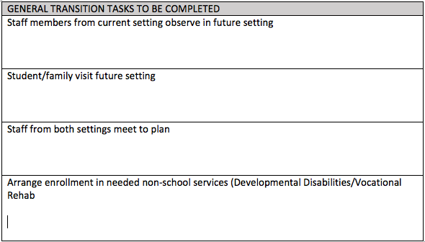
General Transition Tasks
Quality Indicators for Assistive Technology(Pg. 131)
Staff members from current setting observe future setting
Student & Family visit future setting
Staff from both settings meet and plan
Arrange enrollment in non-school services (Developmental Disabilities/Vocational Rehab)

Slide 21
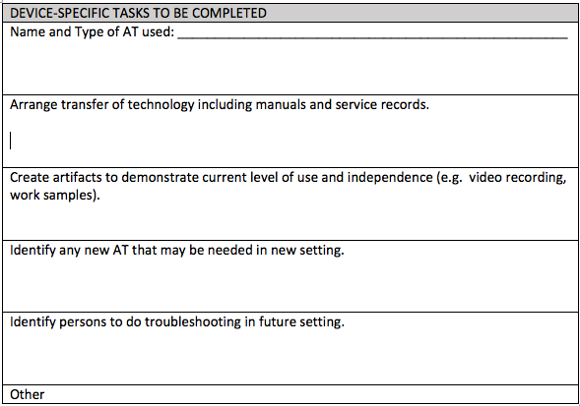
Device Specific Transition Tasks
Quality Indicators for Assistive Technology(Pg. 131)
Arrange transfer of the technology including manuals and service records
Create artifacts to demonstrate current level of use and independence (video recordings or work samples)
Identify any new AT that may be needed in the new setting
Identify persons to do troubleshooting in future setting.

Slide 22
AT Protocol for Transition Planning
National Technology Assistance Center on Transition
AT Protocol for Transition Planning Document
Notes:
The AT Protocol for Transition planning is on the National Technical Assistance Center on Transition Website. It was created in 2001.

Slide 23
Quality Indicators for
AT in Transition
Transition planning empowers the student using assistive technology to participate in the transition planning at a level appropriate to age and ability.
Notes:
Intent: Specific self-determination skills are taught that enable the student to gradually assume responsibility for participation and leadership in AT transition planning as capacity develops. AT tools are provided, as needed, to support the student’s participation
Self-determination is the ability to be a causal agent in one’s own life and has been identified as a critical factor in the continued use of AT in new environments (Fried-Oken, Bersani, Anctil, and Bowser, 1998). Explicit instruction in skills needed for self-determination in relation to one’s AT can begin as soon as a student starts to use AT devices allowing many opportunities to practice.
Students who have been appropriately involved in IEP development throughout their school experience have greater access and independence during transitions and are better prepared to participate in transition planning. Participation can include tools and strategies that help the student plan the agenda, organize ideas, present thoughts, or use an AT device as a planning tool (e.g., use an AAC device during transition planning meetings). As members of their own IEP team, they are empowered to participate in expressing their needs and preferences regarding use of AT and other aspects of their program. Over time, students who use AT have the opportunity to learn self-determination skills at a level commensurate with their age, ability, and comfort level.
Example:
Emily was a junior at Lincoln High School. During her IEP meeting, she advocated for herself using her AAC device to narrate a computer slide presentation she developed explaining the kinds of work she was hoping to be able to do after high school. Emily used her AAC device to ask questions about the kind of assistance she could expect if she entered college or a vocational-technical program and her personal goals were included in her plan. Another meeting was planned after Emily visited two post-secondary settings and learned what strategies she would need for successful transitions.
The QIAT Leadership Team (2015), http://www.qiat.org. Citations listed in Reference document

Slide 24
Center on Technology and Disability
Beyond High School: Making the Transition https://www.ctdinstitute.org/audience/transition
Resources for Families & Students
  Assistive Technology with your Teen and Young Adult
  Assistive Technology Tips for College
  Transition Tech Talk Videos from PACER
  Family Information Guide to Assistive Technology and Transition Planning

Slide 25
Quality Indicators for
AT in Transition
Advocacy related to assistive technology use is recognized as critical and planned for by the teams involved in transition.
Notes:
Intent: Everyone involved in transition advocates for the student’s progress, including the student’s use of AT. Specific advocacy tasks related to AT use are addressed and may be carried out by the student, the family, staff members or a representative.

Slide 26
Quality Indicators for
AT in Transition
AT requirements in the receiving environment are identified during the transition planning process.
Notes:
Intent: Environmental requirements, skill demands and needed AT support are determined in order to plan appropriately. This determination is made collaboratively and with active participation by representatives from sending and receiving environments.
The transition process includes opportunities for communication between settings; visits by the students, parents, and teachers; and planning meetings that include all needed team members. Team members from both sending and receiving environments work collaboratively during transition planning. In order to plan appropriately, team members identify environmental requirements, new tasks, equipment needs, and training needs, as well as services, service providers, and supports that will be needed in the new setting. Examples of tasks related to AT that may be necessary in the new environment include the need to move the technology from class to class, to access a remote printer for written assignments, or to use a new computer platform. In some instances, the new setting will have increased demands to communicate with multiple teachers, school staff, and peers. Team members in the sending environment help prepare the student by providing experiences and practice in using new skills that will be needed before the time for transition arrives.
Example:
Shayna used text-to-speech and word prediction software for all writing tasks of more than three sentences. As Shayna’s team began to plan for her move to middle school, the middle school team members pointed out that the new school has Windows platform computers rather than the iOS computers used at the elementary school. The team made plans to help Shayna with her transition by acquiring a Windows platform computer and the Windows based version of the software she used for reading and writing. The team developed a plan to provide training for her in the operational use of the Windows computer and software during the spring before she moved to her new school.

Slide 27
Quality Indicators for
AT in Transition
Transition planning for students using assistive technology proceeds according to an individualized timeline.
Notes:
Intent: Transition planning timelines are adjusted based on specific needs of the student and differences in environments. Timelines address well mapped action steps with specific target dates and ongoing opportunities for reassessment.
For transitions to post-secondary services, federal law requires that an individualized timeline is developed and documented for the transition no later than age 16. In some states, the age required to begin transition planning is earlier than age 16. It is important to know the specific rules for your state when beginning transition planning. In the timeline, AT needs and activities that require use of AT are addressed. The timeline may include tasks such as acquisition of a new device or software, AT practice in the new environment, direct instruction in communication with new people, guidance in independent AT use, visitations to potential settings, and meetings with service providers.

Slide 28
Quality Indicators for
AT in Transition
Transition plans address specific equipment, training and funding issues such as transfer or acquisition of assistive technology, manuals and support documents.
Notes:
Intent: A plan is developed to ensure that the AT equipment, hardware, and/or software arrives in working condition accompanied by any needed manuals. Provisions for ongoing maintenance and technical support are included in the plan. .
During any transition, whether the student remains in school or moves on to a new program or setting, just providing equipment is not enough. People who have never seen the student in action will need help in understanding how AT helps with functional capabilities and what is needed to support that AT use. For example, when Lance moved from middle school to high school, he stopped turning in the written assignments created on his portable computer. When his new teachers asked him why, he reported that he needed a printer cable that was accessible from the front of the computer attached to printers in each of his classes. Once cables were provided, Lance began to turn in his written assignments with the same frequency that he had in middle school. When a student stops using AT in the new environment, it may be because day-to-day management of equipment is not supported making AT use difficult.
Example:
Ahmed and his transition planning team, which included representatives of the school district, developmental disabilities services, the supported work site, and the group home to which Ahmed was moving, identified the specific equipment he had been using at school. This included a direct select augmentative and alternative communication (AAC) device with 32 options, a single talking switch used to ask for assistance, and a jig for an electric stapler that allowed proper alignment and insertion of papers. The school also provided a portfolio of information about how Ahmed used the AAC devices.
The supported work site had the equipment needed for the stapling task but was not able to provide either of the communication devices. The team determined that additional funding would be required to purchase these and also realized that services available to Ahmed did not include a speech language pathologist (SLP). A community-based SLP was identified and the team acquired funding through Medicaid for equipment purchase and periodic review and updating of vocabulary on Ahmed’s AAC device.

Slide 29
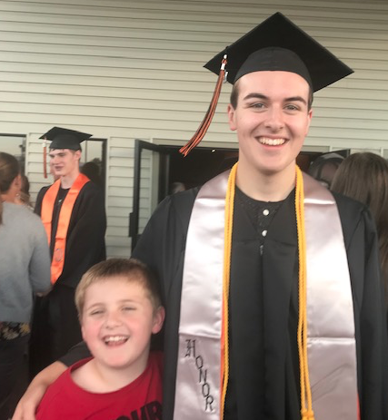
Resources
Quality Indicators for Assistive Technology
https://qiat.org/
National Technical Assistance Center on Transition
https://transitionta.org/
Center on Technology and Disability
Beyond High School: Making the Transition
https://www.ctdinstitute.org/audience/transition
Job Accommodation Network
https://askjan.org/

