Slide 1
Student-Led IEPs
The Difference
Ed Ashworth-Special Education Teacher & Case Manager
Carrie Stokes-Special Education Director
Ande Chapman-Transition consultant

Slide 2
Agenda
  The Difference Ed Ashworth
  How It All Started
  Staff & Students
  The Difference Ande Chapman
  Focused Student Workshop
  The Difference Carrie Stokes
  Administrator’s Perspective
  Questions & Answers

Slide 3
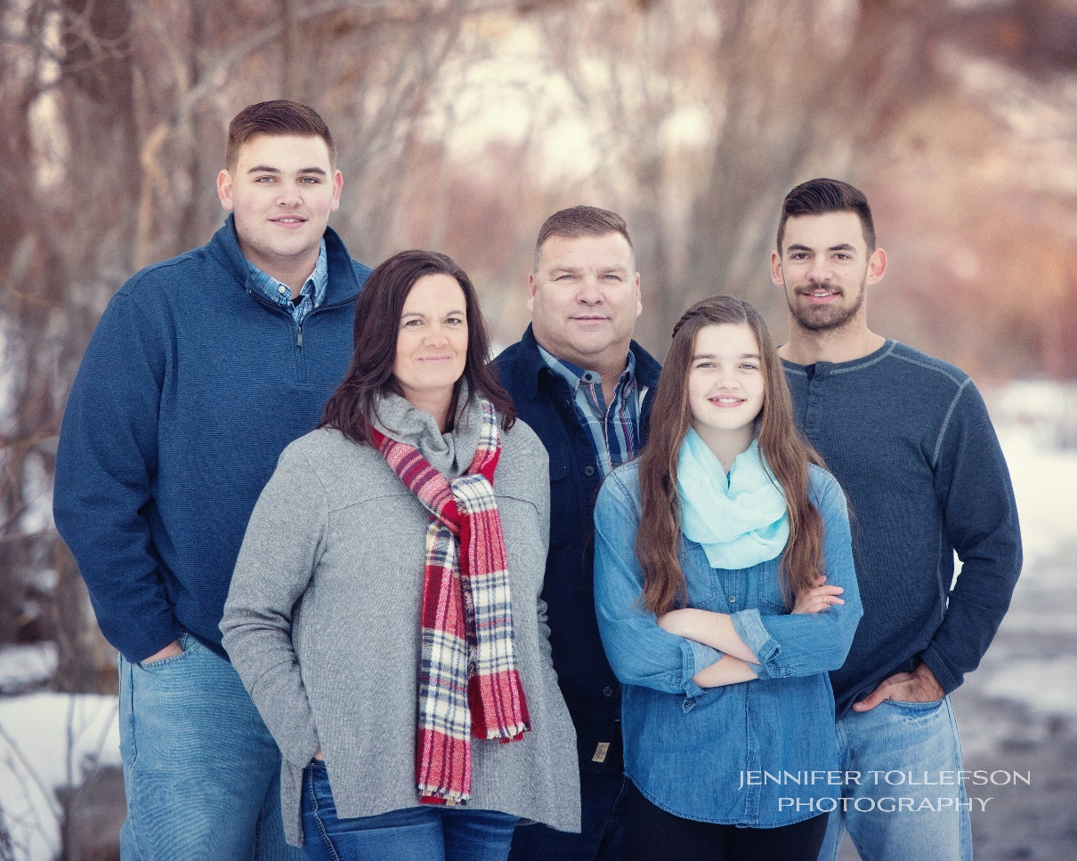
The DIFFERENCE in my Life

Slide 4
THE DIFFERENCE
Student Led IEP Training presented on October 30, 2018
Presenter: Mrs. Hirschmann, Seattle U Center for Change in Transition Services
This training changed the program I supervise and how we can empower our students to self advocate for and promote themselves to faculty and administration for their education!

Slide 5
WHAT ARE THE TEACHERS SAYING IN THE GENERAL EDUCATION FIELD?
I appreciate the format… it gives the kids the “floor.” I like the power it gives them and it gives me a new context… seeing them explaining their different learning processes. Well done. Aaron Nickelson, Junior / Senior History
The Student led IEP ‘s were impressive. The best part about them is what they do for the student. So many of our students have difficulty communicating, especially when they have a need. They also give them confidence and a better understanding of themselves. Ron Cate, 9th/10th History.

Slide 6
IEP Participation: Who Talks?
Notes:
Taken from Introduction to the Student –Led IEP Initiative, OSSE Secondary Transition Institute (May 2014)
Office of State Superintendent of Education- Washington D.C.
U.S. Department of Education’s Office of Special Education Programs (OSEP) has designated DC as “high risk” and imposed Special Conditions for FFY 2013
One of the resolution options was to address youth engagement- increasing the capacity of students to meaningfully participate, collaborate and problem solve

Slide 7
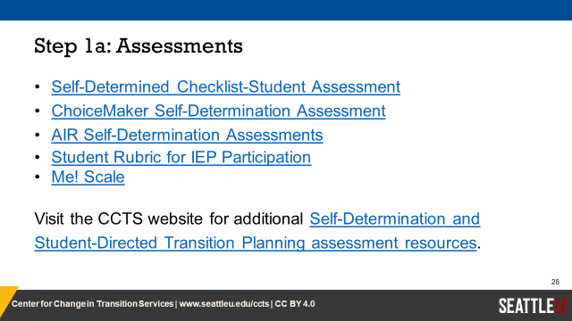
Starting Point (What the student understands about themselves)

Slide 8
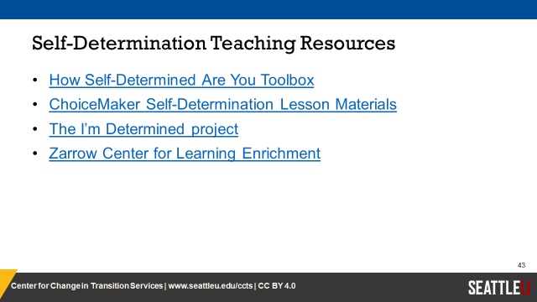
Teaching Resources we used.

Slide 9
Fundamental
Transition skills
Bell ringers
By: Mindy Lingo
Sooner Scholar
University of Oklahoma

Slide 10
Bell Ringer Components
  HOW DO I SEE MYSELF
  DISABILITY INFORMATION (LEARNING STYLE)
  IEP (INDIVIDUALIZED EDUCATION PROGRAM)
  IMPROVEMENT SKILLS
  MY FUTURE

Slide 11



What is my Learning Style?
My particular learning style is in Math Calculation and Math Reasoning. It means:
Dyscalculia is defined as a failure to achieve in mathematics commensurate with chronological age, normal intelligence, and adequate instruction. It is marked by difficulties with visualization; visual-spatial perception, processing and discrimination; counting; pattern recognition; sequential memory; working-memory for numbers; retrieval of learned facts and procedures; directional confusion; quantitative processing speed; kinesthetic sequences; and perception of time.

Slide 12
What it means to ME!
Math has always been a struggle for me, ever since day one. It's degrading knowing when you're the last one finishing a test, with cold sweats as you have NO idea what’s on the paper. An example of work that I have issues with during math is proof, and word problems. I'm very visual, and It's hard piecing pictures together in my mind as so much goes on inside. Trigonometry has been almost a breeze for me however, it involves easy steps with law of sines and cosines. Though once the steps grow too long it can become extremely difficult to remember what I was told.
Listen to her.

Slide 13
The learning style I am living with is ADHD.
What this means to me
I sometimes have trouble understanding but am too ashamed of asking while they're talking in front of the class. I space off a lot, especially during notes. I don’t like asking other people for help except the teacher or close friends. I can forget assignments easily and things that I've learned, id forget most.
Listen to him. Teacher says:

Slide 14
The learning style I am living with is Autism
this means the difficulty in social interaction and communication and by restricted or repetitive patterns of thought and behavior.
What this means to me that I can have a hard time with being social with others and that I have pacific patterns of my behaver that I have to do (or the world well end)

Slide 15
STUDENT-LED IEP meeting Participation: “THE DIFFERENCE”

Slide 16
What are “DIFFERENCES” as seen by the professionals?
What’s fantastic about the student-led IEP meetings is that it shifts the onus back onto the student. With that and through the lens of a teacher, you receive a more authentic glimpse of the learning barriers individuals are facing as well as the accommodations that work best. At the end of the day, getting students to self-advocate in this manner is significant in preparing them for the world beyond school. Zach Spaet, Vocational Teacher
The Student Led IEP in my eyes has shown educators and family members the strengths and challenges that students are experiencing. Also it has been a great way for students to advocate for their needs, as they work towards their high school and post-secondary goals. HS Counselor Brit Carden

Slide 17
Impactful & Influential
This is the first year I have participated in the IEP process in the manner you are using, having the students plan and present their own IEPs. There are some real benefits to doing IEPs this way. First, the students take ownership of their education by presenting their backgrounds, strengths, needs, and plans. The students seem empowered by this process, and instead of the adults discussing the students’ needs and accommodations, the students themselves are explaining what they need to be successful. Second, it was much more informative for me as a teacher to listen to the student first before discussing amongst teachers/administrators. This put the responsibility of communication directly to the student/teacher relationship and is much more helpful.
Sandy Colbert, HS English
This year, our junior class advisory used a power point presentation, similar to the IEP presentations in Mr. Ashworth’s class, for student led conferences. The teachers on the advisory committee were influenced by seeing presentations at IEPs and witnessing how much more dynamic and student-focused a conference could be. Seeing the IEPs guided and influenced our decision to have all the junior students share a similar power point.

Slide 18

SAMPLES OF STUDENT CREATIVITY

Slide 19
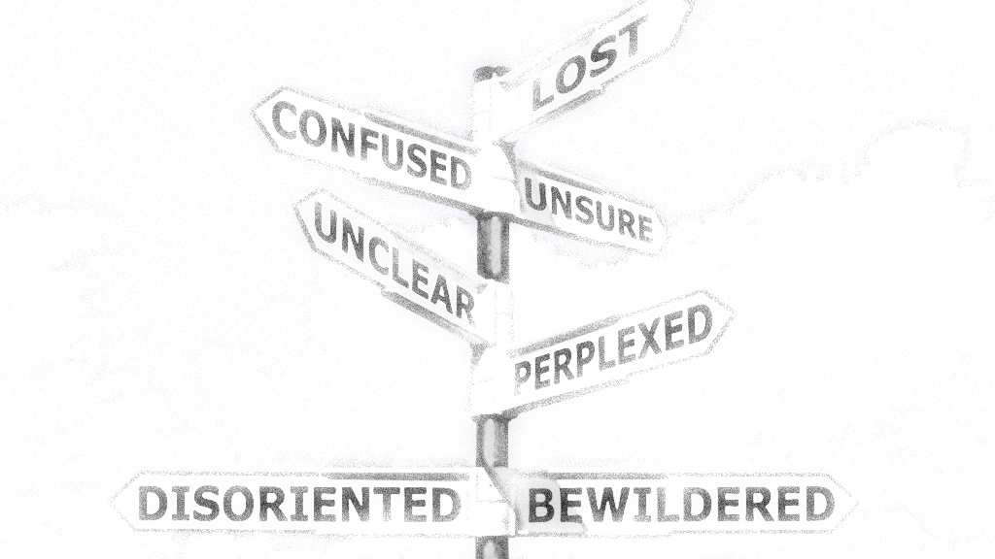
Concerns
Somethings that concerns me is making sure I pass all my work with a B or higher.
Finding the right trade school for me.
I'm fully ready to graduate, but will I.
Me not liking the trade (job) I want to do.
Nervous about spending money and time on something that I don’t want to do.

Slide 20
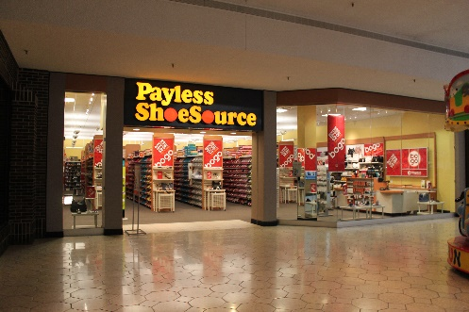
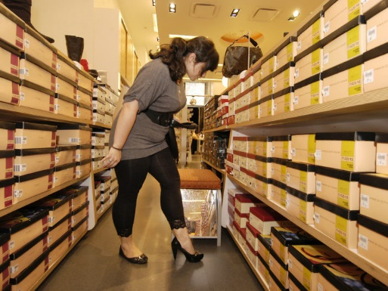
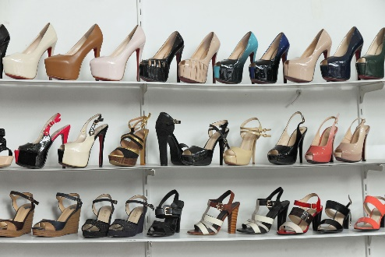
Future – Working Plans
I would like to work at Payless
  Training
  Experiences
  Interact with customers.
  Assist in sales.
  Work cash register
  Stock shelves
  Get shoes from shelves
  Stock storage area
  Answer telephones

Slide 21
Future – Working Plans
I would like to be a barber and cut hair
Skill needed:
Shaving the face, neck and back of the neck
Clipper cutting for both short and long hair
Shear training for men and women’s haircuts
  Professional Barber license
  Job shadowing / work under or for a Master Barber

Slide 22



Interests
School:
Soccer
Basketball
Lunch
Woodshop
PE
Office User Specialist
Home:
Video Games
Dogs
Soccer
Friends
Family

Slide 23

Accommodations
Having a calculator.
Having more time.
Using my notes on assignments or exams.
Longer time to study.
One on one help.
Having math operations and formulas provided to me.
Pre-Load with examples and model expectations for assignments and/or exams.

Slide 24


Strengths
Some of the strengths I have in school include
Reading
Typing
Digitools

Slide 25

S T R E N G T H S .
L E A D E R S H I P
C O O P E R A T I O N
S O C I A L S K I L L S
P E R F E C T I O N I S T
E M P A T H E T I C
O R G A N I Z E D
C O N F I D E N C E

Slide 26
The Difference
Focused Student Workshop

Slide 27

Building My Future
                Blueprints
                Foundations & Tools
                Framing-Goal Setting
                Other Contractors-Resources, Who Else?
                Your Future

Slide 28
Blueprint-I.E.P
Individualized Education Plan
WHY IS IT IMPORTANT? High School, High School & Beyond, Employment, Daily Living
The Vision (The dream)
The Plan and some of the Tools you will need
Making sure the Plan is Complete (What happens when building a home and the blueprint isn’t complete?)
You (owners/builders) have input into the Plan-Student-Led IEPs
Allows for Changes (Reflection & Remodeling)Yearly Review

Slide 29
Foundations & Tools
Self-Determination & Self-Advocacy
Strengths
Interests
Preferences
Needs-Accommodations

Slide 30
The Difference
The Administrator’s Perspective

Slide 31
The Difference
Administrator’s Perspective
Being part of a Student-Led IEP
Professional Collaboration
For Special Education Teacher

Slide 32
QUESTIONS & ANSWERS

