Slide 1
Post-School Survey Overview:
Roles and Resources
Center for Change in Transition Services (CCTS)
Improving post-school outcomes for students with disabilities in Washington state
www.seattleu.edu/ccts
Notes:
Welcome to the Post-School Survey Overview, where we’ll be focusing on roles and responsibilities for the team of people who are involved in the survey, and the resources that are available to support you through the survey process.

Slide 2
Getting started
Notes:
Let’s get started.

Slide 3
CCTS Introductions
Elaine Marcinek, Director
Jay Shepherd, Marketing and Communication Specialist

Slide 4
Agenda
Objective: Apply Post-School Survey training to real-life scenarios
CCTS and the Post-School Survey
Leavers and Leaver Verification
TSF2 Accounts and User Roles
Support and Guidance Materials
Questions
Notes:
We’re going to cover some big-picture ideas around the Post-School Survey.
We’ll be focusing on essential information that everyone involved in conducting the survey should know.
Our objective for today is to be able to take the information we share with you and apply it to real-life Post-School Survey scenarios.
We’ll start with an overview of the Post-School Survey.
Then we’ll define the criteria for the former students you’ll be contacting for the survey. The technical term for those former students is leavers. We’ll define leavers and talk about verifying your leaver survey list before starting the survey.
We’ll also discuss TSF2 accounts and user roles, and then point you in the direction of additional materials you can access for further support and guidance.

Slide 5
CCTS and
Post-School Survey Overview
Notes:
First we’ll get started with an overview of CCTS and the Post-School Survey.

Slide 6
Center for Change in Transition Services
OSPI State Needs Project
Improving post-school outcomes for youth with disabilities
Provides statewide professional development and technical assistance around transition services (including the Post-School Survey)
Located at Seattle University
Notes:
CCTS is a State Needs Project, funded by the Office of Superintendent of Public Instruction Special Education Section.
Our mission is to improve post-school outcomes for youth with disabilities in Washington.
Along with four other State Needs Projects, we provide professional development and technical assistance to school districts, educational service districts, and agencies across the state.
The Post-School Survey is one of the activities that we support, which is why we’re here today.
We’re located at Seattle University in the College of Education, which is why you’ll see Seattle U on our website, PowerPoint slides, and email addresses.

Slide 7
Post-School Survey Logistics
Survey opens June 1-November 1 each year
Phone surveys are conducted by school/school district representatives
Surveys are completed by former special education students (“leavers”) one year after exiting high school
Survey data are reviewed, analyzed, and reported by CCTS
Notes:
As some of you may already know, the Post-School Survey opens June 1 and closes at 11:59 p.m. on November 1 every year.
During that window of time, school and school district representatives make phone calls to former students who have permanently exited high school, and who were receiving special education services at the time they left.
The technical term for these students is “leavers,” but you’ll also notice that we often refer to leavers as former students.
After the survey closes, CCTS reviews and analyzes the data that were collected, and then we provide reports for districts, ESDs, and the state to access.

Slide 8
Importance of the Post-School Survey
Reconnect with former students who received special education services
Gain direct insights into education and employment activities one year after leaving school
Collect post-school outcome data for program improvement and reporting purposes
Notes:
The Post-School Survey is a requirement for state and federal reporting, but it also offers a unique opportunity to reconnect with former students and learn about what they’ve been up to within their first year of leaving high school, specifically in the areas of employment and education.
It’s a useful and important tool for collecting information directly from youth, or from a designated family member who can provide that information.
This information, known as post-school outcome data, is used by school districts, educational service districts, and the state to evaluate and improve on transition planning for youth with disabilities.

Slide 9
Post-School Survey and the TSF2
Transition Systemic Framework 2.0
  www.cctsTSF.com
  www.cctsTSF.org
CCTS’s secure data collection website
Used when conducting the Post-School Survey
View and download reports and presentations
Notes:
This process of collecting and reporting data takes place within the TSF2, which is an abbreviation for the Transition Systemic Framework 2.0.This is the website that CCTS operates for Post-School Survey data collection.
All surveys are conducted within the platform, meaning that if you’re someone who conducts the surveys, then while you’re on the phone with your former student or your former student’s family member, you’re logged into the TSF2, recording information as it’s being shared with you.
All of the information that’s collected in the survey is saved and stored in the TSF2.
Once data are analyzed, finalized reports and PowerPoint presentations are available for your district to view and download directly from the site.

Slide 10
Leavers and
Leaver Verification
Must be completed before making survey phone calls
Notes:
Before survey phone calls can begin, someone from each school or district must confirm that there’s an accurate list of former students in the TSF2 for you to call, that meet the leaver criteria for the current survey year.
It’s important that everyone conducting the survey understands who should be on those lists.

Slide 11
Leaver Criteria for 2017-18 Leaver Year
Former student
Age 16-21 with an IEP at the time of exit
Left school in the 2017-18 year by graduating with a diploma, aging out, dropping out, or was expected to return and did not
2019 = survey year
2017-18 = leaver year
Notes:
Your leaver survey list in the TSF2 should include all former students ages 16-21 who had an IEP when they exited high school, who left during or at the end of the 2017-18 school year because they graduated, aged out, dropped out, or were expected to return and did not.
The Post-School Survey is conducted one year after these youth leave high school, which is why in 2019, schools are contacting leavers from the 2017-18 school year.
At CCTS, we often refer to leavers as former students, when we’re talking about the survey.
Just know that when we do, we’re referring specifically to former students who meet leaver criteria.

Slide 12
Leaver Verification (LV)
Before survey phone calls can begin:
Compare and edit names and demographic information in the TSF2 to match school or district’s records.
Submit confirmation that the TSF2 list is accurate.
  LV must be completed by all schools, even those without leavers.
  Surveys are in read-only mode until LV is submitted.
  After submitted, LV must be reset and resubmitted to in order to make changes to the list.
Notes:
CCTS gets a list of former student names and demographics from the state that we import to the TSF2.
Before schools can start making phone calls, their lists need to be cleaned up to ensure they match district records, and then a box needs to be checked that says, yes, this is an accurate list.
This must be done by all schools, even if there aren’t leavers.
In that instance, you’re verifying that an empty leaver list is accurate.
Once Leaver Verification is completed and submitted, the list is no longer editable. To make changes to a list, like deleting a survey, leaver verification needs to be reset and resubmitted.
Surveys revert to read-only mode when LV is being reset.
No information is lost during this time.

Slide 13
Leaver Verification Support and Guidance
Webinars on Vimeo:
  Submitting Leaver Verification Part 1
  Submitting Leaver Verification, Part 2
Documents in Google Drive:
  Webinar PowerPoints
  Survey Guidance
  TSF2 How-To
Notes:
Today we just want you to understand the big picture of leaver verification.
For additional information about leaver verification, we have two 30 minute webinars that were recorded earlier this year.
They’re captioned and available to view on Vimeo.
The PowerPoints from those webinars, as well as additional training materials, are available in our Post-School Survey training materials Google Drive folder.
There are a number of other training materials available in Google Drive.
You may or may not need to access them all, depending on the user role that’s tied to your TSF2 account.

Slide 14
TSF2 Accounts and User Roles
Notes:
That’s a good segue for us to talk about TSF2 accounts and user roles.

Slide 15
Logging in to the TSF2
New Users
  Anyone new to the system in the last year
  Contact District Manager or CCTS
Existing Users
  Visit https://cctsTSF.com or https://cctsTSF.org
  Enter your email address and password
  Click login
Note: “Reset your password” link only works for existing users.
Notes:
Everyone needs their own account to access the TSF2.
You should not be sharing an account with another person.
If it’s been over a year since you’ve conducted the survey, you probably do not have an account in the TSF2.
To be added to the TSF2, contact your district manager.
If you don’t know who that is, or you need to be added as a District Manager, contact CCTS.
District Manager is one of the user roles in the TSF2, which we’ll talk about next.
If you already have a TSF2 account, you can login from one of two URLs (cctstsf.com and cctstsf.org).
Login credentials are your email address and password.
There is a link on the page to reset your password, but please note that this only works if you’ve logged into the system in the last year.

Slide 16
TSF2 User Roles
District Manager
Post-School Survey User Roles (school-level)
  Submit Leaver Verification
  Conduct Survey
  View Post-School Outcome Reports
Other Users: Admin, State, and ESD
CCTS Post-School Survey Training Materials Google Drive Folder
Notes:
As we mentioned before, District managers, in addition to CCTS, have the ability to add new users to the TSF2.
When you’re added to the system, you’re assigned at least one Post-School Survey user role.
DMs, it’s up to you, your school, or your district to determine how you want to distribute these roles, based on who does what in the survey.
Some people will need both Leaver Verification permissions and Conduct Survey permissions.
Some people will only need to view reports.
Some people need access to multiple schools, some people only need access to one school.
You have the ability to assign access in the way that best serves your team.
So let’s take a closer look each of these roles, and the permissions they have in the site.

Slide 17
Submit Leaver Verification (LV) User Role
District and/or school personnel with access to student data
Permissions:
  Submit and reset leaver verification for assigned schools
  Edit former student demographics
  View, add, and delete surveys that have not been submitted
  View overall survey progress
  View and download post-school outcome reports and presentations for district and state
Notes:
The LV, or Leaver Verification, user role should be someone with access to student-level data.
When we talked earlier about how leaver verification must be done by someone in the school or district before phone calls can begin, it must be someone with LV permissions in the TSF2.
Someone with LV permissions can perform tasks that involve editing the leaver survey list, like editing demographics and adding and deleting surveys (as long as they haven’t been completed).
LV users can view survey progress and reports, but they can’t edit a survey itself.
To be able to edit a survey, you need the Conduct Survey user role.

Slide 18
Conduct Survey (CS) User Role
District and/or school personnel that make survey phone calls.
Permissions:
  View and conduct surveys for all former students
  View and download post-school outcome reports and presentations for district and state
Notes:
Conduct Survey users are the people who are actually making survey phone calls.
If Conduct Survey is your only user role, you can’t add or delete surveys.
You job is to make phone calls for the former students on the leaver survey list.
You can also view reports and presentations after the survey is done.
Again, it’s not uncommon for District Managers to assign both LV and CS permissions to users, especially in smaller districts.

Slide 19
View Post-School Outcome Reports (VPSO) User Role
District and/or school personnel who only need access to reports and presentations.
Permissions:
  View and download post-school outcome reports and presentations for district and state
Notes:
The VPSO user role is a very limited role.
This is for someone who is just looking at reports and presentations.
They can’t make any edits or changes to information in the system.
You may want to give VPSO access to teachers who aren’t conducting the survey, but who will benefit from being able to access the data.

Slide 20
District Manager (DM) User Role
District and/or ESD personnel that manages TSF2 users.
By default, DMs have all Post-School Survey user role permissions for all schools in their assigned district.
Permissions
  View, add, modify, and delete LV, CS, and VPSO user accounts in TSF2
  Unlock completed surveys
Notes:
District Managers, as we’ve said, can assign all these user roles.
They just can’t assign other DMs, only CCTS can do that.
But DMs can do all of the tasks in the TSF2 for all schools in their district.
DMs, keep in mind that some of your users may not be seeing all the same features you have access to in the system.

Slide 21
Other TSF2 User Roles
Admin: CCTS staff
  All TSF2 user permissions
  Plus: view, add, modify, and delete all user accounts in the TSF2
State: OSPI staff
  View and download state, ESD, and district reports and presentations
ESD: ESD staff
  All Post-School Survey user role permissions for all districts and schools in their assigned ESD
  Plus: view and download ESD reports and presentations
Notes:
The other user roles are Admin, State, and ESD.
CCTS team members have admin roles that allow us to add and edit all user accounts in the system, in addition to all other Post-School Survey roles.
State users are members of the OSPI staff. It’s like the View Post-School Outcome Reports role, but they can view reports for all districts and ESDs in the state.
They cannot view individual school or student-level data.
ESD users are typically ESD directors.
They have all Post-School Survey roles for all schools in their districts, plus they can view ESD-level reports (most users can only view district and state).
Some ESD users also have DM permissions, which allows them to add new users in addition to all the other post-school survey roles.

Slide 22
Support and
Guidance Materials
Notes:
We’ve added and updated a number of training resources this year.
Some of them are designed to be used with students in the classroom, others are training manuals to support you as you navigate the site.

Slide 23
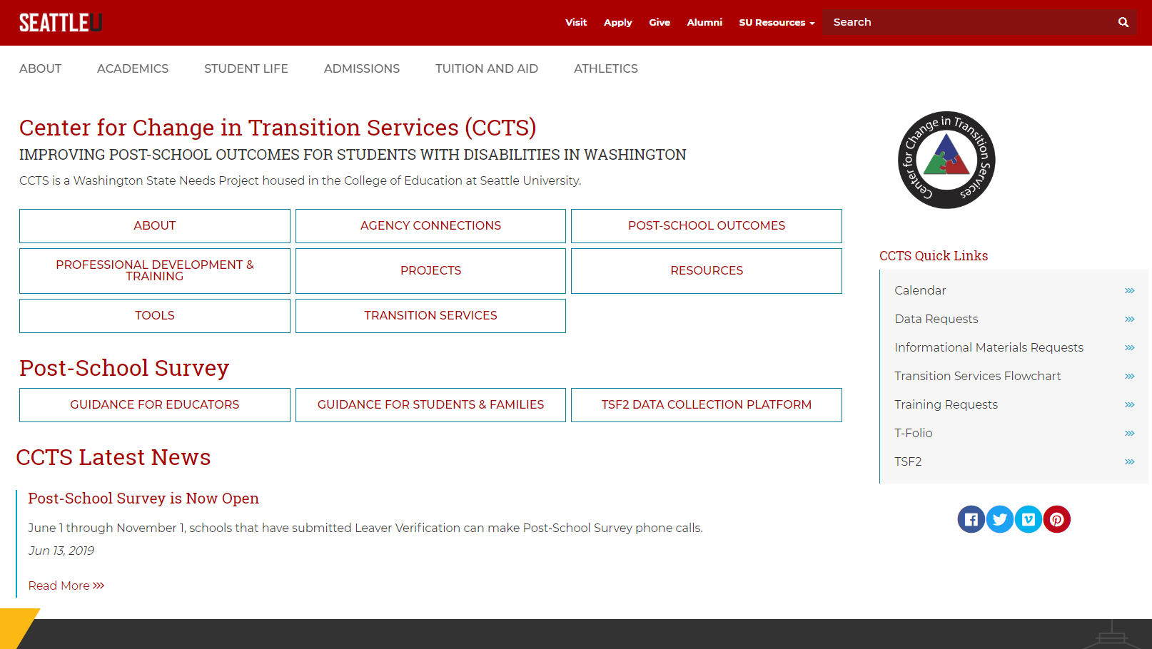
Screenshot: CCTS home page
Notes:
Everything can be linked to from the CCTS website.
If you visit www.seattleu.edu/ccts, on the main page, about midway down, there’s a heading that says Post-School Survey.
From there you can link to the Guidance for Educators page, Guidance for Students and Families, and to the TSF2 data collection platform.
We want to highlight what’s on each of these pages, in hopes that when you need to find something, you’ll know where to look.

Slide 24
CCTS Website: Guidance for Students and Families
Guidance for Students and Families page includes:
Answers to frequently asked questions
Downloadable materials:
  Student and Family Guide (PowerPoint and PDF)
  One-page handout in English and Spanish (Word and PDF)
Use these materials to prepare students for the survey before they leave high school.
Notes:
Let’s start with the newest page and information.
The Guidance for Students and Families page includes links to resources that can be shared with students before they leave high school.
The page itself includes answers to some common questions about they survey, like how to prepare, and what is this information used for?
Those questions are expanded on in a PPT presentation, and also available in a handout format in English and Spanish.
We have them available in PDFs, but also PPT and Word docs so that you can edit them and make them your own.

Slide 25
CCTS Website: Guidance for Educators
Guidance for Educators page includes:
Survey dates
Important links:
  TSF2
  Post-School Survey Training Materials Google Drive folder
  Upcoming and archived training webinars
Download Guidance for Students and Families materials
Download Student Contact Form
Request Post-School Survey reminder postcards
Notes:
The guidance for Educators page is meant for people who have accounts in the TSF2 and some sort of role in the Post-School Survey.
It includes all the essential information: survey dates, links to the TSF2, links to the training materials folder in google drive, which we’ll explore next, and links to our training webinars.
There are also links to all of the materials that were on the Guidance for Students and Families page.
In addition, we have a sample student contact form that you can use to collect information from students before they leave high school, and you can request post-school survey reminder postcards.

Slide 26
PSS Training Materials Google Drive Folder
All Users
Conduct Survey
District Manager
Leaver Verification
Notes:
We mentioned that there is a Post-School Survey Google Drive folder with links to training materials and documents.
If you email CCTS with questions, chances are we’re going to send you a link to this folder and ask that you take a look at these materials first.
There’s a folder with materials that are relevant to all users, and then we’ve broken down the other materials by user role.
If you have multiple user roles, you may need to find instructions in different folders.
But these are here for you to download, print, or copy to your own Google Drive.
Let’s take a look inside each folder.

Slide 27
Google Drive Folder – All Users
All Users folder in Google Drive includes:
Post-School Outcome Terms and Definitions
Post-School Survey Calendar
User Roles and Permissions
Notes:
The All Users folder includes the Calendar and Permissions document you all have on your tables.
It also has a list of terms and definitions related to post-school outcome reporting.
It’s not an exhaustive list of vocabulary words, as it’s meant for anyone who is viewing reports, but there are some good essentials that you should be familiar with.

Slide 28
Google Drive Folder – Leaver Verification (LV)
Leaver Verification Folder in Google Drive includes:
Post-School Survey Guidance: LV (one page document)
Webinar PPT and PDF: Submitting Leaver Verification, Part 1
Webinar PPT and PDF: Submitting Leaver Verification, Part 2
TSF2 How-To: LV
Notes:
Then we get into folders that are broken down by user role.
The contents are pretty much mirrored in each folder.
There’s a one page Guidance document for that user role.
There are the PowerPoint files for each of the webinars we’ve done around that user role.
The PPTs also include a rough script in the notes section, so if you don’t want to listen to the PPT recording, you can click through the slides and read the information that was shared.
And then finally, there’s a how-to document with step by step instructions for all actions in the TSF2 related to that user role.
If you want to know how to delete a survey, go to the TSF2 How-To for Leaver Verification or to the Webinar PPT, Part 1, and the instructions are listed for you.

Slide 29
Google Drive Folder – Conduct Survey (CS)
Conduct Survey Folder in Google Drive includes:
Post-School Survey Guidance: CS (one page document)
Webinar PPT and PDF: Conducting the Survey, Part 1
Webinar PPT and PDF: Conducting the Survey, Part 2
TSF2 How-To: CS
Notes:
The Conduct Survey folder will look very similar.
There’s a one-page summary of the roles and responsibilities, webinar PPTs and PDFs, and TSF2 How-Tos for conducting the survey.

Slide 30
Google Drive Folder – District Manager (DM)
District Manager Folder in Google Drive includes:
Post-School Survey Guidance: DM (one page document)
TSF2 How-To: DM
Notes:
The DM folder has the one-page summary and TSF2 How-To’s.
We haven’t done a webinar for DMs yet, but we might do that in the fall, and the PPT would live here.

Slide 31
TSF2: Guidance
TSF2 Guidance page includes information that is also available on the CCTS Guidance for Educators page:
Survey dates
Important links:
  Post-School Survey Training Materials Google Drive folder
  Upcoming and archived training webinars
Notes:
It’s also worth mentioning that when you login to the TSF2, there’s a page that’s called Guidance.
This page includes some but not all of the same information on the CCTS website.
It includes the survey dates and links to the Google Drive folder and webinars.
Just the training essentials.

Slide 32
Questions for CCTS
Survey Processes
TSF User Roles
Available Resources
Notes:
Are there any questions about the information we’ve covered today?

Slide 33
Questions for participants
Five real-life scenarios
Notes:
We have a few questions for you.
We have five common scenarios that have occurred with TSF2 users.
Names and identities have been changed, but the circumstances are real.
We want to know how you would resolve these issues.

Slide 34
Scenario 1: Surveys in read-only mode after June 1
It’s June 1 and Charles Xavier is ready to start conducting the Post-School Survey for Xavier Institute.
Charles notices that the Post-School Survey column on the Leaver Survey List page says read only.
Why is this happening?
What steps should be taken to start making survey phone calls?
Notes:
Question:
It’s June 1 and Charles Xavier is ready to start conducting the Post-School Survey for Xavier Institute.
However, Charles notices that the Post-School Survey column on the Leaver Survey List page says read only.
Why is this happening?
What steps should be taken to start making survey phone calls?

Slide 35
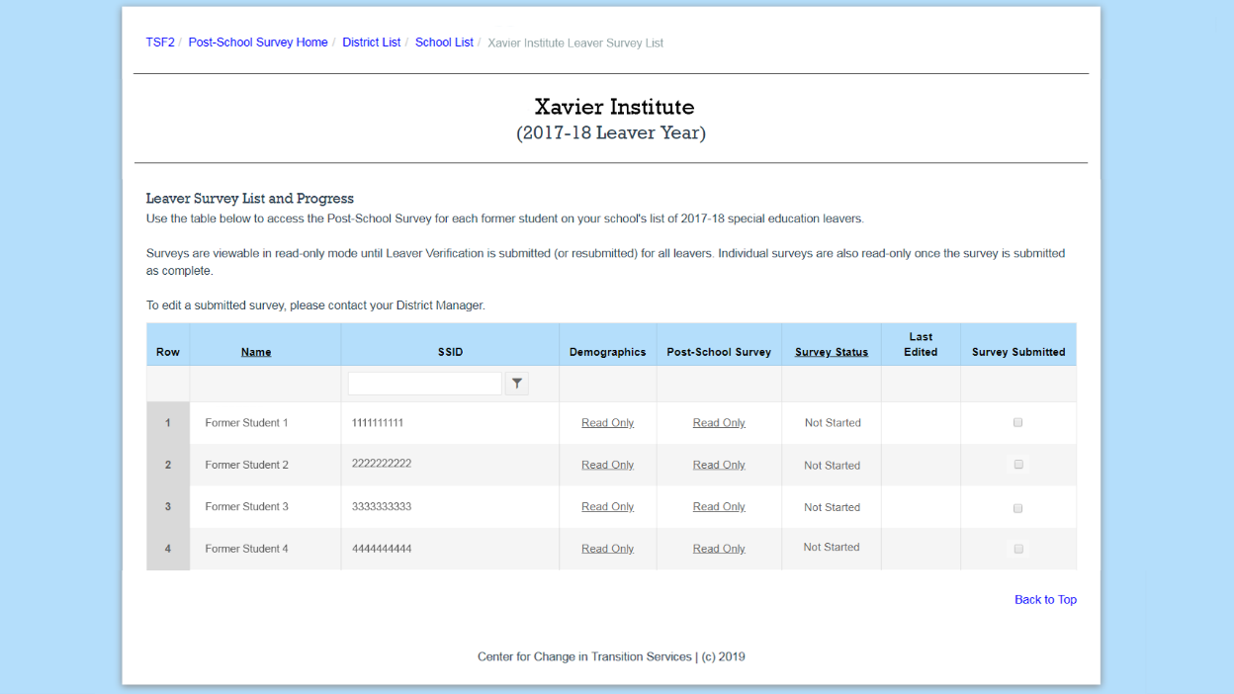
Scenario 1: Screenshot
Image: screenshot of Leaver Survey List in read-only mode.
Notes:
Answer:
Leaver verification has not been submitted.
Since Charles has a Conduct Survey user role, they should contact their DM to resolve the issue.
If Charles had a LV or DM user role, then they could follow instructions to review and edit leaver demographics and submit leaver verification.

Slide 36
Scenario 2: Notification about leaver verification
Thor is a district manager for Asgard district.
Thor received several messages from CCTS that Asgard has one or more schools that have not submitted leaver verification.
Thor checks the School List page and sees all of the schools with leavers have been verified.
Why is Thor receiving these messages from CCTS?
What should Thor do to resolve this?
Notes:
Question:
Thor is a district manager for Asgard district.
Thor received several messages from CCTS that Asgard has one or more schools that have not submitted leaver verification.
Thor checks the School List page and sees all of the schools with leavers have been verified.
Why is Thor receiving these messages from CCTS?
What should Thor do to resolve this?

Slide 37
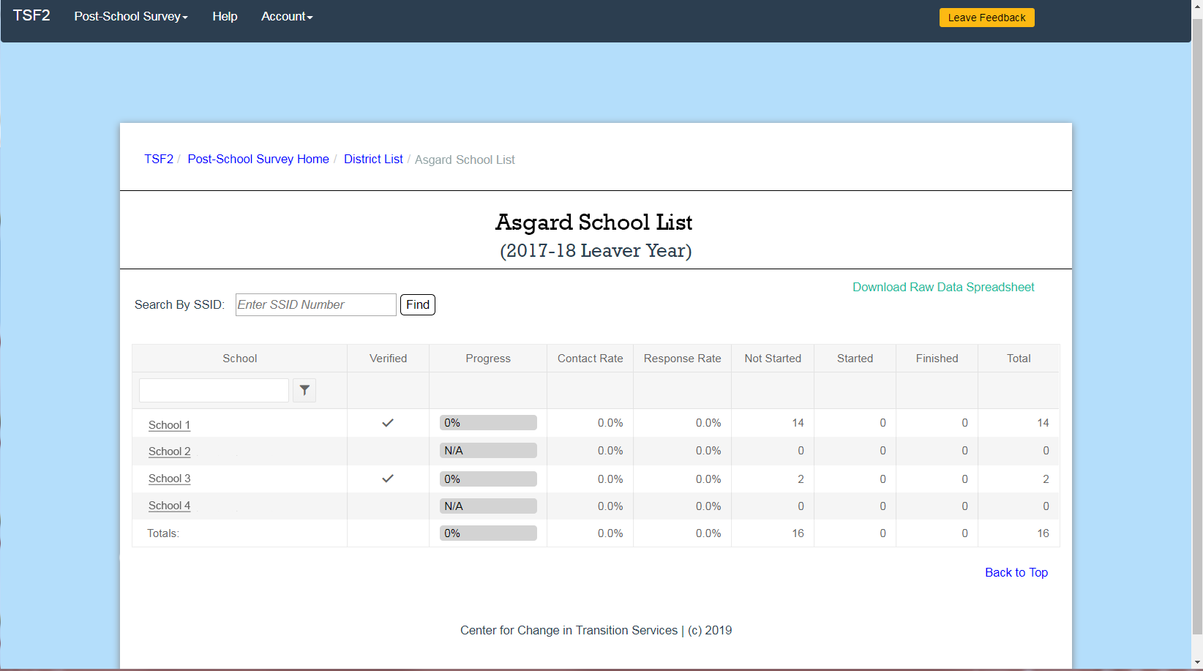
Scenario 2: Screenshot
Image: screenshot of school list page with four schools listed. There are checkmarks in the Verified column for the two schools with leavers. There are no checkmarks for the two schools with no leavers.
Notes:
Answer:
Not all the schools have submitted leaver verification.
Thor also needs to submit verification for the schools that have zero leavers.

Slide 38

Scenario 3: TSF2 user roles
Black Widow doesn’t know what training materials to review, because they don’t know what user role they have in the TSF2.
How can they find out?
Notes:
Question:
Black Widow doesn’t know what training materials to review, because they don’t know what user role they have in the TSF2.
How can they find out?
Answer:
Black Widow should ask their district manager.
If they don’t know who that is, they can contact CCTS.

Slide 39
Scenario 4: Logging in to the TSF2
Hulk hasn’t conducted the Post-School Survey in a few years.
Hulk goes to the TSF2 login page and enters their email address and makes a guess at their password.
Hulk gets as error message that says “username or password mismatch.”
Hulk clicks on link that says “reset your password,” but nothing happens.
Why can’t Hulk reset their password?
What steps can Hulk take to successfully log in to the TSF2?
Notes:
Question:
Hulk hasn’t conducted the Post-School Survey in a few years.
Hulk goes to the TSF2 login page and enters their email address and makes a guess at their password.
They get an error message that says username or password mismatch.
Hulk tries a few more times and gets the same result.
Then hulk clicks on link that says reset password.
Nothing happens.
Why can’t Hulk reset their password?
What steps can Hulk take to successfully log in to the TSF2?

Slide 40
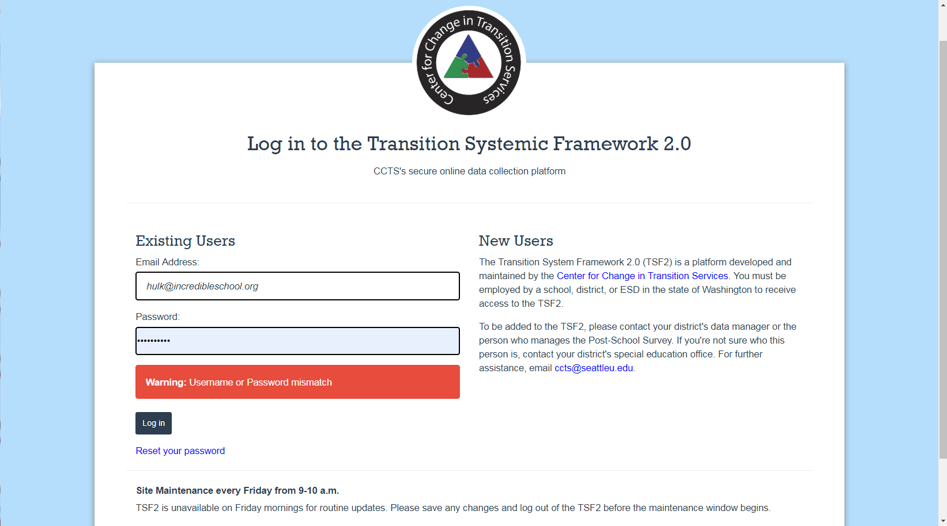
Scenario 4: Screenshot
Image: screenshot of TSF2 login screen with error message “username or password mismatch”
Notes:
Answer:
This is happening because Hulk has either never logged into the TSF2 before or they do not have an account.
The first thing they need to do is check with their district manager to see if they have an account.
If they have an account but have never logged in (last login date = not available), the district manager can send a password reset email.
If they do not have an account, their district manager can add them.

Slide 41

Scenario 5: Guidance Materials
Iron Man is new to Malibu and
has been told they’re in charge
of the Post-School Survey.
Iron Man doesn’t know what this is.
Where should Iron Man look for help?
Notes:
Question:
Iron Man is new to Malibu and has been told they’re in charge of the Post-School Survey.
Iron Man doesn’t know what this is.
Where should Iron Man look for help?
Answer:
Start on the Guidance for Educators page on the CCTS website.

Slide 42
Next Steps

Slide 43
Reminders
June 1-November 1: Survey open
Future Webinars, Survey Tutorials TBD, 3pm
  August 22
  September 19
  October 17
Mid-December: Final post-school outcome reports available
Notes:
The survey is currently open and will remain open through November 1 at 11:59 p.m.
Future webinars will be held later in the summer and fall on topics to be determined.
We’ll see how the survey process is going for folks, and try to address any specific issues at those times.
If you have any special requests, please let us know.
Those will take place on August 22, September 19, and October 17 at 3pm.
And finally, looking farther down the road, we’ll have final reports available in the TSF2 in mid-December.

Slide 44
For more information
Visit the Guidance for Educators Page on the CCTS website
Join us for our next training webinar: August 22, 2019
Contact CCTS
  ccts@seattleu.edu
  206-296-6494
Notes:
Thank you so much for being here today.
Remember that links to all of our training materials can be found on the Guidance for Educators page on the CCTS website.
Please join us for our next webinar on August 22.
And email ccts@seattleu.edu if you have questions that come up as you prepare and conduct the survey.

Slide 45
Thank you

Slide 46

Creative Commons License
Except where otherwise noted, content in this presentation is licensed under a Creative Commons Attribution 4.0 International license. All logos and trademarks are property of their respective owners.
You may share and adapt this material, but you must give appropriate credit, provide a link to the license, and indicate if changes were made.
Notes:
Unless otherwise noted, the material in this presentation is licensed under a Creative Commons Attribution 4.0 International license. All logos and trademarks are property of their respective owners. You may share and adapt this material, but you must give appropriate credit, provide a link to the license, and indicate if changes were made.

Slide 47
OSPI Disclaimer
This training is meant to supplement, not supplant reading bulletins and accompanying documents; guidance from the U.S. Department of Education; chapter 392-172A WAC; Part 300 of the federal regulations; and, the Individuals with Disabilities Act.
This presentation and/or materials should be viewed and applied by users according to their specific needs. The presentation should be used as guidance and is not intended as legal advice.
Notes:
One final disclaimer from the Office of the Superintendent of Public Instruction. This training is meant to supplement, not supplant reading bulletins and accompanying documents; guidance from the U.S. Department of Education; chapter 392-172A WAC; Part 300 of the federal regulations; and, the Individuals with Disabilities Act. This presentation and/or materials should be viewed and applied by users according to their specific needs. The presentation should be used as guidance and is not intended as legal advice.

