Slide 1
Using Post-School Outcome Data for Program Planning
Center for Change in Transition Services (CCTS)
Improving post-school outcomes for students with disabilities in Washington state
www.seattleu.edu/ccts

Slide 2
Agenda
Overview of Post-School Survey
How to interpret post-school outcome (PSO) data
Explore data
  State data
  District/ESD data
Using data for program planning
Notes:
Highlight that PSO is acronym using during presentation

Slide 3
Post-School Survey Overview

Slide 4
Federal Collection & Reporting
Requirement
  States collect data and report to the Office of Special Education Programs (OSEP) on a series of performance indicators.
Purpose
  Increased emphasis on accountability in education
  Determine how well the state is meeting its responsibility under the Individuals with Disabilities Education Act (IDEA)
  System improvement
Notes:
(read)
We are focusing on system and program improvement today, and the post-school outcome data can help guide our efforts

Slide 5
Critical Interrelationship of Indicators
Four of the IDEA indicators relate to secondary transition. These indicators also correlate with one another.
Quality IEPs – Indicator 13
Staying in school – Indicator 2
Graduating – Indicator 1
Positive post-school outcomes – Indicator 14
(Kohler, Gothberg, & Hill, "NSTTAC Evaluation Toolkit", 2009)
Notes:
There is an important interrelationship among the indicators;
Quality IEPs lead to Staying in school, which leads to graduation, and better post-school outcomes.

Slide 6
Data Collection
How are post-school outcome (PSO) data collected?
What data are reported?
Notes:
I’m going to briefly walk through how post-school outcome data are collected and what data are reported

Slide 7
How are PSO Data Collected?
The annual Post-School Survey takes place one year after students exit high school by way of graduation, dropping out, or ageing out.
  Phone calls are conducted by district/school personnel, June 1-November 1.
  Data are recorded in the Transition Systemic Framework 2.0 (TSF2), CCTS’s secure online data collection platform.
  A minimum of three contact attempts are required.
CCTS provides district/school with technical assistance as needed.

Slide 8
What Data are Collected?
Demographics (e.g., gender, disability, race/ethnicity)
Work and school experiences
Type of job or school
Number of hours working or in school
Contact with agencies
Wages
Optional open-ended questions

Slide 9
Raw data: Open-ended follow-up questions
Are there additional reasons why:
  You didn’t work more days (for those who didn’t work 90 days)?
  You didn’t work more hours (for those working less than 20 hours)?
  You didn’t complete a term (for those not enrolled at least one term)?
About how much was your average hourly wage?
I see you left high school before graduating. Are you willing to tell me why?
Notes:
The information in the raw data can provide some additional direction for your questions or hypotheses.

Slide 10
What additional information is in raw data?
Agency connections for each former student:
  Whether they contacted a state agency
  If so, which agency (e.g., DVR, DDA, etc)
Responses to individual questions:
  Whether former student made minimum wage
  Number of hours worked
  School attending
  Program of study
  Job title, company

Slide 11
Limitations of survey data
Self-reported data
Not observational, verifiable
Responses depend upon question phrasing
Missing data
  Refusal to participate
  Questions left unanswered
  Unable to reach leavers
Descriptive data
Notes:
There are some limitations to survey data that I want you to keep in mind as we review the PSO data.
Self-report: dependent on what individuals share with the interviewer
So it’s not observational or verifiable
There have been studies that have shown that results to surveys change depending on how questions are phrased.
There is always missing data, so we have to ask ourselves who are we not hearing from with these results. People might refuse to participate, they might not want to answer all questions, or leavers might be difficult to reach. For example, statewide our respondents are not representative of leavers who have dropped out because those leavers are difficult for school districts to reach.
Finally, data are descriptive. We do not run statistical analyses on these data to determine if differences in outcomes are significant, or beyond chance.

Slide 12
Post-School Outcomes
Terms and Definitions
Notes:
Going to briefly run through our terms and definitions to orient you. There are more details on this in your packets of the post-school outcomes for your district or ESD

Slide 13
Commonly Used Terms for 2016-17 Leaver Year
Leaver: Youth ages 16-21 with an IEP who left school by graduating with a diploma, aging out, dropping out, or who were expected to return and did not.
  Graduated: Any leaver that left school with a diploma.
  Dropped out: Any leaver that left school without a diploma. This includes students who aged out or received a GED or adult high school diploma*.
Responder/Respondent: Young adult leavers or their designated family member who answered the survey interview questions.
Notes:
These are the state’s definitions. *Adult High school diploma is not considered dropping out for the 2017-2018 leaver year.

Slide 14
PSO – Any Engagement vs. No Engagement
Any Engagement: leaver falls into one of the following categories
  Higher education
  Competitive employment
  Other postsecondary education or training
  Some other employment
No Engagement: leaver does not meet reporting requirements for any of the above categories.
The five PSO categories are further defined on the following slides.
Notes:
These are rank ordered 1-4. So if a leaver is engaged in multiple categories, they will just be counted in the highest category of engagement. For example, if a leaver is enrolled in a 2 year college and working, they will just be counted as engaged in Higher Education.

Slide 15
Higher Education
Enrolled full- or part-time
Community college (two-year) program
College/university (four- or more year) program
At least one complete term
(National Technical Assistance Center on Transition, 2018)

Slide 16
Other Postsecondary Education/Training
Enrolled full- or part-time
Education or training program (e.g., adult education, vocational technical school that is less than a two-year program)
At least one complete term
(National Technical Assistance Center on Transition, 2018)
Notes:
Although Other Education/training is rank ordered third I’m reviewing them out of order here so you can see the contrast with higher education. Just like for higher education, a leaver must be enrolled at least a term and can be enrolled full or part time. The difference is other education or training is a non- 2 year or 4- year college. So this includes training programs, certificate programs that are less than two years, adult education, vocational or technical schools

Slide 17
Competitive Employment
Worked for pay at or above minimum wage
Setting with others who are nondisabled
20 hours or more a week
At least 90 days at any time in the year since leaving high school
Includes military employment
(National Technical Assistance Center on Transition, 2018)
Notes:
(read criteria)

Slide 18
Some Other Employment
Worked for pay or has been self-employed
At least 90 days at any time in since leaving high school
Includes working in a family business. (e.g., farm, store, fishing, ranching, catering services, etc.)
(National Technical Assistance Center on Transition, 2018)
Notes:
(Read criteria.)
So the main difference between being competitively employed and engaged in some other employment is that for competitive employment the leaver must be making at least minimum wage and working at least 20 hours per week. There is no wage or hour requirement for some other employment
In addition, the setting for competitive employment is with other employees who are non-disabled. So, although this is less common now, a leaver working in sheltered employment would be counted in this category of other employment.

Slide 19
No Engagement
Leaver does not fall into one of the previous employment or education categories.
The “not engaged” leaver may have had some education or employment experience, but for less time than the minimum period required for reporting.
Notes:
(Read slide)
All the education and employment categories have a minimum time period required- at least one term for education and at least 90 days for employment. So, for example, a leaver might be engaged in work but if it’s for less than 90 days they would be counted as not engaged

Slide 20
Post-School Outcome
Charts and Tables, 2016-17
The following slides include a selection of the state-level charts available in the TSF 2.0 (www.cctsTSF.com).
Each set of charts is followed by a data table summary.
Notes:
So I’m going to go through and orient you to the state outcome data. My purpose is two-fold. So you can see how to interpret the various ways we report and present the data. Second, so you have an overview of the state data as after this we will break into groups and everyone will examine how their district or ESD compares to the state level data.

Slide 21
State – PSO Bar Chart
(CCTS 2019, Indicator 14 Post-School Outcome Mini-Report, Washington state, 2016-17)
Notes:
This chart shows the percentages of respondents in Washington state in each of the five Post-School outcome categories: Higher Education, Competitive Employment, Other Education/Training, Other Employment, and No Engagement.
Contact rate for state leavers was 80.6%, meaning districts were able to get in contact with 80.6% of leavers.
Response rate for the state was 78.5%. So 78% completed the survey. As I mentioned earlier, the lowest representative group is leavers who dropped out of school.
I want to remind you also of all the limitations of survey data. It really is only as good as who we reach. So, although it’s tempting to look at this graph and say that 27.8% of leavers are not engaged, in reality it’s 27.8% of leavers who took the survey. It’s just an important distinction to keep in mind as you look at interpreting results.

Slide 22
State – PSO Summary
Sample Size | Higher Education | Competitive Employment | Other Education | Other Employment | No Engagement
6475 | 21.3% | 34.8% | 3.0% | 13.1% | 27.8%
Notes:
Table of data from previous slide.
As I go through the data you’ll see a line or bar graph, and then a data table like this.
We want to make sure that individuals using screen readers are able to read our presentations.
This also provides specific percentages as those can be difficult to decipher in the charts.

Slide 23
Breaking Down PSO Data by Engagement
Post School Outcomes
No Engage-ment
Any Engagement
Higher Education
Competitive Employment
Other Education/Training
Other Employment
Notes:
In the following slides, Post-School Outcome data is first broken down by Any Engagement and No Engagement.
Then, Any Engagement is further broken down into the four engagement categories: Higher Education, Competitive Employment, Other Education/Training, and Other Employment.

Slide 24
State – Any Engagement vs. No Engagement, Five-Year Overview Line Graphs
(CCTS 2019, Indicator 14 Post-School Outcome Mini-Report, Washington state, 2016-17)
Notes:
These are line charts showing the five-year data points for respondents in Washington state. It should be noted that these are actual data points and lines do not represent trend lines, therefore these charts do not predict future outcomes. This holds true for all the five-year overview charts we will look at on the next slides
These charts show overall engagement (orange) and non-engagement (yellow).
Again, Any Engagement means the respondent falls into any of the four post-secondary education or employment outcome categories, further detailed in the next set of charts.
So you can see that over the past 5 years, engagement rates have been slowly increasing, while Non-Engagement (which is essentially the inverse of engagement) has been slowly declining

Slide 25
State – Any Engagement vs. No Engagement, Five-Year Overview Summary
Leaver Year | Sample Size | Any Engagement | No Engagement
2016-17 | 6475 | 72.2% | 27.8%
2015-16 | 6081 | 72.2% | 27.8%
2014-15 | 6153 | 70.5% | 29.5%
2013-14 | 5717 | 67.4% | 32.6%
2012-13 | 5348 | 65.2% | 34.8%
Notes:
Table of data from previous slide.
Again, in 2012-2013 we had an engagement rate of 65.2%. In our latest leaver year that rate is 72.2%. You can also see from these data that this rate has remained the same statewide for the last two leaver years: 2015-2016 and 2016-2017

Slide 26
State – Engagement Outcomes, Five-Year Overview Line Graphs [1 of 2]
(CCTS 2019, Indicator 14 Post-School Outcome Mini-Report, Washington state, 2016-17)
Notes:
These are line charts showing the five year data points for respondents in Washington state who fall into the Higher Education and Competitive Employment categories.
So we can see that higher education has slightly decreased over the past 5 years, whereas competitive employment rates have slightly increased.
Any hypotheses as to why? (want them to begin to think about reasons)

Slide 27
State – Engagement Outcomes, Five-Year Overview Line Graphs [2 of 2]
(CCTS 2019, Indicator 14 Post-School Outcome Mini-Report, Washington state, 2016-17)
Notes:
These are line charts showing the five year data points for respondents in Washington state who fall into the Other Education/Training and Other Employment categories.
As a reminder, other education refers to non- two year or four year colleges. So technical programs, certificates, adult education.
Other employment refers to employment that is less than 20 hours per week or less than minimum wage. It also includes sheltered employment.
So, here it’s a bit difficult to determine the history with these graphs, but it appears that other education has been pretty steady whereas other employment rates have increased. Let’s look at the actual numbers quickly

Slide 28
State – Engagement Outcomes, Five-Year Overview Summary [1 of 2]
Leaver Year | Sample Size | Higher Education | Competitive Employment
2016-17 | 6475 | 21.3% | 34.8%
2015-16 | 6081 | 21.8% | 35.3%
2014-15 | 6153 | 22.1% | 33.4%
2013-14 | 5717 | 22.3% | 30.9%
2012-13 | 5348 | 23.8% | 28.4%
Notes:
So here’s the data from the previous graphs, showing that overall higher education has decreased slightly whereas competitive employment increased.
I want to highlight that these are descriptive data. First, we don’t know that there’s really a meaningful difference between, for example, the 21.8% higher education rate in 2015-2016 and the 21.3% rate in 16-17. We haven’t run more advanced statistical analyses on things like this. That difference, for example, may be due to the % of leavers who responded or just due to chance.
Second, although it’s really tempting to look at these as trends in the data, it’s not statistically valid to do so. Just because there was a slight dip last year doesn’t mean that is a trend will continue. That would be a different statistical analysis- we are just describing the survey results.

Slide 29
State – Engagement Outcomes, Five-Year Overview Summary [2 of 2]
Leaver Year | Sample Size | Other Education/ Training | Other Employment
2016-17 | 6475 | 3.0% | 13.1%
2015-16 | 6081 | 2.9% | 12.2%
2014-15 | 6153 | 3.3% | 11.6%
2013-14 | 5717 | 3.2% | 11.0%
2012-13 | 5348 | 3.3% | 9.8%
Notes:
If you recall it was difficult to tell the overview of other education and other employment in the graph. We can see here it’s bounced around a bit for other education/training, with the last two years being the lowest at 2.9 and 3%. The rate of other employment did increase approximately 3 percentage points over the past five years.
Any hypotheses or ideas on why this might be?
Just things that come to mind- we may not be able to answer them

Slide 30
Outcomes by demographic categories
Notes:
In the following slides we will review the outcomes by exit categories, gender categories, race/ethnicity categories, and disability categories.

Slide 31
State – Any Engagement vs. No Engagement by Exit Categories Bar Charts
*Includes students who aged out or received an adult high school diploma or GED.
(CCTS 2019, Indicator 14 Post-School Outcome Mini-Report, Washington state, 2016-17)
Notes:
These two charts illustrate the percentage of respondents, by Exit Categories, who fall into the Any Engagement and No Engagement categories.
So, not surprisingly we can see that leavers who graduated are engaged at a much higher rate than students who dropped out, 77% versus 51%

Slide 32
State – Any Engagement vs. No Engagement by Exit Categories Summary
Exit Category | Sample Size | Any Engagement | No Engagement
Graduated | 5219 | 77.2% | 22.8%
Dropped Out* | 1256 | 51.1% | 48.9%
*Includes students who aged out or received an adult high school diploma or GED.
Notes:
Table of data from previous slide.

Slide 33
State – Engagement Outcomes by Exit Categories Bar Charts [1 of 2]
*Includes students who aged out or received an adult high school diploma or GED.
(CCTS 2019, Indicator 14 Post-School Outcome Mini-Report, Washington state, 2016-17)
Notes:
So of those leavers who are engaged, these two charts illustrate the percentage of respondents, by Exit Categories, who fall into the Higher Education and Competitive Employment.
We can see in both categories graduates fare better than non-grads. Not surprisingly this is more so in higher education

Slide 34
State – Engagement Outcomes by Exit Categories Bar Charts [2 of 2]
*Includes students who aged out or received an adult high school diploma or GED.
(CCTS 2019, Indicator 14 Post-School Outcome Mini-Report, Washington state, 2016-17)
Notes:
These two charts illustrate the percentage of respondents, by Exit Categories, who fall into the Other Education/Training and Other Employment categories.
Interestingly, the students who dropped out have higher rates of engagement in these other categories.
Any thoughts or hypotheses on why that would be?
(thought/idea: students drop out because they have jobs or want to engage in other training… but these jobs may tend to be non- competitive employment due to wage or hours)

Slide 35
State – Engagement Outcomes for Exit Categories Summary
Exit Category | Sample Size | Higher Education | Competitive Employment | Other Education | Other Employment
Graduated | 5219 | 25.5% | 36.3% | 2.8% | 12.7%
Dropped Out* | 1256 | 4.1% | 28.3% | 3.9% | 14.7%
*Includes students who aged out or received an adult high school diploma or GED.
Notes:
Table of data from previous slides.

Slide 36
State – Any Engagement vs. No Engagement by Gender Categories Bar Charts
(CCTS 2019, Indicator 14 Post-School Outcome Mini-Report, Washington state, 2016-17)
Notes:
These two charts illustrate the percentage of respondents, by gender categories, who fall into the Any Engagement and No Engagement categories.
You can see that for the state, there’s not a huge gap however it appears leavers who fall into the male category have higher engagement than those falling into the female category

Slide 37
State – Any Engagement vs. No Engagement by Gender Categories Summary
Gender Category | Sample Size | Any Engagement | No Engagement
F | 2349 | 71.1% | 29.0%
M | 4126 | 72.8% | 27.2%
Notes:
Table of data from previous slide.

Slide 38
State – Engagement Outcomes by Gender Categories Bar Charts [1 of 2]
(CCTS 2019, Indicator 14 Post-School Outcome Mini-Report, Washington state, 2016-17)
Notes:
Once we break down engagement into our outcome categories, we see more differences between the male and female categories. Those in the female category are engaged in higher education at a rate of 25.8% whereas those in the male category are engaged at a rate of 18.8%
The opposite is true for competitive employment. 37.5% of those in the male category are competitively employed versus 29.9% of those in the female category.

Slide 39
State – Engagement Outcomes by Gender Categories Bar Charts [2 of 2]
(CCTS 2019, Indicator 14 Post-School Outcome Mini-Report, Washington state, 2016-17)
Notes:
These two charts illustrate the percentage of respondents, by gender categories, who fall into the Other Education/Training and Other Employment categories.
The two groups are pretty equal for other education at 3 and 3.1 percent.
For other employment, leavers in the male category are engaged at a 13.5 percent, whereas the female category is engaged in other employment at 12.2%

Slide 40
State – Engagement Outcomes for Gender Categories Summary
Gender Category | Sample Size | Higher Education | Competitive Employment | Other Education | Other Employment
F | 2349 | 25.8% | 29.9% | 3.1% | 12.2%
M | 4126 | 18.8% | 37.5% | 3.0% | 13.5%
Notes:
Table of data from previous slides.

Slide 41
State – Any Engagement vs. No Engagement by Race/Ethnicity Categories Bar Charts
(CCTS 2019, Indicator 14 Post-School Outcome Mini-Report, Washington state, 2016-17)
Notes:
These two charts illustrate the percentage of respondents, by race/ethnicity categories, who fall into the Any Engagement and No Engagement categories.
This and disability type are where it gets a little trickier to interpret due to the number of categories.
For engagement, the lowest rates are leavers in the categories of American Indian/Native Alaskan at 58.7% followed by multiracial at 69.3%. The highest rates of engagement are Black/African American at 77.1% followed by Asian at 75%
Any hypotheses or thoughts on this?
(we thought interesting that black/African American and Hispanic/latino leavers had higher engagement than white leavers. This is our first year looking at any engagement as an outcome category. Looking back that has been the case for 4 of the past 5 years.)

Slide 42
State – Any Engagement vs. No Engagement by Race/Ethnicity Categories Summary
Race/Ethnicity Category | Sample Size | Any Engagement | No Engagement
American Indian/Native Alaskan | 184 | 58.7% | 41.3%
Asian | 228 | 75.0% | 25.0%
Black/African American | 406 | 77.1% | 22.9%
Hispanic/Latino | 1436 | 74.1% | 25.9%
Caucasian/White | 3728 | 71.7% | 28.3%
Native Hawaiian/Pacific Islander | 54 | 74.1% | 25.9%
Of more than one race/multiracial | 430 | 69.3% | 30.7%
Not provided | < 10 | 77.8% | 22.2%
Notes:
Table of data from previous slide.
I want to point out the sample size column here. The lower the number of leavers in a category the more variable the results. For example, if you only have say 15 leavers in a category then the results depend more upon the characteristics of the leavers that were sampled. This is especially relevant when looking at a district or ESD’s data as often there are low numbers in some categories. It makes it hard to draw reliable conclusions as it may really vary from year to year based on the characteristics of that group.
Finally, as you can see in the not provided category there are less than 10 leavers. Due to confidentiality reasons we don’t report the actual number of leavers in a group if there are less than 10.

Slide 43
State – Engagement Outcomes by Race/Ethnicity Categories Bar Charts [1 of 2]
(CCTS 2019, Indicator 14 Post-School Outcome Mini-Report, Washington state, 2016-17)
Notes:
These two charts illustrate the percentage of respondents, by race/ethnicity categories, who fall into the Higher Education and Competitive Employment categories.
For higher education, the categories of Asian, Black/African American, and multi-racial had the highest rates of engagement.
For competitive employment, the categories of Native Hawaiian/Pacific Islander, Hispanic, and White had the highest rates.
Any hypotheses or thoughts on this?
(Thoughts/Ideas:
Asian students are typically always highest for higher ed;
Statewide: (all students in gen ed/sped) 60.5% of black/African American and 60.5% of white students attend college; whereas 50% of hispanic./latino students attend. So these results don’t exactly mimic those, but not entirely off either especially as all is survey data
It’s possible there’s an issue of representation- are minority students over-represented in special education when they shouldn’t be, therefore they do “better” than a typical special education graduate? This is called disproportionality and it’s something commonly reported in the literature)

Slide 44
State – Engagement Outcomes by Race/Ethnicity Categories Bar Charts [2 of 2]
(CCTS 2019, Indicator 14 Post-School Outcome Mini-Report, Washington state, 2016-17)
Notes:
These two charts illustrate the percentage of respondents, by race/ethnicity categories, who fall into the Other Education/Training and Other Employment categories.
It appears that American Indian/Native Alaskan, Black/African American and Caucasian/White leavers are engaged in other education at the highest rates.
For other employment, the highest percentages are for Black/African American, Native Hawaiian/Pacific Islander, and Hispanic leavers.

Slide 45
State – Engagement Outcomes by Race/Ethnicity Categories Summary
Race/Ethnicity Category | Sample Size | Higher Education | Competitive Employment | Other Education | Other Employment
AIAN | 184 | 14.7% | 31.5% | 4.4% | 8.2%
Asian | 228 | 36.8% | 22.8% | 2.6% | 12.7%
Black | 406 | 25.1% | 30.1% | 3.7% | 18.2%
Hispanic | 1436 | 20.7% | 37.9% | 1.7% | 13.8%
White | 3728 | 20.7% | 35.1% | 3.5% | 12.4%
NHPI | 54 | 7.4% | 50.0% | 0.0% | 16.7%
Two or more races | 430 | 21.4% | 31.9% | 3.0% | 13.0%
Not provided | < 10 | 11.1% | 44.4% | 11.1% | 11.1%
Notes:
Table of data from previous slides.

Slide 46
State – Any Engagement vs. No Engagement by Disability Categories Bar Charts
(CCTS 2019, Indicator 14 Post-School Outcome Mini-Report, Washington state, 2016-17)
Notes:
The two charts illustrate the percentage of respondents, by disability categories, who fall into the Any Engagement and No Engagement categories.
By disability type, statewide leavers with our more high incidence disabilities, Specific Learning Disability and Other Health Impairment, are engaged at the highest rates. This is followed by sensory impairment (so hearing or visual impairments) and autism

Slide 47
State – Any Engagement vs. No Engagement by Disability Categories Summary
Disability Category | Sample Size | Any Engagement | No Engagement
Emotional / Behavioral Disability | 307 | 60.6% | 39.4%
Other Health Impairments | 1682 | 72.4% | 27.6%
Specific Learning Disability | 3172 | 79.5% | 20.5%
Intellectual Disability | 392 | 50.5% | 49.5%
Sensory Impairments | 89 | 68.5% | 31.5%
Autism | 540 | 64.3% | 35.7%
Other Disability | 293 | 48.1% | 51.9%
Notes:
Table of data from previous slide.

Slide 48
State – Engagement Outcomes by Disability Categories Bar Charts [1 of 2]
(CCTS 2019, Indicator 14 Post-School Outcome Mini-Report, Washington state, 2016-17)
Notes:
The two charts illustrate the percentage of respondents, by disability categories, who fall into the Higher Education and Competitive Employment categories.
Sensory Impairment and Autism make up the highest percentages in higher education, following by SLD and OHI
For competitive employment, 42% of SLD leavers were competitively employed, followed by 34% of OHI and 29% of EBD leavers.
Any thoughts/hypotheses there?

Slide 49
State – Engagement Outcomes by Disability Categories Bar Charts [2 of 2]
(CCTS 2019, Indicator 14 Post-School Outcome Mini-Report, Washington state, 2016-17)
Notes:
The two charts illustrate the percentage of respondents, by disability categories, who fall into the Other Education/Training and Other Employment categories.
In the other education category, the highest percentages are for sensory impairment at 7.9% and Autism at 5.2%
For other employment, leavers with ID were the highest category at 20.9% followed by Autism at 15%. This may be reflective of engagement in sheltered or supported employment, which typically occurs on a part time basis

Slide 50
State – Engagement Outcomes by Disability Categories Summary
Disability Category | Sample Size | Higher Education | Competitive Employment | Other Education | Other Employment
EBD | 307 | 12.7% | 29.3% | 4.6% | 14.0%
OHI | 1682 | 22.2% | 34.5% | 3.5% | 12.2%
SLD | 3172 | 23.0% | 42.4% | 2.0% | 12.2%
ID | 392 | 5.9% | 19.9% | 3.8% | 20.9%
SI | 89 | 29.2% | 22.5% | 7.9% | 9.0%
Autism | 540 | 27.4% | 16.7% | 5.2% | 15.0%
Other | 293 | 14.3% | 16.4% | 3.8% | 13.7%
Notes:
Table of data from previous slides.

Slide 51
What do your data tell you?

Slide 52
Examining your data: Compare with state data
How do your outcomes compare with state outcomes?
What changes have occurred over the past 5 years?
Which subgroups are doing comparatively well/worse?
Notes:
(Have participants look at their data packets and use the data interpretation table provided. Have them break into groups of 3 or 4)
Probing question: What is “success”?
(Move onto next slide to show an example, then click back to this one and leave on while groups work. Have groups share after 5-10 minutes)

Slide 53
Data Interpretation Worksheet (1)
What do the data show? | Hypotheses/ Questions | Data needed/ sources | Program Improvement
Leavers in my district are engaged at a lower rate than the state (65% vs. 72%). The main difference appears to be in competitive employment (19% vs. 35%)
Notes:
(read example)
(click back to slide 50 and leave up during group work)

Slide 54
Hypotheses/Questions
What are your hypotheses about the data?
Why do your district’s results differ from the state?
Why do outcomes for some subgroups differ?
Notes:
(Read slide)
(Click to next slide to show an example then back to this slide and leave up while groups discuss. Have groups brainstorm all the reasons for the data. Have them talk about eachother’s data, not only their own to come up with ideas. Have groups report after 5-10 minutes)

Slide 55
Data Interpretation Worksheet (2)
What do the data show? | Hypotheses/Questions | Data needed/ sources | Program Improvement
Leavers in my district are engaged at a lower rate than the state (65% vs. 72%). The main difference appears to be in competitive employment (19% vs. 35%) | Are there large differences between subgroups? What is our dropout rate? Is this impacting outcomes? What areas of transition services are we lacking? Are we providing enough community and work study experiences? Are we connecting students with appropriate agencies?
Notes:
(read example)
I encourage you to just brainstorm all questions/hypotheses
It doesn’t matter at the moment whether you have access to the data readily; often figuring out the data sources or resources takes some group discussion and investigation.
The hypotheses and questions may be specific- for example, what is dropout rate, or they may be more comprehensive, like what areas of transition services are we lacking?
(click back to slide 52 and leave up during group work)

Slide 56
What additional data are needed?
What data do you need to examine your hypotheses/questions?
Are these data readily available or do you need to collect data?
Can you use an evaluation tool?
Think about both system-level and student level data
Notes:
We are going to move onto the next column and get ideas for what data are needed. These could be data readily available at your school/district
These could be data that need to be collected
(For using an evaluation tool- let them know that you are going to show them a slide with some available tools)
(Click to next TWO slides: Example slide then overview of evaluation tools. Then click back to this slide and leave up while groups discuss. Have groups report after 5-10 minutes)

Slide 57
Data Interpretation Worksheet (3)
What do the data show? | Hypotheses/ Questions | Data needed/sources | Program Improvement
Leavers in my district are engaged at a lower rate than the state (65% vs. 72%). The main difference appears to be in competitive employment (19% vs. 35%) | Are there large differences between subgroups? What is our dropout rate? Is this impacting outcomes? What areas of transition services are we lacking? Are we providing enough community and work study experiences? Are we connecting students with appropriate agencies? | PSO data District level data vs. state Dropout vs. graduate engagement QuIST Discussion/survey/IEP review PSO data
Notes:
(Read through examples, discussing the hypothesis then the corresponding data needed. Highlight that you’ll talk about QuIST in next slide. That last question about agencies is something collected in our survey but not in our reports and we’ll review at the end of today’s presentation how to find these other data)

Slide 58
Evaluation Tools
Indicator 13: Transition IEP Review Tool
  Tool to evaluate whether all quality components of the transition IEP are present
QuIST: Quality Indicators for Secondary Transition
  The QuIST is a free program improvement tool that enables school districts to self-evaluate their transition services for students with disabilities.
NTACT Evaluation Toolkit
  Toolkit with resources to assist transition educators and service providers to improve their programs and services by determining what is working, what is not working, and what needs to be changed or replicated.
Notes:
These are some available data evaluation tools that look at transition; essentially these are measures to comprehensively look at how your school or district is doing in providing evidence based transition services.
(read examples)
So, as you go through your group process keep these in mind. You may not know exactly why your PSO appear as it is but you want to look comprehensively at how well your school/district is providing transition services. These are very helpful for that more global look.
(click back to slide 54 and leave up during group work)

Slide 59
Program improvement
What programs could be improved or targeted based on this information?
Keep in mind that data gathered may guide or change this
May be district-level, school-level, or student-level changes
Notes:
(Have participants refer to predictors by outcome areas document)- this may be useful for you to think about as you think about programming. This is from NTACT- the National Technical assistance center on Transition. This document outlines the predictors that have been shown in the research to be predictive of education and employment. So as you look at your outcome areas and gaps you may want to refer to this for programming ideas.
Keep in mind that this step may be a leap. Your data gathered will hopefully provide you more clarity around programming steps. I just want you to begin to think about what areas of transition this may impact, keeping in mind it may change and that’s OK.
(click to next two slides then back to this slide for group work. Have groups work then report back after 5-10 minutes)

Slide 60
What does the system need to support use of date for program improvements?
Administrative leader
Support for data collection
Teachers make the calls
Team review of data
Facilitator for review of data
Stories behind the data, “the heart part”

Slide 61
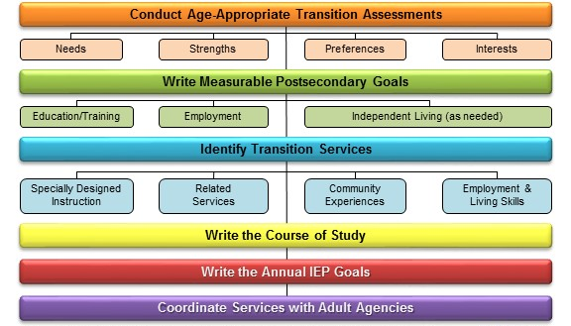
CCTS Transition Services Flow Chart
(Johnson, 2012)
Notes:
You may also want to refer to our flowchart for transition services as you consider program improvement ideas. This is in your materials. This can help guide you in making sure you are addressing all the components of effective transition in the students’ IEP. For example, your program improvement activity might be that all students receive an age- appropriate transition assessment.

Slide 62
Data Interpretation Worksheet (4)
What do the data show? | Hypotheses/ Questions | Data needed/ sources | Program Improvement
Leavers in my district are engaged at a lower rate than the state (65% vs. 72%). The main difference appears to be in competitive employment (19% vs. 35%) | Are there large differences between subgroups? What is our dropout rate? Is this impacting outcomes? What areas of transition services are we lacking? Are we providing enough community and work study experiences? Are we connecting students with appropriate agencies? | PSO data District level data vs. state Dropout vs. graduate engagement QuIST Discussion/survey/IEP review PSO data | ? Strategies to target dropout rate QuIST results will guide New curriculum, community and work-study sites Interagency collaboration efforts
Notes:
So, for my example, I’ve broadly outlined some potential program improvement efforts. For the first question, I’m not sure where that will lead and that’s OK. Asking the question and gathering the data is the first step, then the data results will guide you.
(click back to slide 57 and leave on during group work)

Slide 63
Implementation Resources
NTACT Predictor Implementation School/District Self-Assessment: Checklist to determine degree to which school/district is implementing practices that promote positive post-school outcomes
NTACT Toolkits: Collections of resources on a variety of transition-related topics, including Resource mapping, School based enterprise, Transition Assessment, and Transition Fairs
T-Folio: Free transition portfolio tool to guide youth in exploring, identifying, and planning for their desired post-school goals
Notes:
As you think about implementation, I just wanted to outline some resources for you to return to later.
NTACT predictor implementation school/district self-assessment: If you found the handout with predictors that correlate to outcome areas helpful, then this tool can help you break down each area further and see what gaps your school might have.
NTACT toolkits: group resources into areas you might want to explore for programming, such as…. (read)
T-Folio is our transition portfolio you may have heard about today and (read)

Slide 64
TSF2: Diving deeper into data
Notes:
(if you still have time can go into depth on this section or just show them it’s here and that they can go into the slides later to explore. The slides show how to view reports in the TSF2 for different views of the data, how to see contact and response rates, and how to get data from the other survey questions. If you just have a short period of time recommend going over slides 70-72 regarding what other data are in the PSO raw data)
As you work on strategic planning today or when you go back to your districts or ESD’s, I wanted to show you how you can dig a little deeper into the data on our online system, the TSF2

Slide 65
Reports in TSF2
www.cctstsf.com or www.cctstsf.org

Slide 66
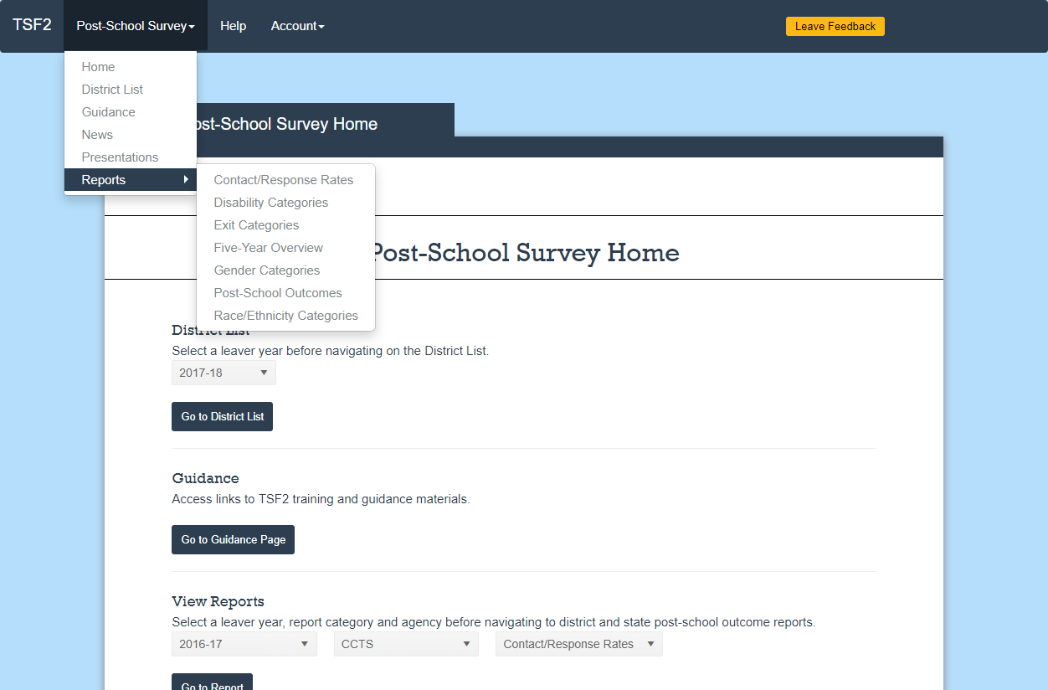
TSF2: Diving deeper into data: Screenshot 1
Notes:
Once I logged into the TSF2, you can see if I click on the top navigation bar for post-school survey, I can then go into reports, and then I can access the reports we reviewed today.
I wanted to show you a few other features that may help as you begin to examine your data.

Slide 67
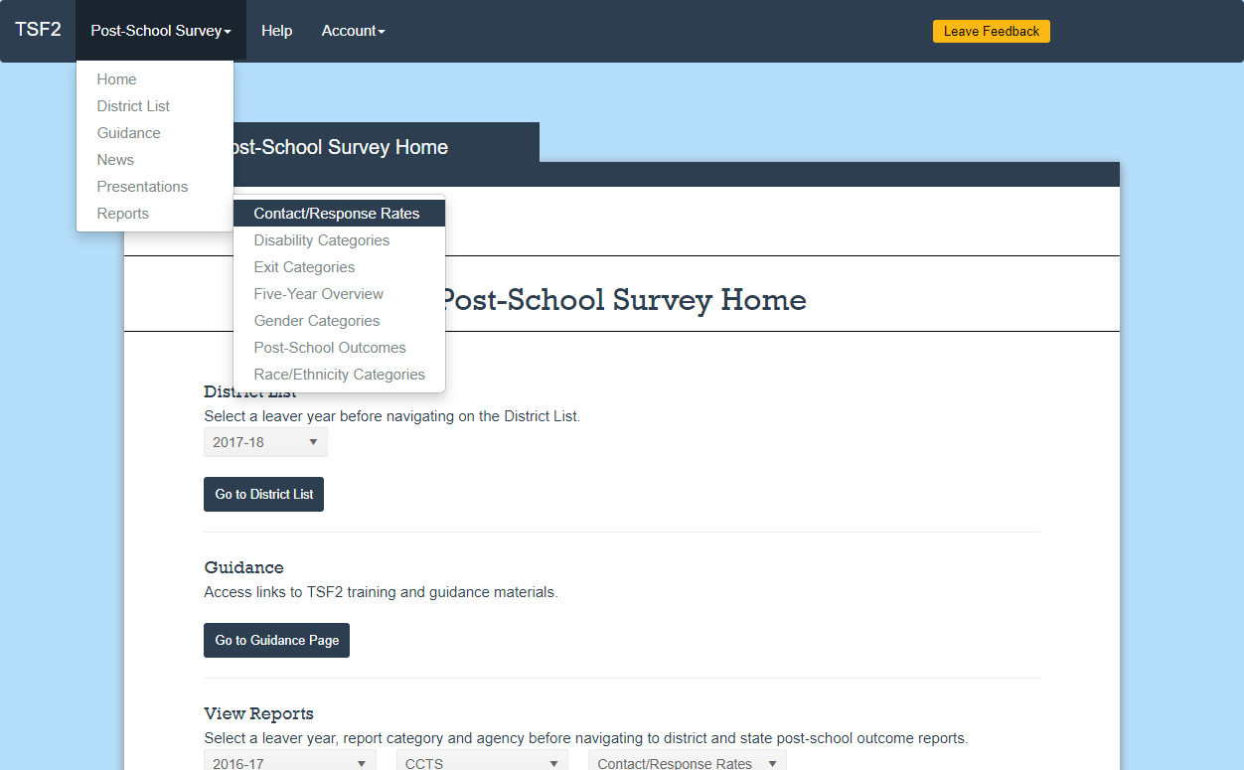
TSF2: Diving deeper into data: Screenshot 2
Notes:
So, I will click on Contact/Response rates

Slide 68
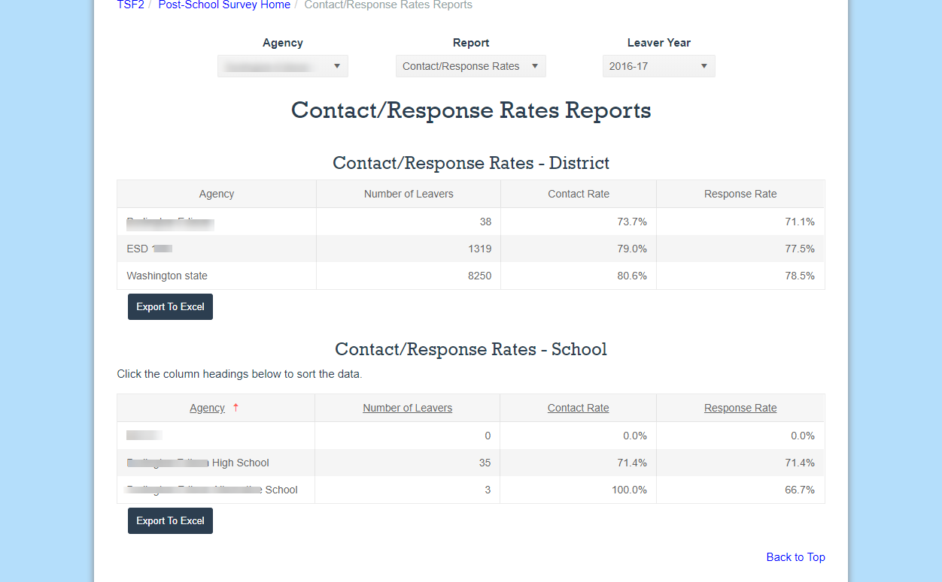
TSF2: Diving deeper into data: Screenshot 3
Notes:
And it will take me to this page. Here you can see the contact rate, which is the percentage of leavers you reached, and the response rate, which is the percentage of leavers who chose to respond to the survey.
You can look at your district, your ESD, and at Washington state.
At the bottom of the page you can see the same statistics for each school in your district.
These data can help if you are wondering if you’re reaching a representative number of your leavers and help you focus improvement efforts if you aren’t.
OSPI’s goal is that every district has a response rate of at least 70%.

Slide 69
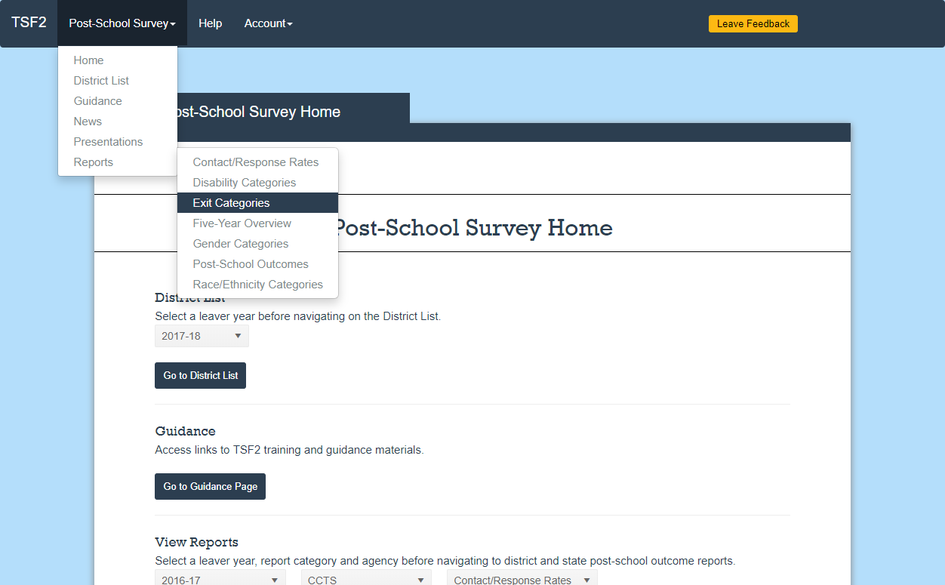
TSF2: Diving deeper into data: Screenshot 4
Notes:
Another feature is different views of data. I’m going to go into Exit categories as an example, but this is true for each of the report pages.

Slide 70
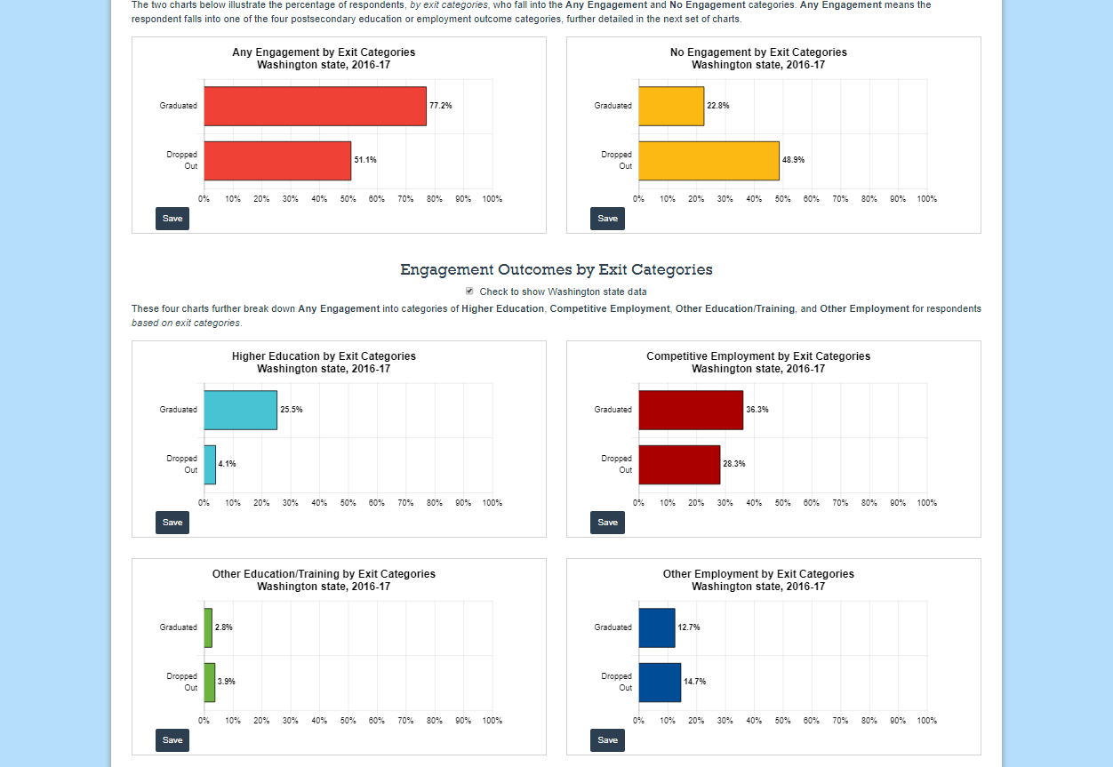
TSF2: Diving deeper into data: Screenshot 5
Notes:
Once we are on the report for exit categories we can see results just like we viewed today, aggregated by engagement and no engagement and then charts for each of the engagement categories.

Slide 71
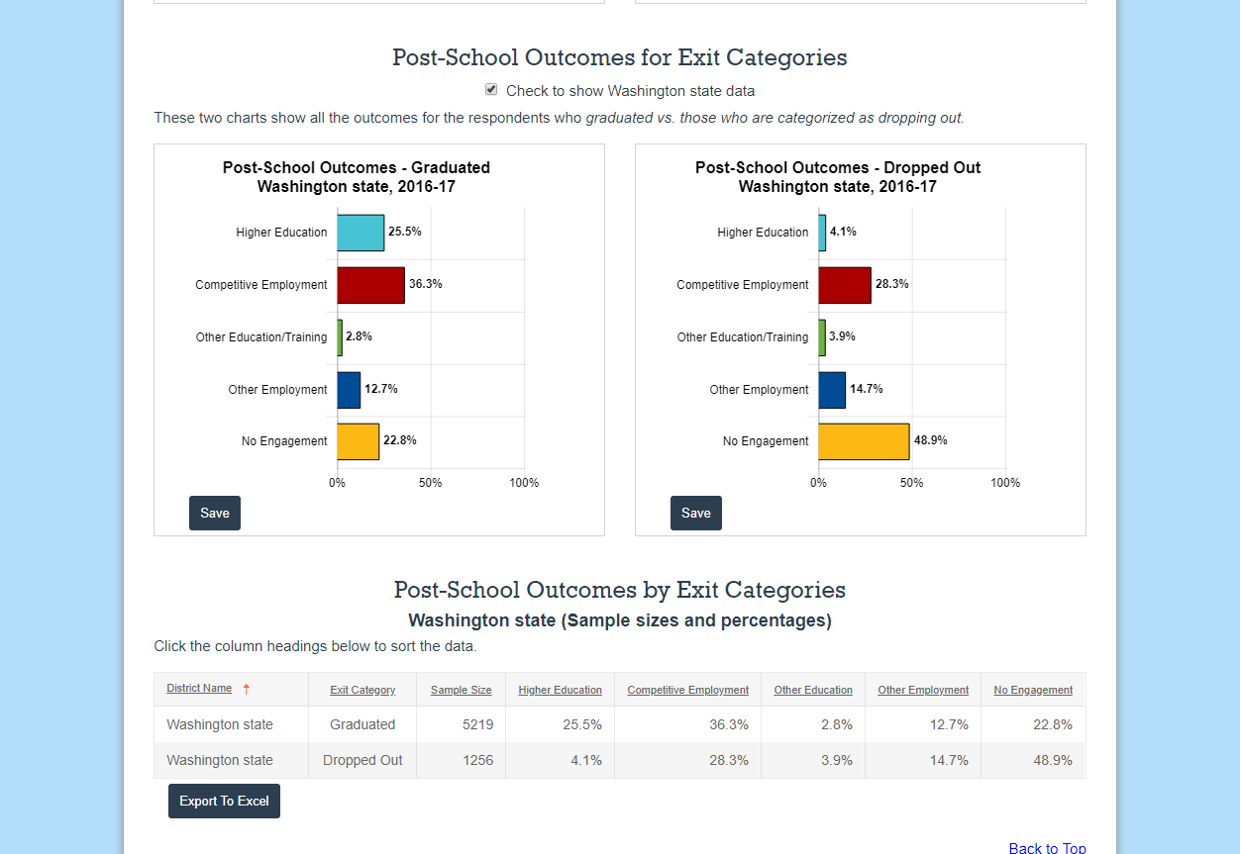
TSF2: Diving deeper into data: Screenshot 6
Notes:
If you page down, though, you can also see the two categories of graduated and dropped out in separate charts. This allows you to look at each group in relation to itself. For example, I notice that the largest outcome category for graduates is competitive employment, followed by higher education.
Sometimes a particular view lends to different realizations or interpretations.

Slide 72
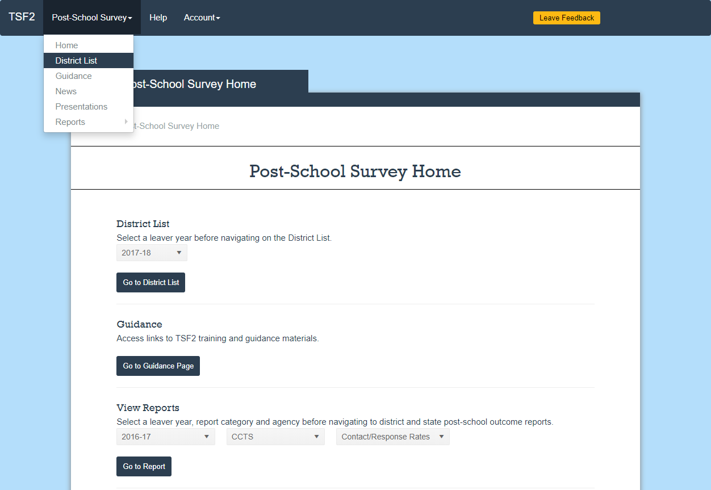
TSF2: Diving deeper into data: Screenshot 7
Notes:
Finally, I want to show you how to get your district’s raw data. Go in through the district list page

Slide 73
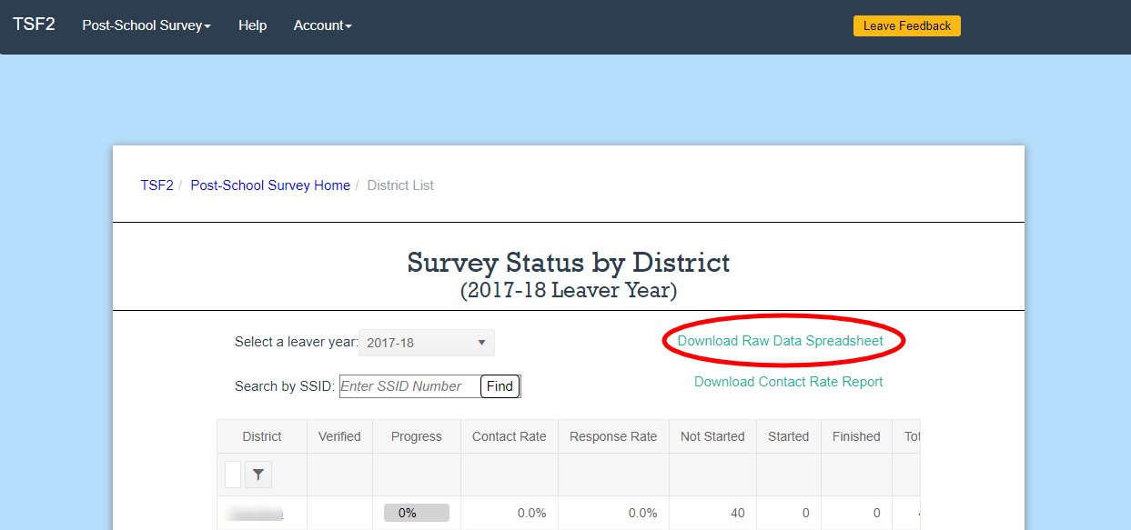
TSF2: Diving deeper into data: Screenshot 8
Notes:
Once you are on your district list there is a link to download the raw data spreadsheet. You should note that this is not currently available but will be available by the time this year’s survey results are compiled, which is in December.

Slide 74
Questions?
Please complete a quick session feedback form. Thank you!

Slide 75
CCTS Contact
CCTS General Information
ccts@seattleu.edu
206-296-6494
www.seattleu.edu/ccts
@WACCTS on Facebook, Twitter, and Pinterest
Notes:
You can email us at ccts@seattleu.edu, or call 206-296-6494. You can find us online at www.seattleu.edu/ccts, and on Facebook, Twitter, and Pinterest @WACCTS.

Slide 76
Citations for PSO Charts and Data
Center for Change in Transition Services, Seattle University (January, 2019). Indicator 14 Post-School Outcome Mini-Report, Washington state, 2016-2017.

Slide 77
Additional Citations
Kohler, P. D., Gothberg, J., & Hill, J. (2009, November 12). NSTTAC Evaluation Toolkit [PDF]. Kalamazoo: Western Michigan University. http://comm.eval.org/HigherLogic/System/DownloadDocumentFile.ashx?DocumentFileKey= 8d43c53a-e804-4647-856c-f783fceccff2&forceDialog=0
Kohler, P. D., Gothberg, J. E., Fowler, C., and Coyle, J. (2016). Taxonomy for transition programming 2.0: A model for planning, organizing, and evaluating transition education, services, and programs. Western Michigan University. Available at www.transitionta.org.
National Technical Assistance Center on Transition. (2018, October). Post-School Outcomes: What’s New, How to Find, Improve, and Use Them [PDF]. Presented at DCDT, Cedar Rapids, Iowa.
Predictors of Post School Success [PDF]. (n.d.) National Technical Center on Transition. http://transitionta.org/system/files /resources/EPP_Matrix_Preds%20revised.pdf

Slide 78

Creative Commons License
Except where otherwise noted, content in this presentation is licensed under a Creative Commons Attribution 4.0 International license. All logos and trademarks are property of their respective owners.
You may share and adapt this material, but you must give appropriate credit, provide a link to the license, and indicate if changes were made.
Notes:
Creative Commons Attribution 4.0 International license

Slide 79
OSPI Disclaimer
This presentation is meant to supplement, not supplant reading bulletins and accompanying documents; guidance from the U.S. Department of Education; chapter 392-172A WAC; Part 300 of the federal regulations; and, the Individuals with Disabilities Act.
This presentation and/or materials should be viewed and applied by users according to their specific needs. The presentation should be used as guidance and is not intended as legal advice.
Notes:
One final disclaimer from the Office of the Superintendent of Public Instruction. This training is meant to supplement, not supplant reading bulletins and accompanying documents; guidance from the U.S. Department of Education; chapter 392-172A WAC; Part 300 of the federal regulations; and, the Individuals with Disabilities Act. This presentation and/or materials should be viewed and applied by users according to their specific needs. The presentation should be used as guidance and is not intended as legal advice.

