Slide 1

DVR and DDA
Services and Resources
Available to Students

Slide 2

Goal of the Presentation
To deliver an overview of the process and services that both DVR and DDA provide.

Slide 3

The Division of
Vocational Rehabilitation
(DVR)

Slide 4
DVR: Division of Vocational Rehabilitation
Vision:
Dedicated professionals leading the field of vocational rehabilitation, delivering exceptional experiences to every customer, every time.
Values:
Transparency through clear, honest communication with customers, staff and partners.
Acting with Integrity, upholding the ethics and values of our profession.
Promoting a culture of Empowerment for customers and staff.
Leading in the Innovation of cutting edge rehabilitation practices.
Collaboration with customers, staff, and partners that produces results.
Advancing Diversity, Equity, and Inclusion in all of its forms to achieve excellence.

Slide 5

Who We Serve and
What We Do
We Serve:
  People with disabilities who want to work but face a substantial barrier to finding employment, keeping employment or advancing in employment.
What we do:
  Provide individualized employment services and vocational counseling.
  We provide technical assistance and training to employers.

Slide 6
Who might be eligible?
DVR may serve an individual if they:
Have a physical, mental, or sensory disability that makes it difficult to get a job or keep a job that matches skills, potential and interest.
Need services and support; such as counseling, training, or assistance with a job search in order to get or keep a job, and
Are capable of working as a result of receiving DVR Services
3

Slide 7
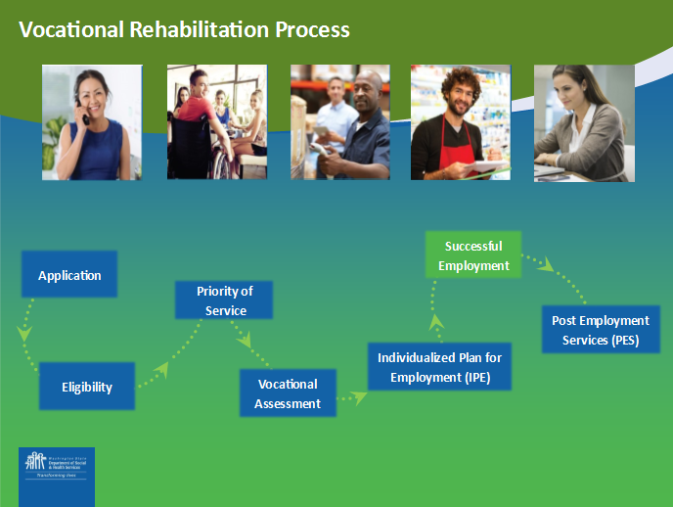
The Rehabilitation Process
Eligibility:
DVR collects records
60 days to collect and review records
Information provided to DVR is kept confidential
Specific consent is required for DVR to release information.
Note: to expand the PPT sections regarding the vocational process, click the “Application” box while PPT is in slide show mode
Note: for more information about each stage of the above Rehabilitation Process, click: HERE
Notes:
APPLICATION:
• must complete an application with DVR before services can begin.
• application will be reviewed by a DVR counselor to determine if eligible for DVR services.
ELIGIBILITY:
• Have a physical, mental, or sensory disability that results in a substantial barrier to employment; and
• require vocational rehabilitation services to get or keep a job or advance in employment; and
• are capable of working as a result of receiving DVR Services.
DVR collects records to document identity, disability, and work status. If no records about disability exist, additional assessments may be needed. DVR pays for the assessment if determined necessary.
ORDER OF SELECTION:
Discuss different categories (NSD, SD, MSD) and wait list
Discuss priority of service and functional losses
Discuss Pre-Ets services during an OOS
VOCATIONAL ASSESSMENT:
Customer and the DVR counselor explore types of jobs that best match interests and strengths and
• abilities and interests;
• work history and skills;
• Information about local job market trends.
Or may complete:
• Interest and/or aptitude tests; or
• Job try-outs.
• If the customer needs more than 90 days from eligibility to explore career options, the timeframe to develop the IPE can be extended.
INDIVIDUALIZED PLAN FOR EMPLOYMENT:
The DVR counselor offers ongoing counseling, guidance, and support as a customer gets or keeps a job. This may include:
• Selecting a job goal;
• Writing a plan that outlines what steps and services are needed to reach the job goal; and
• Beginning to work on the activities outlined in the IPE that may include:
– Training or education, Conducting a job search, Researching job-related resources and referrals, Job search training, Resume and interview techniques, Job placement assistance, Support in keeping a job
SUCCESSFULLY EMPLOYED:
After a job begins, DVR will maintain contact for at least 90 days to make sure the job is a good match.
• After 90 days, if doing well on the job and no other services are needed, case closed successfully employed.
POST EMPLOYMENT SERVICES:
If assistance is needed after a case is closed as successfully employed, DVR can reopen the case and provide assistance to help keep a job, or assist with reapplying for DVR services.
• If a job is lost, DVR can help find a similar job.

Slide 8

The Rehabilitation Process
Application:
An individual seeking services from DVR must first complete an application. The application and other information are reviewed by a DVR counselor to determine eligibility for DVR services.

Slide 9
The Rehabilitation Process
Eligibility:
DVR collects records
60 days to collect and review records
Information provided to DVR is kept confidential
  Specific consent is required for DVR to release information
Notes:
Eligibility:
The DVR counseling team collects records to document identity, disability, and work status.
If no records about the claimed disabling condition exist, additional medical examinations or tests may be needed to verify or support eligibility.
If there is not enough information available, DVR will pay for required assessments in order to verify or support eligibility. A VR Counselor has up to 60 days to collect and review records that document identity, disability, and work status.
Information provided to DVR is kept confidential. Information is shared with others only with written consent, except in very limited circumstances. If a file includes mental health records, HIV/ AIDS and/or STD test results, diagnosis or treatment, and/or chemical dependency services, specific consent would be required for DVR to release the information.

Slide 10
Eligibility Determination & Priority of Service Category
After customers are determined eligible, they are assigned a priority of service category based on the significance of their disability.
The priority service category is based on the impact of the disability, not the type of disability.
Notes:
Individuals with disabilities have to meet eligibility criteria so they have to have a disability, require assistance to gain, maintain or advance in employment and be able to benefit from services to be eligible then they are assigned a priority of service category based on their functional limitations to employment in 7 functional limitation areas

Slide 11
The Rehabilitation Process
Order of Selection:
Required by federal law when DVR does not have sufficient resources to serve all eligible customers.
Establishes service priorities for people who need them most.
DVR serves people with the Most Significant Disabilities first.
The remainder of eligible individuals are placed on a waitlist for services until funds become available.

Slide 12
Why does DVR have a waitlist and what happens to people placed on it?
A waitlist is a result of a closed priority category or multiple categories.
Customers are released off of the waitlist based on priority category and the date of application for DVR services.
Waitlist customers will receive DVR Information & Referral (I&R) services.
Using a waitlist is how DVR manages limited resources.
Notes:
Wait list customers will receive DVR information and referral about other federal or state programs that offer services to assist with employment needs, if available.

Slide 13
Who is a student with a disability?
"Student with a disability" means an individual with a disability who is:
Currently enrolled in a secondary, postsecondary, or other recognized educational program, and
Not younger than 14 years of age and not older than 21 years of age.
Receiving special education or related services under part B of IDEA or is a student with a disability for the purposes of section 504 of the Rehabilitation Act of 1973, as amended.

Slide 14
Pre-Employment Transition Services (Pre-ETS)
Job Exploration
Work Readiness
Work-based Learning
Counseling on post-secondary opportunities
Self-Advocacy

Slide 15
Pre-Employment Transition Services (Pre-ETS) under an Order of Selection
Pre-employment transition services will continue to be offered to potentially eligible students.
If a student with a disability receives Pre-ETS prior to being determined eligible for DVR, the student CAN continue to receive Pre-ETS if they are placed on the statewide waitlist.
If a student is determined ineligible for DVR services, they can no longer receive Pre-ETS.

Slide 16
The Rehabilitation Process
Individualized Plan for Employment (IPE):
The DVR counselor offers ongoing counseling, guidance, and support throughout the vocational process, which may include:
Selecting a job goal
Writing a plan that outlines steps and services needed to reach a job goal, and
Beginning to work on the activities outlined in the plan may include:
  Training and Education, Conducting a job search, Researching job-related resources and referrals, Job search training, Resume and interview techniques, Job placement assistance, Support in keeping a job

Slide 17
Supported Employment
Supported Employment Services include:
Competitive and integrated employment, including customized employment.
Time limited support services (intensive training services) provided by DVR.
Long-term supports (extended services) are required for the individual to maintain employment over time.
Notes:
Time limited support services provided by DVR for up to 24 months from initial job placement to transition to extended services provided by an entity other than DVR.

Slide 18
The Rehabilitation Process
Successfully Employed:
After successful job placement occurs, DVR will maintain contact for at least 90 days to make sure the job is a good match.
After 90 days, if the individual is doing well on the job and no other services are needed, the case is closed as successfully rehabilitated.

Slide 19
The Rehabilitation Process
Post Employment Services (PES):
If brief assistance is needed after a case is closed as successfully employed, DVR can reopen the case and provide assistance to help keep a job, or assist with reapplying for DVR services.

Slide 20
Services Available from DVR
What types of services does DVR offer?
Variety of services to assist people with disabilities to prepare for, obtain, and keep jobs.
Depends on individual needs and circumstances
Information necessary to assist in deciding which services are needed to reach desired job goals.

Slide 21
Examples of services include:
For more information, click on the hyperlinks below:
Assessment services
Benefit planning services
Counseling and guidance services
Independent living services
Assistive technology services
Training services
Pre-employment services
Job placement
Note: to expand the PPT sections regarding DVR services, click each service topic while PPT is in slide show mode
Note: For a complete list of VR Services, please refer to the DVR Customer Handbook DSHS Publication No. 22-1629 or visit: https://www.dshs.wa.gov/sites/default/files/SESA/publications/documents/22-1629.pdf
Notes:
Assessment services to measure strengths, capabilities, work skills, and interests. These services assist in selecting a job goal and the DVR services needed to reach that goal.
Benefit planning services are available if receiving disability cash or medical benefits (e.g. SSI or SSDI) in order to make good decisions about vocational goals.
Counseling and guidance services provided throughout the rehabilitation process to help make good decisions about how to reach employment goals.
Independent living services to help understand and deal with disability issues that prevent working; these include, but are not limited to:
Training in self-care
Money management
Using community transportation
Assistive technology services help remove communication and/or physical barriers that may prevent getting and keeping the desired employment outcome. These may include such devices as hearing aids, visual aids, or special computer software. ASL?
Training services to provide work skills needed to achieve the approved employment goal.
Job placement to help carry out job search, including:
Assistance completing application forms
Developing a resume
Practicing interview skills, and identifying job leads

Slide 22
Customer Rights
DVR wants to see everyone reach their employment goals. Customers have rights and resources to help them resolve disputes if needed.
Note: a DVR Customer Rights brochure may be requested to provide information regarding the available complaint resolution options or visit https://www.dshs.wa.gov/office-of-the-secretary/resolving-concerns
Notes:
Talk with the VR counselor, the VR supervisor, or talk with the DVR Director or designee
Seek assistance from the Client Assistance Program (CAP) by calling, (800) 544-2121 www.washingtoncap.org
Submit a written request to the DVR counselor or their supervisor for an exception to policy
Request formal mediation from DVR, and/or
Request a fair hearing
Any DVR staff person can provide further information about the above options including contact information.

Slide 23
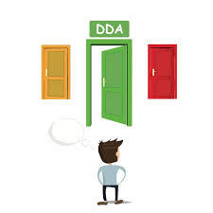
Developmental Disabilities Administration
(DDA)

Slide 24

What is DDA?
Developmental Disabilities Administration:
The main door to services for individuals with intellectual/developmental disabilities

Slide 25

What is a Developmental Disability?
The disability must:
Originate before the individual turns 18
Continue or be expected to continue indefinitely, and
Constitute a substantial limitation to the individual.

Slide 26


4 Things to Know
Must be a Resident of the State
Must have a Qualifying Condition
Being Eligible Does Not Automatically Result in Enrollment into services
Must attempt to access private insurance/Medicaid prior to DDA services

Slide 27

Required Documentation
Evidence of Substantial Limitations
  IQ scores
  Physical assistance needs
  Adaptive functioning test scores

Slide 28

Eligibility
The definition of a developmental disability is:
  A disability attributable to:
    Intellectual Disability;
    Cerebral Palsy;
    Epilepsy;
    Autism; or
    Another neurological or other condition similar to intellectual disability.

Slide 29

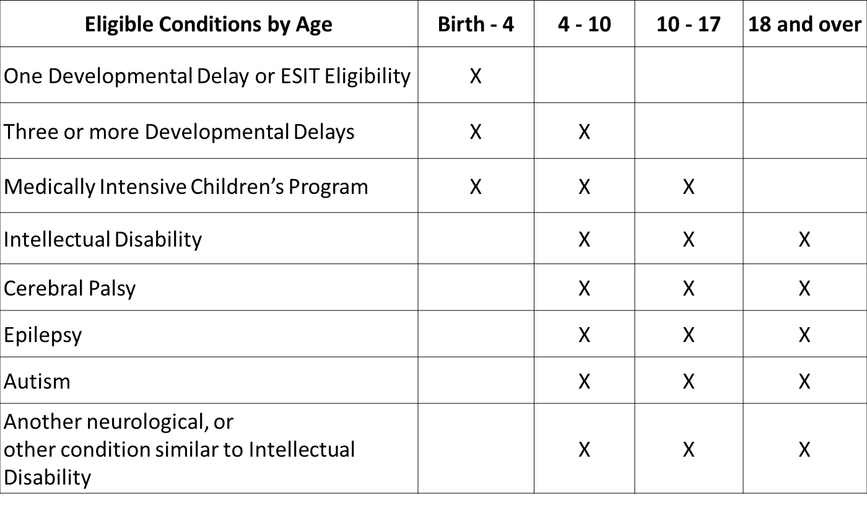
Age and Eligibility

Slide 30

Expiration and Reviews
Children’s eligibility expires
  On the 4th birthday
  On the 10th birthday for developmental delays only
  On the 18th birthday for MICP
Reviews
  At age 19 if the last determination was before age 16
  When there is evidence of insufficient, mistaken, or fraudulent information

Slide 31

You May Reapply If:
Your eligibility will expire at your next birthday;
You were previously eligible but your eligibility has expired;
Your eligibility was terminated because DDA could not locate you; or
You were previously found ineligible, but now have additional or new information that is acceptable and relevant to a determination.

Slide 32
The Process Looks Like This…
Submit a “Request for dda eligibility determination”
Submit Required Documentation
DDA Case Manager assists in gathering information
Information entered into CARE
Evidence is Evaluated
Verification for eligible applicants

Slide 33
Now that you are eligible…
You can request services by calling one of the numbers below:
Call to request for the county you live in: | Phone Number
Asotin, Chelan, Douglas, Ferry, Garfield, Lincoln, Okanogan, Pend Oreille, Spokane, Stevens, Whitman | (800) 319-7116
Adams, Benton, Columbia, Franklin, Grant, Kittitas, Klickitat, Walla Walla, Yakima | (866) 715-3646
Island, San Juan, Skagit, Snohomish, Whatcom | (800) 567-5582
King | (800) 974-4428
Kitsap, Pierce | (800) 735-6740
Clallam, Clark, Cowlitz, Grays Harbor, Jefferson, Lewis, Mason, Pacific, Skamania, Thurston, Wahkiakum | (888) 707-1202
Or request services on-line at:
https://www.dshs.wa.gov/dda/service-and-information-request

Slide 34

Waivers
Waive the Option to Receive Services in an Institutional Setting
IFS
(Individual and Family Services)
Basic Plus
CORE
CIIBS
(Children’s Intensive In-Home Behavioral Support)
Community Protection

Slide 35
Examples of Non-Residential Services
Child Development Services
Employment Services
Community Inclusion
Community First Choice (CFC)
Respite care
Architectural or vehicular modifications
Equipment and supplies
Specialized nutrition and clothing
Excess medical costs not covered by another source
Counseling
Behavior support
Parent/Sibling education
Nursing provided by Registered Nurse (RN) or a Licensed Practical Nurse (LPN)
Therapeutic services, such as Occupational Therapy, Physical therapy or Communication Therapy
Crisis prevention, intervention and stabilization services
Psychiatric services

Slide 36
Examples of Non-Residential Services
What Services are available?
Employment Services
Individual Employment service (IE)
Group Supported Employment (GSE)
Day Program Services
Community Inclusion (CI)
Child Development Services (CDS)

Slide 37

Residential Services
Adult Family Homes
Alternative Living
Companion Homes
Group Homes
Supported Living
State Operated Living Alternatives
Voluntary Placement Services

Slide 38
 | DVR | DDA
Goal | Supporting individuals with disabilities in obtaining and maintaining competitive, integrated employment | Supporting individuals with disabilities in all aspects of their life
Requirements | Pre-ETS (Student; 14-21; IEP, 504, or documented disability) Employment: Documented disability/barrier to employment | Originated before age 18 Expected to continue indefinitely, and Results in substantial limitations
Services Provided | Pre-Employment Transition Services Employment: Vocational Rehabilitation Counseling & Guidance | Employment plus other life services
Age Range | Pre-Employment Transition Services: Age 14-21 No age restriction to apply for DVR services | Life span
Length of Service | Short-term: Pre-Employment Transition Services Individualized counseling and guidance to obtain and maintain employment | Long-term support

Slide 39

Questions

Slide 40
Contact Information
Terry Redmon: redmot@dshs.wa.gov
  DDA Employment Program Manager
Tammy Doyle: doylet@dshs.wa.gov
  DVR Secondary Transition Manager
Merri Snow: Abattma@dshs.wa.gov
  DDA Field Service Administrator
Rod Duncan: duncara@dshs.wa.gov
  DDA Regional Employment Specialist

