Slide 1
Conducting the 2019
Post-School Survey
Center for Change in Transition Services (CCTS)
Improving post-school outcomes for students with disabilities in Washington state
www.seattleu.edu/ccts
Notes:
June 25, 2019
CCTS Transition Forum | Breakout Session 2
Cinda Johnson and Jay Shepherd

Slide 2
Getting started
Notes:
Welcome!

Slide 3
CCTS Introductions
Cinda Johnson, Principal Investigator, Associate Professor
Jay Shepherd, Marketing and Communication Specialist

Slide 4
Today’s Agenda
Objective: Conduct the Post-School Survey
  Survey overview
  User role and responsibilities
  Survey response rates
  Survey structure and sequence
  Survey questions
Notes:
The primary objective for today’s session is centered around conducting the Post-School Survey.
We’ll do a brief overview of the Post-School Survey—what it is and why we do it.
We’ll also talk about the roles and responsibilities around conducting the Post-School Survey.
Then we’ll go through a survey from start to finish, examining the structure, sequence, and meaning of the questions.
And then we’ll take your questions at the end.

Slide 5
2019 Post-School Survey Training Webinars
Submitting Leaver Verification, Part 1
Submitting Leaver Verification, Part 2
Conducting the Survey, Part 1
Conducting the Survey, Part 2
Captioned recordings are available on Vimeo.
PowerPoints and PDFs are available on Google Drive.
Notes:
I do want to mention that the information we’re covering today is also addressed in the training webinars we held earlier this year.
We highly recommend reviewing those for some additional guidance.
Each webinar is about 30 minutes.
There’s Submitting Leaver Verification Parts 1 and 2, and Conducting the Survey Parts 1 and 2.
You can view captioned recordings on Vimeo and access the PowerPoints and other handouts in Google Drive.

Slide 6
Post-School Survey Overview
Notes:
Let’s start with a brief overview of the Post-School survey.

Slide 7
Survey Logistics
June 1 to November 1 each year
Phone surveys are conducted by school/school district representatives
Surveys are completed by former special education students (“leavers”) one year after exiting high school
Survey data are reviewed, analyzed, and reported by CCTS
Notes:
As some of you may already know, the Post-School Survey opens June 1 and closes at 11:59 p.m. on November 1 every year.
During that window of time, school and school district representatives make phone calls to former students who have permanently exited high school, and who were receiving special education services at the time they left.
The technical term for these students is “leavers,” but you’ll also notice that we often refer to leavers as former students.
After the survey closes, CCTS reviews and analyzes the data that were collected, and then we provide reports for districts, ESDs, and the state to access.

Slide 8
Importance of the Post-School Survey
Reconnect with former students who received special education services
Gain direct insights into education and employment activities one year after leaving school
Collect post-school outcome data for program improvement and reporting purposes
Notes:
The Post-School Survey is a requirement for state and federal reporting, but it also offers an opportunity to reconnect with former students and learn about what they’ve been up to in their first year after leaving high school, specifically in the areas of employment and education.
It’s a useful and important tool for collecting information directly from youth or a designated family member who can provide that information.
This information, known as post-school outcome data, is used by school districts, educational service districts, and the state to evaluate and improve on transition planning for youth with disabilities.

Slide 9
Post-School Survey and the TSF2
Transition Systemic Framework 2.0
  www.cctsTSF.com
  www.cctsTSF.org
CCTS’s secure data collection website
Used when conducting the Post-School Survey
View and download reports and presentations
Notes:
This process of collecting and reporting data takes place within the TSF2, which is an abbreviation for the Transition Systemic Framework 2.0.
This is the website that CCTS operates for Post-School Survey data collection.
All surveys are conducted within the platform, meaning that if you’re someone who conducts the surveys, then while you’re on the phone with your former student or your former student’s family member, you’re logged into the TSF2, recording information as it’s being shared with you.
All of the information that’s collected in the survey is saved and stored in the TSF2.
Once data are analyzed, finalized reports and PowerPoint presentations are available for your district to view and download directly from the site.

Slide 10
TSF2 User Role:
Conduct Survey
Notes:
In order to conduct the survey, you must have a designated user role that gives you the permissions needed to conduct a survey.

Slide 11
TSF2 User Roles
Post-School Survey User Roles (school-level)
  Submit Leaver Verification
  Conduct Survey
  View Post-School Outcome Reports
District Manager
Other Users: Admin, State, and ESD
CCTS Post-School Survey Training Materials Google Drive Folder
Notes:
Conduct Survey is one of three Post-School Survey user roles in the TSF2.
There’s also a user role that’s just for leaver verification permissions, and just for viewing reports.
The District Manager can assign these roles to users by school, and users can have multiple roles.
We have training materials available for Leaver Verification and District Managers in our Google Drive folder.
Today we’ll be focusing on just the Conduct Survey role.

Slide 12
Pre-Survey Tasks
Ensure access to the TSF2
  District Manager (DM) manages district accounts
  Email ccts@seattleu.edu if need contact info for your DM
  Reset password as needed
Access contact information for all former students
Review Post-School Survey guidance and training materials
Notes:
Before you can conduct the survey in the TSF2, you’ll want to make sure you have access to the system.
Your District Manager can set you up with an account.
If you don’t know who that is, CCTS can look that up for you.
If you already have an account but need to reset your password, you can go to the site and click a link to reset your password.
You’ll also want to have access former student contact information.
Every school and district has a different method of tracking this information.
Some classroom teachers keep their own records, other districts use larger database systems.
Whatever method works for your school or district, please be sure to keep all information safe and confidential.
And you’ll want to be sure to review the training materials, like you are today.

Slide 13
June 1-November 1: Conduct Survey
Enter survey responses directly into the TSF2
Connect with the former student, if possible (self-determination!)
  Other possible survey respondents: family member, guardian, or caregiver
  Document at least three contact attempts (date and time) before submitting as incomplete
Survey closes November 1 at 11:59 p.m.
Notes:
And then, when it comes time to conduct the surveys, which happens on June 1 every year, you’ll want to start making survey phone calls.
All surveys are conducted within the TSF2 platform, meaning when you’re making phone calls to former students, you are logged into the TSF2, entering the information as it’s being shared with you.
Ideally, that information is coming directly from the former students, themselves.
That’s, most likely, the most accurate way to collect survey responses.
It’s also a great way to continue to promote self-determination with former students, which we’re all about.
If it’s not possible to connect directly with a former student, then a parent or family member who has intimate knowledge of the former student’s work and education history is eligible to answer the survey questions.
Ideally, this is someone that was designated by the former student as an alternate contact before they left high school.
So make sure when you’re collecting contact information to ask them if there’s someone that might be able to answer the survey questions if they’re not available.
Whoever ends up answering the survey questions, whether it’s the former student or a designated contact, we call them the survey respondent.
If you’re not able to reach anyone who can be an appropriate survey respondent, that survey is submitted as incomplete.
We recommend that you try to reach a former student at least three times before submitting a survey, because the number of incomplete surveys you have affects your overall response rate. And Cinda’s going to talk about that next.
You have until November 1 at 11:59 p.m. to contact all of your former students and collect as many responses as possible.
After November 1 surveys are closed and cannot be edited.

Slide 14
Response rate
The percentage of former students or designated family members who were contacted and answered the Post-School Survey questions.
The response rate is not the same as contact rate!
The higher the response rate, the better the data.
Notes:
We mentioned that you should try to reach a former student at least three times in order to improve your chances of reaching them.
Contact rate is the percentage of former students or designated family members who were successfully reached for the Post-School Survey.
School districts are required to attempt to contact all former special education students.

Slide 15
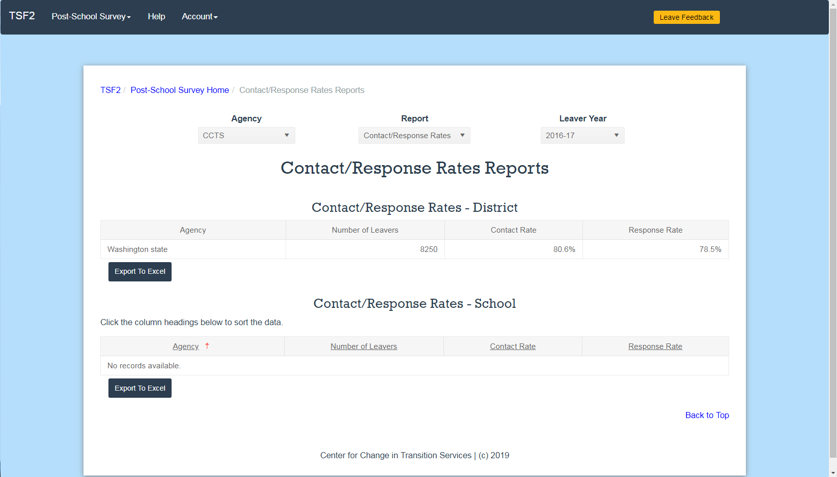
Screenshot: Contact/Response Rate Report page
Washington state, 2016-17
  Number of leavers: 8250
  Contact rate: 80.6%
  Response Rate 78.5%
Notes:
This slide is a screenshot from the TSF2.
It shows the contact and response rates from 2016-17 for Washington state.
There were a total of 8,250 leavers.
Of those, 80.6% were contacted by survey conductors, and 78.5% of them answered the survey questions.

Slide 16
Improving Response Rates
Explain the survey and collect contact information before the students leave school
  Post-School Survey Guidance for Students and Families
Have someone who personally knows the students make the phone calls
Vary the time of day you attempt to contact former students
Utilize your community and online resources to locate a former student or update your contact information
Notes:
There are a few other strategies that you can implement to increase your overall response rate.
The first is to prepare students for the survey before they leave high school. Let them know what they survey is and why it’s done, that way they’ll be better prepared.
We have materials on the CCTS website that you can use and share with students and families.
It’s helpful if the former student knows the person who is making the phone call. This may be a ­teacher, counselor, paraeducator, or other employee from the school who has a special connection with the student.
If that individual is not available to make the phone call, have the person who does make the call say they are calling on behalf of that person.
When you’re making your repeated contact attempts, be sure to vary both the day and the time you’re calling.
And if you’re having trouble finding a former student, use social media or other local connections to track down a phone number.
Be sure not to reveal a former student’s disability status at any time.

Slide 17
OSPI’s Determination Requirements
Washington’s criteria for meeting requirements (determination level 1) is a response rate of 70% or higher.
Learn more about Washington’s criteria for calculating annual Determination Levels for school districts.

Slide 18
Do you know your response- rate from last year’s survey?

Slide 19
Where to locate response rates
From the Post-School Survey Home page
  Locate the “View Reports” heading
  Select leaver year, district, and “Contact/Response Rates”
  Click the blue “Go to Report” button
From the top bar navigation
  Click Post-School Survey
  Scroll down to Reports
  Select Contact/Response Rates
  Adjust district and leaver year at the top of the screen, if needed

Slide 20
Survey Structure
Notes:
Next we’ll talk about the survey and how it’s structured.

Slide 21
Survey Sequence
Former Student Demographics (1-10 – prepopulated data)
Pre-survey Questions (11-13)
Connect with Survey Respondent (phone scripts)
Survey Respondent Information (14-15)
Postsecondary Employment Questions (16, 16a-f)
Postsecondary Education Questions (17, 17a-d)
Agency Connections Questions (18, 18a)
Additional Comments
End Survey
Notes:
Once we’re in the survey, you’ll notice that it’s broken into nine sections:
Former Student Demographics, Pre-survey Questions,
Connect with Survey Respondent, Postsecondary Employment Questions,
Postsecondary Education Questions, Agency Connections Questions,
Additional Comments, and End Survey.
There are a total of 35 questions on the survey, but you will never be asking 35 questions. Some of these questions are prepopulated with responses, like the former student demographics. Other questions may or may not appear depending on how the respondent answers earlier questions.
For example, if a student said no, they weren’t employed in the last year, then there won’t be any additional questions about employment. You’ll skip to the next section.
If they said yes, they were employed, then a series of questions about their employment dates, and hours, and wages would appear.
This, sort-of, choose-your-own-adventure feature of the survey is known as “skip logic.” It’s built directly into the TSF2 so you don’t have to worry about keeping track of the sequence yourself. Just ask the questions as they appear on the screen as you go. This means that you will likely see different questions each time you conduct the survey. Keep this in mind as we move forward.

Slide 22
Follow-up Questions (+)
Six supplemental questions: 16a+, 16b+, 16c+, 17+, 17d+, 18a+
Provide additional valuable data
  Why did they drop out of high school?
  Why don’t they meet competitive employment requirements?
  Why don’t they meet postsecondary education/training requirements?
Use your judgement when it comes to asking these questions
Notes:
Speaking of skip-logic, there are up to six questions that may appear in the survey that are not required by the state.
We call them Follow-up questions, and they’re indicated by a plus sign.
These questions first appeared in last year’s survey, and based on the interesting and informative responses, we’re excited to continue to include these questions to get some additional information about post-school activities.
Please keep in mind that if, while you’re conducting the survey, you sense that the respondent is losing energy or focus, you can use your best judgment as to whether or not you want to ask these follow-up questions.

Slide 23
Timeframe for Questions
12 months from high school exit date (see demographics #5)
Not necessarily current activities
Notes:
One more general note about survey questions before we launch in.
The Post-School Survey is a follow-up survey.
The questions you’re asking are about what former students have been doing in the year since they left high school, or 12 months from their exit date.
The former student’s exit date is listed in the demographics section of they survey, which I’ll be sure to point out.
This becomes a consideration if you’re conducting the survey in later months, like September or October, or if the former student left school earlier in the year.
If the former student left school in January of 2018, then the question timeframe is January 2018 to January 2019.
You may need to emphasize that while you’re asking the questions.

Slide 24
Questions so far?

Slide 25
What next?
Former Student Demographics (1-10 – prepopulated data)
Pre-survey Questions (11-13)
Connect with Survey Respondent (phone scripts)
Survey Respondent Information (14-15)
Postsecondary Employment Questions (16, 16a-f)
Postsecondary Education Questions (17, 17a-d)
Agency Connections Questions (18, 18a)
Additional Comments
End Survey

Slide 26
Navigating to the
Leaver Survey List in TSF2
“Example High School”
Notes:
Ok. So we’re going to spend the rest of our time today looking at the survey questions in the TSF2.
I’ll be taking on the role of someone from Example High School in Example School District with a Conduct Survey TSF2 user role.
We’ll quickly log into the TSF2, navigate to Example High School’s leaver survey list, start a survey, and enter the pre-survey question information.
Please note that the instructions I’m about to go over are embedded in this slide deck, and available in a Word document and PDF format, all of which can be linked to from the Guidance for Educators page on the CCTS website.

Slide 27
Accessing Leaver Surveys
Log in to TSF2: https://cctsTSF.com or https://cctsTSF.org
From Post-School Survey Home:
    Confirm leaver year (2017-2018)
    Click “Go to District List”
From District List, select school district
From School List, select school
To begin survey, click “Start” or “Edit” under “Post-School Survey” column

Slide 28
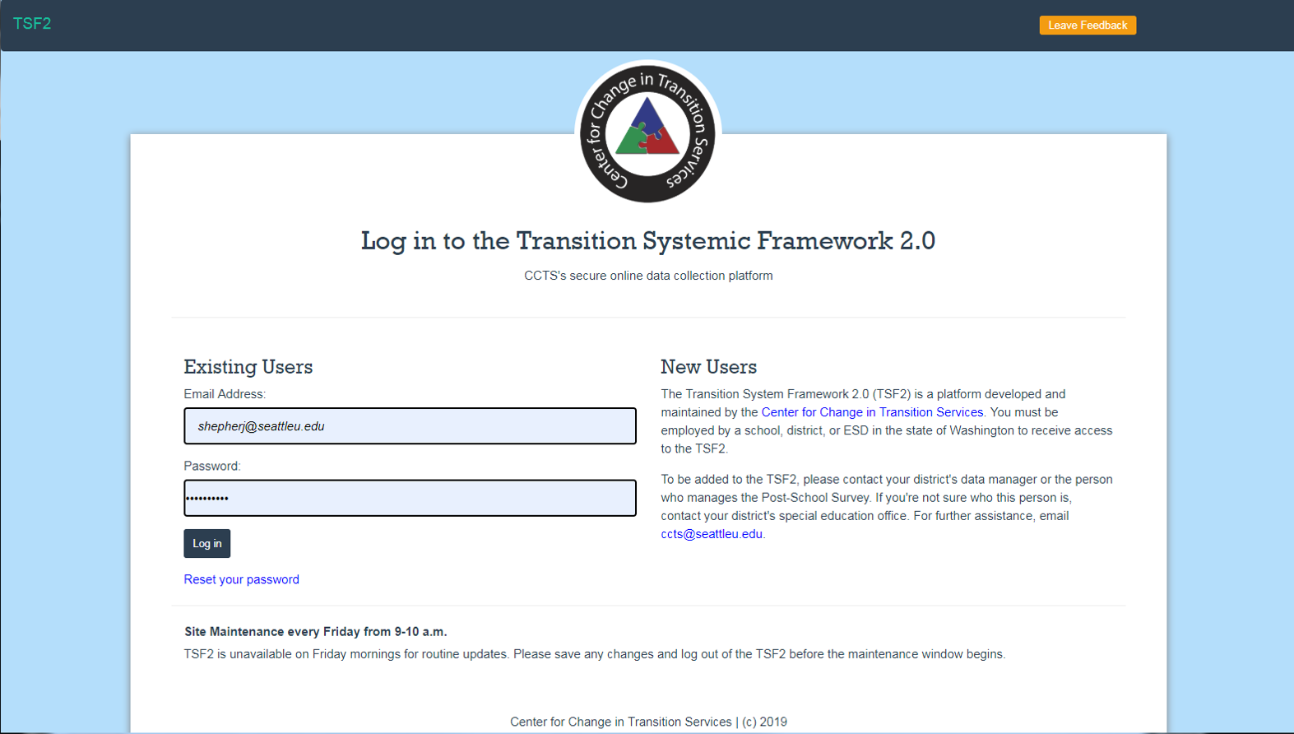
Log in to the TSF2 Screenshot
Notes:
To get to Example High School’s Leaver Survey List, I’m going to log in to the TSF2 by going to ccts TSF dot com or ccts TSF dot org.
I’m going to enter my email address and password, then click log in.

Slide 29
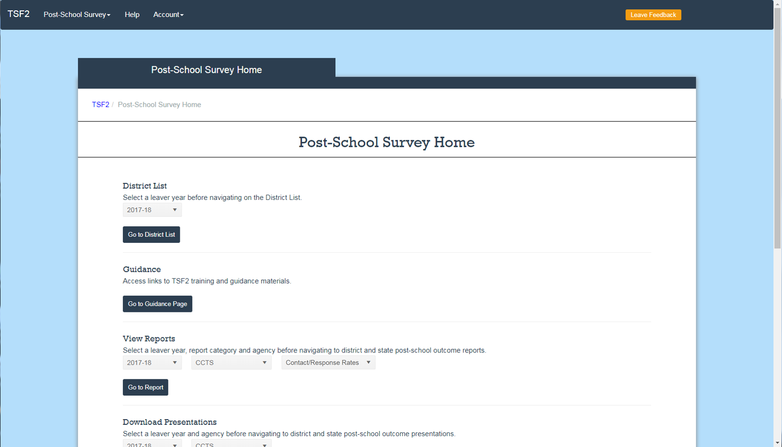
Post-School Survey Home Screenshot 1
Notes:
After I log in, I’m directed to the Post-School Survey Home page.
From here, under the District List Heading, I’m going to confirm that 2017-18 leaver year is selected, and then click the blue “Go to District List” button.

Slide 30
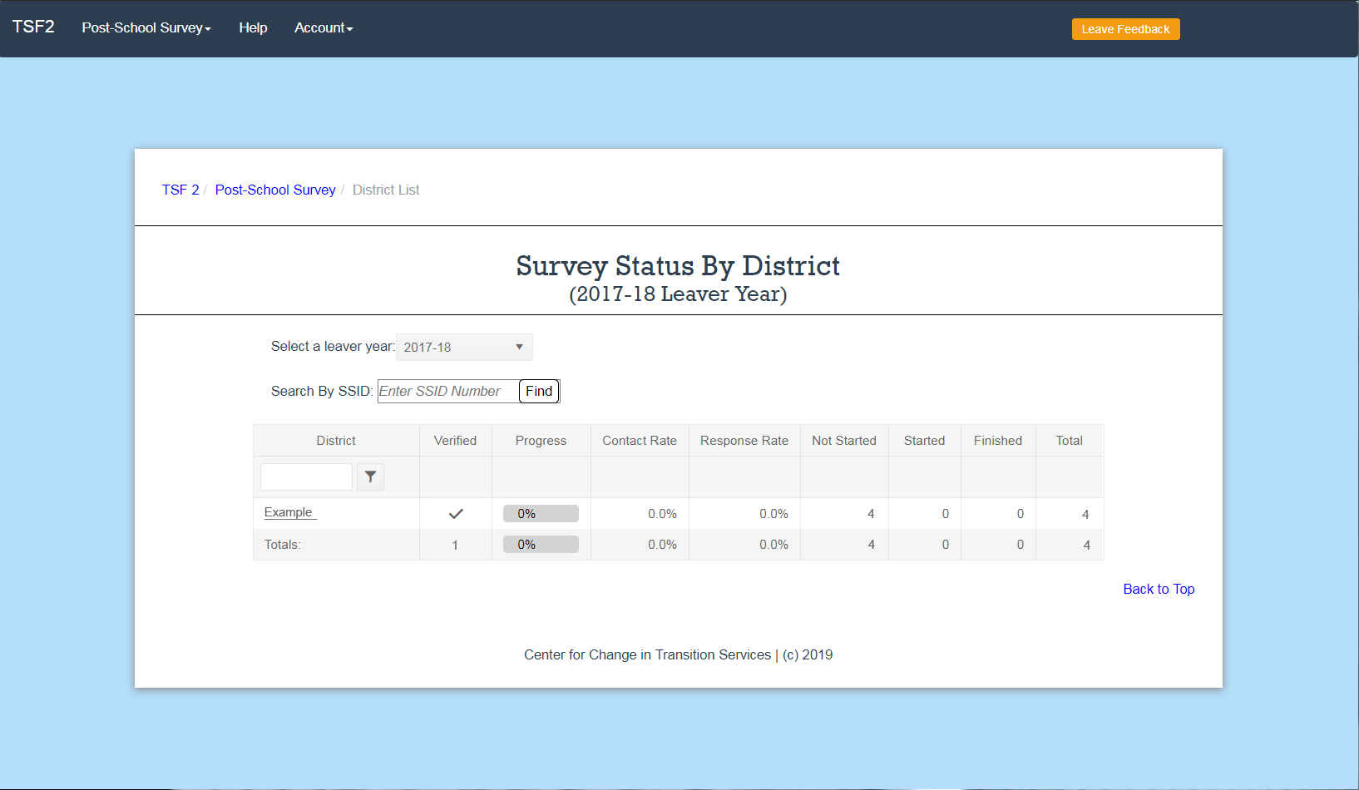
Survey Status by District/District list Screenshot
View survey progress by your district in Progress Table format
Click on desired district
Notes:
This takes me to my District List page.
Here I can see every district that I have access to in the TSF2. For me, it’s just Example district.
I’m going to click on Example.

Slide 31
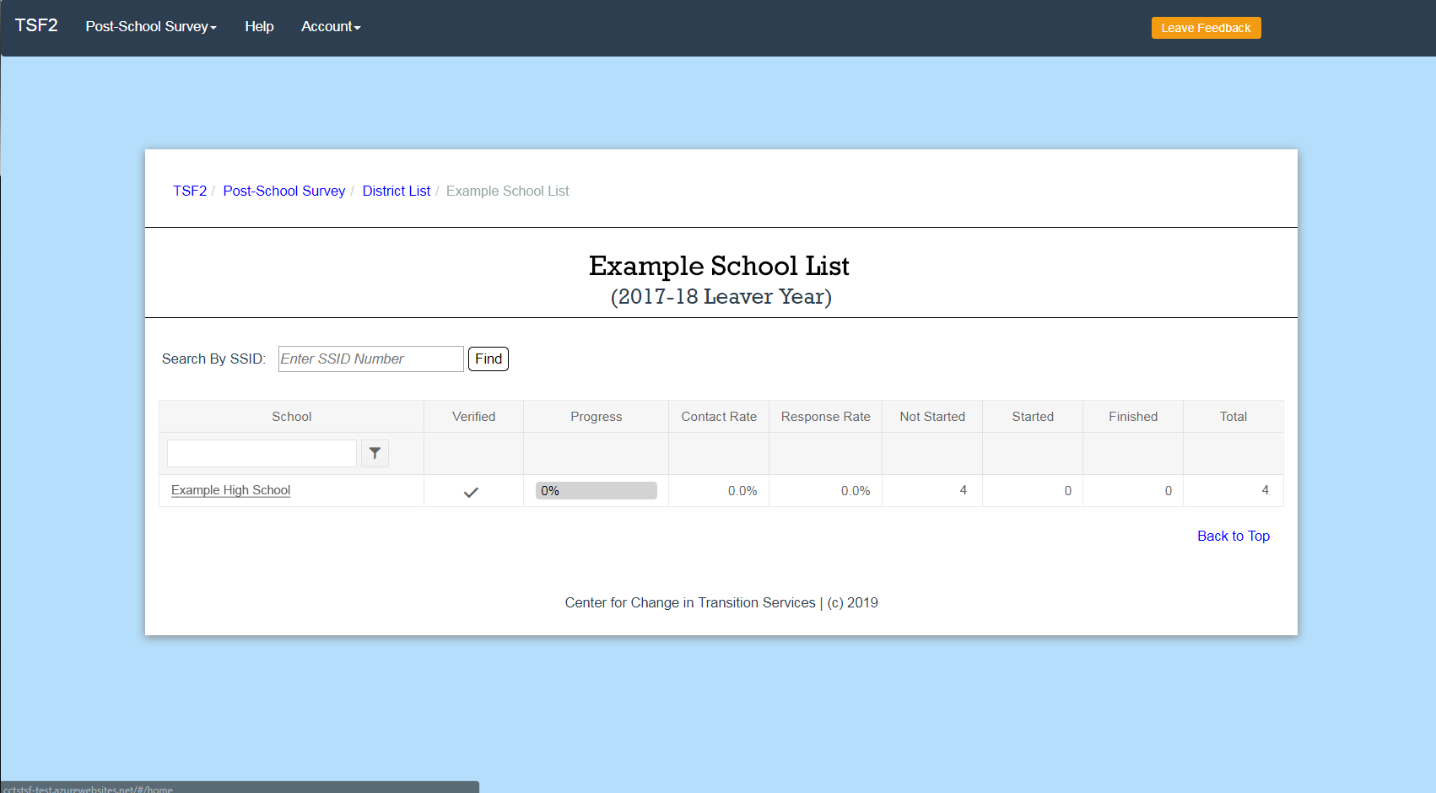
Survey Status by School/School List Screenshot
View survey progress by school in Progress Table format.
Click on desired school.
Notes:
And that takes me to my school list page.
This page shows me all the schools I have access to in Example District.
For me, it’s just Example High School.
I’m going to click the Example High School link.

Slide 32
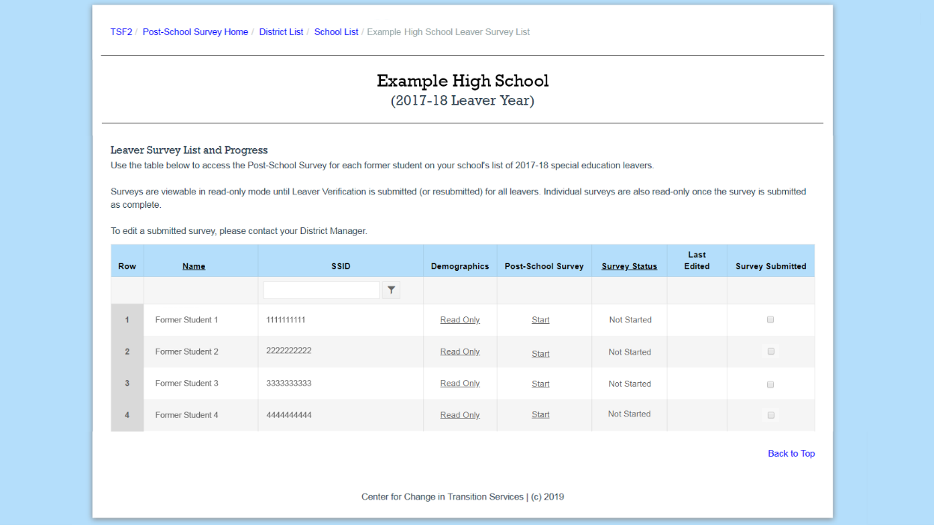
Leaver Survey List Screenshot 1
List by former student name or SSID.
View survey status by leaver.
Click on “Start” or “Edit” to access survey.
Notes:
That takes me to the Leaver Survey List page for Example High School.
From here I can see all four former students that need to be contacted.
To begin a survey for Former Student 1, under the “Post-School Survey” column, I can click “Start.”

Slide 33
I. Former Student Demographics (1-10)
Prepopulated data
Notes:
The first section we see in the survey is Former Student Demographics.
These are considered questions 1-10, and they’re all prepopulated.

Slide 34
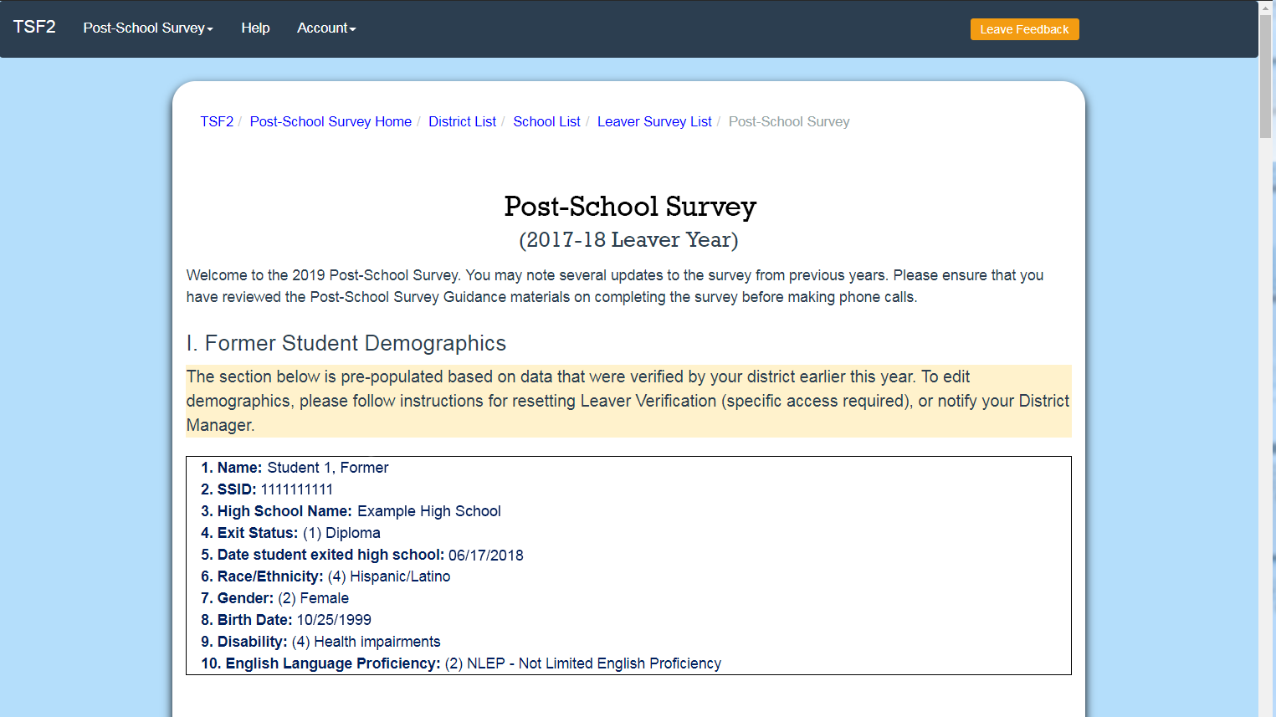
Former Student Demographics
1. Name:
2. SSID:
3. High School Name:
4. Exit Status:
5. Date student exited high school:
6. Race/Ethnicity:
7. Gender:
8. Birth Date:
9. Disability:
10. English Language Proficiency:
Notes:
If you notice an error in these demographics and you do not have a Leaver Verification or District Manager user role, please notify your District Manager so they can make the update.
You can still proceed with the survey, just be sure to make a note and follow up on it.

Slide 35
Exit Date
1. Name:
2. SSID:
3. High School Name:
4. Exit Status:
5. Date student exited high school:
6. Race/Ethnicity:
7. Gender:
8. Birth Date:
9. Disability:
10. English Language Proficiency:
Notes:
I mentioned earlier that I would point out number 5 here, date student exited high school.
This establishes the timeframe for the survey questions, which is 12 months from exit date.
So, June 2018 to June 2019.

Slide 36
II. Pre-survey Questions (11-13)
Complete these questions before the making phone call to former student. Update this section with each contact attempt.
Notes:
The next section, Section II, are Pre-survey Questions.
These questions are to capture the contact attempts.
These should be completed before making a phone call to the former student.

Slide 37
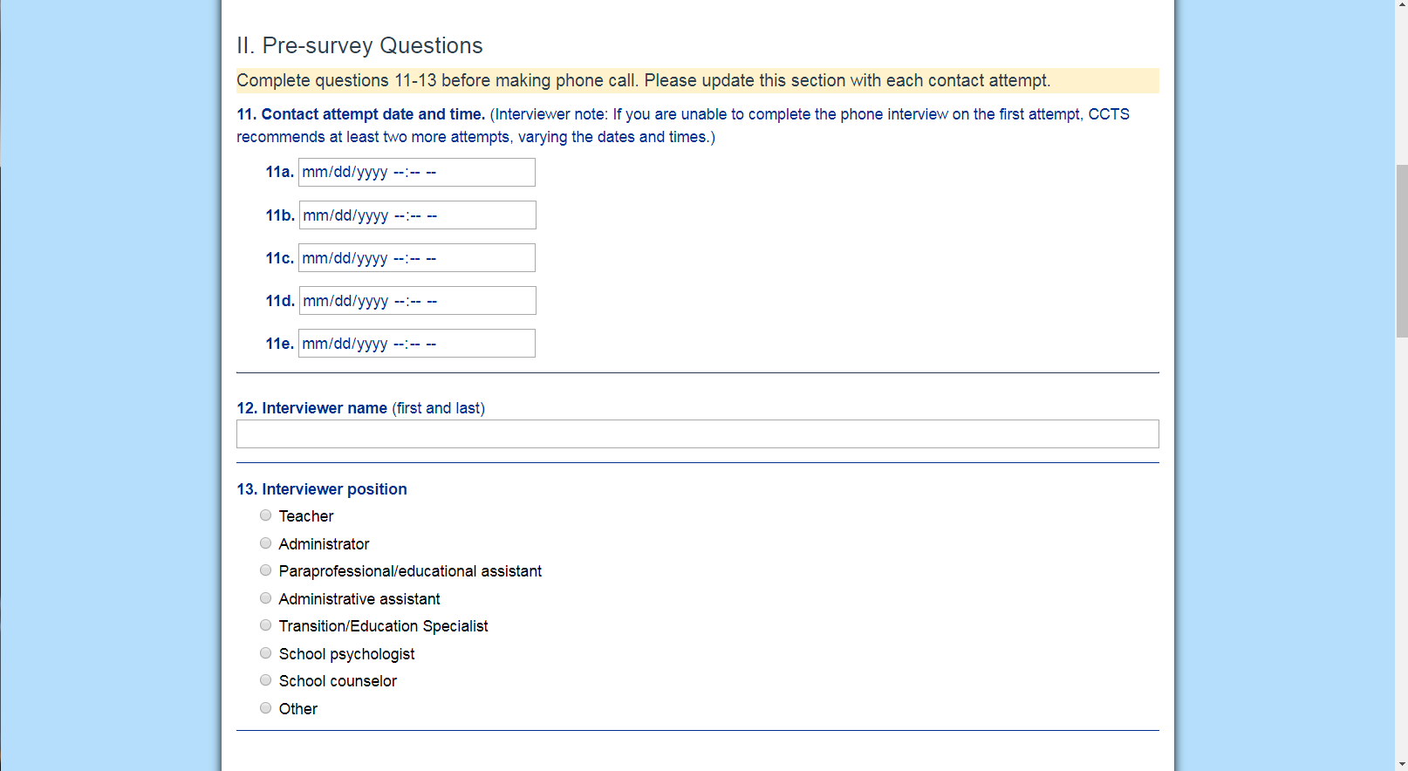
Contact Date/Time
Complete questions 11-13 before making phone call. Please update this section with each contact attempt.
11. Contact attempt date and time. (Interviewer note: If you are unable to complete the phone interview on the first attempt, CCTS recommends at least two more attempts, varying the dates and times.)
[5 calendar dropdowns, 11a-11e]
Notes:
There are five spaces for number 11, Contact attempt date and time.
Here, I can document up to five phone calls where I tried to reach the former student, whether I reached someone or not.
CCTS recommends trying at least three times before counting the former student as a non-responder.
Don’t forget to add the time here.
I’ve done that a few times when testing the survey.
There must be at least one date and time here in order to submit a survey.
And that’s important information, because if you’re making multiple contact attempts, you want to try and vary both the days and times you call to help improve your chances of reaching that former student.

Slide 38
Interviewer Name and Position
12. Interviewer name (first and last)
[textbox]
13. Interviewer position
Teacher
Administrator
Paraprofessional/educational assistant
Administrative assistant
Transition/Education Specialist
School psychologist
School counselor
Other
Notes:
Questions 12 and 13 are Interviewer name, and Interviewer position.
If different people are making the contact attempts, be sure to update these fields each time.
After answering these questions, I’m ready to make my phone call.
Again, this is where we left off in the last webinar.

Slide 39
III. Connect with Survey Respondent
Make phone call to former student.
Use the Former Student Script or Parent/Family Member Script to connect with survey respondents, or make note of a date/time to try again.
Notes:
The next section of the survey, Section III, contains a sample script that can be used to help connect with the former student or their designated family member.
Please feel free to paraphrase the content in the script so that it feels more natural for you.
The script is broken into different sections, depending on who you get on the phone and whether or not they’re available or agree to participate.
For the sake of time, I’m not going to go though the parent/family member script today, but there are slides in this slide deck that include that script.
You’ll also be able to see it clearly labeled when you open the survey.
It’s just a variation of the former student script that asks if they feel like they have enough knowledge about the former student to answer the questions.
I definitely encourage you to take a look before making any phone calls.

Slide 40
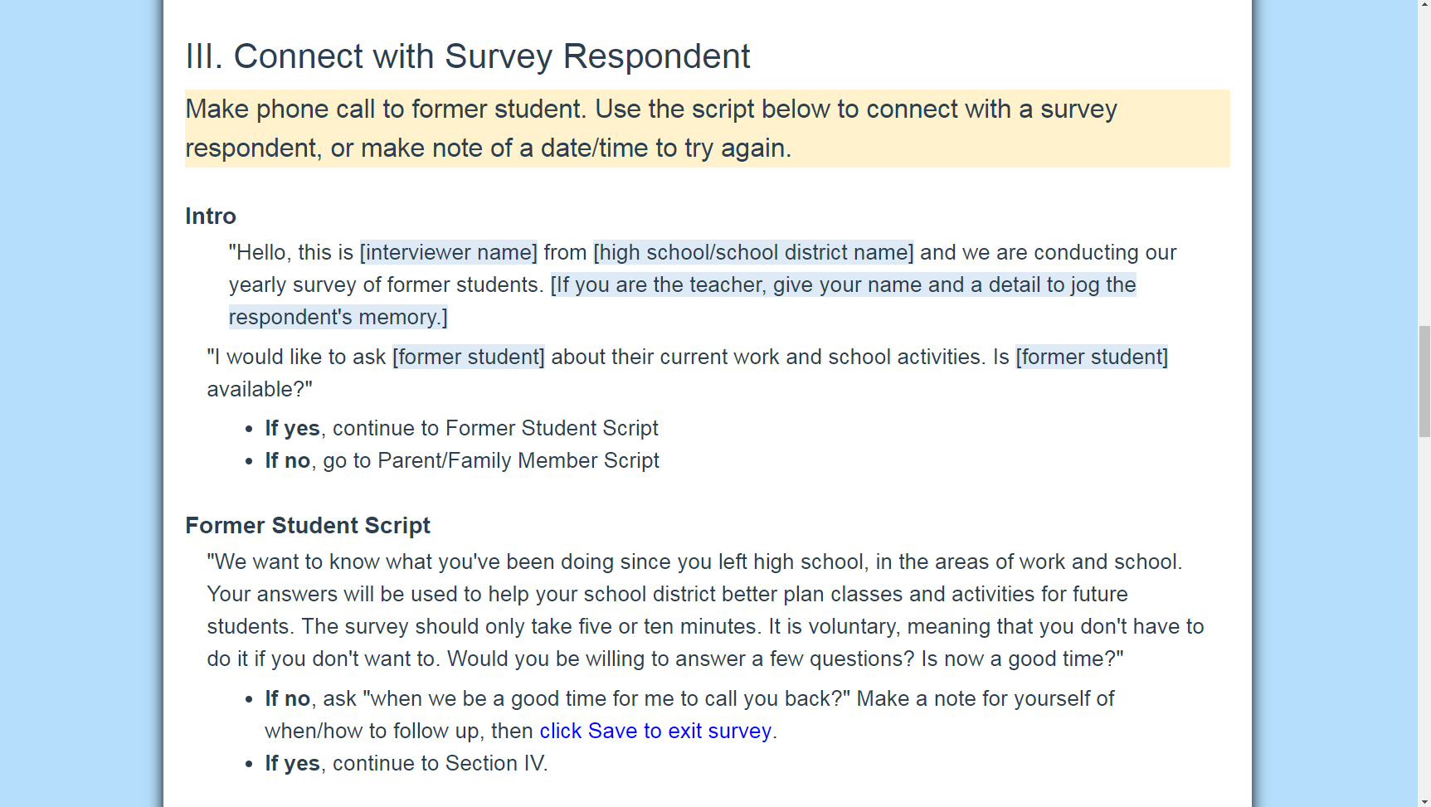
Script: Introduction (Former Student)
Intro
“Hello, this is [interviewer name] from [high school/school district name] and we are conducting our yearly survey of former students. [If you are the teacher, give your name and a detail to jog the respondent’s memory.]
“We would like to ask [former student] about their current work and school activities. Is [former student] available?”
If yes, continue to Former Student script
If no, go to Parent/Family Member script
Notes:
If I place the call and get someone on the phone, the first thing I want to do is introduce myself, and explain that I’m conducting a survey of former students.
It’s important to mention that I should not reveal the former student’s disability status to whoever answers the phone.
That’s a confidentiality issue.
So if I was making this call, I’d say, “Hi, this is Jay Shepherd from Example High School.
We’re conducting a yearly survey of former students.
I’d like to ask Former Student 1 some questions about their work and school activities over the last year.
Are they available?”
Remember, it is preferred that I’m able to talk directly with the former student.
If I am able to talk with them, I’ll proceed to the Former Student Script.
If not, I’d scroll down to the Parent/Family member script.

Slide 41
Former Student Script
Former Student Script
“We want to know what you’ve been doing since you left high school, in the areas of work and school. Your answers will be used to help your school district better plan classes and activities for future students. The survey should only take five or ten minutes. It is voluntary, meaning that you don’t have to do it if you don’t want to. Would you be willing to answer a few questions? Is now a good time?”
If no, ask “when we be a good time for me to call you back?” Make a note for yourself of when/how to follow up, then click Save to exit survey.
If yes, continue to Section IV.
Notes:
Once I know I have the former student on the phone, I may need to reintroduce myself.
I’d say something like, “Hi, this is Jay from Example High School.
Your former teachers and I want to know what you’ve been doing since you graduated, like whether or not you’ve been working or going to school.
Your feedback will help us plan classes and activities for students next year.
The survey should take only five or ten minutes.
It’s voluntary, meaning that you don’t have to do it if you don’t want to.
Would you be willing to answer a few questions, and is now a good time?”
If they say yes, that they are willing to answer the questions and it is a good time, then I’d continue on to Section IV, Survey Respondent Information.
If they said no, I don’t want to do the survey at all, then I’d also continue on to Section IV.
If they said they’re willing to do the survey but now is not a good time, then I’d ask when would be a good time call back, and I’d make a note to follow up.
But for today’s purposes, let’s assume I have someone on the phone ready to start the survey.
I’d move on to section IV: Survey Respondent information.

Slide 42
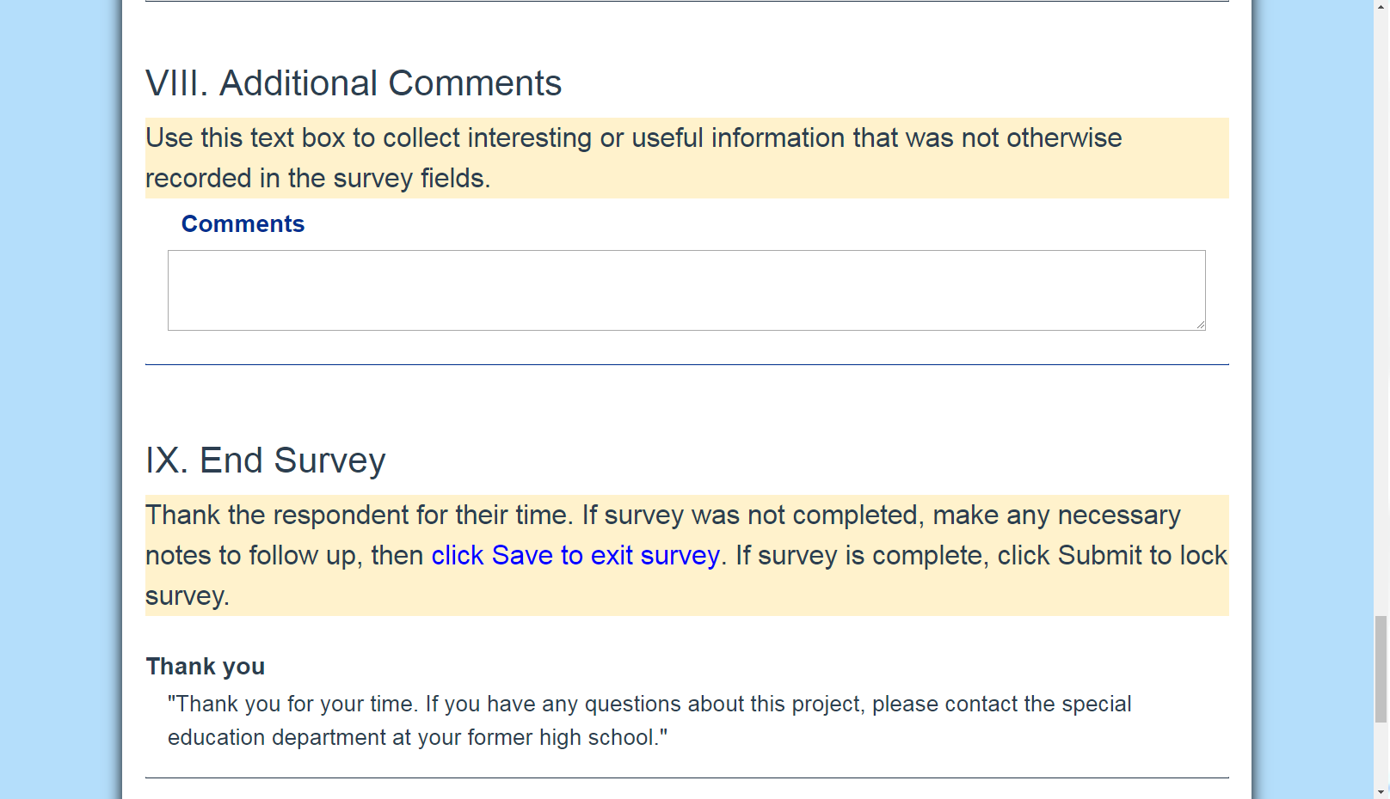
Additional Comments
Use this text box to collect interesting or useful information that was not otherwise recorded in the survey fields.
[textbox]
Notes:
You may want to make those notes in the Additional Comments section of the survey.
Section VIII is always visible no matter where you are in the survey if you scroll down to the bottom of the page.
You may want to track details about your contact attempts in this box, if you choose.
It’s completely optional.
If that’s the end of the conversation, and I’m planning to call back another time, I’m going to want to save what I’ve entered so far, which is my contact attempt information, and exit the survey.

Slide 43
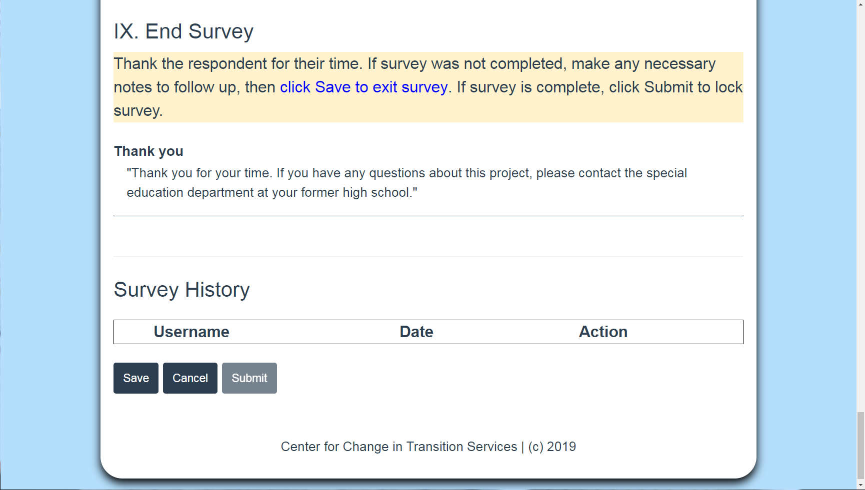
Save Survey Screenshot
Notes:
To do that, I’d scroll down to the very bottom of the page and click Save.

Slide 44
Script: Introduction (Parent/Family)
Intro
“Hello, this is [interviewer name] from [high school/school district name] and we are conducting our yearly survey of former students. [If you are the teacher, give your name and a detail to jog the respondent’s memory.]
“We would like to ask [former student] about their current work and school activities. Is [former student] available?”
If yes, continue to Former Student script
If no, go to Parent/Family Member script
Notes:
Let’s go back a second.
If when I first introduced myself the former student was not available, rather than moving on to the Former Student script, I’d move on to the Parent/Family member script, assuming that that’s who I’m speaking with.

Slide 45
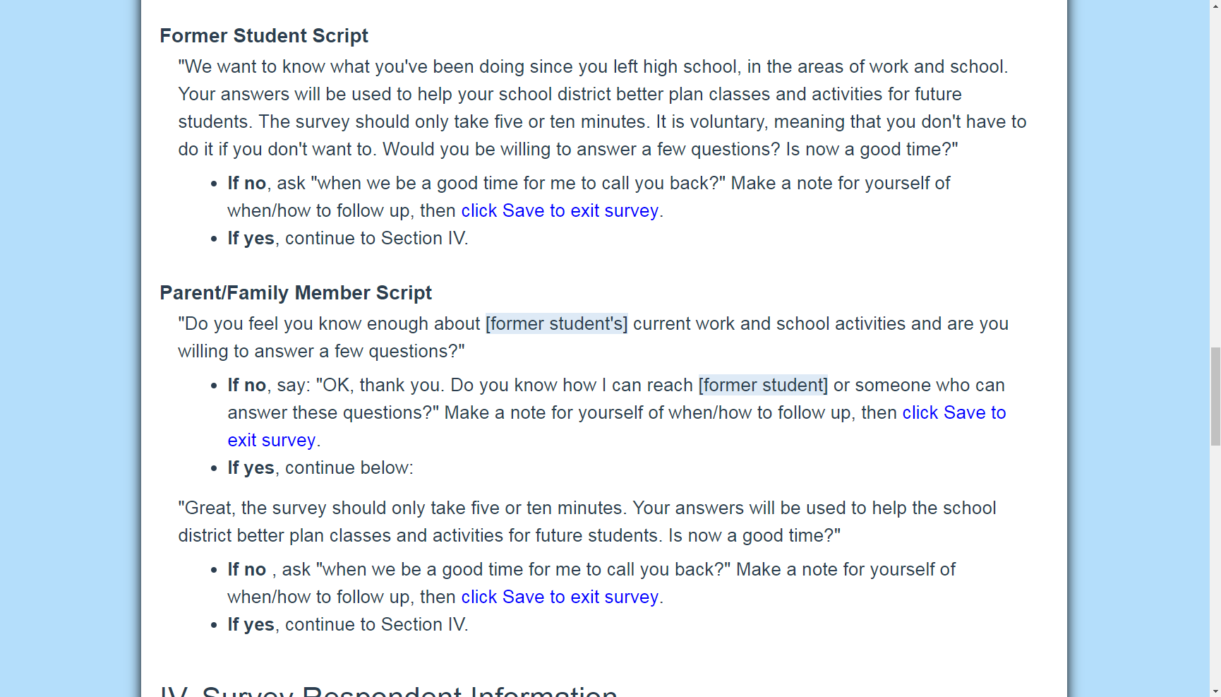
Parent/Family Member Script [1 of 2]
Parent/Family Member Script
“Do you feel you know enough about [former student’s] current work and school activities and are you willing to answer a few questions?”
If no, say: “OK, thank you. Do you know how I can reach [former student] or someone who can answer these questions?” Make a note for yourself of when/how to follow up, then click Save to exit survey.
If yes, continue below:
Notes:
I’d ask if they feel they know enough about the former student’s recent work and school activities to answer the survey questions.

Slide 46
Parent/Family Member Script [2 of 3]
Parent/Family Member Script
“Do you feel you know enough about [former student’s] current work and school activities and are you willing to answer a few questions?”
If no, say: “OK, thank you. Do you know how I can reach [former student] or someone who can answer these questions?” Make a note for yourself of when/how to follow up, then click Save to exit survey.
If yes, continue below:
Notes:
If they said no, I’d try to find out the best way or time to reach the former student.
I’d make a note for myself, then I’d click the link to Save and exit the survey.

Slide 47
Parent/Family Member Script [3 of 3]
“Great, the survey should only take five or ten minutes. Your answers will be used to help the school district better plan classes and activities for future students. Is now a good time?”
If no, ask “when we be a good time for me to call you back?” Make a note for yourself of when/how to follow up, then click Save to exit survey.
If yes, continue to Section IV.
Notes:
If they say yes, they do have detailed knowledge of the former student’s work and education history, then I’d say something like, “Great!
The survey should only take five or ten minutes, and your answers will be used to help our school district plan classes and activities for future students.
Is now a good time to talk?”
If it is, I’d continue on to Section IV.
If not, I’d find out how and when I can follow up.

Slide 48
IV. Survey Respondent Information
Respondent is ready
Respondent declined
Three unsuccessful contact attempts
Former student is deceased
Notes:
There are other reasons you would move on to Section IV.
You move on to this section is you’re not planning to make another contact attempt.
This could be because someone is on the phone and we’re ready to start the survey, which is the scenario we’re working with today.
I would also stop making contact attempts if
The former student (or their family member) declined to participate in the survey
this was my third or fourth unsuccessful contact attempt, or
the former student is deceased. And in this case, if I knew this ahead of time, I wouldn’t actually call the family.
I’d enter a contact attempt (which would just be that day’s date and time), and then I’d skip the phone scripts and move directly to section IV.

Slide 49
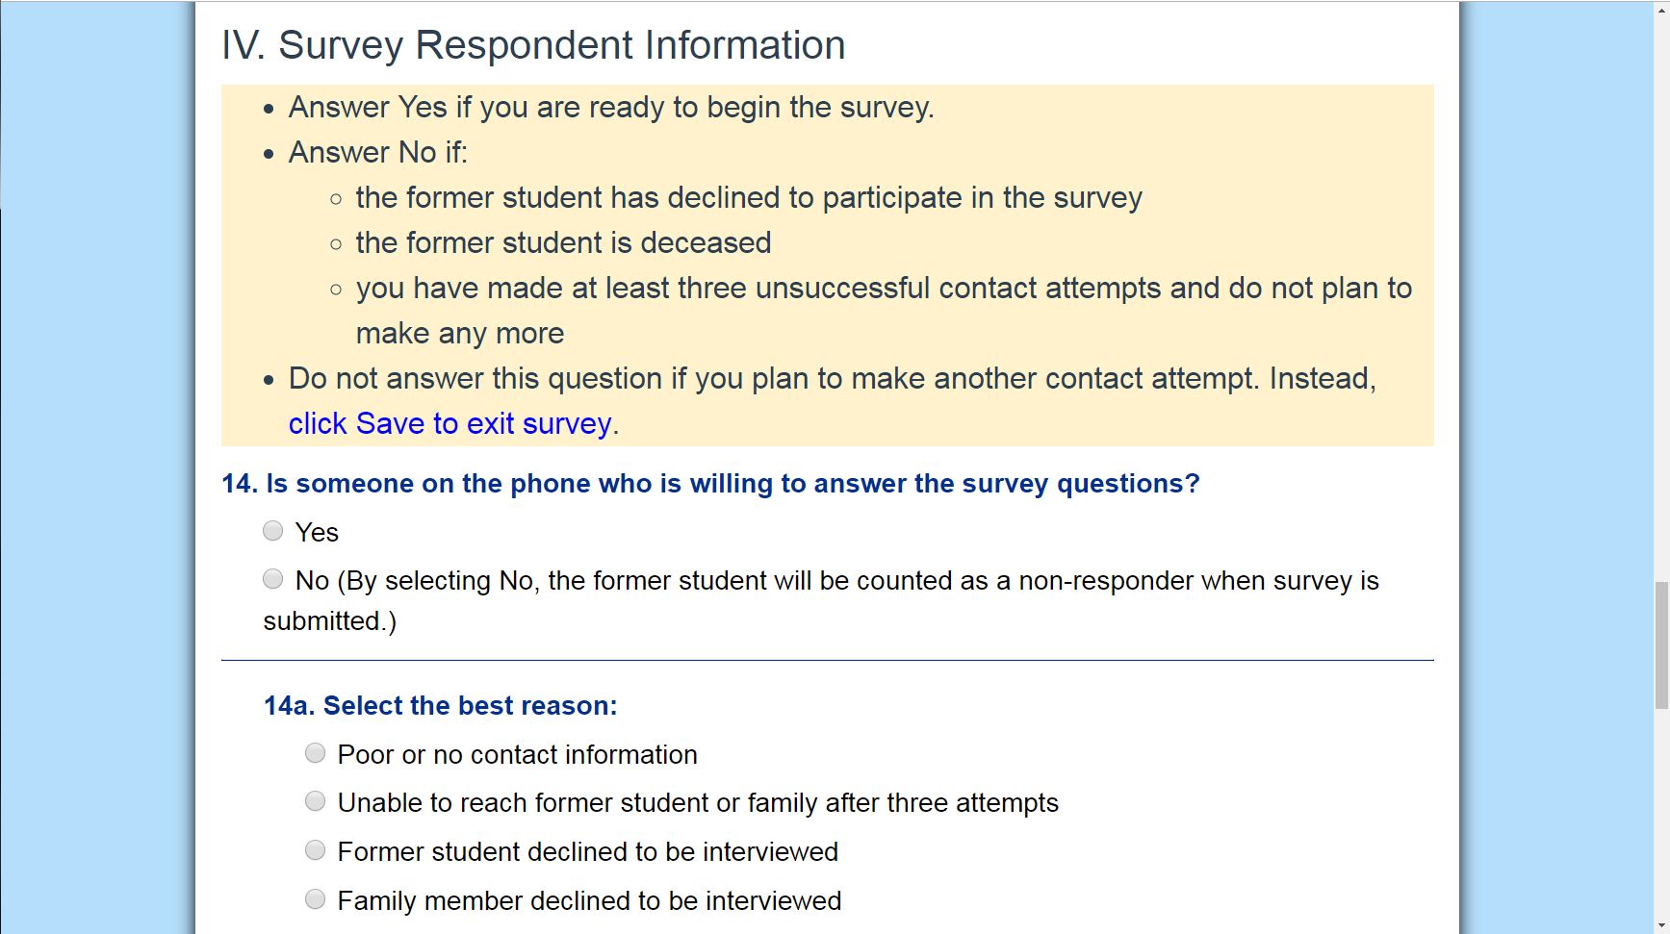
Begin the Survey
For Question 14
Answer Yes if you are ready to begin the survey.
Answer No if
  the former student has declined to participate in the survey
  the former student is deceased
  you have made at least three unsuccessful contact attempts and do not plan to make any more.
Do not answer the question if you plan to make another contact attempt. Instead, click Save to exit survey.
14. Is someone on the phone who is willing to answer the survey questions?
Yes
No (By selecting No, the former student will be counted as a non-responder.)
Notes:
So, section IV starts with question 14, is someone on the phone who is willing and able to answer the questions?

Slide 50
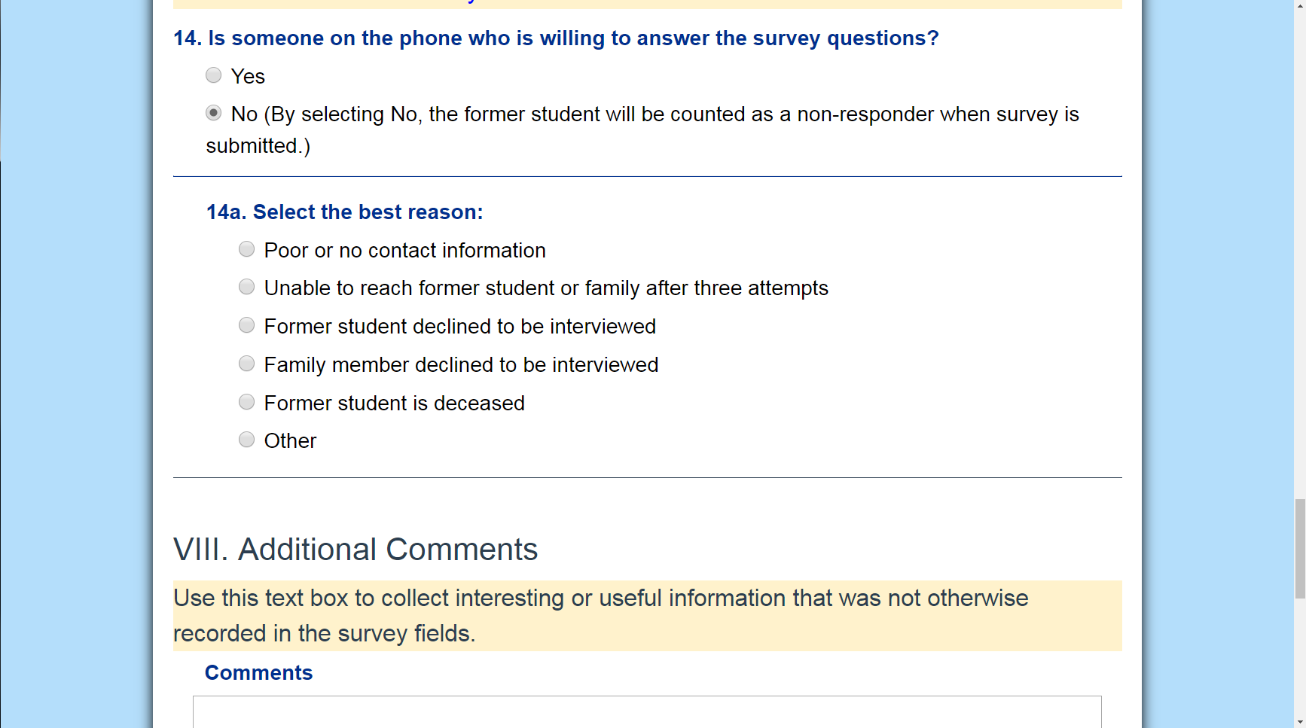
If No: Select Best Reason
14a. Select the best reason:
Poor or no contact information
Unable to reach former student OR family after three attempts
Former student declined to be interviewed
Family member declined to be interviewed
Former student is deceased
Other
Notes:
If I selected No, then I indicate my reason in 14a.
Options include: poor or no contact information; unable to reach former student or family after three attempts; former student declined to be interviewed; family member declined to be interviewed; former student is deceased; or other.

Slide 51
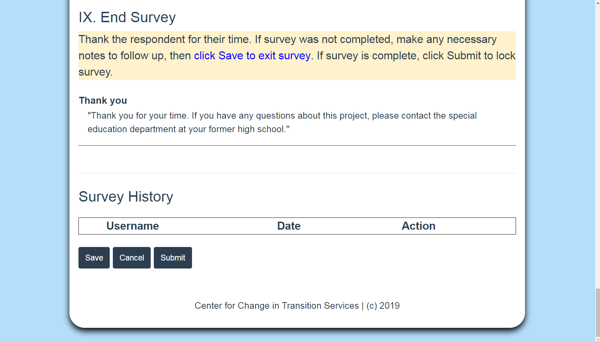
Submit Survey Screenshot
Notes:
Then I’d be done with the survey for this former student.
I’d scroll down and click the blue “Submit” button.
Just a reminder that once I submit a survey, it’s locked and viewable in read-only mode.
It can’t be edited unless a District Manager unlocks it for me.
So if I’m not done, if I’m planning to make another contact attempt, I’d just click Save here.
But if I’m not making any further contact attempts, I’d click Submit.

Slide 52
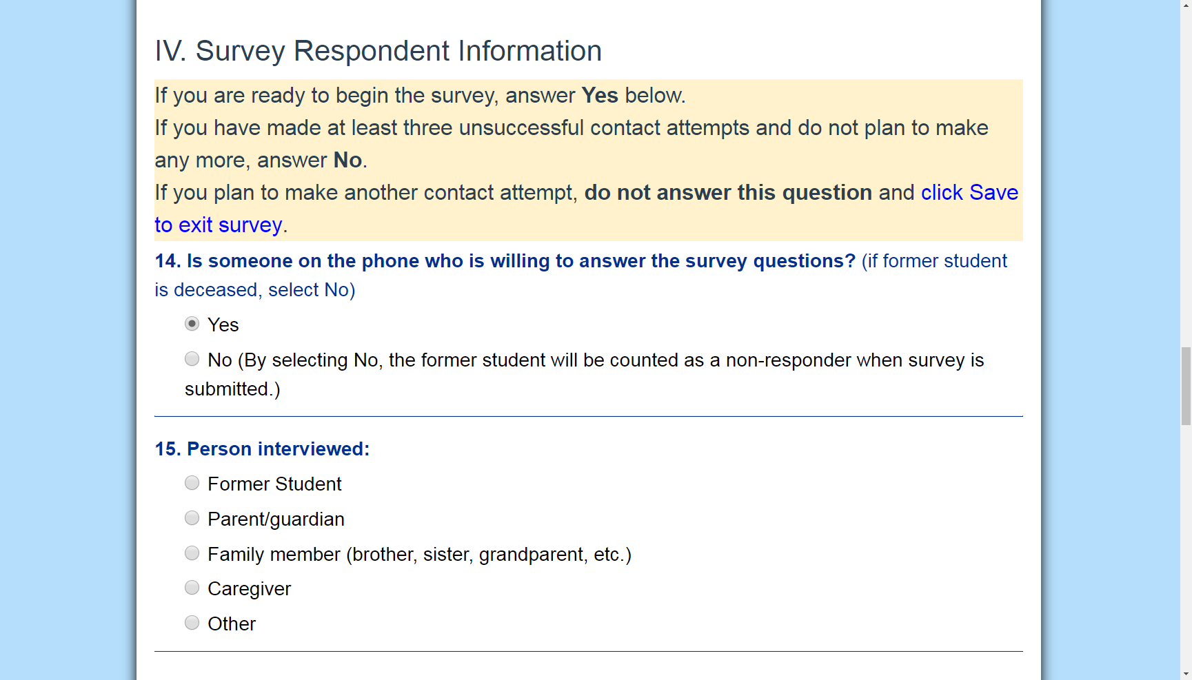
If Yes: Person Interviewed
15. Person Interviewed:
Former Student
Parent/guardian
Family member (brother, sister, grandparent, etc.)
Caregiver
Other
Notes:
If I select yes, then question 15 appears.
I’d indicate who I’m going to interview.
Options include: former student; parent or guardian; other family member, such as brother, sister, or grandparent; caregiver; and other.
Remember that if I’m not speaking directly with the former student, it must be someone with personal knowledge of their work and educational activities.

Slide 53
V. Postsecondary Employment Questions
Ask about work experience since leaving high school. Additional questions may appear based on their responses (16, 16a-16f).
Notes:
Ok, now I’m ready to start asking survey questions.
We start with Section V, Postsecondary Employment Questions.
Remember that the timeframe for all of these questions is going to be within the 12 months since the former student exited high school.
For this former student it was June 2018-June 2019.

Slide 54
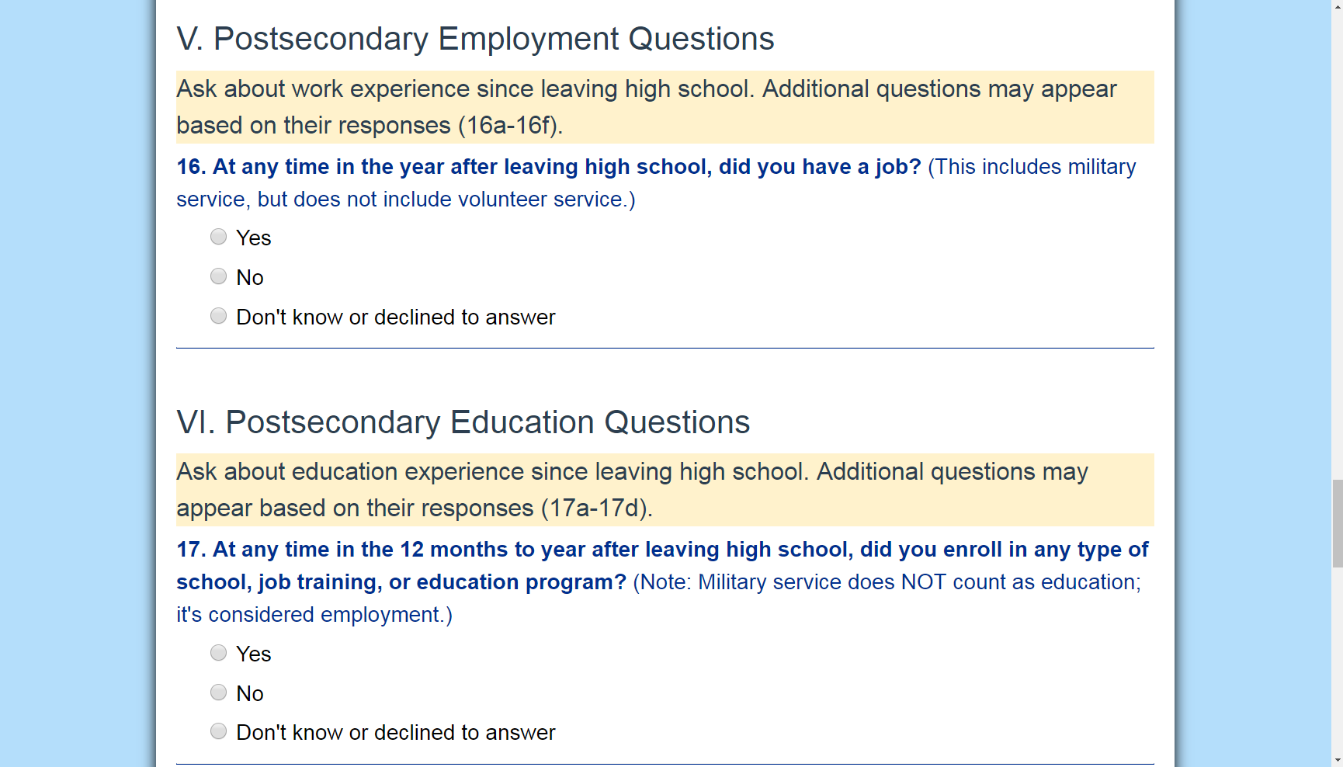
Postsecondary Employment
Ask about work experience since leaving high school. Additional questions may appear based on their responses (16a-16f).
16. At any time in the year after leaving high school, did you have a job? (This includes military service, but does not include volunteer service.)
Yes
No
Don’t know or declined to answer
Notes:
The first question in this section is number 16.
If I was speaking with the former student, I’d ask, “at any time in the year since you left high school, did you have a job?”
If I was talking to a family member, I’d ask “At any time in the year after leaving high school, did Former Student have a job?”
Note that there’s a comment in parentheses after the question.
This is an interviewer note that gives more direction and context.
It’s not meant to be included when asking the question.
This interviewer note reminds us that military service is considered employment, but volunteer work is not.
Those are common questions we get every year.
It must be paid employment, and military service is paid employment.
If the respondent answers Yes to question 16, then I’ll select yes and questions 16a through 16f will appear.
If they answer No, or they don’t know, or they don’t want to answer that question, which is always an option, then I’d select that option and continue on to Section VI. Postsecondary Education Questions.

Slide 55
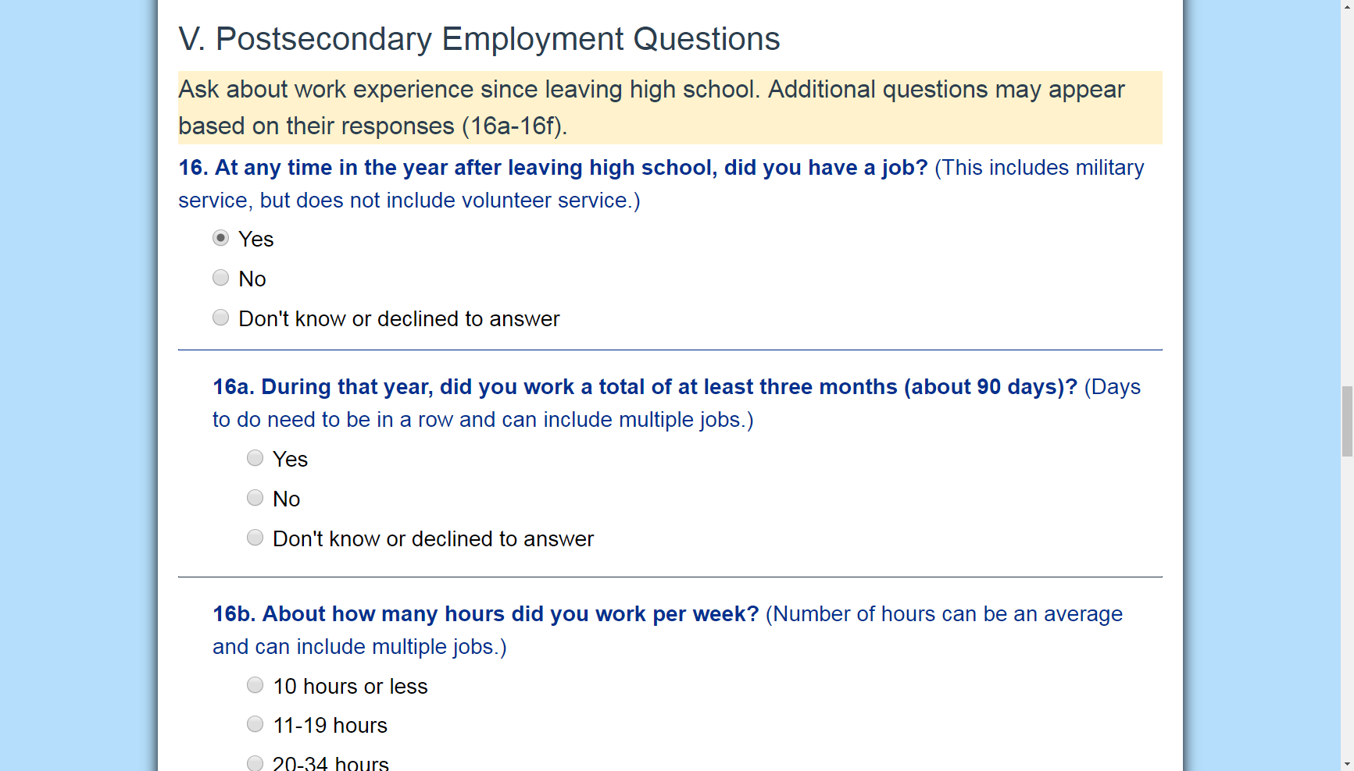
Amount of Time Worked
16a. During that year, did you work a total of at least three months (about 90 days)? (Days do not need to be in a row and can include multiple jobs.)
Yes
No
Don’t know or declined to answer
Notes:
So let’s say they answer yes to 16, the next question is 16a.
It asks if the former student worked at least three months, or about 90 days, in the year since leaving high school.
Our interviewer note reminds us that those 90 days do not need to be consecutive and can be across multiple jobs.
It’s ok if there are gaps in their employment.
This question is about total days worked within the year since leaving high school, all added together.
Answer options include “Yes”; “No”; and “Don’t know or declined to answer.”
If the former student is unsure and can’t really remember how many days they worked, or had multiple short-term jobs, I could try asking additional questions to get a sense of their timeline.
For example, “Around when did you start the job? Was it the beginning of summer, Halloween, or closer to Thanksgiving?” and help make some determinations from there.

Slide 56
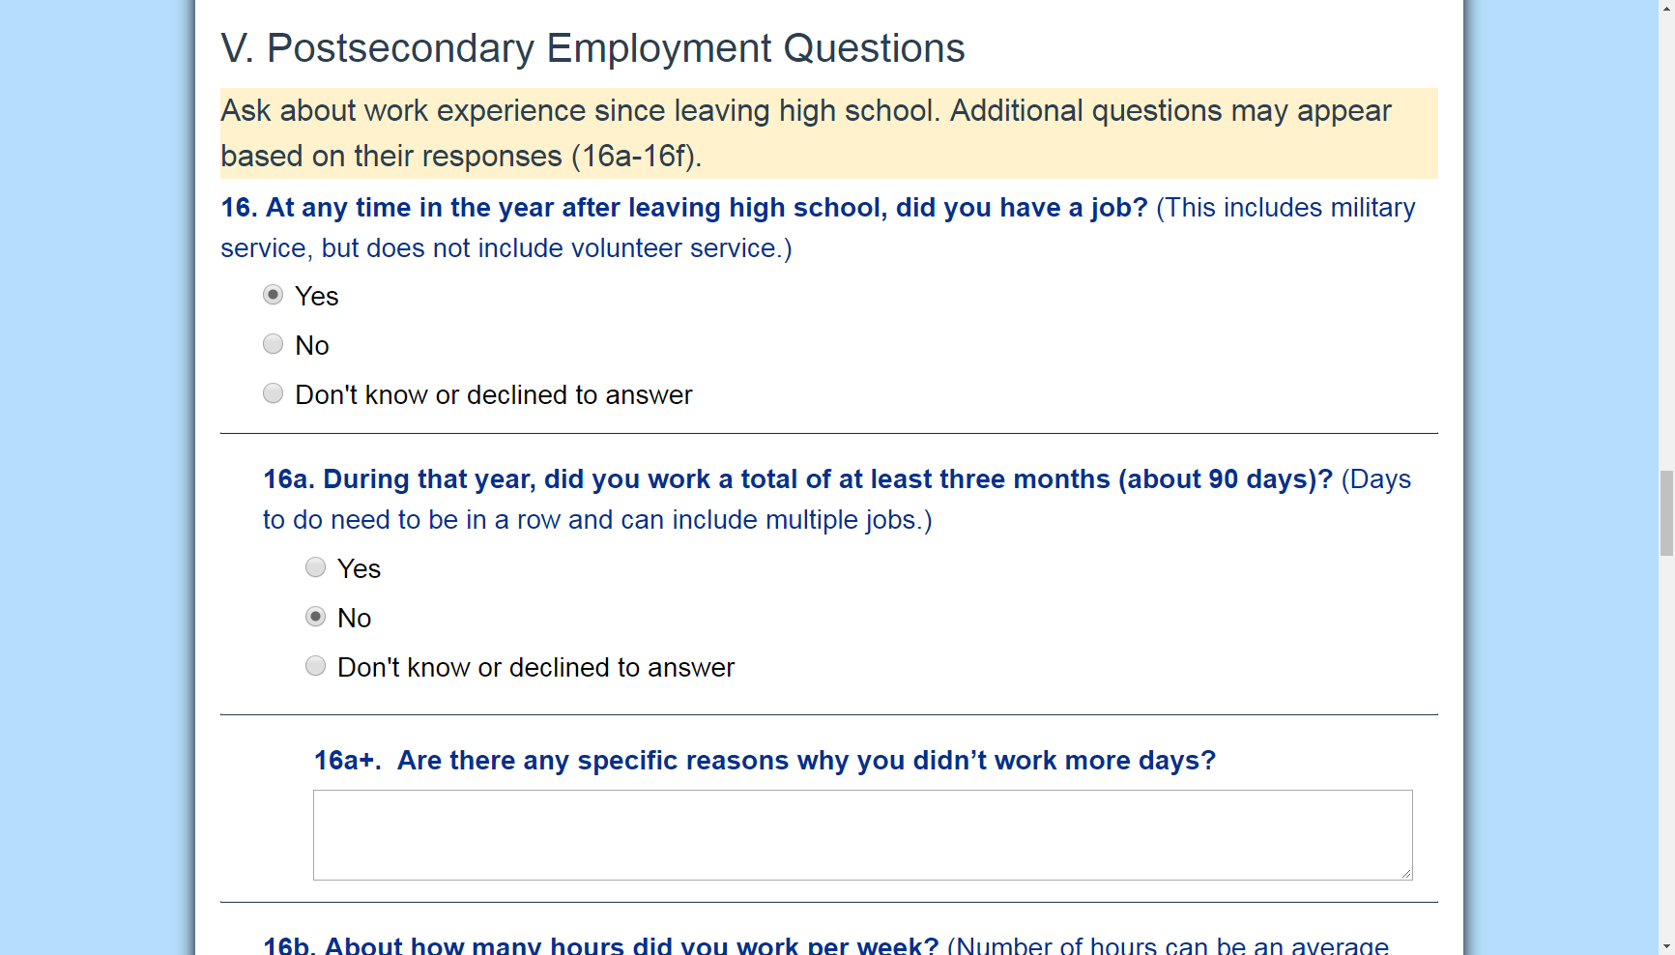
Follow-up Question: Days Worked
Question 16a+. Are there any specific reasons why you didn’t work more days?
[textbox]
Notes:
If the respondent answers No to 16a, question 16a+ appears.
This is our first follow-up question, indicated by that plus sign, and it’s designed to gather insights into why the former student doesn’t meet the reporting requirements for competitive employment.
It’s up to me to decide if I want to ask this question.
If I asked if there any specific reasons why the former student didn’t work more days, then I’d record their answer in the text box.
Otherwise I’d move on to 16b.

Slide 57
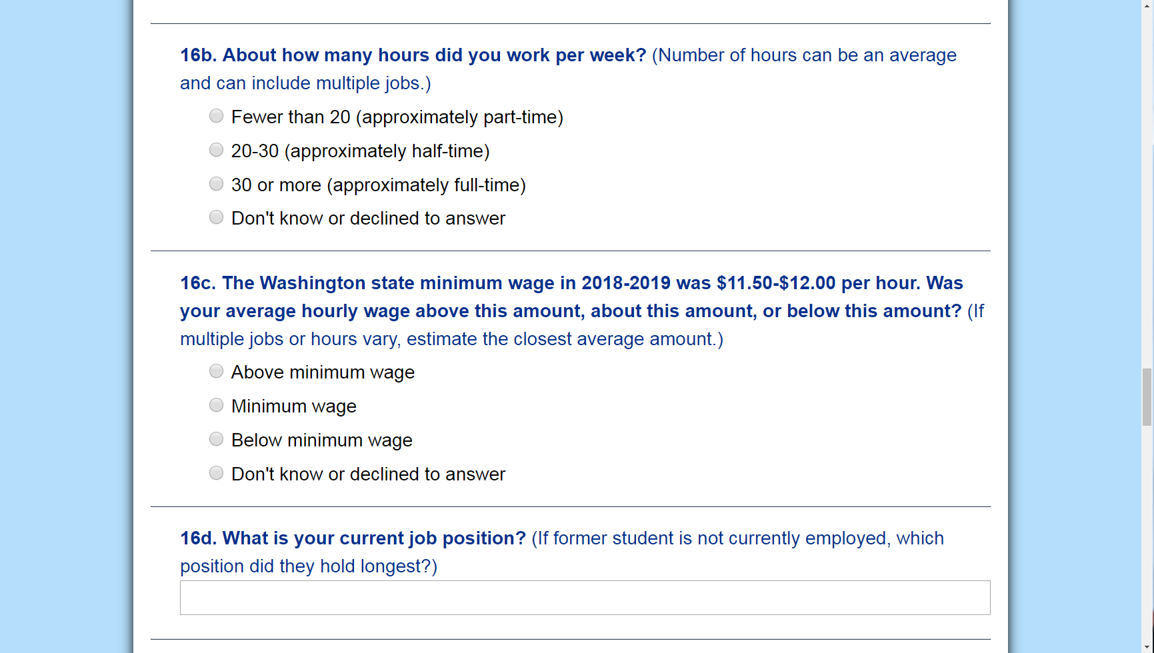
Number of Hours Worked
16b. About how many hours did you work per week? (Number of hours can be an average and can include multiple jobs.)
Fewer than 20 (approximately part-time)
20-30 (approximately half-time)
30 or more (approximately full-time)
Don’t know or declined to answer
Notes:
16b asks the respondent to estimate the typical number of hours worked per week while they were employed.
Like with total number of days worked, these can be hours across multiple jobs that were worked over different time periods.
Again, we’re looking for a general idea, an average.
I could read the options to the respondent if they’re having a hard time answering this question, or try and break it down into hours worked in a typical day, and make a determination that way.
We’re looking to know if it’s full, part, or half-time employment.
As with all questions, don’t know or declined to answer is an option.

Slide 58
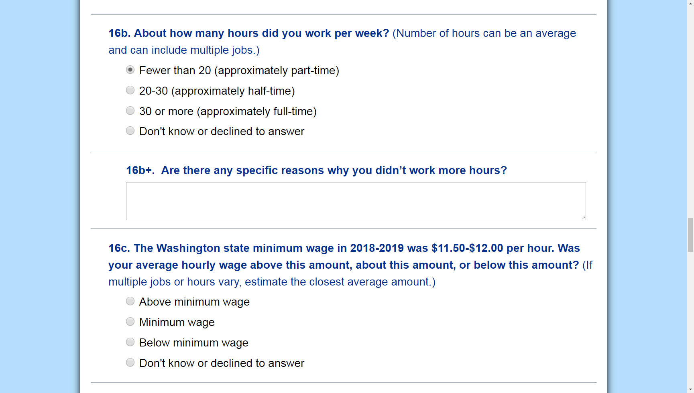
Follow-up Question: Hours Worked
Question 16b+. Are there any specific reasons why you didn’t work more hours?
[textbox]
Notes:
If the respondent answers that they worked fewer than 20 hours, or approximately part time, I’d select that option, and question 16b+ appears.
This is our second follow-up question.
It’s another question to better understand why this former student isn’t meeting the reporting requirements for competitive employment.
If I decide to ask if there are specific reasons the former student didn’t work more hours, then I’d record the comments in the text box.
Otherwise I’d move on to 16c.

Slide 59
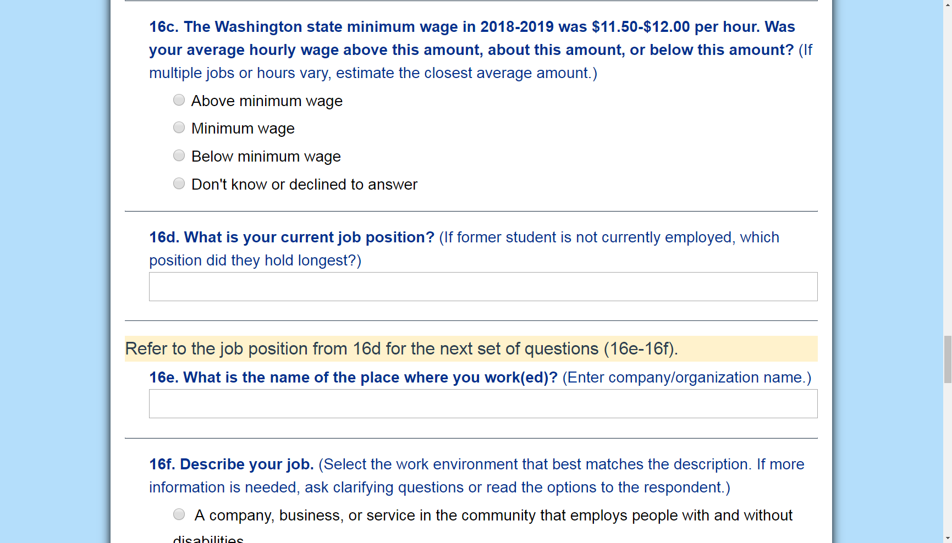
Average Hourly Wage
16c. The Washington state minimum wage in 2018-2019 was $11.50-$12.00 per hour. Was your average hourly wage above this amount, about this amount, or below this amount? (If multiple jobs or hours vary, estimate the closest average amount.)
Above minimum wage
Minimum wage
Below minimum wage
Don’t know or declined to answer
Notes:
16c asks about wages earned per hour.
I could just ask that question, How much did you make per hour, and select the answer based on Washington’s minimum wage of $11.50-$12 an hour in 2018 to 2019.
Or I could ask something like, were you making more or less than $12 an hour?
If wages varied with different jobs, I’d help the respondent to estimate the closest average.
It will be helpful to get a number here, because unless they don’t know, a follow-up question is going to pop up next asking for that information.

Slide 60
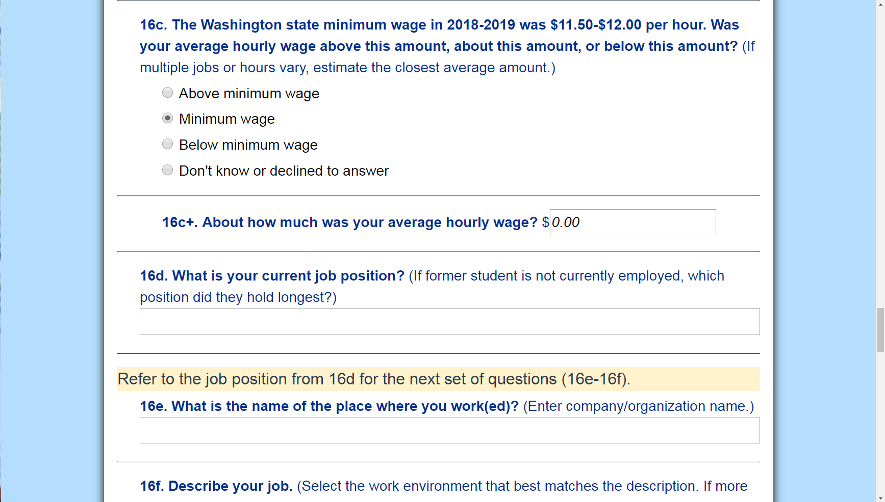
Follow-up Question: Hourly Wage
Question 16c+. About how much was your average hourly wage?
[textbox]
Notes:
If they answer above, at, or below minimum wage, 16c+ appears.
If I already asked the question in order to get my answer to 16c, I’d just enter it here.
And remember that an estimate is fine.

Slide 61
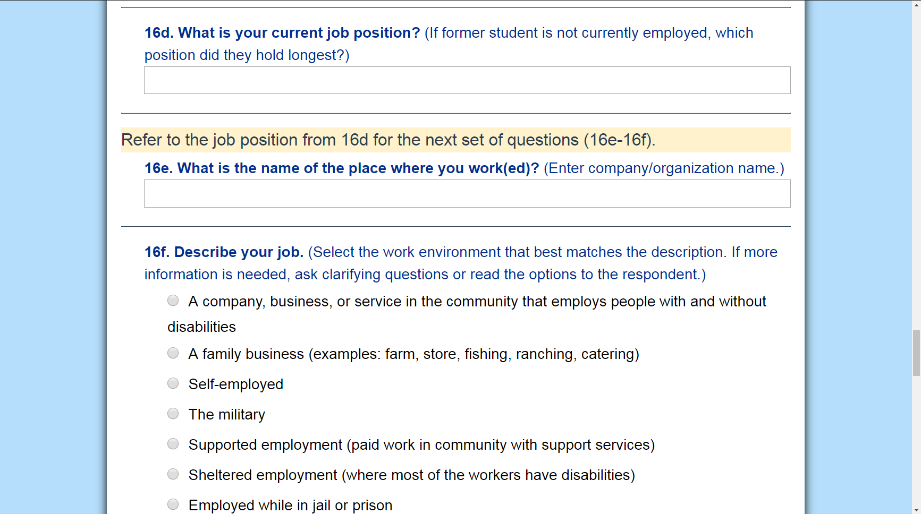
Job Position
16d. What is your current job position? (If former student is not currently employed, which position did they hold the longest?)
[textbox]
Notes:
Next, is question 16d.
This question is essentially a primer in order to get answers to the following questions about their work environment.
I’m going to ask the respondent what their current job position is and enter their response in the text box.
If the former student isn’t currently employed, I’d ask them to name the job they held for the longest timeframe in the last year.

Slide 62
Company/Organization Name
16e. What is the name of the place where you work(ed)? (Enter company/organization name.)
[textbox]
Notes:
The next question, 16e, asks for the name of the place where they worked when they held the position they named in the previous answer.
I’d record their answer in the textbox.
And then I’d keep these responses in mind as I move on to the next question.

Slide 63
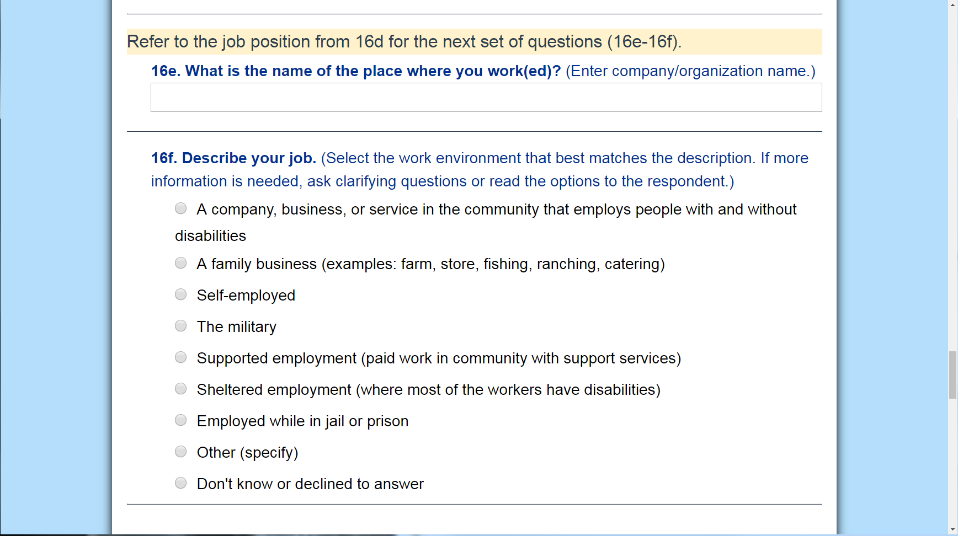
Work Environment
16f. Describe your job. (Select the work environment that best matches the description. If more information is needed, ask clarifying questions or read the options to the respondent.)
Notes:
Question 16f asks the survey respondent to “Describe their job.”
It’s a very open-ended question that could get a wide range of responses.
We’re trying to get an idea of their work environment here.
So, as the respondent is describing the job that they named in question 16d, I’m going to be looking at these options about work environment, trying to narrow it down.
I don’t need to record what they say, but I’m going to use their answer to select the best response here.

Slide 64
Work Environment Responses
A company, business, or service in the community that employs people with and without disabilities
A family business (examples: farm, store, fishing, ranching, catering)
Self-employed
The military
Supported employment (paid work in community with support services such as job coach or agency)
Sheltered employment (where most of the workers have disabilities)
Employed while in jail or prison
Other (specify) _______________
Don’t know or declined to answer
Notes:
I could read the options to the respondent, but it’s a long list to have to read and keep track of over the phone.
I will read them to you now though. They are:
A company, business, or service in the community that employs people with and without disabilities, like Target or Starbucks
A family business, such as working on a farm, in a store, fishing, ranching, catering, and others
Self-employment
The military
Supported employment: which would mean that the former student works in a community organization or company where people with and without disabilities work. In this situation, the former student is supported by a job coach or similar support person who helps them in daily job tasks. The goal of this type of employment environment is that they will eventually work without the presence of the job coach.
Other options include
Sheltered employment, which means that the work environment is segregated and consists mostly of people with disabilities.
This setting may be used for training or work skills, or it may be a long-term placement.
Employed while in jail or prison
Other, which if you select, a text box will appear so that you can specify what that is
And then don’t know or declined to answer
If I wasn’t sure which answer is the best match, I’d ask the respondent clarifying questions.
Examples might be: “Is this your family’s business?”; “Do you work for yourself?”; “Do you have a job coach?”.
I could also ask the respondent to select one of the options if I’ve narrowed them down a bit.

Slide 65
VI. Postsecondary Education Questions
Ask about education experience since leaving high school. Additional questions may appear based on their responses (17a-17d).
Notes:
And that’s it for employment questions.
Next we’ll move on to the Postsecondary Education Questions.
Remember, again, timeframe for these questions is 12 months from the exit date.

Slide 66
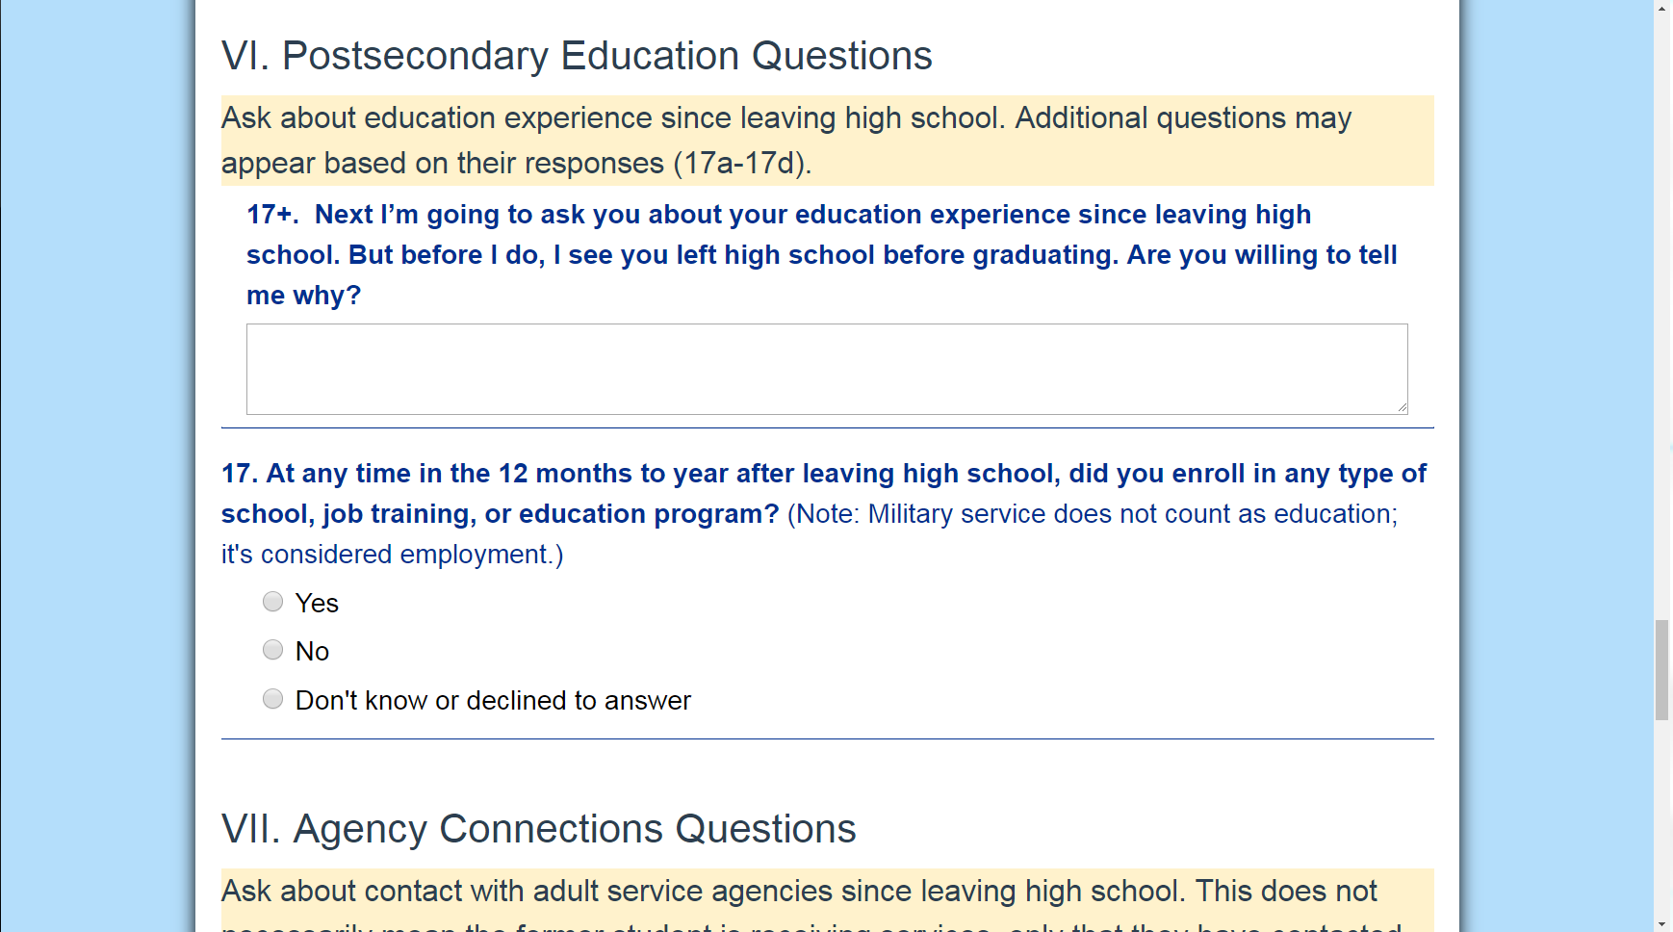
Follow-up Question: Exit Status
Ask about education experience since leaving high school. Additional questions may appear based on their responses (17a-17d).
17+. Next I’m going to ask you about your education experience since leaving high school. But before I do, I see you left school before graduating. Are you willing to tell me why?
[textbox]
Notes:
If I noticed at the beginning of the survey that the former student’s exit status is dropped out, then I’d know ahead of time that follow-up question 17+ is going to appear in the survey.
So 17+ prompts us to say:
“Next I’m going to ask about your education experience since leaving high school.
But before I do, I see you left school before graduating.
Are you willing to tell me why?”
If I decided to ask this follow-up question, I’d record the response in the text box.
Otherwise, I’d move on to question 17.

Slide 67
School, Training, or Education
17. At any time in the year after leaving high school, did you enroll in any type of school, job training, or education program? (Military service does not count as education; it’s considered employment.)
Yes
No
Don’t know or declined to answer
Notes:
17 asks if the former student was ever enrolled in an education program in the year since leaving high school.
Note that it does not ask if they are currently enrolled or if they completed a term, only if they were enrolled at any time in that 12-month period. Keyword is enrolled.
If the respondent answers Yes, I’ll select that and questions 17a through 17d will appear.
If the respondent answers No, doesn’t know, or declines to answer, I’d select that option and continue on to Section VII. Agency Connections.

Slide 68
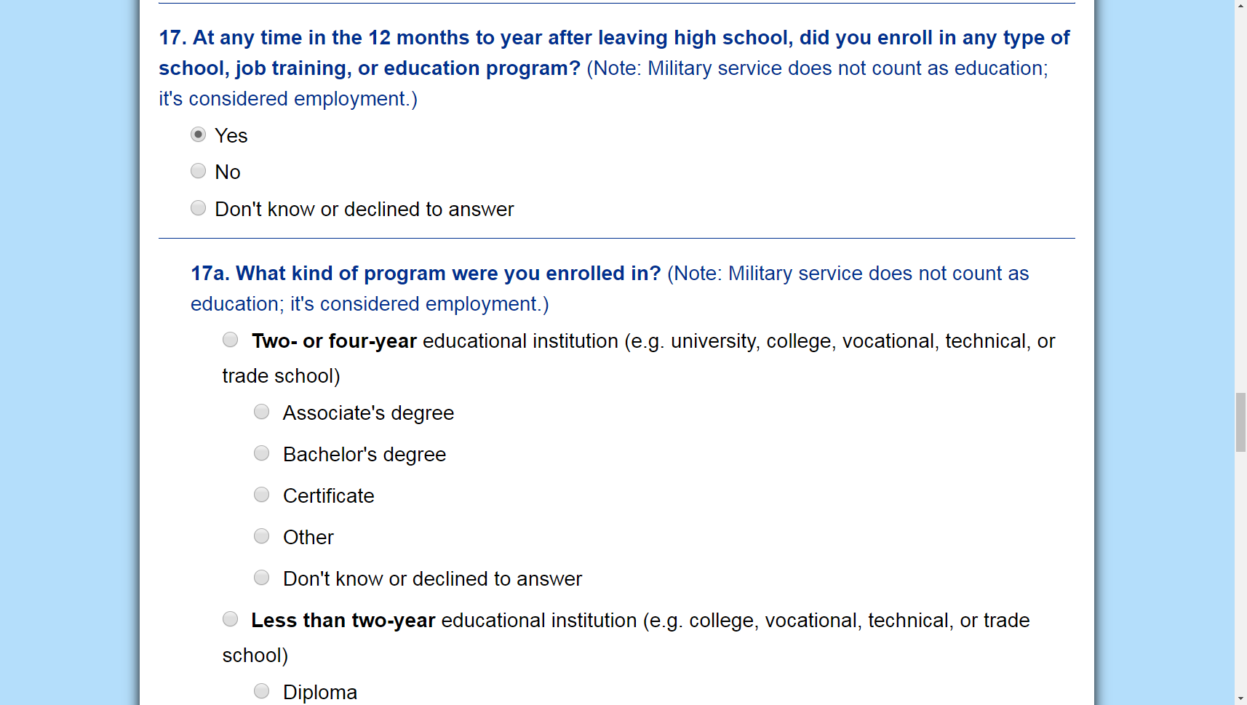
What Kind of Program? [1 of 7]
17a. What kind of program were you enrolled in? (Military service does not count as education; it’s considered employment.)
Two- or four-year educational institution (e.g. university, college, vocational, technical, or trade school)
  Associate’s degree
  Bachelor’s degree
  Certificate
  Other
  Don’t know or declined to answer
Notes:
If the respondent answers yes to 17, then 17a asks what kind of program the former student was enrolled in.
Again, I need to choose the option that best matches the respondent’s answer.
And for some of these options, there are suboptions, like here, two- or four-year educational institution gives me an example of the programs, which include, Associate’s and Bachelor’s degrees, certificates, other, or don’t know or declined to specify.
I want to get an answer that’s as specific as possible here.

Slide 69
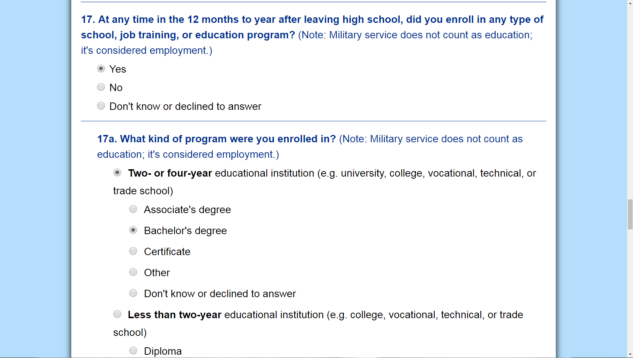
What Kind of Program? [2 of 7]
17a. What kind of program were you enrolled in? (Military service does not count as education; it’s considered employment.)
Two- or four-year educational institution (e.g. university, college, vocational, technical, or trade school)
  Associate’s degree
  Bachelor’s degree
  Certificate
  Other
  Don’t know or declined to answer
Notes:
And note that if I select one of the suboptions, the main category is automatically selected.
So here, when I select Bachelor’s degree, two-or four year institution automatically selects as well.
For the sake of time, I’m not going to go through all the suboptions, but I will zoom out and read the main categories.

Slide 70
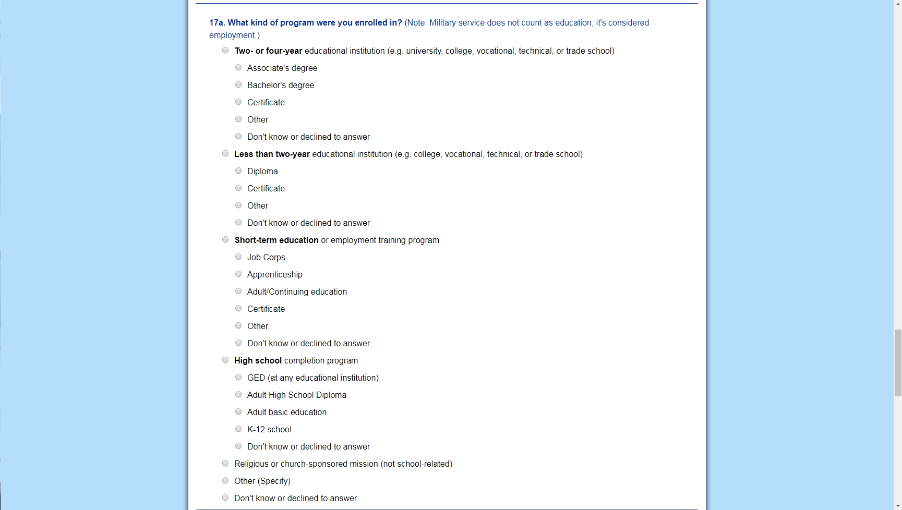
What Kind of Program? [3 of 7]
17a. What kind of program were you enrolled in? (Military service does NOT count as education; it’s considered employment.)
Two- or four-year educational institution (e.g. university, college, vocational, technical, or trade school)
  Associate’s degree
  Bachelor’s degree
  Certificate
  Other
  Don’t know or declined to answer
Notes:
In addition to two- or four year educational institution, those seven primary categories are less than two year educational institution, short-term education, high school completion program, religious or church-sponsored mission, other, and don’t know or declined to answer.
There are additional slides in this deck that take a closer look at each of the suboptions in this list in case you need more direction about how to answer this question before moving on to 17b.

Slide 71
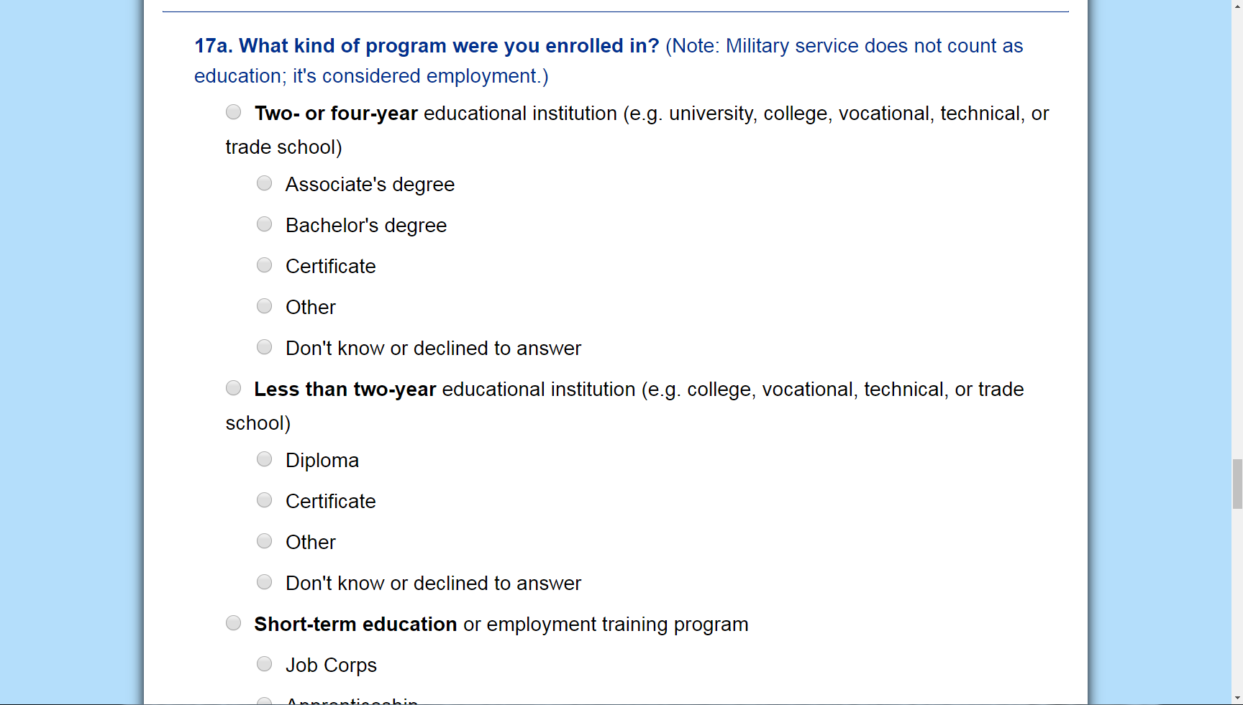
What Kind of Program? [4 of 7]
Less than two-year educational institution (e.g. college, vocational, technical, or trade school)
  Diploma
  Certificate
  Other
  Don’t know or declined to answer
Notes:
If the former student had been enrolled in a less than two-year educational institution, something like a college, vocational, technical, or trade school, that offers programs less than two-years in duration, I’ll want to specify whether it was a program designed to earn a diploma, certificate, other credential, or the if respondent doesn’t know or declines to specify.

Slide 72
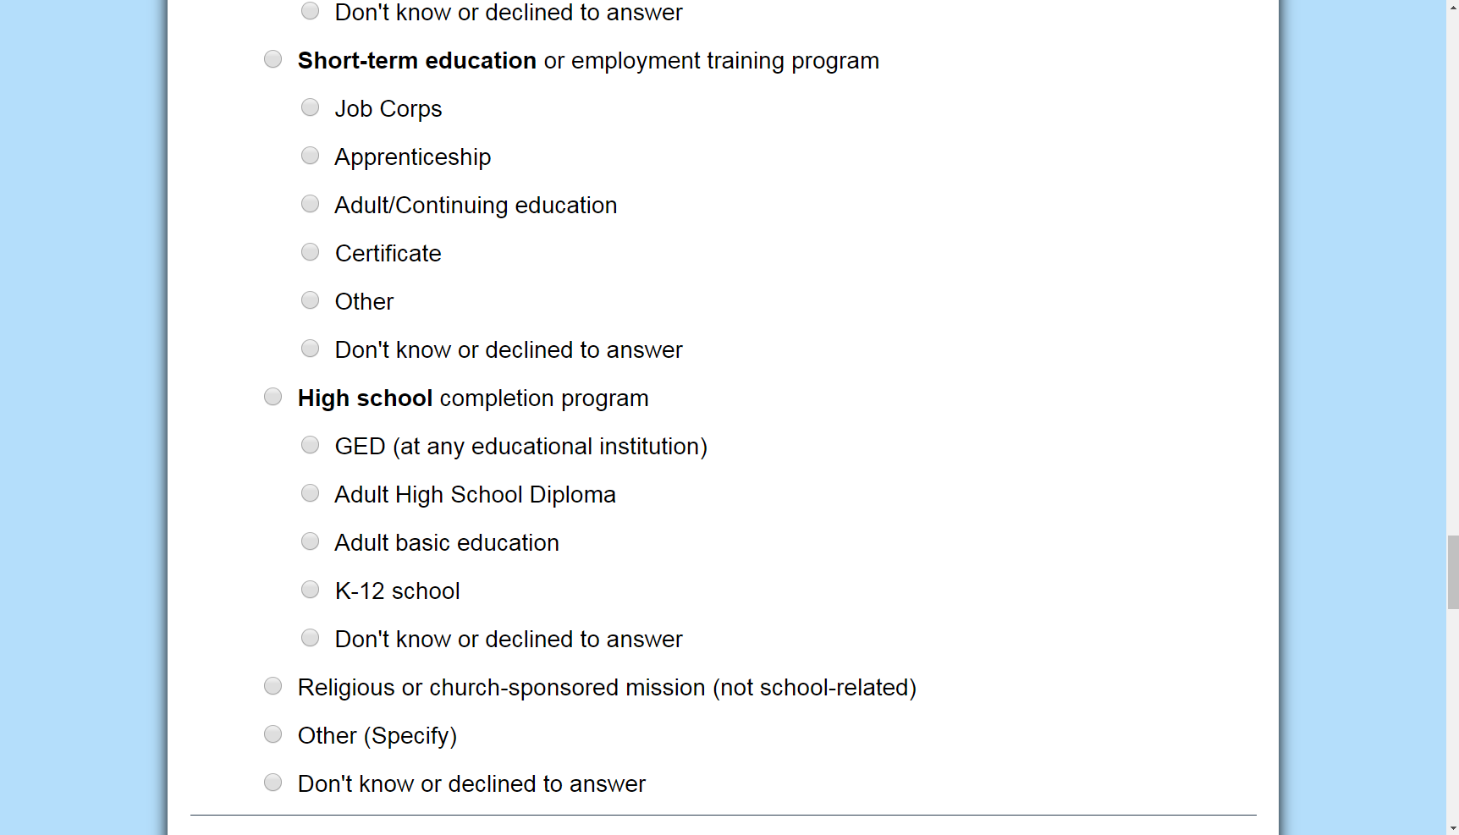
What Kind of Program? [5 of 7]
Short-term education or employment training program
  Job Corps
  Apprenticeship
  Adult/continuing education
  Certificate
  Other
  Don’t know or declined to answer
Notes:
The respondent may describe a short-term education or employment training program. Suboptions for those categories include Job Corps, apprenticeship, adult or continuing education, certificate, other, or perhaps the respondent didn’t know the program or declined to specify.

Slide 73
What Kind of Program? [6 of 7]
High school completion program
  GED (at any educational institution)
  Adult High School Diploma
  Adult basic education
  K-12 school
  Don’t know or declined to answer
Notes:
The last category with suboptions is high school completion program, which includes GED, adult high school diploma, adult basic education, or K-12 school, or the respondent doesn’t know or declines to specify.
Please note that if you select K-12 school, it is assumed that this is no longer a former student.
This would be a current student who has re-enrolled in a K-12 institution, so they’re not considered a leaver.
Choosing this option would prompt me to end the survey and delete the former student from my leaver survey list.
A pop-up would appear asking me to confirm that this survey should end and the student should be deleted.
I could cancel to return to the survey if I had selected it by mistake.
Or I could click OK to confirm.
If I canceled and returned to the survey, I’d need to select a different answer to continue.

Slide 74
What Kind of Program? [7 of 7]
Religious or church-sponsored mission (not school-related)
Other (specify) _____________
Don’t know or declined to answer
Notes:
The remaining options for answering 17a include: “Religious or church-sponsored mission,” “Other”; or “Don’t know or declined to answer.”
For Religious or church-sponsored mission, this answer assumes that it is not a school-related mission.
If it were school-related, I’d instead select the option that matches the educational institution where the former student was enrolled.

Slide 75
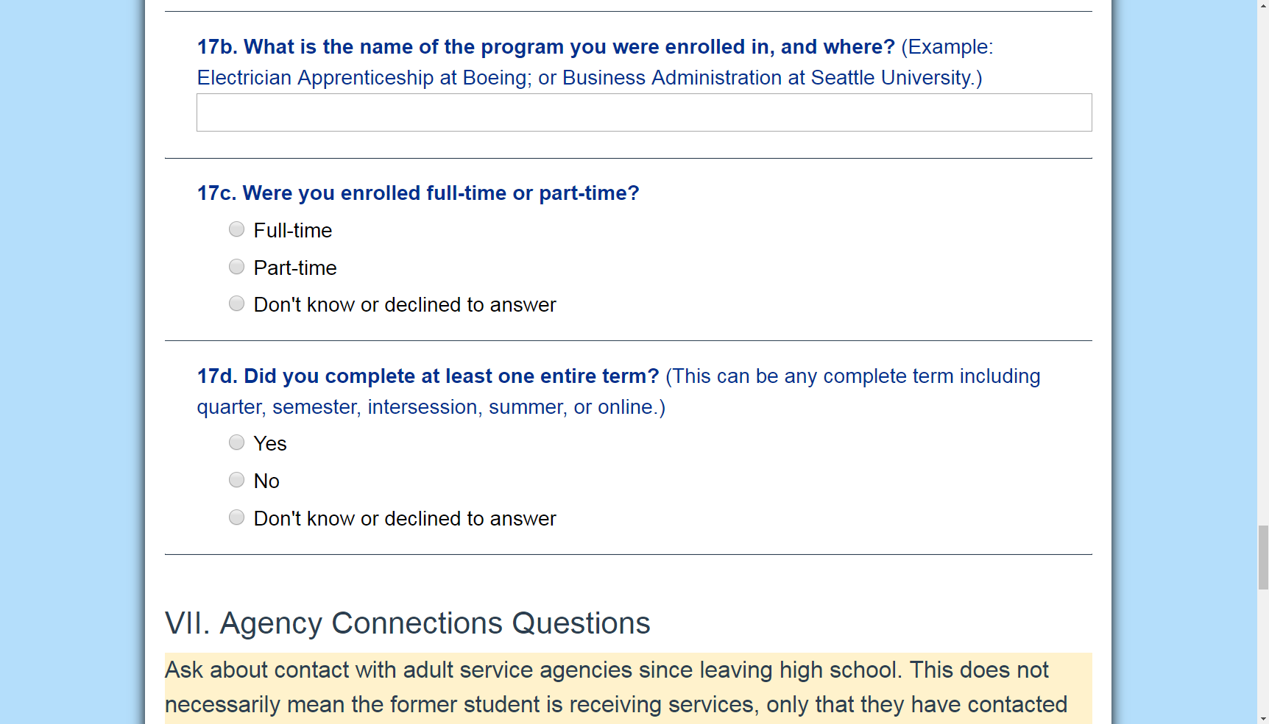
Program Name and Location
17b. What is the name of the program you were enrolled in, and where? (Example: Electrician Apprenticeship at Boeing; or Business Administration at Seattle University)
[textbox]
Notes:
17b asks for the name of the program in which the former student was enrolled and where it was.
I’d enter their response into the text box.
This answer is a good way to check your response from 17a and make sure they line up.
If the respondent said Business Administration at Seattle University, then I’d want to make sure Bachelor’s degree at a two- or four-year college was selected above.

Slide 76
Additional Program Information [1 of 2]
17c. Were you enrolled full-time or part-time?
Full-time
Part-time
Don’t know or declined to answer
Notes:
Questions 17c and 17d ask for additional information about the former student’s enrollment.
17c asks if the former student was enrolled full-time or part-time in the year since leaving high school.

Slide 77
Additional Program Information [2 of 2]
17d. Did you complete at least one entire term? (This can be any complete term including quarter, semester, intersession, summer, or online.)
Yes
No
Don’t know or declined to answer
Notes:
17d asks if the former student completed at least one term.
Note that this can be any complete term including quarter, semester, intersession, summer, or online.
If the respondent answers Yes, then I’d select that and move on to the last set of questions, Agency Connections.

Slide 78
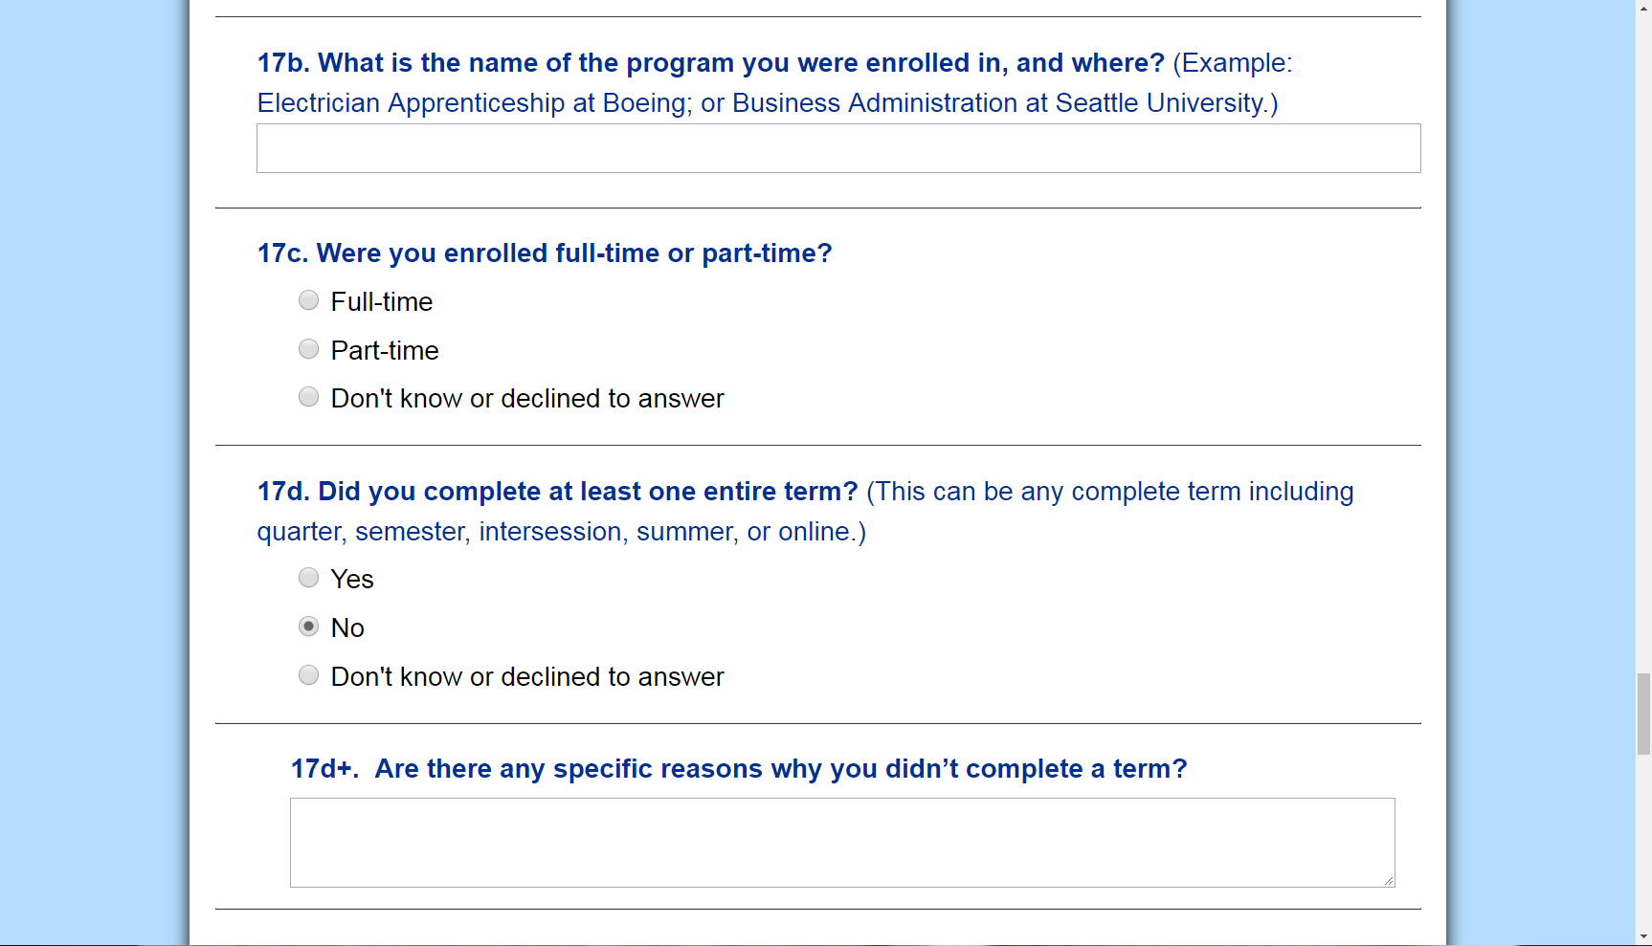
Follow-up Question: Reason for Not Completing Term
17d+. Are there any specific reasons why you didn’t complete a term?
[textbox]
Notes:
If the respondent answers No to 17d, question 17d+ appears.
I could ask if there are any specific reasons why they didn’t complete a term, and record their response in the text box before moving on.
If I didn’t ask this question, we’d move on to Section VII, Agency Connections.

Slide 79
VII. Agency Connections Questions
Ask about contact with adult service agencies since leaving high school. This does not necessarily mean the former student is receiving services, only that they have contacted an agency post-high school.
Notes:
Agency Connections is the last and shortest section of questions.
Here, we just want to know if the student made contact with an adult agency.
We’re not asking if they received services, only if the former student reached out, like making a phone call or having a meeting.
Contact is the keyword here.

Slide 80
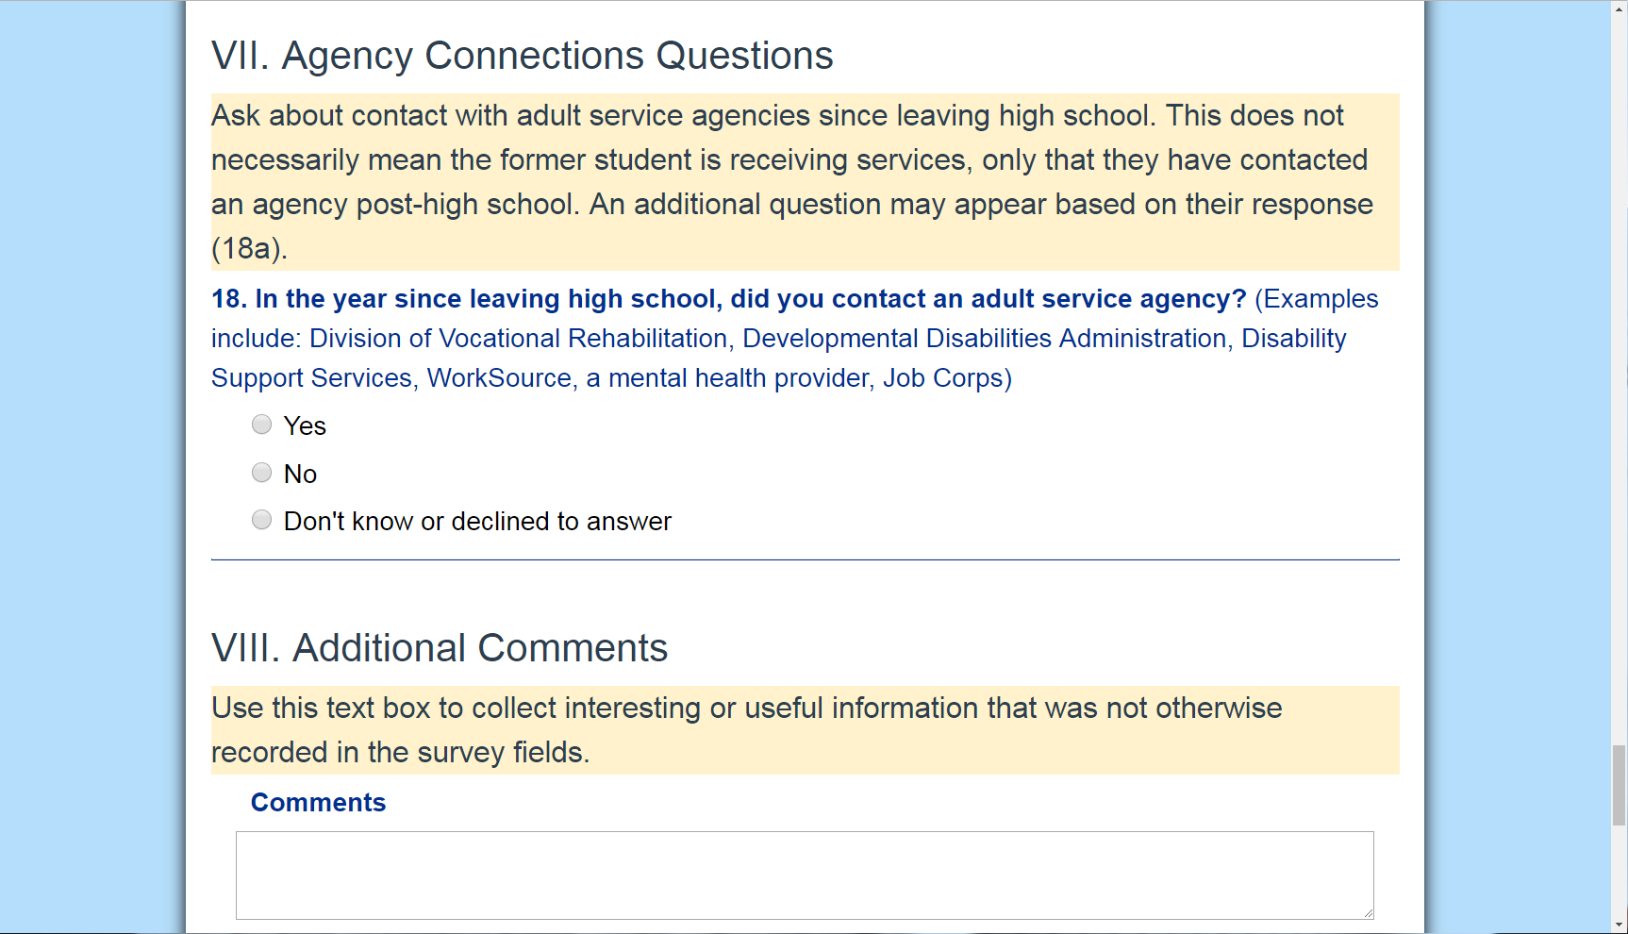
Agency Connections
18. In the year since leaving high school, did you contact an adult service agency? (Examples include: Division of Vocational Rehabilitation, Developmental Disabilities Administration, Disability Support Services, WorkSource, a mental health provider, Job Corps)
Yes
No
Don't know or declined to answer
Notes:
So Question 18 asks if the former student has contacted an adult service agency in the 12-month period after leaving high school.
If the respondent isn’t sure what I’m asking, I could give them some examples, like Division of Vocational Rehabilitation, Developmental Disabilities Administration, Disability Support Services through a college.
If they answer Yes, they did make contact, 18a, the final question appears.

Slide 81
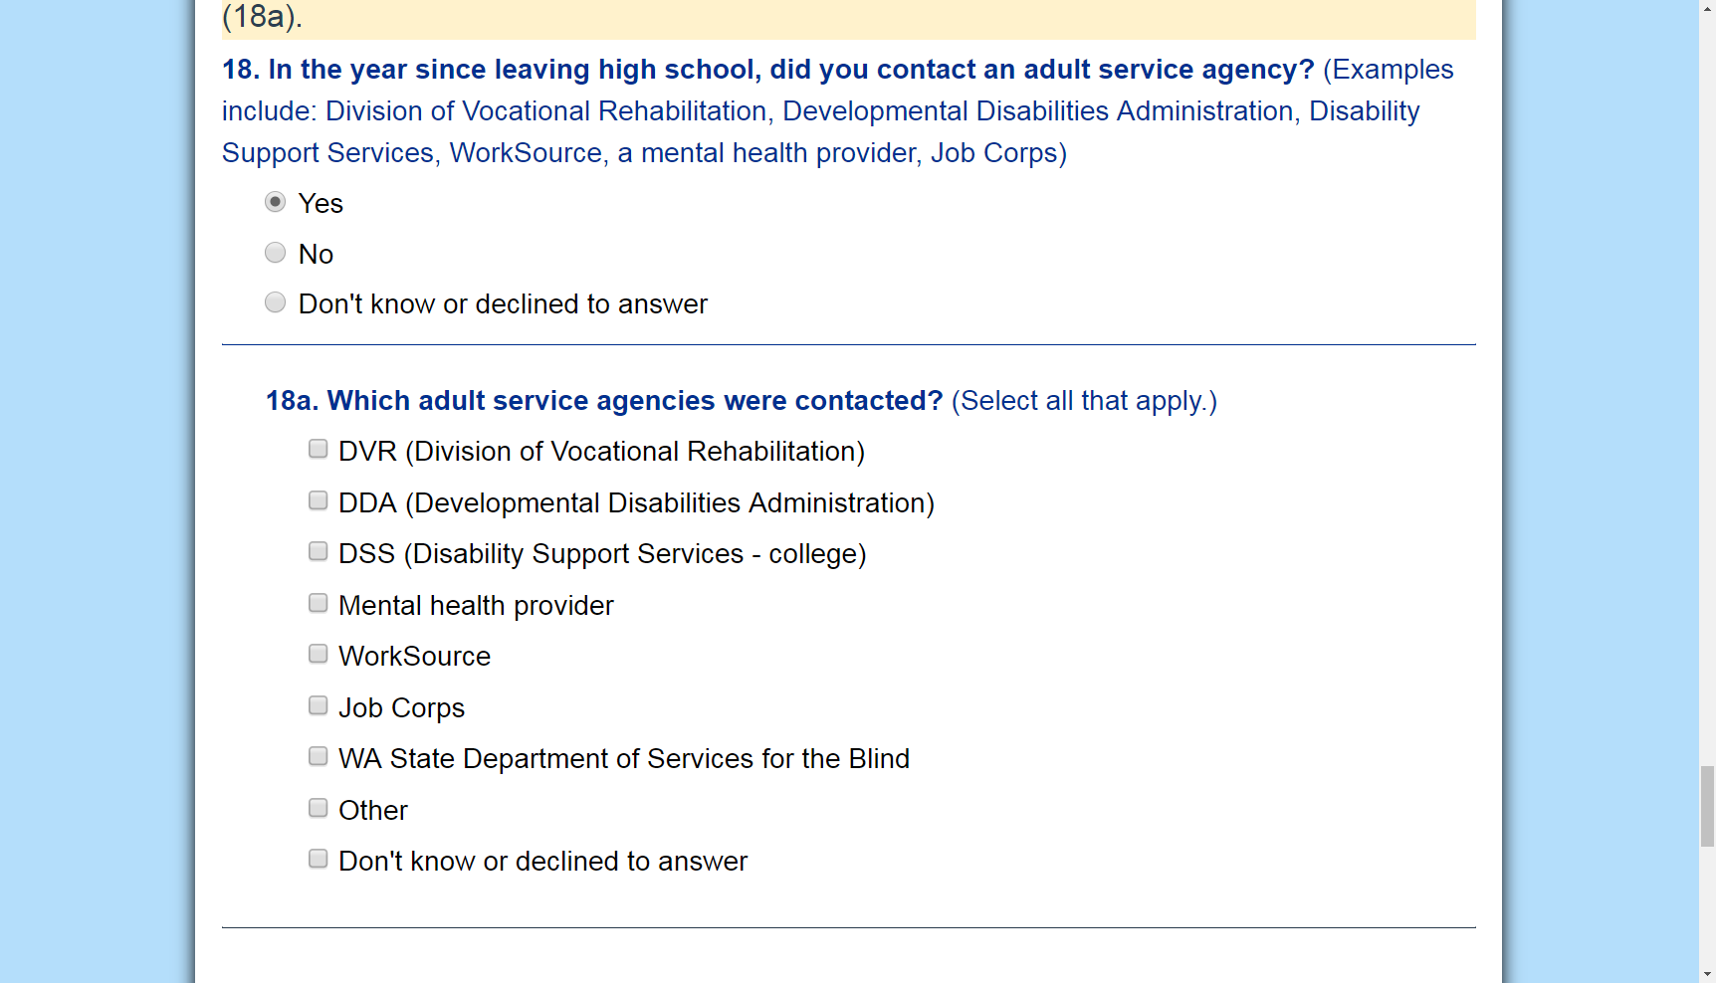
Specify Which Agency
18a. Which adult service agencies were contacted? (Select all that apply.)
DVR (Division of Vocational Rehabilitation)
DDA (Developmental Disabilities Administration)
DSS (Disability Support Services - college)
Mental health provider
WorkSource
Job Corps
WA State Department of Services for the Blind
Other
Don't know or declined to answer
Notes:
Question 18a asks for the names of the agencies contacted.
I can select multiple answers here.
If the agency is not listed, I’d select Other.
And that’s it for Agency Connections questions.
We are almost done with the survey.

Slide 82
VIII. Additional Comments
Notes:
Section VIII is the ever-present additional comments section.

Slide 83
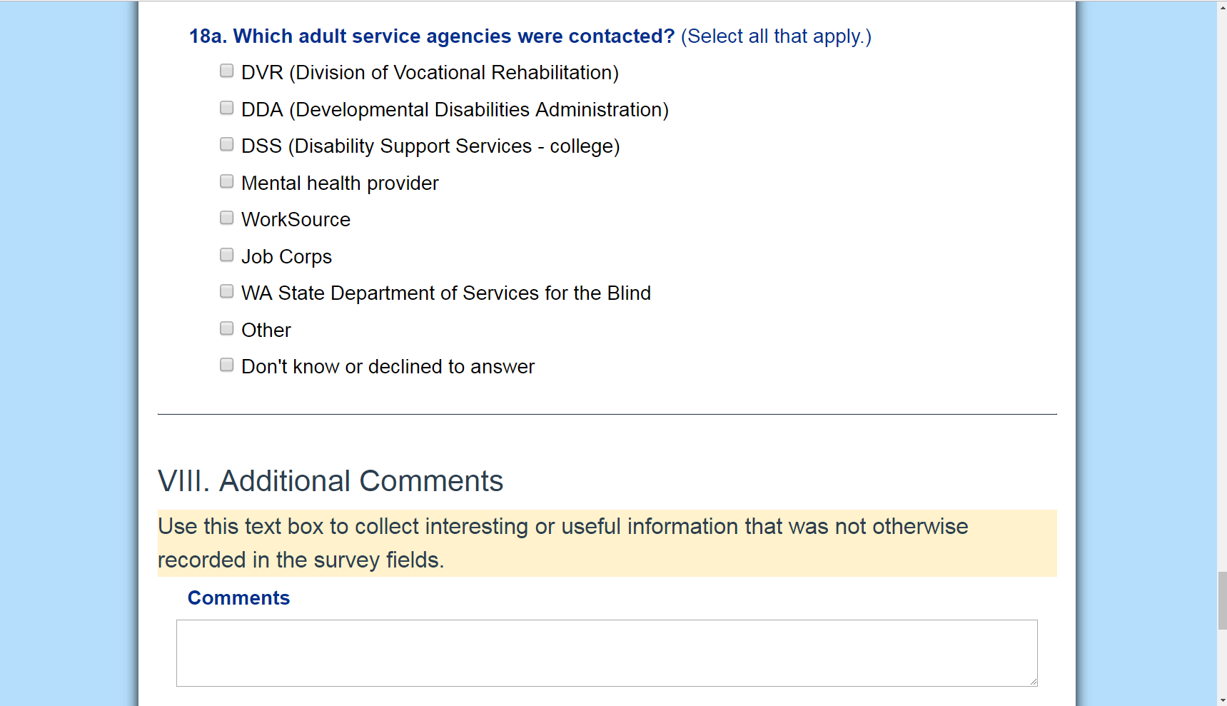
Additional Comments Textbox
Use this text box to collect interesting or useful information that was not otherwise recorded in the survey fields.
[textbox]
Notes:
I could have been using this section throughout the survey to capture any interesting or useful information that was not otherwise recorded, like if the former student is currently enrolled in school or employed after the 12-month timeframe.
If I didn’t have anything to add here, that’s ok, too.
This is an optional section.

Slide 84
IX. Ending the Survey
Notes:
Now we’re ready to wrap up.
Assuming all the required fields are complete, I can end and submit the survey.

Slide 85
Thank Respondent
Thank the respondent for their time.
Thank You
“Thank you for your time. If you have any questions about this project, please contact the special education department at your former high school.”
Notes:
Before I do, I’d be sure to thank respondent for their time.
There’s a short script here for that.
“Thank you for your time.
If you have any questions about this survey, please contact the Example High School special education department.”

Slide 86
End Survey
If survey was not completed, make any necessary notes to follow up, then click Save to exit survey. If survey is complete, click Submit to lock survey.
Notes:
And if the survey is complete, I should be able to click the blue “Submit” button.
If that submit button is not blue, if it looks greyed out, I’ve missed something and need to double check my work.
Did I enter a time in my contact attempt? I always miss that one.
If for any reason, I’m not able to complete the survey once I start it, then I can Save my progress and come back to it another time.
That might happen if we got interrupted and I needed to call back to finish.
I’d make any necessary notes to follow up, and then I’d click the Save button to save my progress and exit the survey.
I’d only click Cancel here if I wanted to exit the survey without saving changes.
Please note that when you click any of these buttons, you’ll get a popup that asks you to confirm your selection before moving on.
You can click ok in the popup window to procede, or cancel to return to this page.

Slide 87

Leaver Survey List Screenshot
Notes:
But that’s it!
After I click submit, I’d return to my leaver survey list, and I’m ready to begin the next survey.

Slide 88
Next Steps

Slide 89
Reminders
June 1-November 1: Survey open
Future Webinars, Survey Tutorials TBD, 3pm
  August 22
  September 19
  October 17
Mid-December: Final post-school outcome reports available
Notes:
The survey is currently open and will remain open through November 1 at 11:59 p.m.
Future webinars will be held later in the summer and fall on topics to be determined.
We’ll see how the survey process is going for folks, and try to address any specific issues at those times.
If you have any special requests, please let us know.
Those will take place on August 22, September 19, and October 17 at 3pm.
And finally, looking farther down the road, we’ll have final reports available in the TSF2 in mid-December.

Slide 90
Questions
Notes:
Does anyone have any questions?

Slide 91
For more information
Visit the Guidance for Educators Page on the CCTS website
Join us for our next training webinar: August 22, 2019
Contact CCTS
  ccts@seattleu.edu
  206-296-6494
Notes:
Thank you so much for being here today.
Remember that links to all of our training materials can be found on the Guidance for Educators page on the CCTS website.
Please join us for our next webinar on August 22.
And email ccts@seattleu.edu if you have questions that come up as you prepare for the survey.

Slide 92
Thank you
Notes:
Thank you!

Slide 93

Creative Commons License
Except where otherwise noted, content in this presentation is licensed under a Creative Commons Attribution 4.0 International license. All logos and trademarks are property of their respective owners.
You may share and adapt this material, but you must give appropriate credit, provide a link to the license, and indicate if changes were made.
Notes:
Unless otherwise noted, the material in this presentation is licensed under a Creative Commons Attribution 4.0 International license. All logos and trademarks are property of their respective owners. You may share and adapt this material, but you must give appropriate credit, provide a link to the license, and indicate if changes were made.

Slide 94
OSPI Disclaimer
This training is meant to supplement, not supplant reading bulletins and accompanying documents; guidance from the U.S. Department of Education; chapter 392-172A WAC; Part 300 of the federal regulations; and, the Individuals with Disabilities Act.
This presentation and/or materials should be viewed and applied by users according to their specific needs. The presentation should be used as guidance and is not intended as legal advice.
Notes:
One final disclaimer from the Office of the Superintendent of Public Instruction. This training is meant to supplement, not supplant reading bulletins and accompanying documents; guidance from the U.S. Department of Education; chapter 392-172A WAC; Part 300 of the federal regulations; and, the Individuals with Disabilities Act. This presentation and/or materials should be viewed and applied by users according to their specific needs. The presentation should be used as guidance and is not intended as legal advice.

